Slide 1
IBM Cloud Data Services
Put data to work
with advanced analytics on Cloud

Slide 2
Today’s Agenda
Topic | Speaker
An introduction to IBM’s Cloud Data Services | David Sloan Sales Lead Cloud Data Services, IBM A/NZ
Enterprise-grade NoSQL for web and mobile data | Bharath Kadiam Sales Lead Cloud Data Services, IBM A/NZ
Cloud data warehousing for the next generation of Builders
Tackling Big Data with Hadoop service via Cloud | Suraj Pandey Technical Lead. Cloud Data Services, IBM A/NZ.
IBM and Spark for future fast analytics.
A customer’s Journey to Cloud, local customer story | David Sloan Sales Lead Cloud Data Services, IBM A/NZ

Slide 3
IBM Cloud Data Services
David Sloan
Cloud Data Services
IBM Analytics

Slide 4
Cloud Data Services
Introduction to IBM Cloud Data Services
Is IBM a cloud company?
Is my company ready for Cloud?
Cloud offerings aren’t secure enough for my sensitive data.

Slide 5
What’s what in the cloud zoo
Infrastructure as a Service Bring your software licenses to be hosted. You are still responsible for the management and operations of the environment.
  Examples: Hosting your software licenses on IBM SoftLayer, AWS, Microsoft Azure, etc.
Platform as a Service Infrastructure and software provided by vendor. Customer controls software deployment and configuration settings
  Examples: IBM CDS Offerings, DB2 on Cloud, IBM Bluemix, AWS database offerings
Software as a Service: Applications that are consumed over the internet and are typically not customizable and developed
  Examples: SalesForce.com, Gmail, IBM Cognos on Cloud, dashDB,
.

Slide 6





IBM Cloud Data Services—Managing data in the cloud
DB2 on Cloud | dashDB | BigInsights on Cloud | Spark as a Service | Cloudant
Hosted Database in the Cloud | Analytic Data Warehouse | Hadoop in the Cloud | Fully-managed Spark Service | NoSQL DBaaS
Power of DB2 Fast Provisioning Flexible pricing No loss of DBA control Built for Systems of Record | SQL interface Massively parallel ACID compliance Columnar, in-memory performance BLU augmented with NZ in-DB analytics Built for Systems of Insight | Bare metal performance Build on reference architecture BigInsights enterprise features | Optimized for extremely fast and large scale data processing Spark SQL, Streaming, MLlib, GraphX Build and run apps benefiting from operational, maintenance and hardware excellence | Global data distribution Massively scalable Eventually consistent data model Built for mobile, Systems of Engagement
6
Notes:
IBM offers an extensive and highly differentiated set of cloud data services for handling a variety of workloads:
Application development…especially good for mobile apps – Cloudant NoSQL operational data store
Analytics services – of structured and unstructured data – dashDB
Deep analytics on Hadoop – BigInsights on Cloud.
Hosted Database in the Cloud – DB2 on Cloud
All fully managed for you, integrated via the IBM Bluemix PaaS for ease of use and development, and running on IBM SoftLayer’s cloud with its bare-metal performance advantages.
Let’s take a deeper look into the individual services.

Slide 7
Is IBM a cloud company?

Slide 8

Some Facts
IBM’s overall cloud business is running at an $8.7 billion annual run rate
  Growing 75% per year
  Projected to be $40 billion by 2018 and representing 44% of the corporation’s revenue
  Revenue and business from IaaS, PaaS, SaaS offerings
Strong partnerships, investments, and acquisition bring value to our clients
  Acquisitions of SoftLayer, Cloudant, Compose, BlueBox
  Partnerships with Twitter, Facebook, Box, the Weather Company
IBM’s leading IP leadership, investment in open source, integrated experience, and flexibility of deployment makes the IBM Cloud and offerings best suited for enterprises and developers alike
40,000+ cloud consultants and experts
Choice of deployment; public, private and hybrid
Modular services to fit your need
Envision, build and deploy, manage and transform with expert services
Notes:
They heard about the benefits of NoSQL databases, thought their app could benefit from it, and were exploring options. They saw this app as critical to their plan to disrupt the market, and too get it all together, they thought it could take upwards of 20 months.
Thanks the benefits of Cloudant and its managed service, this company was able to get their new app out in less than 9 months! This is less than half the time they thought it would take them to do themselves. Cloudant is hugely compelling on its own… now with the rest of the Cloud Data Services portfolio beside it, it’s even more compelling, and for users and sellers alike.
Company Background
Payment processor and issuer of fleet fuel cards company headquartered in Tennessee.
Needed to create a mobile app that delivers a better experience for end users of Comdata’s payment processing system.
This mobile app is critical for Comdata’s strategic plan to be disruptive in their market.
Success Criteria
Show locations of vendors that use Comdata’s payment processing
Provide offline access to data
Optiminze routes to based on distance, Comdata vendors, amenities, discounts, etc.
Solution & Results
With Cloudant, Comdata is building the next generation of their mobile payment app
Cloudant’s advanced geospatial capabilities give Comdata a competitive advantage in terms of the experience they can deliver to their end users
Cloudant’s managed service means Comdata does not have to add more DBAs to support the system
Cloudant supports the data and usage scalability that Comdata required without having to grow an on-premise hardware footprint
Cloudant’s JSON document store supports data formatting & schema flexibility enable Comdata to leverage a wide range of data sources in a single app without the costs, overhead, or latencies of ETL.

Slide 9

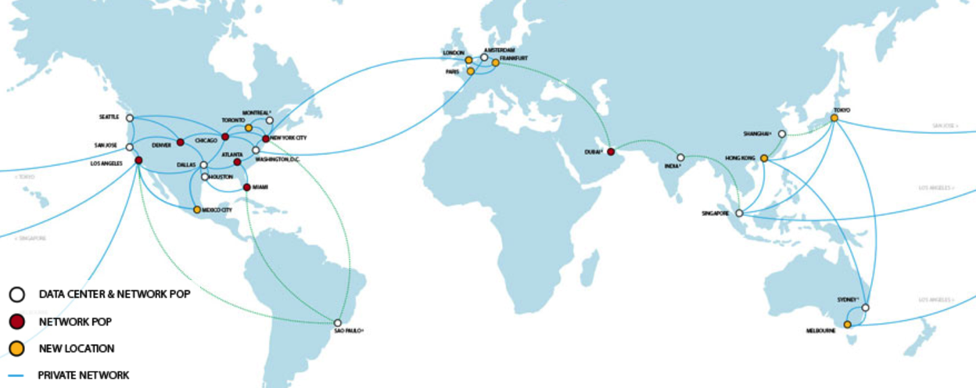
The IBM Cloud
- “Bare-metal” outperforms virtualized
- Dedicated hardware
- 40 data centers worldwide
Data Centers in Sydney & Melbourne

Slide 10














IBM Bluemix
Bluemix is an open-standard, cloud-based platform for building, managing, and running applications of all types (web, mobile, big data, new smart devices, and so on).
Go Live in Seconds
The developer can choose any language runtime or bring their own. Zero to production in one command.
On-Prem Integration
Build hybrid environments. Connect to on-premise assets plus other public and private clouds.
Flexible Pricing
Sign up in minutes. Pay as you go and subscription models offer choice and flexibility.
APIs and Services
A catalog of IBM, third party, and open source API services allow the developer to stitch an application together in minutes.
Layered Security
IBM secures the platform and infrastructure and provides you with the tools to secure your apps.
DevOps
Development, monitoring, deployment, and logging tools allow the developer to run the entire application.

Slide 11


A complete and growing Portfolio
Risk
Marketing
Social Media Analytics
SPSS Data Collection
Risk Content & Data Services
Algo Risk Content
Algo Risk Service
OpenPages GRC
Horizontals
SPSS Modeler Gold
Watson Analytics
Watson Curator
Business Intelligence
Case Manager
Content Manager on Demand
Internet of Things Foundation
Insight as a Service
Finance
Cognos Controller
Cognos Disclosure Management
Concert
Cognos TM1
CDS Platform
Cloudant
Informix
dashDB
BigInsights
DataWorks
DB2 on Cloud
SQL Database
Analytics for Apache Spark
Content Fabric
Operations
Maximo Asset Management
Maximo Inventory Insights
Intelligent Operations Center
Intelligent Transportation
Intelligent Water
Intelligent City Planning & Operations
Insights Foundation for Energy
Engineering
Managed Continuous Engineering
Rational DOORS Next Generation
Continuous Engineering
Internet of Things Workbench
Sales
Incentive Compensation Management
Territory Management
Quota Management
Notes:
End to end from platforms for development, horizontals to support BI and Content and full suite of LOB solutions to meet the needs of everyone at your customer…..and there is more coming each month.
So in closing I have one simple call to action – starting today…..every customer meeting you do, whether its for Cloud offerings or selling an appliance or DB2….start that meeting off by asking you customer what they are doing around Cloud, whats their strategy, how do they plan to modernize their architecture…… you will be delighted by their response……and they will need IBMs help.

Slide 12
Is my company ready for the cloud?

Slide 13


4.2 Billion
2015 Cloud Market in Australia

Slide 14
72%
Of business leaders say cloud will be vital to their success by next year

Slide 15
Cloud offerings aren’t secure enough for my sensitive data

Slide 16

Unparalleled security
Don’t avoid the security conversation, START IT
6,000+ IBM security experts worldwide
3,000+ IBM security patents
4,000+ IBM security clients worldwide
70+ new products/enhancements
27 leadership positions in analyst rankings
25 IBM Security labs worldwide

Slide 17
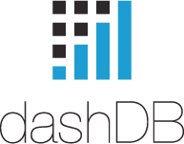

Let’s Look At One Offering’s Security Features
Security Features:
  Encryption at rest: Automatic with Advanced Encryption Standard (AES) in Cipher-Block Chaining (CBC) mode with a 256 bits key.
  Encryption in transit: Secure Socket Layer (SSL) is automatically configured when your dashDB database is provisioned. The dashDB console itself is automatically deployed with HTTPS so all your exchanges with the console are also protected with SSL.
  Database activity monitoring with Guardium to understand what sensitive data may be in your database and a connections report to see who is accessing it
  Database access controls including table level privileges and role based access control
  The database server employs a host firewall to protect listening services against port scans and other network security threats
Security Certifications & Attestations:
  3Q: US Safe Harbor, ISO 27001k, SOC2 Risk Assessment Report
  4Q: HIPAA, PCI-DSS
  Early 2016: SOC2-type 2 certification

Slide 18

IBM Cloud-based analytics summary
Global Operations
Datacentres in Sydney and Melbourne
100s of dedicated enterprise clients
50,000+ users

Slide 19
Moving Forward….
On to BK to cover Cloudant and dashDB in more detail

Slide 20


Slide 21






IBM Cloud Data Services
The real world—lessons learnt
David Sloan CDS Specialist

Slide 22
How to be the smartest cloud person in the room
memorise the following terms
Disruptive
Flexible
Agility
Utility based pricing
Reassemble them in any order
Notes:
In a 2013 report, 451 Research predicted that by 2016, two thirds of enterprises would be using database as a service in some form.
The reason IBM is focused on creating an amazing cloud data services experience, is to meet that demand and enable the benefits it generates for customers:
#1 – Faster Innovation – customers can be focused on creating new apps, features, and insight…putting the data to work, instead of administering databases
#2 – Better IT Economics – use cloud data services on a pay-as-you-grow basis, and avoid the usual, big up-front capital costs for database software, hardware. Plus you’re up and running instantly, without the usual wait for procurement, installation, and configuration.
#3 – And lastly, fully managed cloud data services help lower your risk of failure…the services are operated by the developers of the technology you’re using; experts who can keep your data layer growing smoothly, secure, and always on,

Slide 23
A journey to Cloud-based Analytics
Issue
The current way of doing BI was slow, costly and failed to deliver the business what was needed when needed.
Opportunity
The customer had funding to implement a new core system. They could create a new paradigm for BI
BETTER IT
ECONOMICS
LOWER RISK
OF FAILURE
FASTER
INNOVATION
Solution
The customer wanted to explore if new technology could deliver better outcomes for the business at lower cost
Notes:
In a 2013 report, 451 Research predicted that by 2016, two thirds of enterprises would be using database as a service in some form.
The reason IBM is focused on creating an amazing cloud data services experience, is to meet that demand and enable the benefits it generates for customers:
#1 – Faster Innovation – customers can be focused on creating new apps, features, and insight…putting the data to work, instead of administering databases
#2 – Better IT Economics – use cloud data services on a pay-as-you-grow basis, and avoid the usual, big up-front capital costs for database software, hardware. Plus you’re up and running instantly, without the usual wait for procurement, installation, and configuration.
#3 – And lastly, fully managed cloud data services help lower your risk of failure…the services are operated by the developers of the technology you’re using; experts who can keep your data layer growing smoothly, secure, and always on,

Slide 24





A journey to Cloud-based Analytics
The current world
Source Systems
CRM
Enterprise Data Warehouse
Data
Integrationn
ERP
HR
LOWER RISK
OF FAILURE
Billing
External Sources
Too rigid to support the business
Data Marts
The cost is $250K and it takes 6 months.
Now, what do you need?
Notes:
In a 2013 report, 451 Research predicted that by 2016, two thirds of enterprises would be using database as a service in some form.
The reason IBM is focused on creating an amazing cloud data services experience, is to meet that demand and enable the benefits it generates for customers:
#1 – Faster Innovation – customers can be focused on creating new apps, features, and insight…putting the data to work, instead of administering databases
#2 – Better IT Economics – use cloud data services on a pay-as-you-grow basis, and avoid the usual, big up-front capital costs for database software, hardware. Plus you’re up and running instantly, without the usual wait for procurement, installation, and configuration.
#3 – And lastly, fully managed cloud data services help lower your risk of failure…the services are operated by the developers of the technology you’re using; experts who can keep your data layer growing smoothly, secure, and always on,

Slide 25
A journey to Cloud-based Analytics
Why is the current world a problem?
Internal survey
I am not getting all the data
‘Data coverage’ was identified as the top issue for business users. Business decisions are being made on sub sets of data. I need all the data.
I don’t trust the data I get
Because I am working with limited data, I cannot reconcile with other data.
BETTER IT
ECONOMICS
No agility and too expensive
Making changes too slow and too expensive
Notes:
In a 2013 report, 451 Research predicted that by 2016, two thirds of enterprises would be using database as a service in some form.
The reason IBM is focused on creating an amazing cloud data services experience, is to meet that demand and enable the benefits it generates for customers:
#1 – Faster Innovation – customers can be focused on creating new apps, features, and insight…putting the data to work, instead of administering databases
#2 – Better IT Economics – use cloud data services on a pay-as-you-grow basis, and avoid the usual, big up-front capital costs for database software, hardware. Plus you’re up and running instantly, without the usual wait for procurement, installation, and configuration.
#3 – And lastly, fully managed cloud data services help lower your risk of failure…the services are operated by the developers of the technology you’re using; experts who can keep your data layer growing smoothly, secure, and always on,

Slide 26
A journey to Cloud-based Analytics
Source Systems
The Cloud Vision
CRM
ERP
?
HR
LOWER RISK
OF FAILURE
Billing
External Sources
Notes:
In a 2013 report, 451 Research predicted that by 2016, two thirds of enterprises would be using database as a service in some form.
The reason IBM is focused on creating an amazing cloud data services experience, is to meet that demand and enable the benefits it generates for customers:
#1 – Faster Innovation – customers can be focused on creating new apps, features, and insight…putting the data to work, instead of administering databases
#2 – Better IT Economics – use cloud data services on a pay-as-you-grow basis, and avoid the usual, big up-front capital costs for database software, hardware. Plus you’re up and running instantly, without the usual wait for procurement, installation, and configuration.
#3 – And lastly, fully managed cloud data services help lower your risk of failure…the services are operated by the developers of the technology you’re using; experts who can keep your data layer growing smoothly, secure, and always on,

Slide 27
A journey to Cloud-based Analytics
What would the data Lake provide?
All data would be in the cloud.
Completeness
New business requirements can be satisfied in days rather than months. Time to value is improved
Agility
Cost reduction
BETTER IT
ECONOMICS
LOWER RISK
OF FAILURE
The data lake is moving to customer self service. Old expensive data marts will be migrated into the new environment
Transformation
IT will move to an on demand model.
Individual business units can determine cost/performance. There is infinite scale up/scale down capability.
Move from Capex to Opex
Notes:
In a 2013 report, 451 Research predicted that by 2016, two thirds of enterprises would be using database as a service in some form.
The reason IBM is focused on creating an amazing cloud data services experience, is to meet that demand and enable the benefits it generates for customers:
#1 – Faster Innovation – customers can be focused on creating new apps, features, and insight…putting the data to work, instead of administering databases
#2 – Better IT Economics – use cloud data services on a pay-as-you-grow basis, and avoid the usual, big up-front capital costs for database software, hardware. Plus you’re up and running instantly, without the usual wait for procurement, installation, and configuration.
#3 – And lastly, fully managed cloud data services help lower your risk of failure…the services are operated by the developers of the technology you’re using; experts who can keep your data layer growing smoothly, secure, and always on,

Slide 28




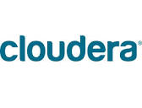

A journey to Cloud-based Analytics
The decision process RFP Issued to
LOWER RISK
OF FAILURE
Notes:
In a 2013 report, 451 Research predicted that by 2016, two thirds of enterprises would be using database as a service in some form.
The reason IBM is focused on creating an amazing cloud data services experience, is to meet that demand and enable the benefits it generates for customers:
#1 – Faster Innovation – customers can be focused on creating new apps, features, and insight…putting the data to work, instead of administering databases
#2 – Better IT Economics – use cloud data services on a pay-as-you-grow basis, and avoid the usual, big up-front capital costs for database software, hardware. Plus you’re up and running instantly, without the usual wait for procurement, installation, and configuration.
#3 – And lastly, fully managed cloud data services help lower your risk of failure…the services are operated by the developers of the technology you’re using; experts who can keep your data layer growing smoothly, secure, and always on,

Slide 29
A journey to Cloud-based Analytics
IBM falls at the first hurdle
6.3 Customer’s Obligation
Customer is responsible for:
maintaining the software platform (i.e. BigInsights and the operating system) to its security standards.
c. maintaining the software firewall on internet facing servers in a manner that will provide the required protection it chooses.
IBM’s enterprise Hadoop as a Service is not ‘as a service’
Notes:
In a 2013 report, 451 Research predicted that by 2016, two thirds of enterprises would be using database as a service in some form.
The reason IBM is focused on creating an amazing cloud data services experience, is to meet that demand and enable the benefits it generates for customers:
#1 – Faster Innovation – customers can be focused on creating new apps, features, and insight…putting the data to work, instead of administering databases
#2 – Better IT Economics – use cloud data services on a pay-as-you-grow basis, and avoid the usual, big up-front capital costs for database software, hardware. Plus you’re up and running instantly, without the usual wait for procurement, installation, and configuration.
#3 – And lastly, fully managed cloud data services help lower your risk of failure…the services are operated by the developers of the technology you’re using; experts who can keep your data layer growing smoothly, secure, and always on,

Slide 30

A journey to Cloud-based Analytics
“In short, the first duty of every man or woman in any executive position is to follow the motto of this business: THINK.”
Thomas J. Watson Sr. IBM founder
Memo from Thomas Watson Sr. to his management team 1920
LOWER RISK
OF FAILURE
Notes:
In a 2013 report, 451 Research predicted that by 2016, two thirds of enterprises would be using database as a service in some form.
The reason IBM is focused on creating an amazing cloud data services experience, is to meet that demand and enable the benefits it generates for customers:
#1 – Faster Innovation – customers can be focused on creating new apps, features, and insight…putting the data to work, instead of administering databases
#2 – Better IT Economics – use cloud data services on a pay-as-you-grow basis, and avoid the usual, big up-front capital costs for database software, hardware. Plus you’re up and running instantly, without the usual wait for procurement, installation, and configuration.
#3 – And lastly, fully managed cloud data services help lower your risk of failure…the services are operated by the developers of the technology you’re using; experts who can keep your data layer growing smoothly, secure, and always on,

Slide 31

A journey to Cloud-based Analytics
No vendor can deliver what the customer needs. This is building a mission critical data platform, using customer data, as a service, in the cloud, for a bank, in months, not years.
LOWER RISK
OF FAILURE
IBM decided to change our thinking
IBM is taking a bank to the cloud as a Service
What is a bank?
Notes:
In a 2013 report, 451 Research predicted that by 2016, two thirds of enterprises would be using database as a service in some form.
The reason IBM is focused on creating an amazing cloud data services experience, is to meet that demand and enable the benefits it generates for customers:
#1 – Faster Innovation – customers can be focused on creating new apps, features, and insight…putting the data to work, instead of administering databases
#2 – Better IT Economics – use cloud data services on a pay-as-you-grow basis, and avoid the usual, big up-front capital costs for database software, hardware. Plus you’re up and running instantly, without the usual wait for procurement, installation, and configuration.
#3 – And lastly, fully managed cloud data services help lower your risk of failure…the services are operated by the developers of the technology you’re using; experts who can keep your data layer growing smoothly, secure, and always on,

Slide 32
A journey to Cloud-based Analytics
What were the design metrics FOAC
Security had to approve
If the Security, risk and Compliance teams did not support putting customer data into the cloud, the cloud would fail
APRA
The regulatory requirements needed to be met
It was a critical system
BETTER IT
ECONOMICS
LOWER RISK
OF FAILURE
The system had to have Disaster Recovery capabilities built in a standard (not just High Availability/Back up)
The bank has large investments in traditional technologies, particularly Information Server. These tools needed to be available on the cloud.
Leverage current skills and tools
If it goes wrong you are FOACed !!!
Notes:
In a 2013 report, 451 Research predicted that by 2016, two thirds of enterprises would be using database as a service in some form.
The reason IBM is focused on creating an amazing cloud data services experience, is to meet that demand and enable the benefits it generates for customers:
#1 – Faster Innovation – customers can be focused on creating new apps, features, and insight…putting the data to work, instead of administering databases
#2 – Better IT Economics – use cloud data services on a pay-as-you-grow basis, and avoid the usual, big up-front capital costs for database software, hardware. Plus you’re up and running instantly, without the usual wait for procurement, installation, and configuration.
#3 – And lastly, fully managed cloud data services help lower your risk of failure…the services are operated by the developers of the technology you’re using; experts who can keep your data layer growing smoothly, secure, and always on,

Slide 33
A journey to Cloud-based Analytics
IBM eHaaS
IBM Guardium Encryption
IBM Guardium Data Access management
IBM Softlayer
IBM Datastage
IBM R & D
IBM Labs
IBM Eminent Fellows
IBM US Specialists
IBM SWG Services
IBM Project Stampede
‘This is customer driven product design’ Kevin McIntyre CDS Executive
Notes:
In a 2013 report, 451 Research predicted that by 2016, two thirds of enterprises would be using database as a service in some form.
The reason IBM is focused on creating an amazing cloud data services experience, is to meet that demand and enable the benefits it generates for customers:
#1 – Faster Innovation – customers can be focused on creating new apps, features, and insight…putting the data to work, instead of administering databases
#2 – Better IT Economics – use cloud data services on a pay-as-you-grow basis, and avoid the usual, big up-front capital costs for database software, hardware. Plus you’re up and running instantly, without the usual wait for procurement, installation, and configuration.
#3 – And lastly, fully managed cloud data services help lower your risk of failure…the services are operated by the developers of the technology you’re using; experts who can keep your data layer growing smoothly, secure, and always on,

Slide 34
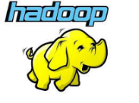


A journey to Cloud-based Analytics (APRA)
Softlayer Private Cloud
Bare Metal Servers
Data Lake
as a Service
LOWER RISK
OF FAILURE
Bare Metal Servers
Softlayer Private Cloud
Notes:
In a 2013 report, 451 Research predicted that by 2016, two thirds of enterprises would be using database as a service in some form.
The reason IBM is focused on creating an amazing cloud data services experience, is to meet that demand and enable the benefits it generates for customers:
#1 – Faster Innovation – customers can be focused on creating new apps, features, and insight…putting the data to work, instead of administering databases
#2 – Better IT Economics – use cloud data services on a pay-as-you-grow basis, and avoid the usual, big up-front capital costs for database software, hardware. Plus you’re up and running instantly, without the usual wait for procurement, installation, and configuration.
#3 – And lastly, fully managed cloud data services help lower your risk of failure…the services are operated by the developers of the technology you’re using; experts who can keep your data layer growing smoothly, secure, and always on,

Slide 35
A journey to Cloud-based Analytics
Lessons learnt
Don’t think Cloud, think transformation
Politics
Sell business transformation/disruption. Needs executive sponsorship. Do not sell up the organisation
BETTER IT
ECONOMICS
Security
Get the Security and Risk and Compliance teams in the boat EARLY
Understand the differences between the security team, the Risk and compliance team and the legal team
Risk and compliance
Deploy on bare metal, ensure a dedicated, single-tenant environment. Your people are reading APRA.
Notes:
In a 2013 report, 451 Research predicted that by 2016, two thirds of enterprises would be using database as a service in some form.
The reason IBM is focused on creating an amazing cloud data services experience, is to meet that demand and enable the benefits it generates for customers:
#1 – Faster Innovation – customers can be focused on creating new apps, features, and insight…putting the data to work, instead of administering databases
#2 – Better IT Economics – use cloud data services on a pay-as-you-grow basis, and avoid the usual, big up-front capital costs for database software, hardware. Plus you’re up and running instantly, without the usual wait for procurement, installation, and configuration.
#3 – And lastly, fully managed cloud data services help lower your risk of failure…the services are operated by the developers of the technology you’re using; experts who can keep your data layer growing smoothly, secure, and always on,

Slide 36
A journey to Cloud-based Analytics
Lessons learnt
Don’t think Cloud, think transformation
The Network
Fibre links to the cloud take time,
Response time is not the cloud, it is the application
BETTER IT
ECONOMICS
LOWER RISK
OF FAILURE
Internal process
Do you control all of the IT infrastructure. If not plan ahead of time.
What’s the business case?
Don’t take old stuff to the cloud--yet. Go Hybrid
Notes:
In a 2013 report, 451 Research predicted that by 2016, two thirds of enterprises would be using database as a service in some form.
The reason IBM is focused on creating an amazing cloud data services experience, is to meet that demand and enable the benefits it generates for customers:
#1 – Faster Innovation – customers can be focused on creating new apps, features, and insight…putting the data to work, instead of administering databases
#2 – Better IT Economics – use cloud data services on a pay-as-you-grow basis, and avoid the usual, big up-front capital costs for database software, hardware. Plus you’re up and running instantly, without the usual wait for procurement, installation, and configuration.
#3 – And lastly, fully managed cloud data services help lower your risk of failure…the services are operated by the developers of the technology you’re using; experts who can keep your data layer growing smoothly, secure, and always on,

Slide 37
A journey to Cloud-based Analytics
Data Lake Status
IBM announced as partner and teams engaged July
Soft launch of data lake, live data, live customers November 23rd
Hard Launch late February early March.
The data lake is now the default BI Platform in the bank
LOWER RISK
OF FAILURE
Notes:
In a 2013 report, 451 Research predicted that by 2016, two thirds of enterprises would be using database as a service in some form.
The reason IBM is focused on creating an amazing cloud data services experience, is to meet that demand and enable the benefits it generates for customers:
#1 – Faster Innovation – customers can be focused on creating new apps, features, and insight…putting the data to work, instead of administering databases
#2 – Better IT Economics – use cloud data services on a pay-as-you-grow basis, and avoid the usual, big up-front capital costs for database software, hardware. Plus you’re up and running instantly, without the usual wait for procurement, installation, and configuration.
#3 – And lastly, fully managed cloud data services help lower your risk of failure…the services are operated by the developers of the technology you’re using; experts who can keep your data layer growing smoothly, secure, and always on,

Slide 38
A journey to Cloud-based Analytics
The future
Enterprise applications aaS
Cognos as a service
Cognitive computing as a service
Integration
IBM Watson explorer crawls the data lake.
IBM MDM is the traditional single view of customer
Single screen for the Data lake and MDM
Edge Nodes
Third party applications as a service
Tableau as a service
Notes:
In a 2013 report, 451 Research predicted that by 2016, two thirds of enterprises would be using database as a service in some form.
The reason IBM is focused on creating an amazing cloud data services experience, is to meet that demand and enable the benefits it generates for customers:
#1 – Faster Innovation – customers can be focused on creating new apps, features, and insight…putting the data to work, instead of administering databases
#2 – Better IT Economics – use cloud data services on a pay-as-you-grow basis, and avoid the usual, big up-front capital costs for database software, hardware. Plus you’re up and running instantly, without the usual wait for procurement, installation, and configuration.
#3 – And lastly, fully managed cloud data services help lower your risk of failure…the services are operated by the developers of the technology you’re using; experts who can keep your data layer growing smoothly, secure, and always on,

Slide 39

A journey to Cloud-based Analytics
Softlayer Private Cloud
Enterprise tools
Bare Metal Servers
Unstructured Data Lake
LOWER RISK
OF FAILURE
Edge Nodes
Bare Metal Servers
Softlayer Private Cloud
Notes:
In a 2013 report, 451 Research predicted that by 2016, two thirds of enterprises would be using database as a service in some form.
The reason IBM is focused on creating an amazing cloud data services experience, is to meet that demand and enable the benefits it generates for customers:
#1 – Faster Innovation – customers can be focused on creating new apps, features, and insight…putting the data to work, instead of administering databases
#2 – Better IT Economics – use cloud data services on a pay-as-you-grow basis, and avoid the usual, big up-front capital costs for database software, hardware. Plus you’re up and running instantly, without the usual wait for procurement, installation, and configuration.
#3 – And lastly, fully managed cloud data services help lower your risk of failure…the services are operated by the developers of the technology you’re using; experts who can keep your data layer growing smoothly, secure, and always on,

Slide 40


A journey to Cloud-based Analytics
Softlayer Private Cloud
Enterprise tools
Bare Metal Servers
Unstructured Data Lake
LOWER RISK
OF FAILURE
Edge Nodes
Bare Metal Servers
Softlayer Private Cloud
Notes:
In a 2013 report, 451 Research predicted that by 2016, two thirds of enterprises would be using database as a service in some form.
The reason IBM is focused on creating an amazing cloud data services experience, is to meet that demand and enable the benefits it generates for customers:
#1 – Faster Innovation – customers can be focused on creating new apps, features, and insight…putting the data to work, instead of administering databases
#2 – Better IT Economics – use cloud data services on a pay-as-you-grow basis, and avoid the usual, big up-front capital costs for database software, hardware. Plus you’re up and running instantly, without the usual wait for procurement, installation, and configuration.
#3 – And lastly, fully managed cloud data services help lower your risk of failure…the services are operated by the developers of the technology you’re using; experts who can keep your data layer growing smoothly, secure, and always on,

Slide 41
How to be the smartest cloud person in the room
memorise the following terms
Disruptive
Flexible
Agility
Utility based pricing
Reassemble them in any order
Notes:
In a 2013 report, 451 Research predicted that by 2016, two thirds of enterprises would be using database as a service in some form.
The reason IBM is focused on creating an amazing cloud data services experience, is to meet that demand and enable the benefits it generates for customers:
#1 – Faster Innovation – customers can be focused on creating new apps, features, and insight…putting the data to work, instead of administering databases
#2 – Better IT Economics – use cloud data services on a pay-as-you-grow basis, and avoid the usual, big up-front capital costs for database software, hardware. Plus you’re up and running instantly, without the usual wait for procurement, installation, and configuration.
#3 – And lastly, fully managed cloud data services help lower your risk of failure…the services are operated by the developers of the technology you’re using; experts who can keep your data layer growing smoothly, secure, and always on,

Slide 43

IBM Cloud Data Services
BigInsights on Cloud
Suraj Pandey
Cloud Data Services Technical Lead, Australia and New Zealand

Slide 44
Agenda
IBM and Open Source – Hadoop
Hadoop as a service – BigInsights on Cloud
Notes:
Here’s an overview of what I’ll cover. I want to introduce the BigInsights on Cloud offering and some of the use cases and value add for the customers. I’ll cover the big picture first and then drill more deeply into BigInsights for Cloud, our Enterprise-Hadoop-as-a-Service offering. Then I’ll wrap up by explaining how to size and order the solution and how to actually go about selling BigInsights on Cloud. So let’s dive in . . .

Slide 45

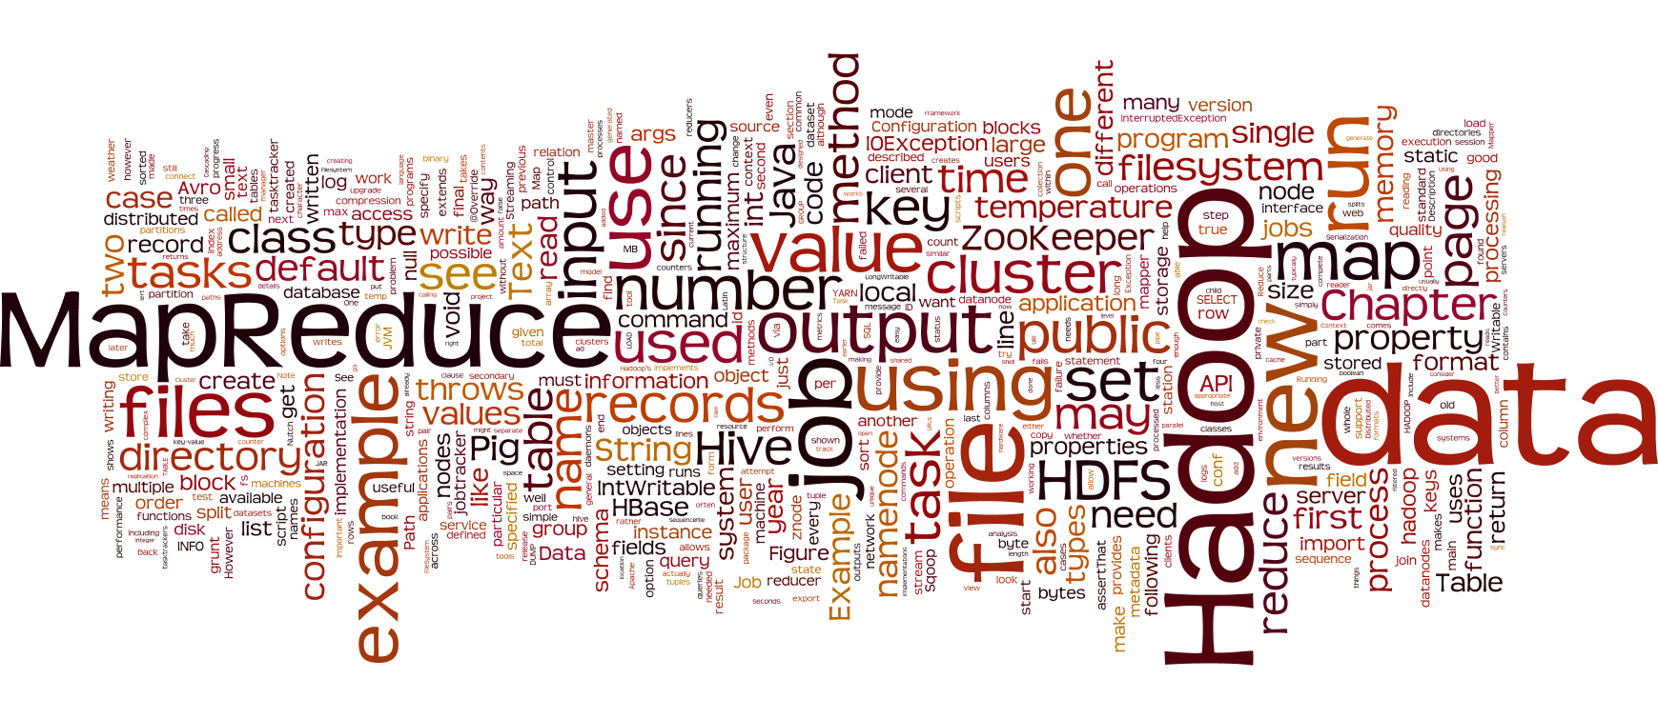

Slide 46
What is changing in the realm of big data & analytics?
Decision-making is moving from the
elite few to the empowered many
As the value of data continues to grow – current systems can’t keep pace
Data is the new Oil
Over 2 billion people (25% of the world’s population) are online
Every driver generates 900 rows of data per 15 minute commute
Global data center traffic
will grow at an annual rate of 25% reaching 7.7 zettabytes by end of 2017
Gartner
Directline Insurance 2013
Cisco Global Cloud Index: 2012 - 2017
Hadoop has become the way to store massive volumes of information and perform analytics on a wider set of data
Notes:
IBM Big Data & Analytics
© 2013 IBM Corporation
46

Slide 47
The Hadoop Market is Evolving Rapidly
SQL
Machine Learning
Data access for the developer expanding to data insight for the scientist
Emerging Technology
Board room
Promising technology is now transforming business strategy
Open Source
Consistent Platform
Industry shifting to an open and consistent platform to drive innovation for all

Slide 48



Open Data Platform Initiative (ODPi)
Community-based effort to standardize Apache Hadoop for improved adoption
Powerful DBaaS
Certify a standard “ODP Core” set of open source Hadoop family projects with specific versions and patch levels
Develop tools and methods to help solution providers to test applications against the ODP Core
Contribute changes and fixes in the ODP Core Hadoop family projects to the ASF using the ASF processes
http://opendataplatform.org/
© 2015 IBM Corporation
Notes:
IBM Big Data & Analytics
© 2014 IBM Corporation
48
IBM Big Data & Analytics
© 2014 IBM Corporation
48
To solve the problem of a lack of Hadoop standards, the Open Data Platform (ODP) initiative was started by IBM and other companies investing in Hadoop. There are a few basic goals:
The ODP will certify a standard ODP core set of Hadoop family projects at specific versions and patch levels. The point here is to ensure these components will have the same behavior, regardless of the Hadoop distro they’re bundled in.
The ODP will also develop tools and methods to help solution providers to test applications against the ODP Core. This is the only real code base the ODP will develop: specifically, test buckets.
The ODP will ensure that any changes needed in the Hadoop components are contributed back to the appropriate ASF project, using the ASF processes. That might seem like an obvious thing, but one common practice has been for vendors to apply their own patches. These patches sometimes never make their way into Apache, or they may be checked into Apache, but aren’t associated with the release branches. Bottom line, this isn’t helpful to the community, and the ODP is committed to supporting the ASF.
These goals all point to the greater goal for the ODP, which is captured in their slogan: “Enabling Big Data solutions to flourish atop a common core platform.“
48

Slide 49
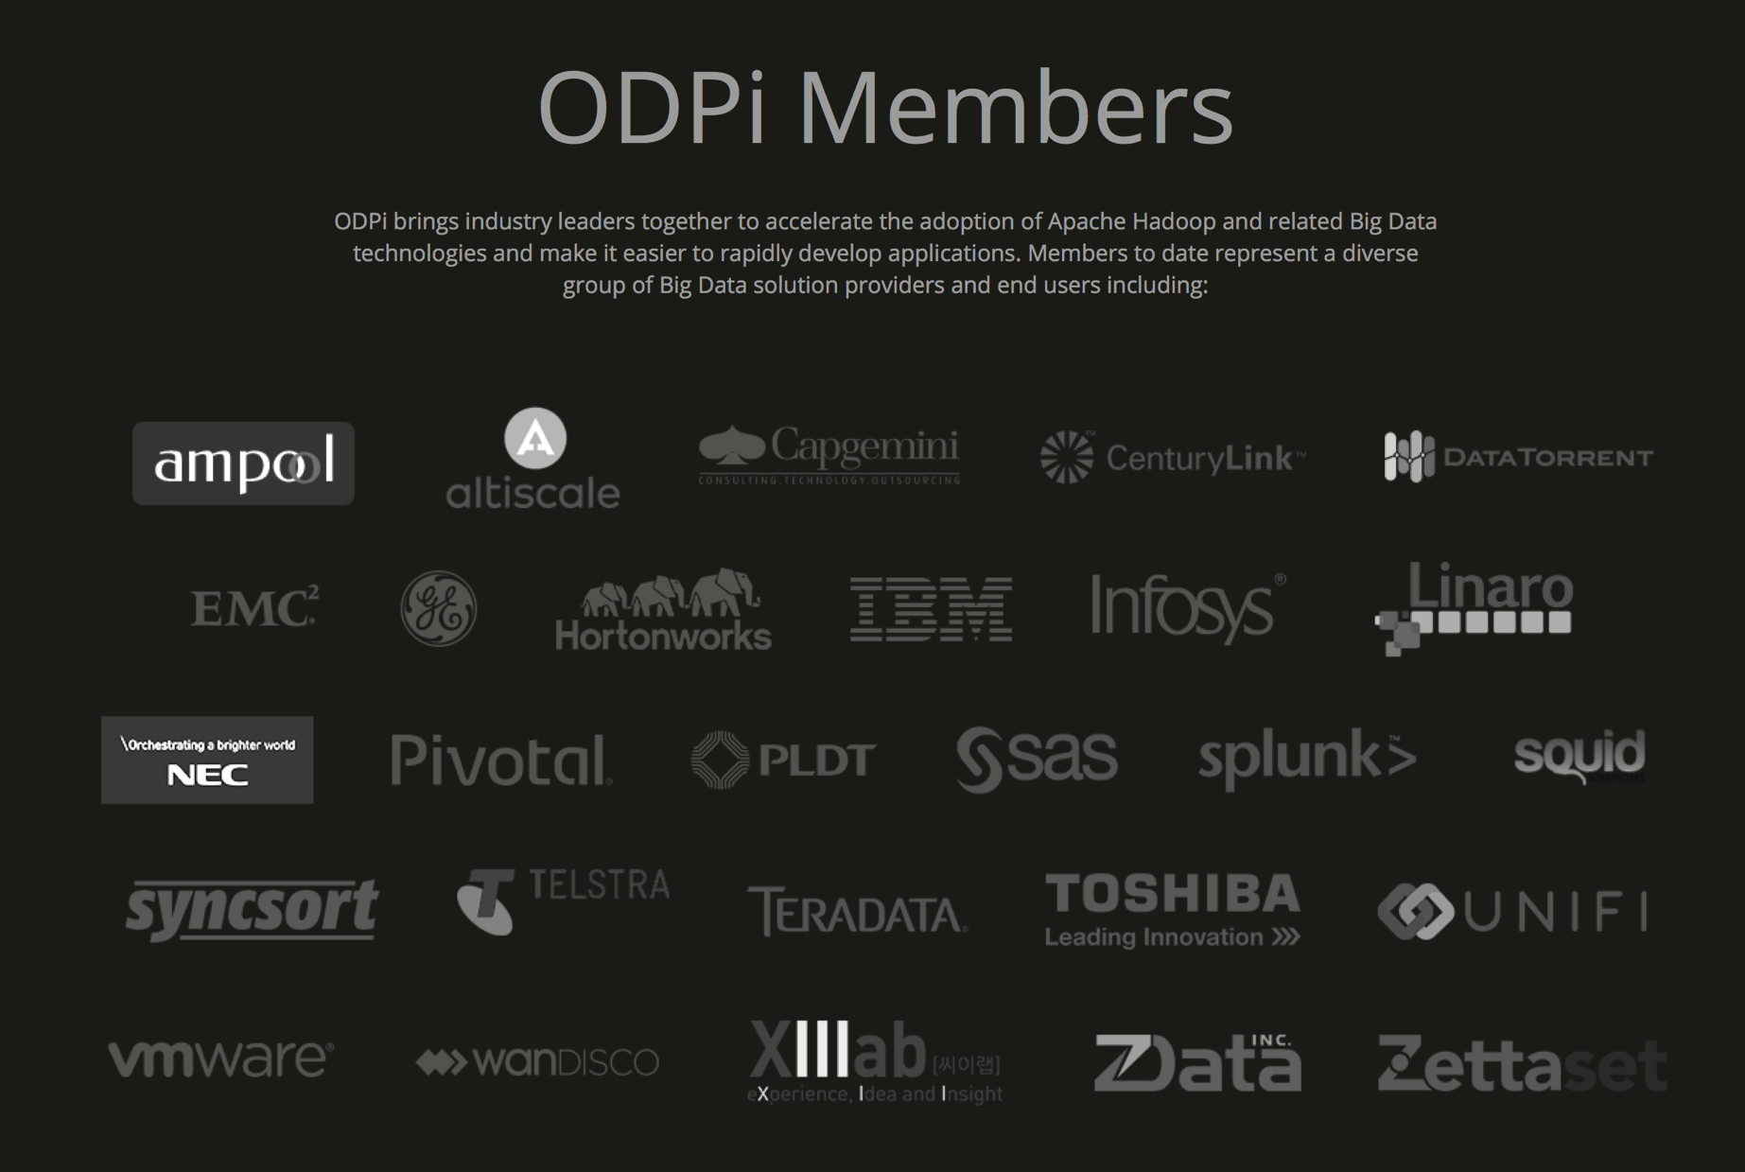

Slide 50
IBM Open Platform (IOP)
IBM Open Platform (IOP)
HDFS
Spark
Hive
HCatalog
Pig
MapReduce
YARN
HBase
Flume
Sqoop
Solr / Lucene
Ambari
IOP package of 100% open source Hadoop distributions from IBM
and the Apache Software Foundation
  Includes Apache Spark for in-memory MapReduce processing
  Includes Apache Ambari for simplified Hadoop administration
  Free for production usage
    Support (paid) available for customers who desire it
Notes:
This brings us to what IBM is doing with Hadoop and Spark.
In early 2015, IBM radically changed its Hadoop strategy. Customers wanting to use IBM’s Hadoop distribution now have the ability to download what’s called the IBM Open Platform with Apache Hadoop (IOP) and use it for free in production. Everything in this package is 100% open source, including Apache Spark. Before, IBM BigInsights was a complete package, which combined the open source components with IBM’s capabilities, like Big SQL. Also, the Hadoop development team in IBM has adapted different techniques to ensure that the open source components themselves will be updated much more quickly, with a goal of four weeks delta from new project release to being available in IOP.
One huge change here is that IOP includes Apache Ambari, which is a Hadoop installation and administration toolkit. This replaced the old BigInsights Console. Again, this shows IBM’s buy-in to the open source Hadoop movement, which is to say, that wherever it makes sense, we’ll align ourselves with open source options rather than “only invented by IBM solutions”. Also, Ambari is very well suited to dealing with modular components, which is common in Hadoop deployments.
IBM also offers a support plan for IOP for those who want it.
In short, for customers who only want a pure open source Hadoop offering, we can now offer that, with support.

Slide 51

IBM Open Platform (IOP) Adopts ODP Core Standards
IBM Open Platform (IOP)
HDFS
Spark
Hive
HCatalog
Pig
MapReduce
YARN
HBase
Flume
Sqoop
Solr / Lucene
Ambari
Open Data Platform (ODP)
Hadoop Open-source Components
ODP certification & standards will initially target core Hadoop packages, with plans for further coverage of the IOP stack in the future
  Enables IBM Hadoop capabilities to run on any ODP-certified Hadoop distributions
  Better compatibility with minimal testing required against ecosystem software
Notes:
This brings us to what IBM is doing with Hadoop and Spark.
In early 2015, IBM radically changed its Hadoop strategy. Customers wanting to use IBM’s Hadoop distribution now have the ability to download what’s called the IBM Open Platform with Apache Hadoop (IOP) and use it for free in production. Everything in this package is 100% open source, including Apache Spark. Before, IBM BigInsights was a complete package, which combined the open source components with IBM’s capabilities, like Big SQL. Also, the Hadoop development team in IBM has adapted different techniques to ensure that the open source components themselves will be updated much more quickly, with a goal of four weeks delta from new project release to being available in IOP.
One huge change here is that IOP includes Apache Ambari, which is a Hadoop installation and administration toolkit. This replaced the old BigInsights Console. Again, this shows IBM’s buy-in to the open source Hadoop movement, which is to say, that wherever it makes sense, we’ll align ourselves with open source options rather than “only invented by IBM solutions”. Also, Ambari is very well suited to dealing with modular components, which is common in Hadoop deployments.
IBM also offers a support plan for IOP for those who want it.
In short, for customers who only want a pure open source Hadoop offering, we can now offer that, with support.

Slide 52

Usual story related to Hadoop & Big Data
Limited personnel, skills and data center capacity
Many big data initiatives are early stage – fast moving ecosystem, requirements uncertain & evolving quickly
Spiky or unknown infrastructure requirements
Challenges meeting time-to-market expectations
Hadoop
HDFS
MapReduce
HCatalog
Flume
HBase
Zookeeper
Pig
Lucene
Oozie
Sqoop
Admin &
Security
Flume
Network
Hive
Development
Tools

Slide 53





IBM BigInsights on Cloud
Enterprise Hadoop as a Service (EHaaS)
For apps that need:
    Elastic scalability
    High availability
    Data model flexibility
    Data mobility
    Text search
    Geospatial
Available as:
    Fully managed DBaaS
    On-premises private cloud
    Hybrid architecture
IBM Open Platform
(IOP)
on Cloud
Simple IBM Cloud provisioning & scaling
Performant bare metal deployments
Managed solution
  Monitoring for availability & security of
  critical platform components
  Patching of OS, Hadoop, and BigInsights
IBM Open Platform (IOP) packages + BigInsights v4.1 module add-ons
  Latest open source packages (Hadoop 2.6, YARN, Spark, Ambari) available for no charge
Open Data Platform
(ODPi)
BigInsights v4
Module
Add-Ons
SoftLayer
Bare Metal
© 2015 IBM Corporation
Notes:
IBM Big Data & Analytics
© 2014 IBM Corporation
53
IBM Big Data & Analytics
© 2014 IBM Corporation
53
We’ve talked about the IBM Open Platform with Apache Hadoop as IBM’s 100% open source Hadoop distribution. But what about BigInsights?
BigInsights is now a modular offering. The base module is IOP – the free Hadoop layer. On top of the Hadoop layer, we have three other modules: BigInsights Analyst, BigInsights Data Scientist, and BigInsights Enterprise Management. Each module is tailored for specific kinds of business value. BigInsights Analyst is geared for data analyst types, and includes Big SQL and BigSheets. BigInsights Data Scientist includes these capabilities, and also the IBM Text Analytics toolkit, Big R, and IBM’s scalable machine learning libraries. Finally, the BigInsights Enterprise Management module features GPFS, which is a POSIX-compliant file system alternative to HDFS, and Platform Symphony, which offers an alternative scheduler that can plug into the YARN scheduler.
One quick note: when people buy the modules on top of IOP, they will need to purchase a support contract for IOP itself.
53

Slide 54
IBM BigInsights on Cloud – Scope of Managed Operations
Managed operations:
  Proactive monitoring for availability of critical platform components
  Ongoing patching for high severity fixes, security flaws, and new functionality
  24 x 7 severity level-one support
Managed by Customers
Applications
Data
Hadoop Operations
BigInsights Operations
Managed by IBM
OS Patches
BigInsights Patches
Operating System
Security
Servers
Storage
Networking

Slide 55
IBM BigInsights on Cloud – v4.1 Paid Add-on Modules
IBM Open Platform (IOP) with Apache Hadoop
100% open source distribution, Open Data Platform Initiative (ODPi) standards, free for production use
HDFS
Spark
Hive
HCatalog
Pig
MapReduce
YARN
HBase
Flume
Sqoop
Solr / Lucene
Ambari
Notes:
This brings us to what IBM is doing with Hadoop and Spark.
In early 2015, IBM radically changed its Hadoop strategy. Customers wanting to use IBM’s Hadoop distribution now have the ability to download what’s called the IBM Open Platform with Apache Hadoop (IOP) and use it for free in production. Everything in this package is 100% open source, including Apache Spark. Before, IBM BigInsights was a complete package, which combined the open source components with IBM’s capabilities, like Big SQL. Also, the Hadoop development team in IBM has adapted different techniques to ensure that the open source components themselves will be updated much more quickly, with a goal of four weeks delta from new project release to being available in IOP.
One huge change here is that IOP includes Apache Ambari, which is a Hadoop installation and administration toolkit. This replaced the old BigInsights Console. Again, this shows IBM’s buy-in to the open source Hadoop movement, which is to say, that wherever it makes sense, we’ll align ourselves with open source options rather than “only invented by IBM solutions”. Also, Ambari is very well suited to dealing with modular components, which is common in Hadoop deployments.
IBM also offers a support plan for IOP for those who want it.
In short, for customers who only want a pure open source Hadoop offering, we can now offer that, with support.

Slide 56
IBM BigInsights on Cloud – v4.1 Paid Add-on Modules
IBM Open Platform (IOP) with Apache Hadoop
100% open source distribution, Open Data Platform Initiative (ODPi) standards, free for production use
HDFS
Spark
Hive
HCatalog
Pig
MapReduce
YARN
HBase
Flume
Sqoop
Solr / Lucene
Ambari
BigInsights Analyst Module
Includes Big SQL, BigSheets, and the IOP stack
Big SQL
BigSheets
Notes:
This brings us to what IBM is doing with Hadoop and Spark.
In early 2015, IBM radically changed its Hadoop strategy. Customers wanting to use IBM’s Hadoop distribution now have the ability to download what’s called the IBM Open Platform with Apache Hadoop (IOP) and use it for free in production. Everything in this package is 100% open source, including Apache Spark. Before, IBM BigInsights was a complete package, which combined the open source components with IBM’s capabilities, like Big SQL. Also, the Hadoop development team in IBM has adapted different techniques to ensure that the open source components themselves will be updated much more quickly, with a goal of four weeks delta from new project release to being available in IOP.
One huge change here is that IOP includes Apache Ambari, which is a Hadoop installation and administration toolkit. This replaced the old BigInsights Console. Again, this shows IBM’s buy-in to the open source Hadoop movement, which is to say, that wherever it makes sense, we’ll align ourselves with open source options rather than “only invented by IBM solutions”. Also, Ambari is very well suited to dealing with modular components, which is common in Hadoop deployments.
IBM also offers a support plan for IOP for those who want it.
In short, for customers who only want a pure open source Hadoop offering, we can now offer that, with support.

Slide 57
IBM BigInsights on Cloud – v4.1 Paid Add-on Modules
IBM Open Platform (IOP) with Apache Hadoop
100% open source distribution, Open Data Platform Initiative (ODPi) standards, free for production use
HDFS
Spark
Hive
HCatalog
Pig
MapReduce
YARN
HBase
Flume
Sqoop
Solr / Lucene
Ambari
BigInsights Analyst Module
Includes Big SQL, BigSheets, and the IOP stack
Big SQL
BigSheets
BigInsights Data Scientist Module
Includes Big R, machine learning & text analytics libraries, as well as Analyst Module and IOP stacks
Big R
Machine Learning,
Text Analytics
Notes:
Month to Month subscription of the IBM Open Platform Hadoop distribution include optional add-ons for advanced text analytics, System Machine Learning which improves developer productivity, Big SQL which supports ANSI SQL workloads against Hadoop, and Big Sheets which supports data discovery & exploration of Hadoop data.
Managed by IBM so secure and up to date.
Reserved Instances (dedicated) deliver billing predictability, performance consistency, and security isolation.
Truly elastic clusters coming in 2H15.
This brings us to what IBM is doing with Hadoop and Spark.
In early 2015, IBM radically changed its Hadoop strategy. Customers wanting to use IBM’s Hadoop distribution now have the ability to download what’s called the IBM Open Platform with Apache Hadoop (IOP) and use it for free in production. Everything in this package is 100% open source, including Apache Spark. Before, IBM BigInsights was a complete package, which combined the open source components with IBM’s capabilities, like Big SQL. Also, the Hadoop development team in IBM has adapted different techniques to ensure that the open source components themselves will be updated much more quickly, with a goal of four weeks delta from new project release to being available in IOP.
One huge change here is that IOP includes Apache Ambari, which is a Hadoop installation and administration toolkit. This replaced the old BigInsights Console. Again, this shows IBM’s buy-in to the open source Hadoop movement, which is to say, that wherever it makes sense, we’ll align ourselves with open source options rather than “only invented by IBM solutions”. Also, Ambari is very well suited to dealing with modular components, which is common in Hadoop deployments.
IBM also offers a support plan for IOP for those who want it.
In short, for customers who only want a pure open source Hadoop offering, we can now offer that, with support.

Slide 58
BigInsights Analyst Module – Detailed
Big SQL
BigSheets
Big SQL
  ANSI SQL 2011 compliant, built for native Hadoop data sources
  Executes queries 3.6x faster than Impala, 5.4x faster than Hive
  Supports IBM Cognos, SPSS, MicroStrategy
  Runs 100% of TPC-DS (RDBMS benchmark standard) queries at 30TB scale
BigSheets
  Spreadsheet-style analysis for business users
  Scalable to massive datasets, multiple data sources
  Built-in parsing for multiple (structured and semi-structured) data formats
  Visualize results through spreadsheets, charts, and graphs
  Entirely driven by graphical user interface (no programming skills required)

Slide 59
BigInsights Data Scientist Module – Detailed
Big R
Machine Learning,
Text Analytics
Big R
  Explore, visualize, and transform BigInsights data using R language syntax
  Partitioning of large data & parallel cluster execution of push-down R code
  Connect against BigInsights using RStudio, work with native R environment
Text Analytics
  Extract information from unstructured data sources for business insight
  Apply user-defined or pre-built rules for creation & extraction of key data
  Users do not need to know AQL: driven by graphical user interface (GUI)

Slide 60
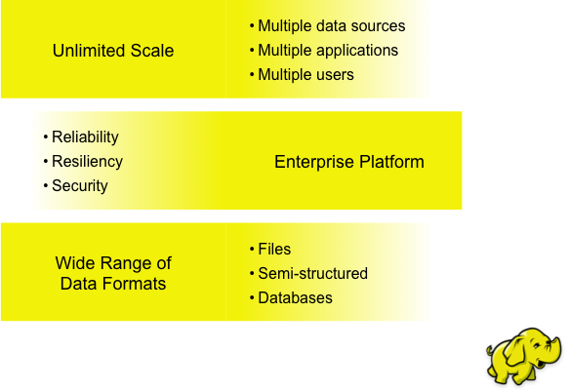
Hadoop Advantages

Slide 61
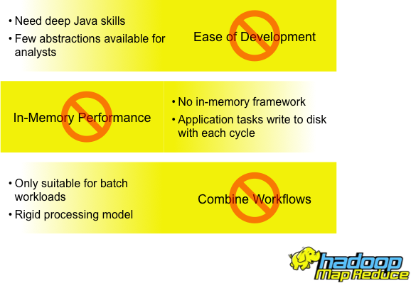
Hadoop MapReduce Challenges

Slide 62

IBM Cloud Data Services
Spark as a Service
Suraj Pandey
Cloud Data Services Technical Lead, Australia and New Zealand

Slide 63
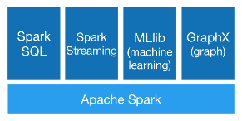
Apache Spark
An Apache Foundation open source project. Not a product.
An in-memory compute engine that works with data. Not a data store.
Enables highly iterative analysis on large volumes of data at scale
Unified environment for data scientists, developers and data engineers
Radically simplifies process of developing intelligent apps fueled by data.
from http://spark.apache.org

Slide 64
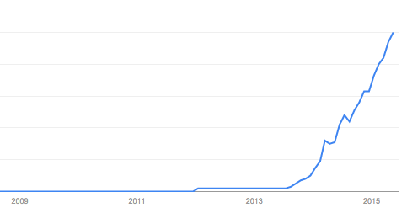
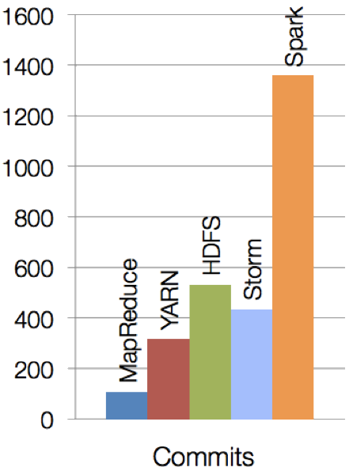
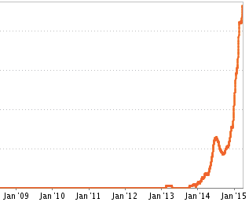
Evolving quickly, High Traction
Spark is one of the most active open source projects
Interest over time (Google Trends)
Job Trends (Indeed.com)
Source: https://www.google.com/trends/explore#q=apache%20spark&cmpt=q&tz=
http://www.indeed.com/jobanalytics/jobtrends?q=apache+spark&l=
Notes:
One thing to note here is how recent all of this attention is – keep in mind that Spark was only founded in 2009 and open-sourced in 2010

Slide 65
Key reasons for interest in Spark
High Performance
In-memory architecture greatly reduces disk I/O
Anywhere from 20-100x faster for common tasks
Productive
Concise and expressive syntax, especially compared to prior approaches (up to 5x less code)
Single programming model across a range of use cases and steps in data lifecycle
Integrated with common programming languages – Java, Python, Scala
New tools continually reduce skill barrier for access (e.g. SQL for analysts)
Leverages existing investments
Works well within existing Hadoop ecosystem
Improves with age
Large and growing community of contributors continuously improve full analytics stack and extend capabilities

Slide 66
IBM is all-in on its commitment to Spark
Contribute to the Core
Launch Spark Technology Center (STC), 300 engineers
Open source SystemML
Partner with databricks
Foster Community
Infuse the Portfolio
Integrate Spark
throughout portfolio
3,500 employees working on Spark-related topics
Spark however customers want it – standalone, platform or products
Educate 1M+ data scientists and engineers via online courses
Sponsor AMPLab, creators and evangelists of Spark

Slide 67
IBM’s vision for IBM Analytics for Apache Spark
We make Spark ACCESSIBLE and USEFUL
Free Trial
As-A-Service
Pay as you go
Managed
Education
Datasets
Notebooks / Tools
Templates / Boilerplate
Autoscaling (elastic)
Connectors

Slide 68

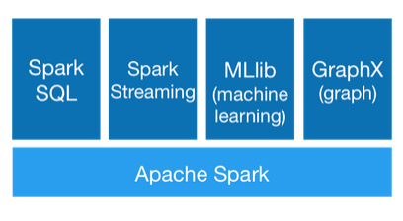
Apache Spark as a Service Offering
http://ibm.com/spark
Access to Spark as a Service for data processing at scale
Pay only for what you use
No lock-in – 100% standard Spark runs on any standard distribution
Elastic scaling – start with experimentation, extend to development and scale to production, all within the same environment
Quick start – service is immediately ready for analysis, skipping setup hurdles, hassles and time
Peace of mind – fully managed and secured, no DBAs or other admins necessary
as a
service
IBM hosted, managed, secure environment
Fully-managed Spark environment accessible on-demand

Slide 69
Getting Started
Discover - Visit IBM Big Data Hub to read the latest news
Learn - Start with the “Spark Fundamentals” at Big Data University
Try Spark - Sign up for Apache Spark as a Service on IBM Bluemix at http://ibm.com/spark
Try Spark with Hadoop - Download at IBM.com/Hadoop
Engage - Join the IBM Spark Technology Center at www.spark.tc

