Slide 1
WELCOME
to the ARN and IBM Breakfast Briefing on Cloud Backup Services Made Easy

Slide 2
RIMIN DUTT
Senior Editor ARN

Slide 3
CAM WAYLAND
Co-founder & Director
Channel Dynamics
THOMAS BAK
Co-founder & Partner
Front-Safe
ROB MACEACHERN
IBM Tivoli Storage Software Leader
Australian and New Zealand

Slide 4
CAM WAYLAND
Co-founder & Director
Channel Dynamics

Slide 5
Backup as a Service
Tips, Ideas & Thoughts For Aspiring Service Providers
Cam Wayland
9 January, 2013

Slide 6
About Channel Dynamics
Channel
Training
Channel
Programs
Channel
Consulting
Notes:
6

Slide 7
BaaS – Next Big Thing Or……?

Slide 8
Productisation or Practice Building Process
Define - customer target market & business requirements, do they align with core strategy
Productise – document the technical solution to be 80% repeatable
Skills – develop technical & sales skills to deliver the solution, especially certifications
Marketing – develop & refine the differentiated value proposition, build campaign & execute
Sales – commit resources with aligned KPIs to meet financial targets
Delivery – benchmark first & each delivery to update documentation as required

Slide 9
My Top BaaS Tips
Its billing & provisioning first, everything else next
Clearly define your product/service offering – both customer/market & technical deliverables, productise where possible
You don’t have to do it all yourself, build, deploy, manage vs just sell the outcome
Understand the working capital & cash flow requirements of any new service
Backup, DR & BC implications are generally not understood by SMB customers & a great opportunity for the channel
Sales people must be able to talk business language, not product specs
Notes:
9

Slide 10
THOMAS BAK
Co-founder & Partner
Front-Safe

Slide 11
IBM Tivoli Storage Manager as Backup Cloud Service
Thomas Bak – Front-safe A/S, Chief Sales Officer & Partner

Slide 12
TSM Portal results
Front-safe Denmark
Started year 2006
TSM Cloud Service Provider in Denmark - including own datacenter, TSM infrastructure, TSM Cloud Portal, service and support, etc.
Results: more than 150 OEM partners, more than 3000 end customers and 9000 servers backed up by TSM in the Cloud – all competitors take outs
Notes:
In Denmark Front-safe delivers the full TSM Cloud Backup solution. Outside Denmark Front-safe delivers the TSM Portal only – nothing else. In that way all TSM software and storage revenue stays with IBM and/or IBM partner in the local area of the customer for the portal.

Slide 13
The TSM Portal of opportunities is available for your business
Notes:
1/9/2013 2:46 PM
13

Slide 14
Validated by IBM
The TSM Portal is classified under the new 'Backed up by IBM TSM‘ program in Ready for IBM Tivoli.
The TSM Portal has been validated by IBM and can be found in the IBM ISM Library:
http://www-304.ibm.com/software/brandcatalog/ismlibrary/details?catalog.label=1TW10SM45
Notes:
1/9/2013 2:46 PM
14

Slide 15
The impact of Cloud
Customers are now asking for services
Service providers are looking at how to deliver
Notes:
1/9/2013 2:46 PM
15

Slide 16
Great place to start
Backup as Cloud Service
Backup - the evil necessity
IDC & Gartner
Traditional backup growth 1-8%
Backup as service growth 33-40%
Notes:
1/9/2013 2:46 PM
16

Slide 17
IBM TSM opportunity
Turn your IBM TSM 180 degrees around
From cost to REVENUE
Notes:
1/9/2013 2:46 PM
17

Slide 18
The TSM Portal for Cloud
IBM Tivoli provides the technical platform
IBM Tivoli provides Capacity licensing
The TSM Portal provides the business model:
Client side deployment
Easy to understand reporting
Flexible billing
OEM Channel setup support
No client side enterprise complexity
Notes:
1/9/2013 2:46 PM
18

Slide 19
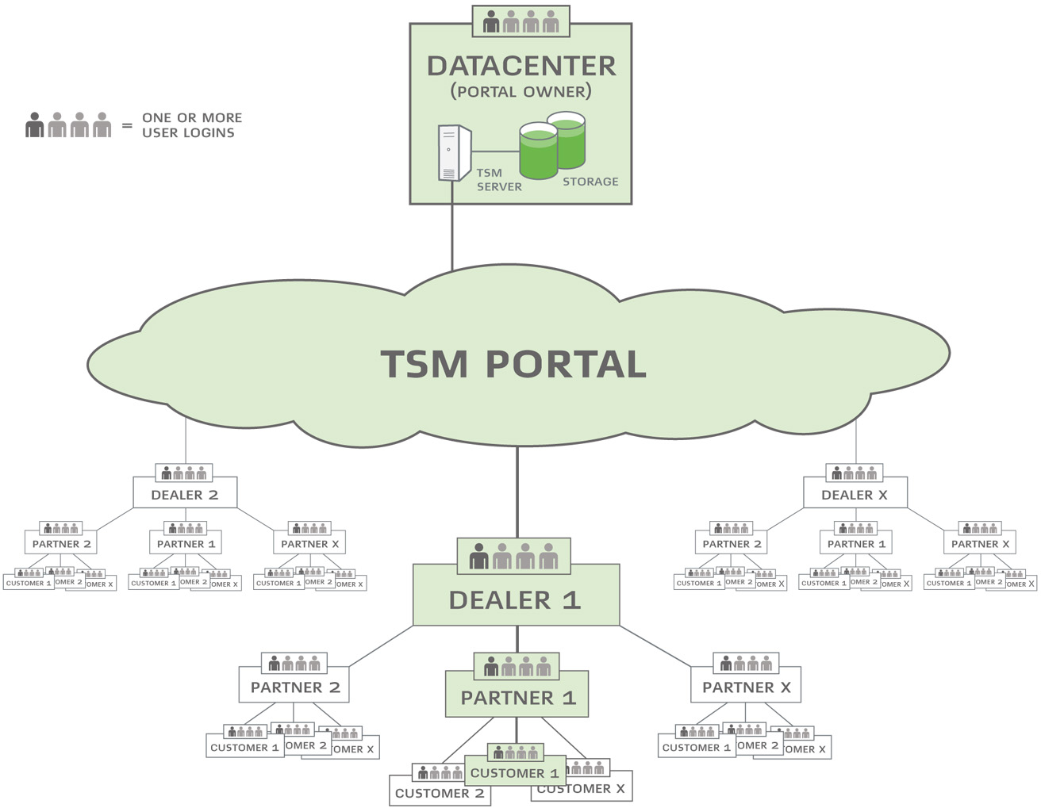
Effective go to market model
Notes:
1/9/2013 2:46 PM
19

Slide 20
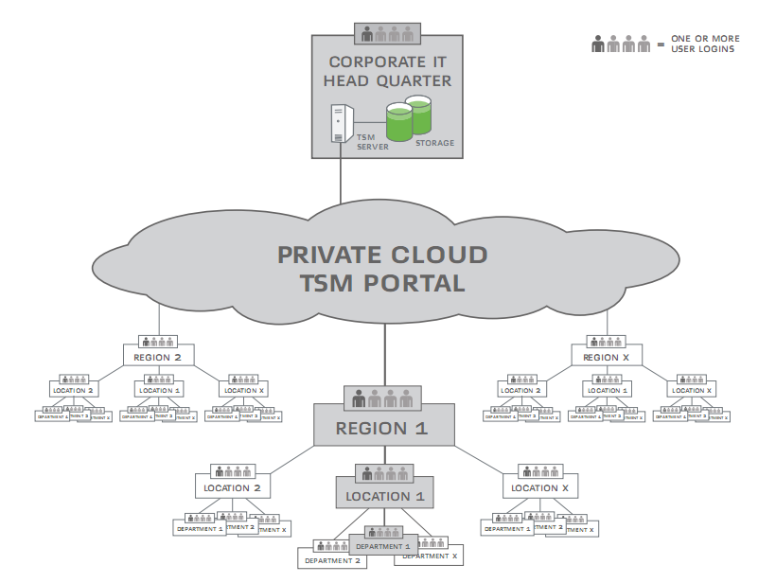
Private TSM Cloud enabler
Notes:
1/9/2013 2:46 PM
20

Slide 21
Intuitive user interface takes out all enterprise complexity
Notes:
1/9/2013 2:46 PM
21

Slide 22
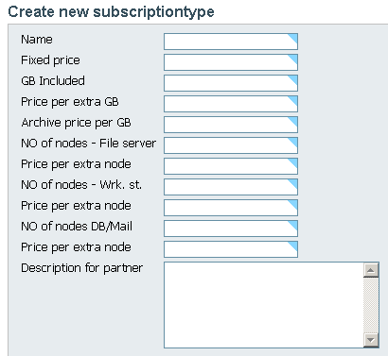
Billing system
The TSM Portal includes a billing system
CSV billing files are created for all entities
Flexible way to set charge back on all levels
Notes:
1/9/2013 2:46 PM
22

Slide 23
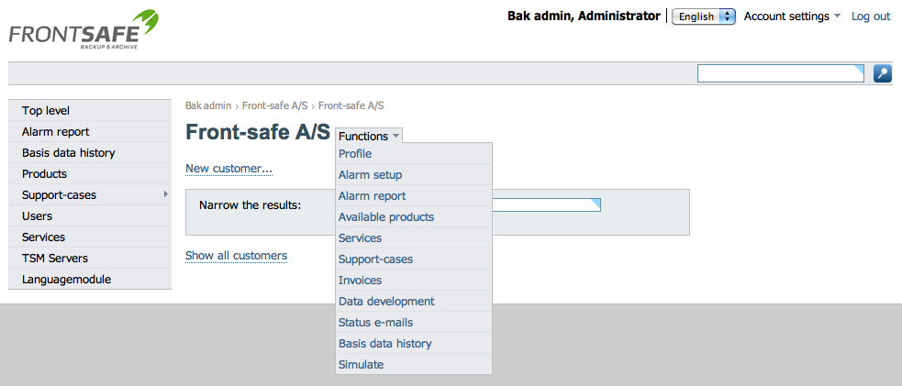
Quick access to all functionality
Short cuts and drop down menu gives easy access to all functions in the portal
Notes:
1/9/2013 2:46 PM
23

Slide 24
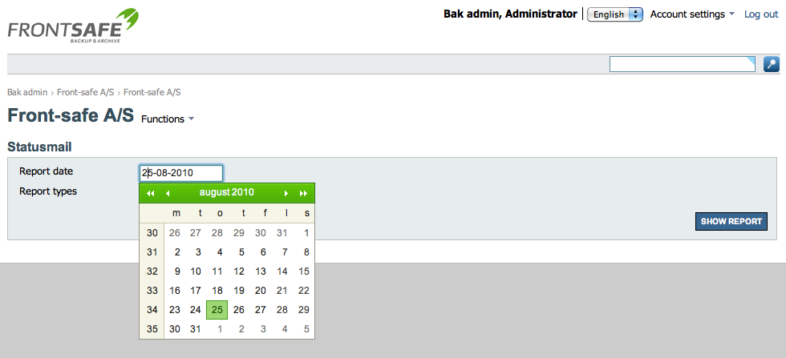
Daily reports
Access to most recent and historical reports.
Notes:
1/9/2013 2:46 PM
24

Slide 25
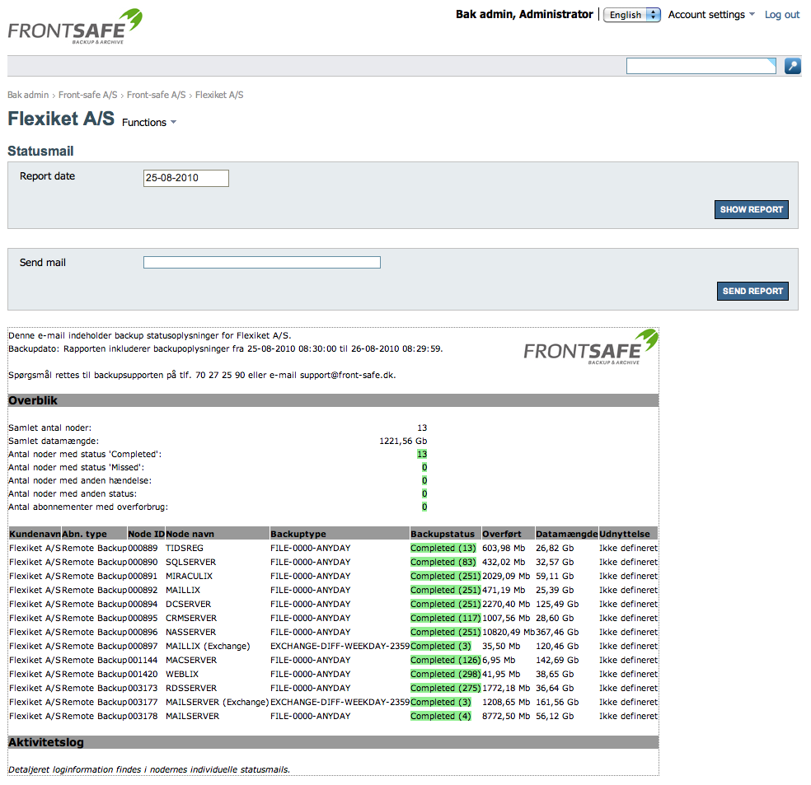
End customer report
All reports are user friendly and easy to understand – even for non-technical people.
Notes:
1/9/2013 2:46 PM
25

Slide 26
OEM branding
OEM branding of the portal and all reports.
Notes:
1/9/2013 2:46 PM
26

Slide 27
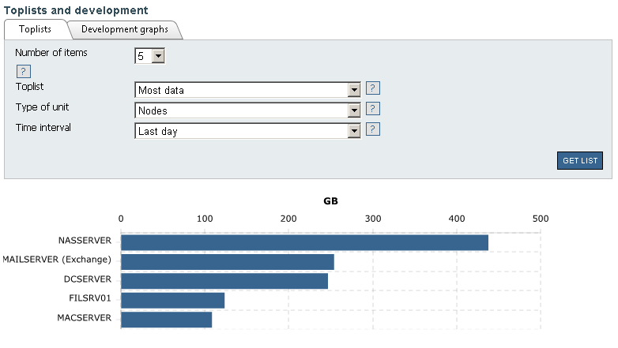
Business intelligence reports
BI reports add great overview
Notes:
1/9/2013 2:46 PM
27

Slide 28
Interested? Contact information Thomas Bak CSO & Partner +45 4090 6979 tba@front-safe.dk
Notes:
1/9/2013 2:46 PM
28

Slide 29
Thank You
Notes:
IBM PULSE 2012
PULSE2012_Steve Mills_template
1/9/2013 2:46 PM
29
1/9/2013

Slide 30
ROB MACEACHERN
IBM Tivoli Storage
Software Leader
Australian and New Zealand

Slide 31
What Next
Why IBM?
TSM is a leading solution
Already have BaaS?
IBM has tools to analyse what you've got
Understand the how IBM solutions can reduce the tapes, disks, drives, effort!
Butterfly (no, it's not a codename)

Slide 32
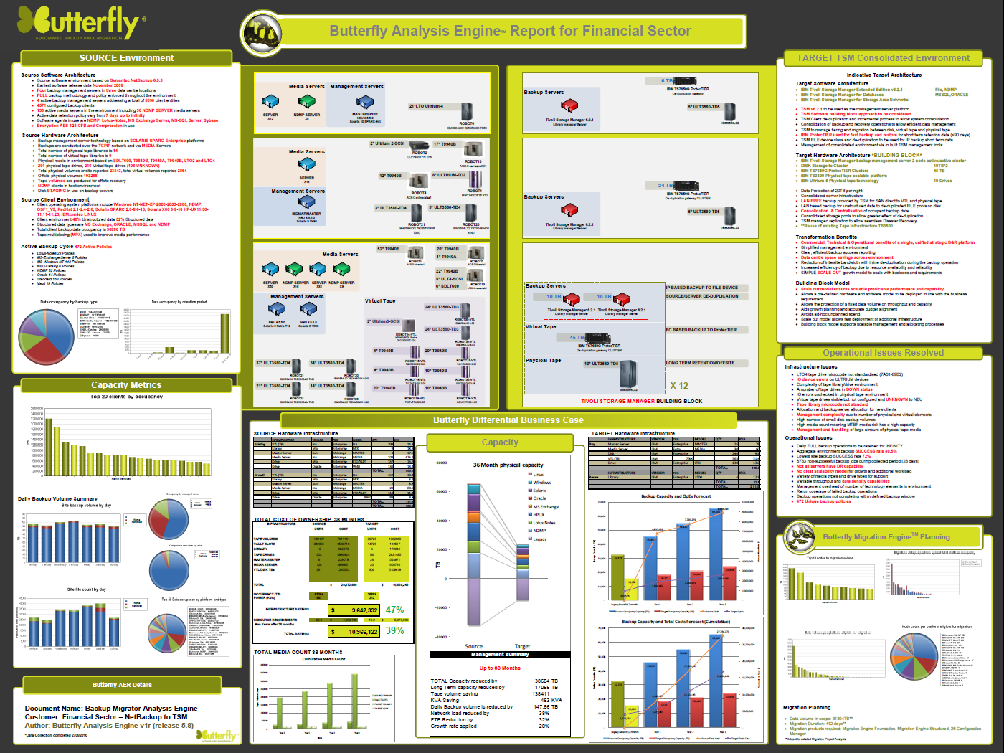
Current
environment
Reduction in
HW infrastructure
Benefits of
change
Operational
Issues resolved
Infrastructure &
resource savings
Media
capacity savings
Migration Plan

Slide 33
What Next
2. Join IBM's MSP Program to leverage:
IBM’s brand pull and the breadth of IBM’s offerings portfolio
Access to co-marketing
Large partner ecosystem
Flexible business models (ASL)
https://ibm.com/partnerworld/msp
If you're a member of IBM PartnerWorld already - update your profile!

Slide 34
What Next
3. Need help building a business plan? Call IBM
Rob MacEachern
IBM Tivoli Storage Leader, ANZ m: +61(0) 429 184 765 e: mrobert@au1.ibm.com
Pádraig Byrne
IBM Cloud Software Sales Specialist
m: 0401 652 249
e: pbyrne@au1.ibm.com
Luke Thomas
IBM A/NZ Tivoli Channel Executive m: 0402 908 013 e: lthomas@au.ibm.com

Slide 35
To Learn More
Tivoli Storage Manager Web Page
IBM - Storage management software - Tivoli Storage Manager - Software
Front-safe
http://www.front-safe.com
Whitepapers
Cloud-based data protection services for managed service providers
http://public.dhe.ibm.com/common/ssi/ecm/en/tiw14136usen/TIW14136USEN.PDF
Whitepaper on the architecture of the Front-safe portal:
http://www.front-safe.dk/media/8084/tsmcloudserviceproviderwhitepaper111123.pdf
Migrate to IBM Tivoli Storage Manager easily and confidently" http://public.dhe.ibm.com/common/ssi/ecm/en/tis14080usen/TIS14080USEN.PDF
Butterfly Webcast On Demand http://event.on24.com/r.htm?e=480397&s=1&k=89E4832B333CD481143B1DC4060317DB
IBM Partnerworld for MSPs
http://www.ibm.com/partnerworld/msp
Notes:
35

Slide 36
Q A
&

Slide 37
On behalf of ARN and IBM
Thank you for attending today’s breakfast briefing

