Slide 1
A New Way to Think
Welcome to the Cognitive Era with IBM Watson
Peter Haggar
Senior Technical Staff Member – IBM Master Inventor
Watson Platform Services Architecture
IBM Watson Group

Slide 2

Watson is creating a new partnership between people and computers that enhances, scales and accelerates human expertise.
Notes:
The world’s progress is driven by expertise. Watson is creating a new partnership between people and computers that, enhances, scales and accelerates human expertise.

Slide 3
Watson is ushering in a new era of computing
Tabulating
Systems Era
Programmable
Systems Era
Cognitive
Systems Era
1900
1950
2011
Notes:
All of this has led us to a new era of computing: Cognitive Systems Era. This is significant in the history of computing – there have only been 2 previous ones.
Tabulating systems era – the advent of the adding machine to tabulate the census
Programmable Systems era – Fortran, Cobol, PL1, etc.
Cognitive - Watson
3

Slide 4
Watson Value Proposition
healthcare data
government & education data
99%
88%
94%
84%
90% of worlds data created in last 5 years
  80% is unstructured and not very usable by the majority of today’s computing systems
  The data of today is not neatly organized (or organise-able) into rows and columns etc.
  Data collectors are nearly everywhere, and growing
growth by 2017
unstructured
growth by 2017
unstructured
Healthcare data comes from sources such as:
Government & education data comes from sources such as:
Patient
Sensors
Electronic Medical Records
Test Results
Vehicle Fleet Sensors
Traffic Sensors
Student Evaluations
utilities data
Media data
93%
84%
97%
82%
growth by 2017
unstructured
growth by 2017
unstructured
Utilties data comes from sources such as:
Media data comes from sources such as:
Utility Sensors
Employee Sensors
Location Data
Video
and Film
Images
Audio

Slide 5
When your business thinks, you can outthink.
Advantages of Cognitive Systems:
Advantages of Cognitive Business:
Specialize in unstructured data: text, speech, images
Reason
Never stop working / learning
Deeper human engagement.
Elevated expertise.
Cognitive products and services.

Slide 6


IBM has radically expanded access to Watson services
Access restricted to partners and IBM developers
Accessible by anyone with a Bluemix account
Wait until services are GA to release
Release in Beta and gather input from user community
North America
Global
One service
19 services and more coming

Slide 7
Developers and partners worldwide are infusing cognitive capabilities in their applications / products
77,000+
3B
10,000+
350+
28
19
  Developers
  WW
Peak API
calls / mo
Apps in test,
experimentation
or production
Partners in
17 industries &
36 countries
Cognitive
APIs
Cognitive
Services

Slide 8








These APIs form the basis for all Watson cognitive solutions
Advisors
App Store
Cross Industry Editions
Target Industry Editions
Powered by Watson Offerings
Engagement
Discovery
Oncology
Wealth Mgmt.
Industry Aligned
Market Aligned
Healthcare
Call Center
Decision
Policy
Intelligence
Cooking
Travel
Research
.
.
.
.
.
.
Core Offerings
Watson Analytics
Watson Explorer
Financial Svc.
User Profiling
Developers Cloud
Specialties
Cognitive Services (APIs)
Tooling
Models
Assemble
Design
Visualize
Train
Deploy
Content
Admin
Data Services
Extract
Ingest
Curate
Annotate
The same services are used by business partners, customers, and IBM Developers.

Slide 9
IBM Watson
The Waston that competed on Jeopardy! in 2011 comprised what
is now a single API—Q&A—built
on five underlying technologies.
Since then, Watson has grown to
a family of 28 APIs.
By the end of 2016, there will
be nearly 50 Watson APIs—
with more added every year.
Questions
&
Answers
Personality
Insights
Keyword Extraction
Image Link
Extraction
Language
Detection
Relationship Extraction
Feed
Detection
^{Natural Language Processing}
^{Machine Learning}
^{Question Analysis}
^{Feature Engineering}
^{Ontology Analysis}
Concept
Expansion
Dialog
Sentiment Analysis
Visual
Recognition
Concept
Insights
Concept
Tagging
Natural
Language
Classifier
Language
Translation
Message
Resonance
Text to
Speech
Retrieve
&
Rank
Taxonomy
Author
Extraction
Tone
Analyzer
Image
Tagging
Tradeoff
Analytics
Watson
News
Text
Extraction
Speech to
Text
Entity
Extraction
Face
Detection

Slide 10
Watson Developer Cloud Services Available Now
Language Services | Availability
Alchemy Language | GA
Concept Expansion | Beta
Concept Insights | GA
Dialog | GA
Document Conversion | Experimental
Language Translation | GA
Natural Language Classifier | GA
Personality Insights | GA
Question and Answer | Beta
Relationship Extraction | Beta
Retrieve and Rank | GA
Tone Analyzer | Experimental
Vision Services | Availability
Alchemy Vision | GA
Visual Insights | Experimental
Visual Recognition | Beta
Speech Services | Availability
Speech to Text | GA
Text to Speech | GA
Data Insight Services | Availability
AlchemyData News | GA
TradeOff Analytics | GA

Slide 11


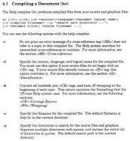
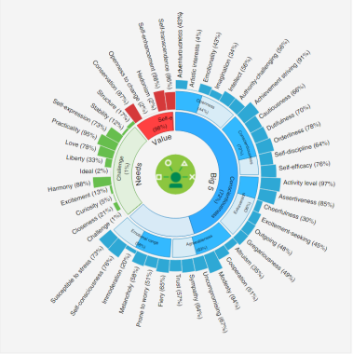


Personality Insights
Derives insights from text/social media data to identify psychological and behavioral traits
AlchemyVision
Analyzes images and videos to understand their content and context
Provides
Image Tagging, Face Detection/Recognition, age, gender, identities of people (in the case of celebrities)

Slide 12


AlchemyLanguage
Function
Entity Extraction
Sentiment Analysis
Keyword Extraction
Concept Tagging
Relation Extraction
Taxonomy Classification
Author Extraction
Language Detection
Text Extraction
Microformats Parsing
Feed Detection
Linked Data Support
APIs can process text and help understand its sentiment, keywords, entities, and high-level concepts
Tone Analyzer
Helps detect, understand, and revise the language tones of emotions, social propensities and writing styles in written communications

Slide 13

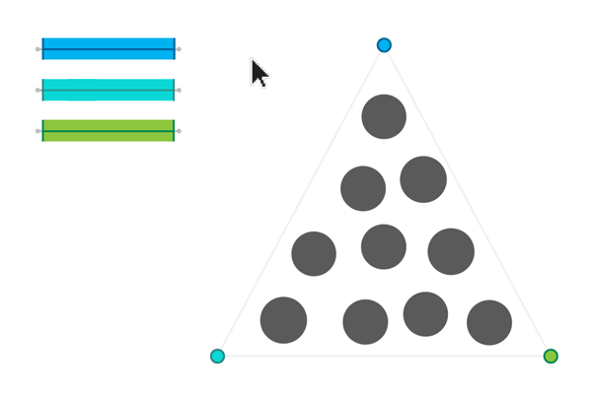

Tradeoff Analytics
Helps make better choices under multiple conflicting goals
Combines smart visualizations and analytical recommendations for tradeoff exploration
Relationship Extraction
Parses sentences and detects relationships into their various components:
Noun, verb, adjective, conjunction, subjects, objects, predicates, etc
© 2015 International Business Machines Corporation
13

Slide 14


Speech to Text
Languages Supported
English (US), Spanish, Japanese, Brazilian Portuguese, Mandarin
Text to Speech
Languages Supported
English, French, German, Italian, Japanese, Spanish
Generates an audio file with verbal representation of the input text – complete with appropriate cadence and intonation

Slide 15


Concept Insights
Links documents
Explicitly when a document directly mentions a concept
Implicitly connecting documents to relevant concepts that are not directly mentioned in them
Concept Expansion
Analyzes text and learns similar terms (words or phrases) based on context
Ex: Interprets “The Big Apple” as “New York City”

Slide 16


Language Translation
Language identification for 62 languages
Utilizes domain specific models to convert between languages
Conversational, News, Patent
AlchemyData News
Provides news and blog content enriched with natural language processing to allow for highly targeted search and trend analysis

Slide 17


Natural Language Classifier
Returns the best matching classes for a sentence or phrase
Classify tweets into a set of classes, such as events, news, or opinions
Analyze text messages into categories, such as Personal, Work, or Promotions
Dialog
Engage end-users in a conversational dialog

Slide 18

Question and Answer
Interprets and answers user questions based on primary data sources that have been gathered into a body of data or 'corpus‘
Returns candidate responses with associated confidence levels and links to supporting evidence

Slide 19
Example IP in Cognitive
Answer accuracy based on
“Speaker” expertise
Question asker
Multiple QA pipelines
Determining Corpus Value
Load Balancing based on question difficulty
Generating answers when answer not in corpus
Image/Video content for answer generation

Slide 20
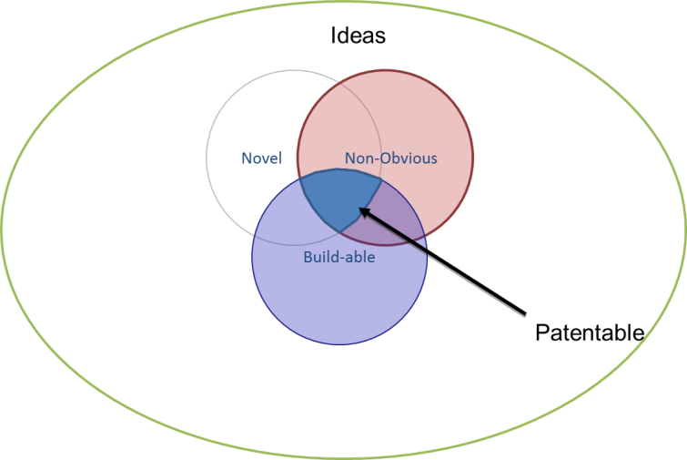
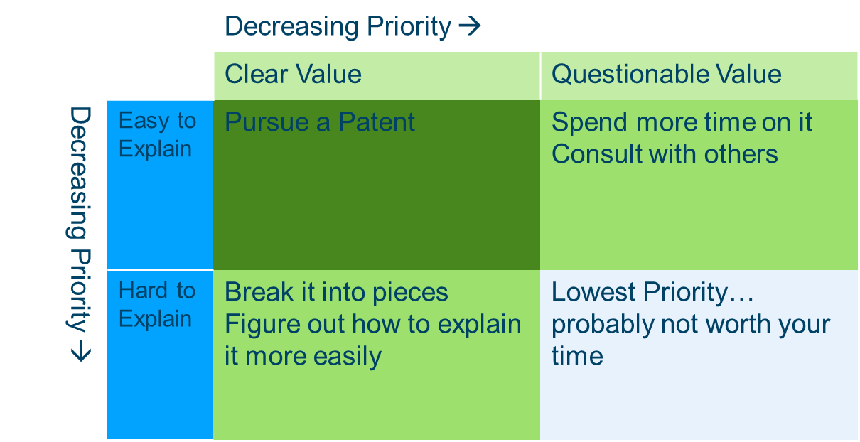
Process of Innovation

Slide 21





The Power of Watson Developer Cloud
Individual Services are unique and useful
Combining services is Powerful
Speech to Text
Text
Tone Analyzer
Alchemy Language
Personality
Insights
Advanced Customer Profile

Slide 22




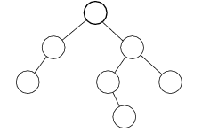
Putting Speech, Classifier and Dialog together
Phone, Text, Chat
How do I reset my password?
If speech, convert to Text
Context = “Online Banking”
Natural Language Classifier
Identifies Intent
Intent = “Password_Reset”
Confidence – 0.876655900
Passes to appropriate node in dialog tree to walk user to outcome
- Intent=“Password_Reset”
- Context = “Online Banking”
Dialog

Slide 23
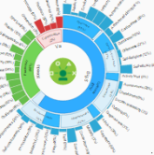
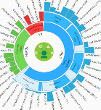
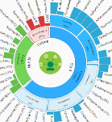

Example: Services Support App
Personalized, automated self service (Dialog & Personality Insights)
Can you help me pick the right insurance?
Can you help me pick the right insurance?
Can you help me pick the right insurance?
Here’s a link to a step by step guide to walk you through this
Sure. I can walk you through step by step. Ready to get started?
Based on our previous conversations and low but rising interest rates, let me tell you more about 30 year fixed. Ready to learn more?

Slide 24
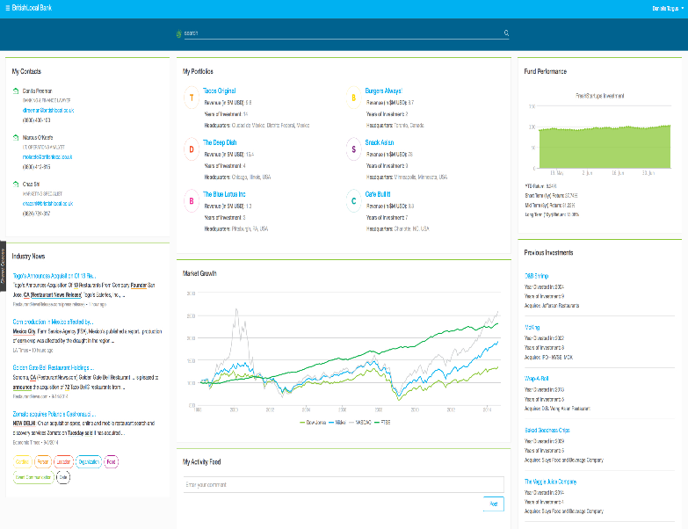
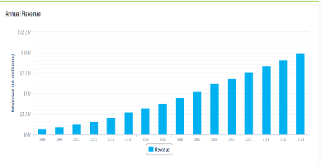

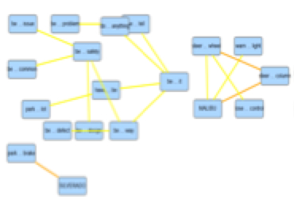
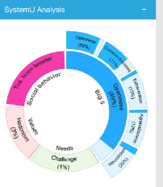

Example: Watson Explorer with Watson Developer Cloud services for Agent Assisted Insurance Claims CRM
Watson Explorer
Build a 360 view of all your information
Q&A
Direct responses to user inquiries fueled by primary document sources
Relationship Extraction Intelligently finds relationships between sentence components
AlchemyVision
Imagine recognition
Concept Insights Explores information based on the ideas, rather than traditional text matching
Personality Insights
Deeper understanding of people's personality characteristics, and values
Sentiment Analysis
Identify the positive or negative sentiment within any comment, tweet, blog, document or webpage
Notes:
Relationship Extraction- Intelligently finds relationships between sentence components. In this case, “What are common occurrences within Z3 accidents?
Q&A - Direct responses to user inquiries fueled by primary document sources. In this case, things like “What is the car window policy for this user?”
AlchemyVision Imagine Recognition: Can look up other car tags like this one
Sentiment Analysis (Alchemy service inside AlchemyLanguage): How it works:
AlchemyAPI's sentiment analysis algorithm looks for words that carry a positive or negative connotation then figures out which person, place or thing they are referring to. It also understands negations (i.e. "this car is good" vs. "this car is not good") and modifiers (i.e. "this car is good" vs. "this car is really good"). The sentiment analysis API works on documents large and small, including news articles, blog posts, product reviews, comments and Tweets.

Slide 25
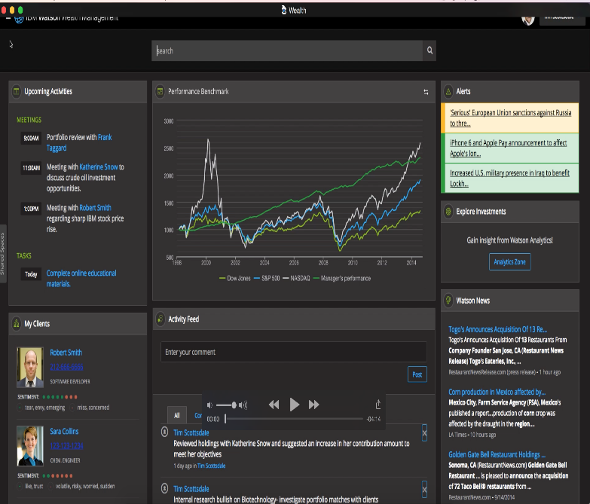
Wealth and Information Management CRM (AlchemyLanguage, Concept Expansion, Relationship Extraction, Personality Insights, etc...)
Tradeoff Analytics- Which stocks are affected most by different market information variables.
Watson Explorer
Build a 360 view of all your information
Q&A
Ask a natural language question about your data: “Which portfolio is growing the fastest?”
AlchemyLanguage- find people, places, timelines from all major news and financial sites
Personality Insights- What personality insights can I gain through public articles about ownership?
Relationship Extraction- Find new connections between News and investments

Slide 26
Watson Developer Cloud – Summary
Aggressively investing in enhancing and broadening the portfolio of IBM Watson Cognitive services
Integrating these services into and across IBM products
Enables
  Deeper human engagement
  Discovery & Innovation
  Better decision making
  The Cognitive Era

