Slide 1


A New Way to Build
Notes:
Please note: Presenter notes are on every slide. Written as a suggested script to help with messaging.

Slide 2



Digital Transformation

Slide 3

15 minutes

Slide 4

7 1/2 minutes

Slide 5
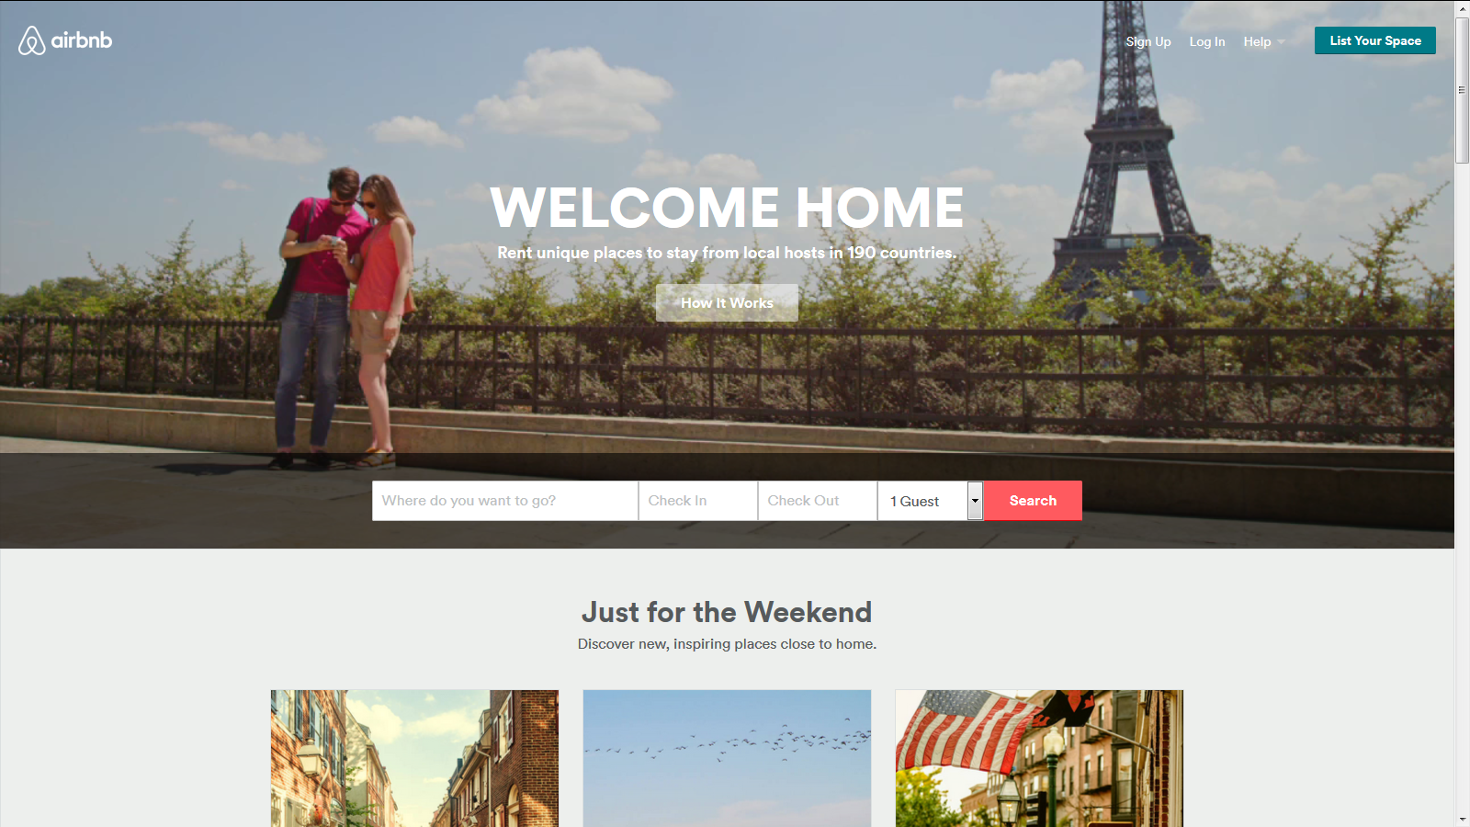
Seconds

Slide 6
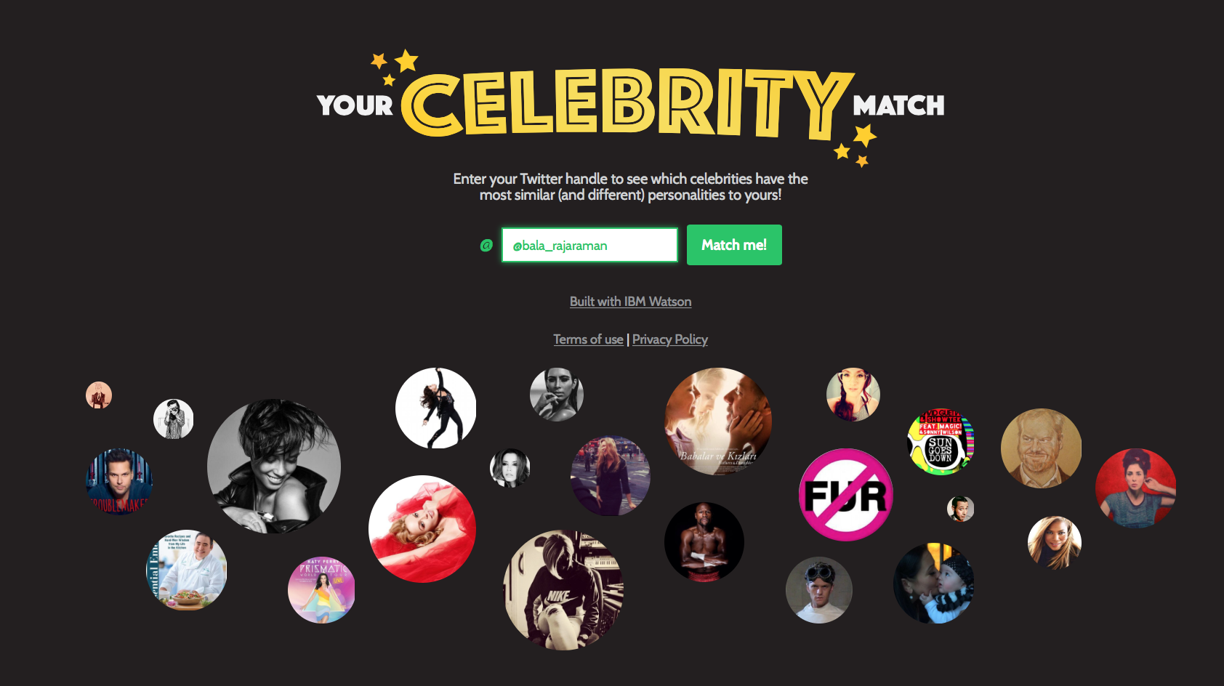
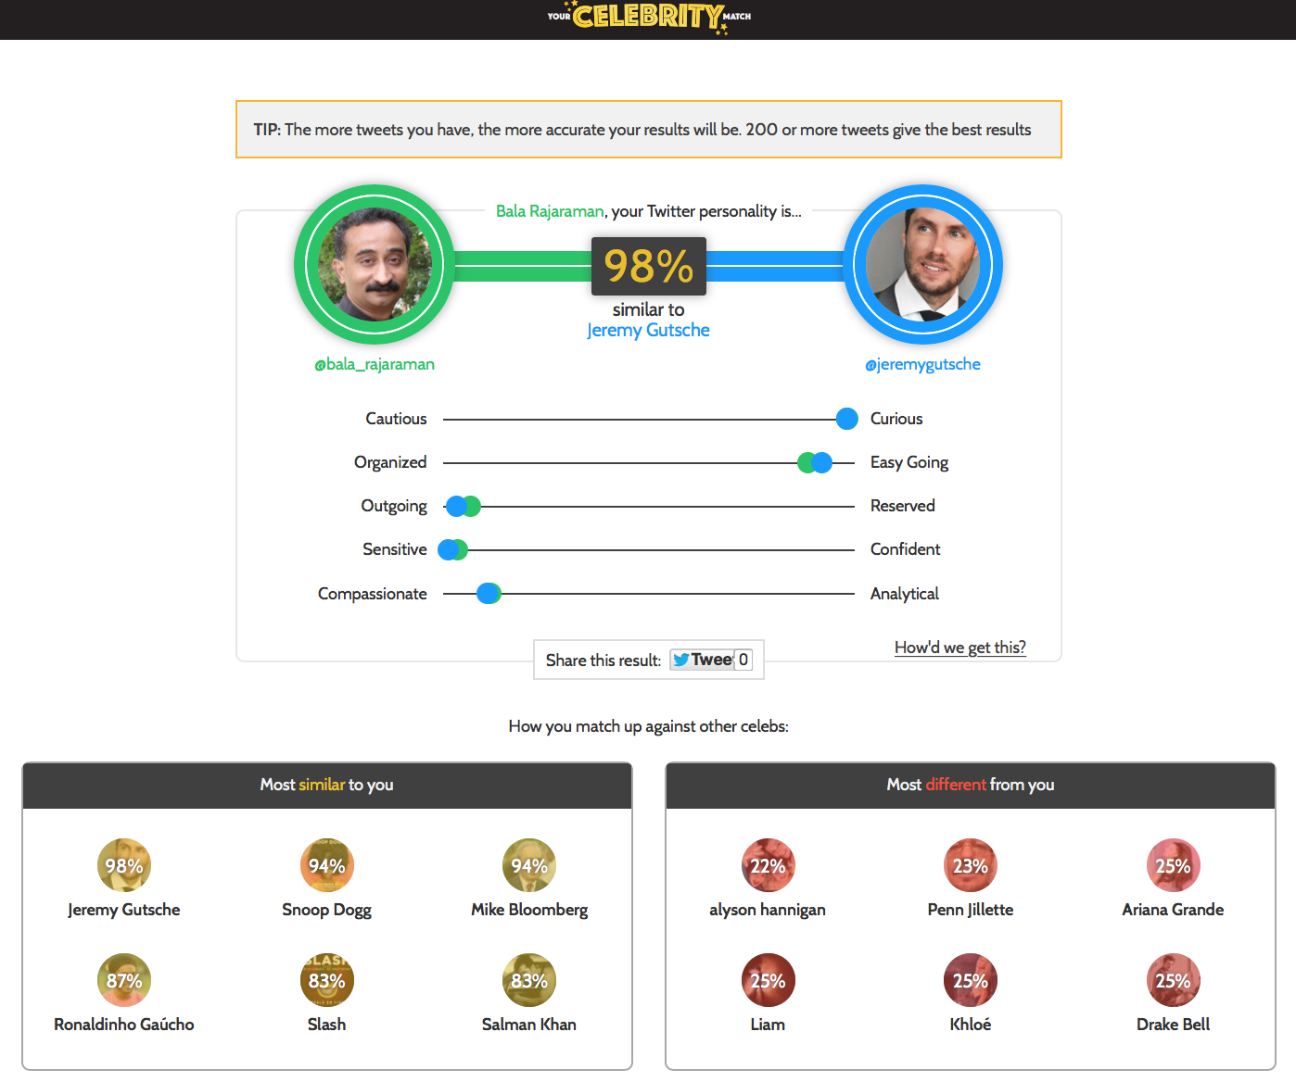
http://your-celebrity-match.mybluemix.net/

Slide 7
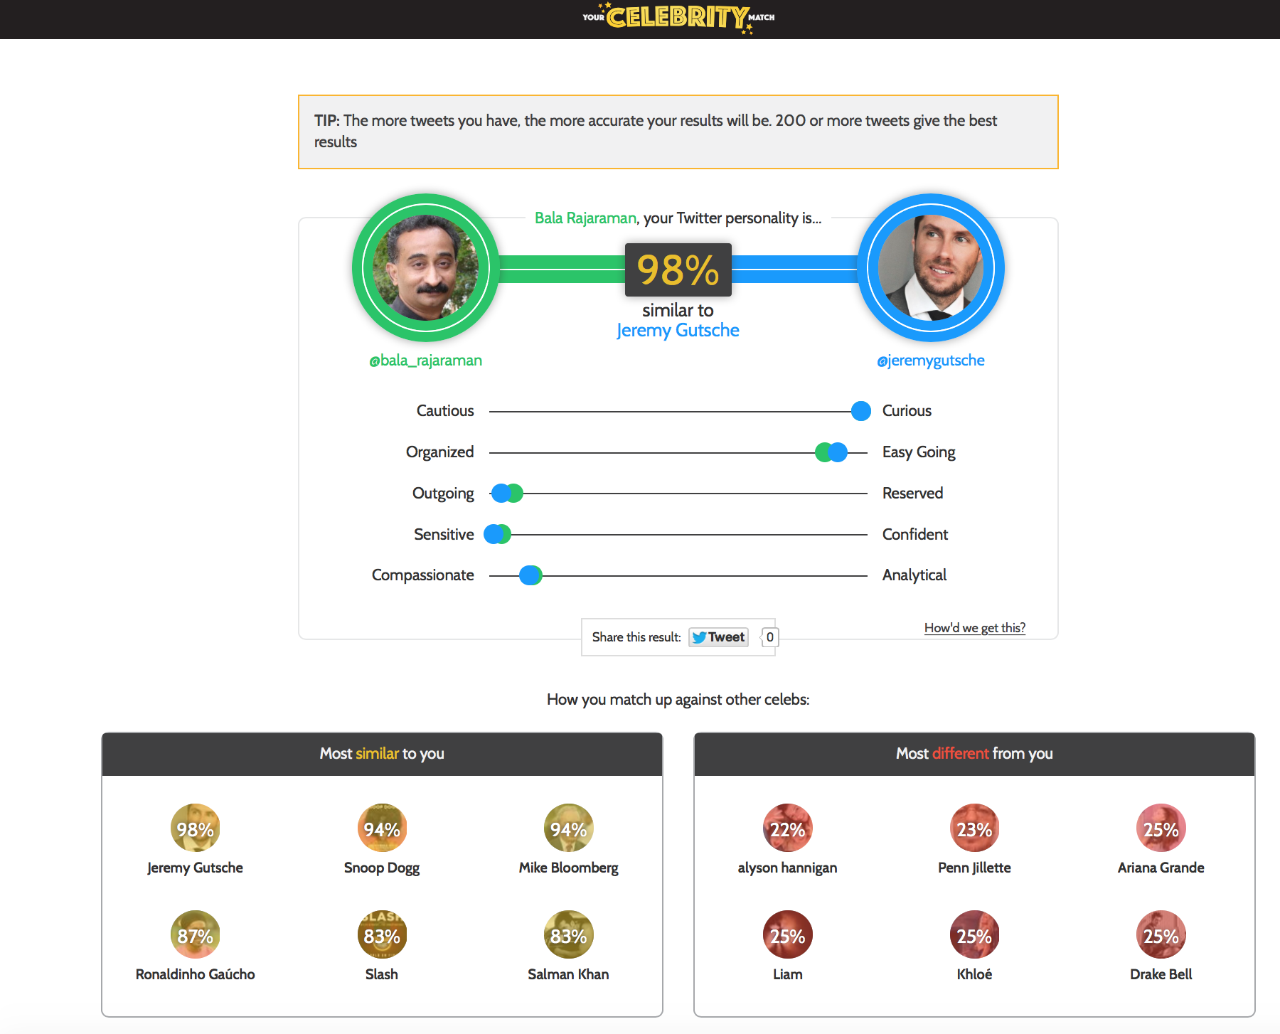
Really ?
Awesome !

Slide 8
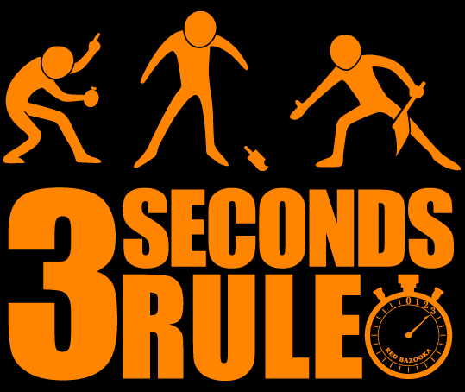

GameCo has about 3 seconds to captivate “Bobby” as he enters a store.
We call this the “3 Second Rule”

Slide 9

As Bobby enters the store a video trailer plays;
(non-coincidentally) it’s the game he wants to buy…
What GameCo needs to figure out in 3 seconds:
That this is indeed Bobby
Where is Bobby?
Is Bobby a Club Member?
What has he purchased recently?
What have others “like”
Bobby purchased?
Score these results and
pick recommendation
Start playing a video trailer of “the perfect game” for Bobby

Slide 10
















The rate of innovation is expediential
“Two guys in a Starbucks can have access to the same computing power as a Fortune 500 company.”
Jim Deters - Founder, Galvanize
Design Thinking
Runtimes
APIs
Micro
services
IoT
Extreme
Agile
Tooling
Containers
Notes:
The digital disruption is underway across all industries, and at the core of this disruption is a transformation and acceleration of innovation, development and delivery methods. Enterprise executives recognize the significance of this transformation and are seeking ways to bring the culture of startup innovation into their enterprise. They need to lead the digital disruption or risk being disrupted -- digitally disintermediated from their customers, employees, or suppliers. Born on the cloud startups are leading many disruptions and using new methods to achieve these disruptive innovations.
These digital disruptors are delivering new business models and customer value at high speed and high quality, continuously iterating and experimenting in-field to achieve their desired business outcomes. Pivoting and rapidly iterating to achieve customer adoption and revenue growth.
These new methods, typically discussed as DevOps, encompasses a transformation of culture, processes and tools. In a manor that accelerates innovation, rapid instantiation of new services, and data driven iterations

Slide 11
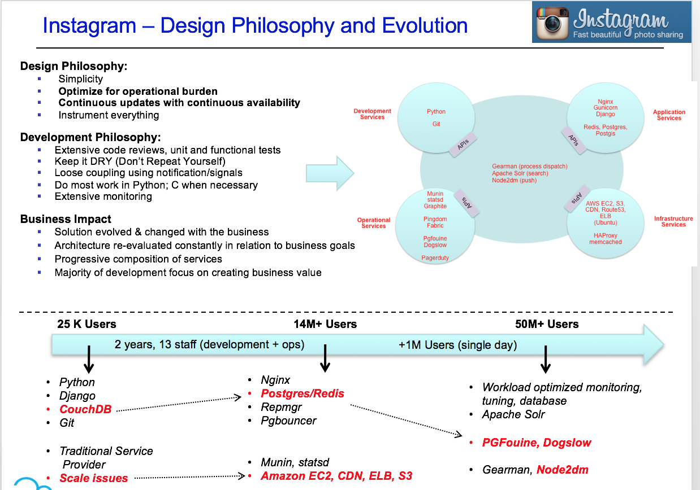
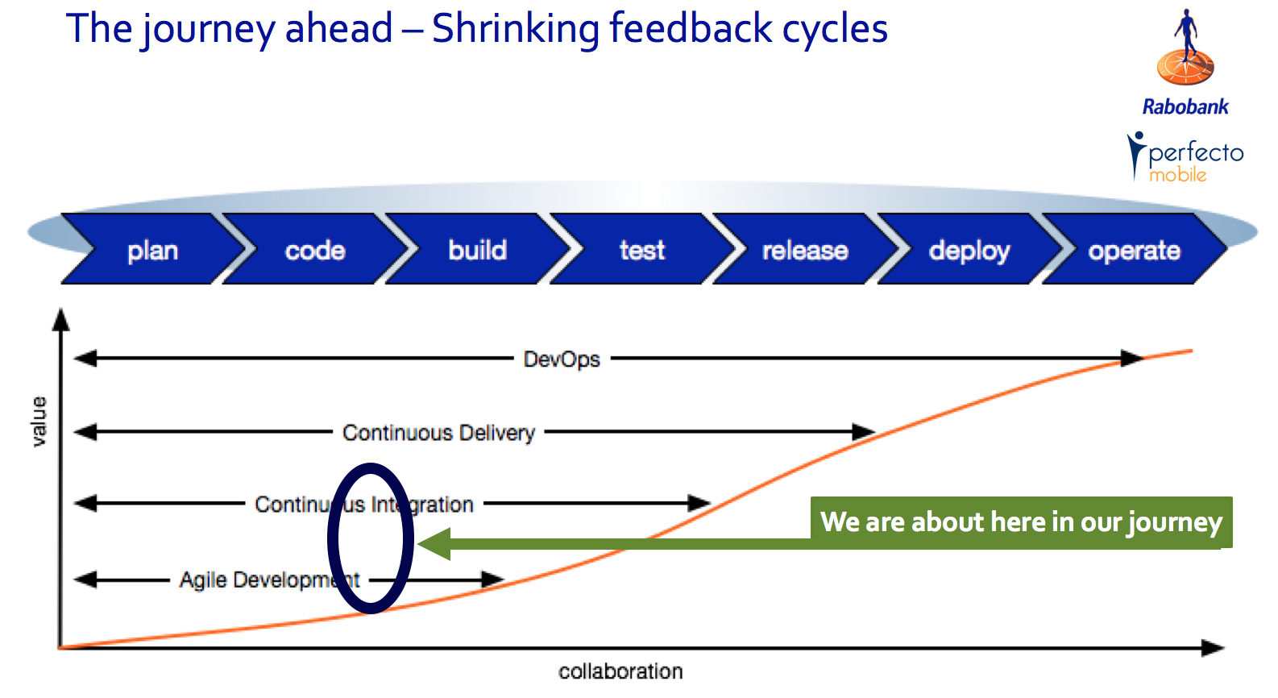
Innovation is continuous

Slide 12
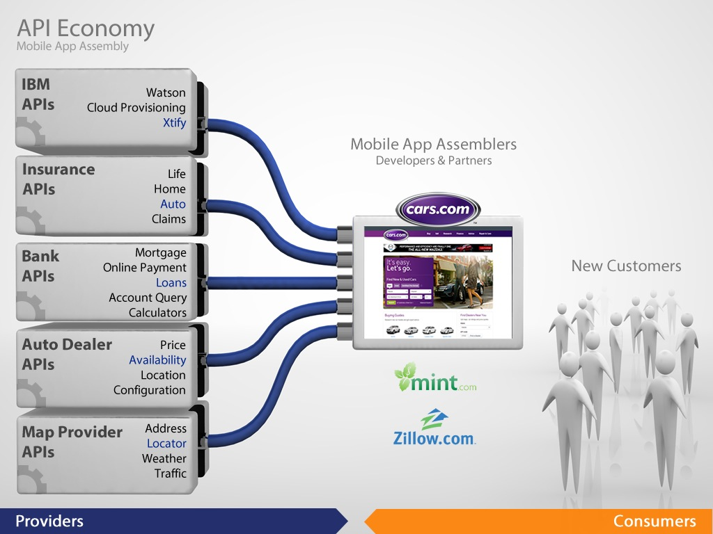
Speed and Adaptability through Composition
© 2014 IBM Corporation

Slide 13
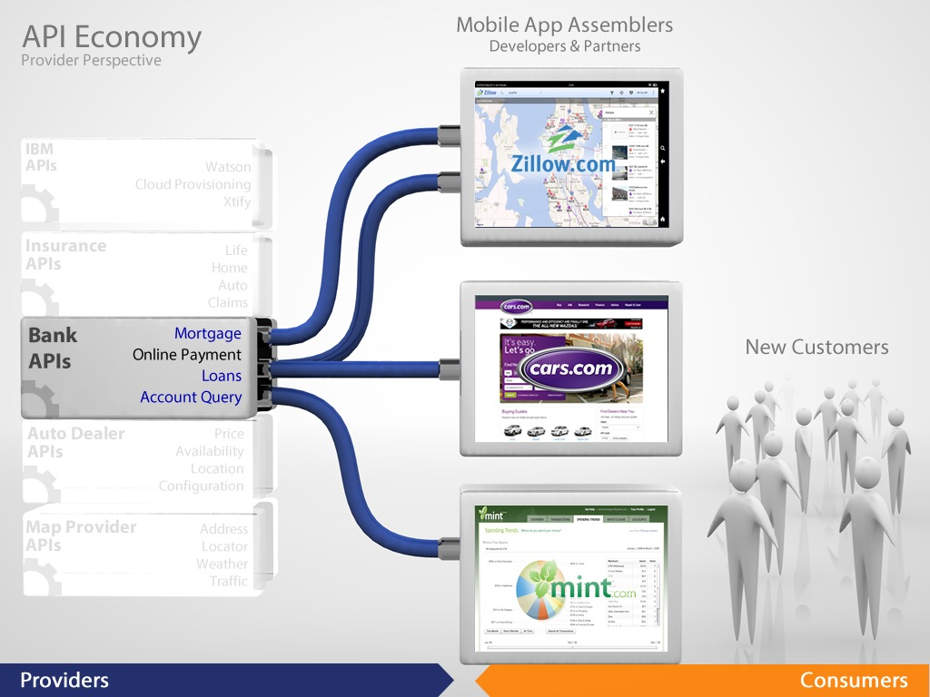
Scale through Ecosystem
© 2014 IBM Corporation

Slide 14

New Business Value
Enterprises want to disrupt, but...
Existing
Applications

Slide 15






















Hybrid Cloud Applications are increasingly becoming the norm for the Integrated Digital Enterprise …
IBM Bluemix
Public Cloud
Dedicated Cloud
Private Cloud
DMZ
Enterprise
DMZ
APP
Service
APP
Social & Internet Data sources
Mobile, PoS, ATMs
APP
DB
Service
APP
DB
APP
DB
Internet
Internet
API
API
Internet of Things
Sensors
Developer & Customer communities
Trading partner communities
Master Data Management
Big Data
Notes:
14
Click 1: define APIs that you want to expose outside
Click2: add mobile access to your env. i.e. create mobile apps that access your enterprise and provide service.
Click3: add bigdata, analytics and take advantage of social media. Also IOT
Click 4: trading partner communities and customer communites to gain access to your enterprise function through APIs. Think bestbuy api and googlemap api

Slide 16




An integrated set of Cloud capabilities is necessary to address some of the common challenges
EXISTING IT
ANALYTICS
3rd PARTY APIs
4
1
Cloud Platform
CLOUD APP MID TIER
API
API Catalog
2
2
Services
Customer Information
Run Times
Services
(e.g. DB Service)
Foundational Services
(e.g. Event & Queues)
API
3
Secure Integration
API
Connectors & Integration
API
Inventory Database
Platforms
App Centric | Containers
API
4
Existing Apps
SECURE
3
1
5
DevOps
Infrastructure Services
On-Premises | Off-Premises | Multi-cloud
Business Process
DEVELOPMENT
5
MANAGEMENT
DEPLOYMENT & DELIVERY

Slide 17
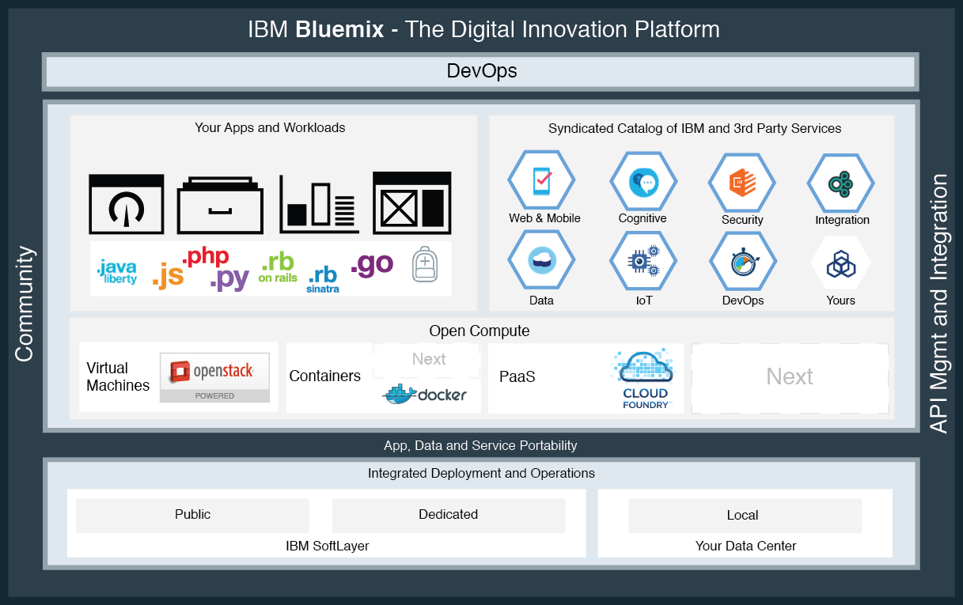



An Integrated Cloud Platform
IBM Cloud Platform
Cloud
Foundation
Services
Patterns

Slide 18
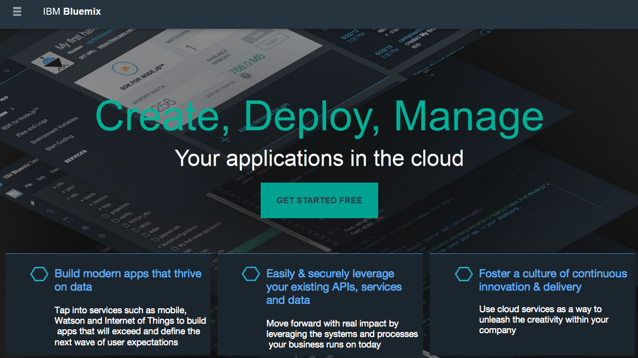

Slide 19
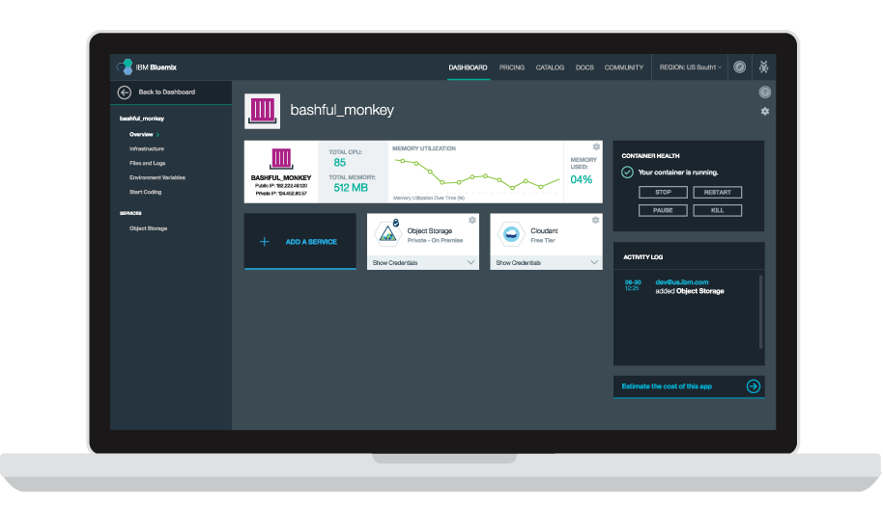


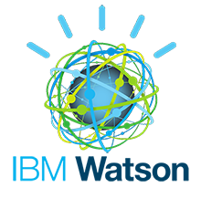


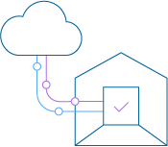
The Bluemix Platform
Core Platform
App Centric Compute
Global // Hybrid // Open
Global // Hybrid // Open
PaaS // Container // VM’s
API’s
Data Driven App’s
IBM // 3rd Party // Yours
Watson // IoT // Big Data
Easily & Securely leverage your existing API’s & Data
Build modern apps that thrive on data
Powered by Open
Built for enterprise
IaaS // PaaS // SaaS
Development // Integration // DevOps
Optimize and transform existing apps
Foster a culture of continuous innovation & delivery
Notes:
Enterprises need a cost efficient, robust and open platform to unleashes developer productivity and foster digital innovation
Bluemix is IBM's digital innovation platform that is cloud based, open, ready for hybrid, leverages existing assets, productive, modern, up to date etc.

Slide 20
Global footprint
Over 26 global locations with geographic disperse network PoPs
Carrier grade private network with over 2,000 Gbps of connectivity

Slide 21
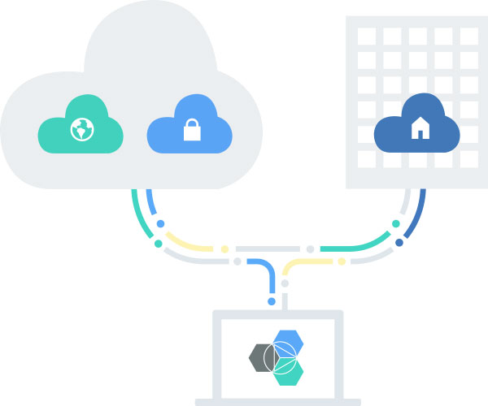
Hybrid Deployment Models
Public, Dedicated, Local
2 | Dedicated
Everything is dedicated and connected to you — agility of public cloud, yet feels like home.
1 | Public
Maximize on cloud economics and agility.
3 | Local
Behind the firewall for the most sensitive workloads.c
Seamless Experience
Regardless of which combination you choose, you can expect a single, seamless experience.

Slide 22













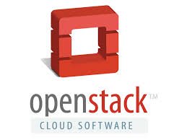





IBM Cloud is Open By Design
Open technology lynchpins maximize the effectiveness of Cloud investments
OAuth
SaaS
PaaS
IaaS
Private Cloud
Hybrid Cloud
Off-premise cloud

Slide 23


Enabling a Cloud Microservices Architecture
Client Browser
Client Browser
Web Server
Web Server
Enabling Services
Service Registry
Service Proxy
API Gateway
Failure testing
‘Circuit-Breaker’
HA/DR
CI/CD
…
Application Server
Storefront
Service
Monolithic
WAR File
Store Front
Catalog
Recommendations
Inventory
Billing
Catalog
Service
Recommendations
Service
Inventory
Service
Billing
Service
Database Server
3rd Party
Existing

Slide 24
Foundational Cloud Services
Integrated foundational services to create and operate scalable and elastic application and services
Underpinning of a microservices strategy
Data
 | Cf Configuration Store
Pt Patterns | Kv Key Value Store
Ca SW Config Automation | Db SQL DB | Sa Security Analytics |  | Sg Storage Gateway | Tx File Transfer | Sb CF Service Broker | A API Mgmt |  | Eg Event Generation
Dc DevOps Control | D Doc DB | Ky Key Management | Sc Secure Connectivity | Ar Archive/Backup | Ob Object Store | Sp Service Proxy | Ft Feature Toggles | Am Availability Monitoring (Uptime) | Mk Controlled Failure Testing
Pi Delivery Pipeline | ID Identity Mgmt | Ac Access Control | Dn DNS | Lb L3 Load Balancer | Eb Block Store | E Event Bus | Sd Service Discovery | L Logging | Da Service Dashboard
Im Image Builder | Vm Virtual Machines | As^{v} VM Autoscaler | N SDN | Cn CDN | Fi Distributed File | C Containers | As^{c} Container Autoscaler | Mc Monitoring Collection | Al Alerting
Delivery
Security
Storage
Integration
Operations
Compute
Networking

Slide 25

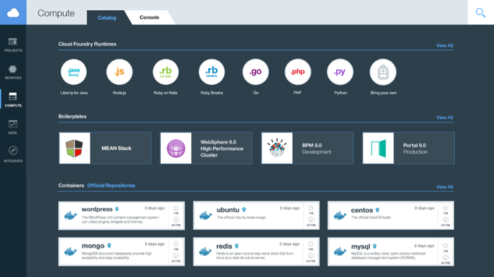



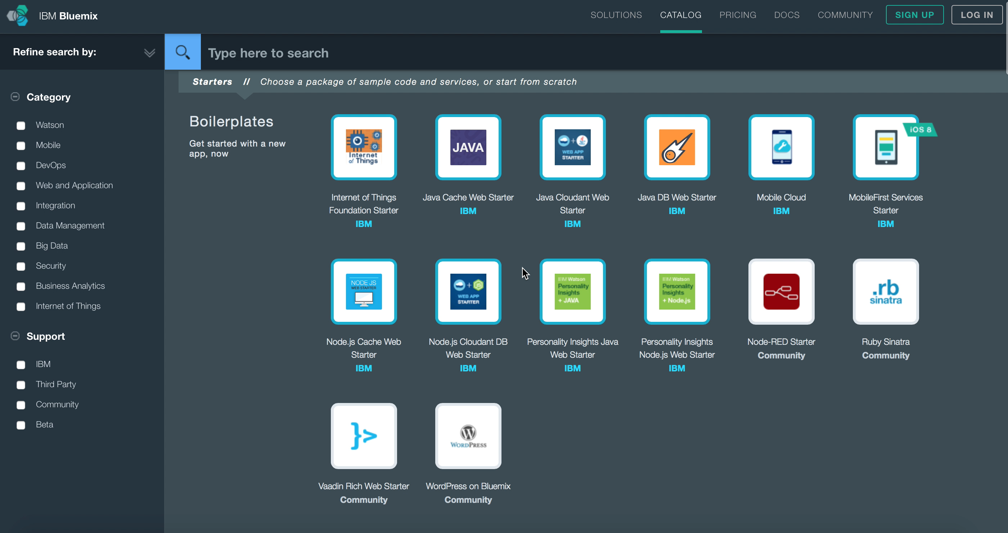

















A Broad Set of Middleware & Business Services
Cloud Foundry PaaS is one thing, but true differentiated business value emerges from a catalog of 100+ IBM and third party services.
IBM
Partner
Your Own
Open Source
Commerce
Healthcare
Analytics
Watson
Security
Notes:
Idea here is to illustrate that the depth and breadth of services that we offer is a differentiator, but also to delve into the customer value that these services provide, instead of just talking about how many there are, and how cool they are.
Watson services allow developers to build cognitive apps that help enhance, scale, and accelerate human expertise…
IBM’s cognitive engine, Watson, will be used to provide development assistance. For example, devOps practitioners will be able to request guidance in the selection of API based functionality from across the market.
DataWorks transforms raw data into relevant information. It includes IBM DataWorks Forge, an app primarily for knowledge workers, as well as APIs for application developers. IBM DataWorks leverages a highly performant and scalable engine to discover, profile, enrich, mask and deliver data to applications.
Business Rules enables developers to spend less time recoding and testing when the business policy changes. The Business Rules service minimizes your code changes by keeping business logic separate from application logic.
Even in cases in which the services in the catalog are basic offerings that many application developers could code up themselves (push notifications, for example), being able to provision them into an application quickly, as a composable module, saves time, allowing application developers to focus on the core parts of their application, and get them deployed more quickly.
Important to mention here that we’re talking about more than services that are in the Bluemix catalog, but also complementary services from Cloud Fabric, IBM Cloud Managed Services, and beyond.

Slide 26








New Patterns of Integration
IBM Hybrid Integration Services Core Capabilities
Services
Attributes
Components
Secure
Gateway &
Connectors
IT
Connect
Securely connecting Bluemix to your local cloud
Data
Analyst
Shaping your data for use by mobile and analytics
DataWorks
Refine
Delivering your data closer to your users
DataWorks
Data
Analyst or
Mobile
Developer
Deliver
Rapidly compose and mix APIs into new apps
Connect &
Compose
Compose
Mobile
Application
Developer
Exposing APIs and Data sets into the API Economy
API
Management
Expose

Slide 27



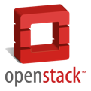




New Ways to Optimize & Transform Existing Applications
Standardization, Automation, Refactoring
Full-stack Application Pattern
Your applications are managed throughout the entire release process with predictable automation and inventory services
Your full-stack blueprints capture the relationships between your applications and cloud infrastructure
OpenStack API provides defacto standards for interacting with all of your cloud resources
UrbanCode
Deploy
Your Applications &
Middleware
Heat Blueprints
Compute
Network
Storage
26

Slide 28

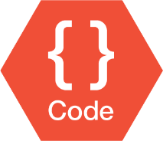

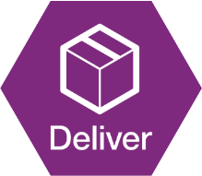


New Ways to Develop
IBM Design Thinking
Minimum viable product
Rank ordered backlog
Small batches
Did experiments prove the hypothesis
Time to pivot?
Build, Measure, learn
Daily standup
Behavior Driven Development
Test Driven Development
Pair Programming
Pull requests
Learn
Cloud
Automated monitoring
Scalable environments
Resilient operations
Chaotic testing
Fast recovery
Unattended automation
Limited blast radius
Dark launches and feature toggles
Decoupled releases
Continuous improvement, autonomous co-located squads, fail fast, minimize distractions
Collaboration, Freely share ideas, Peer recognition, Empowered teams, Flexible squads better than rigid structure

Slide 29
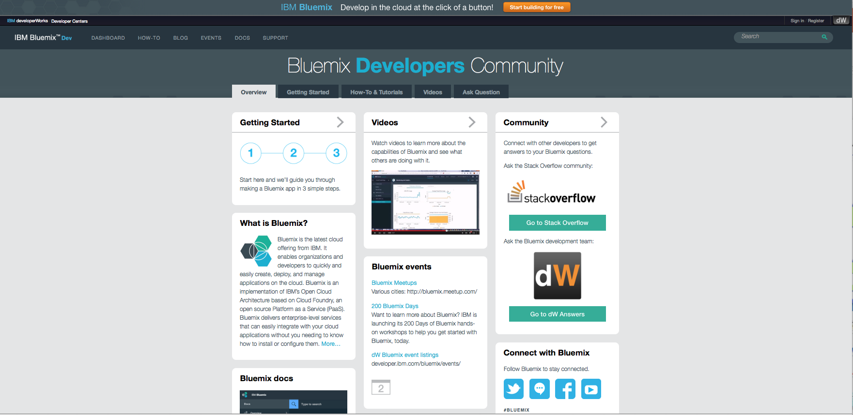

Slide 30
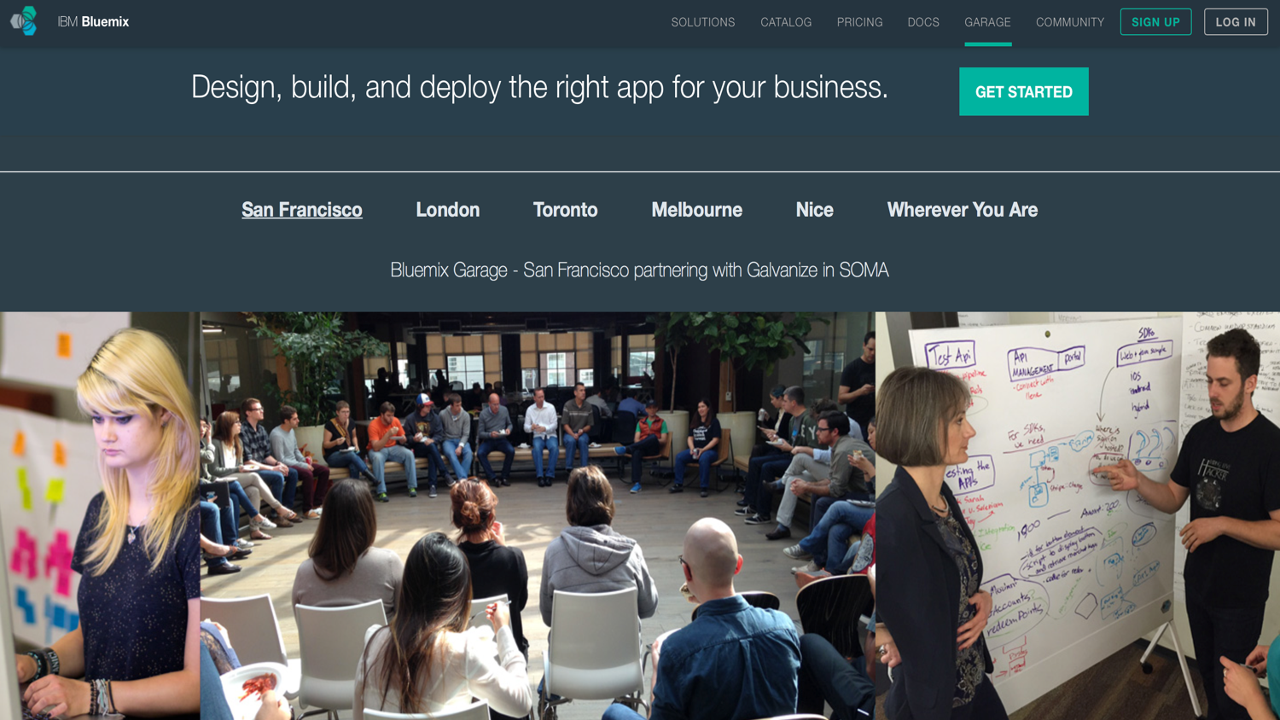
@ibmbluemix
@robinsonsj

Slide 31
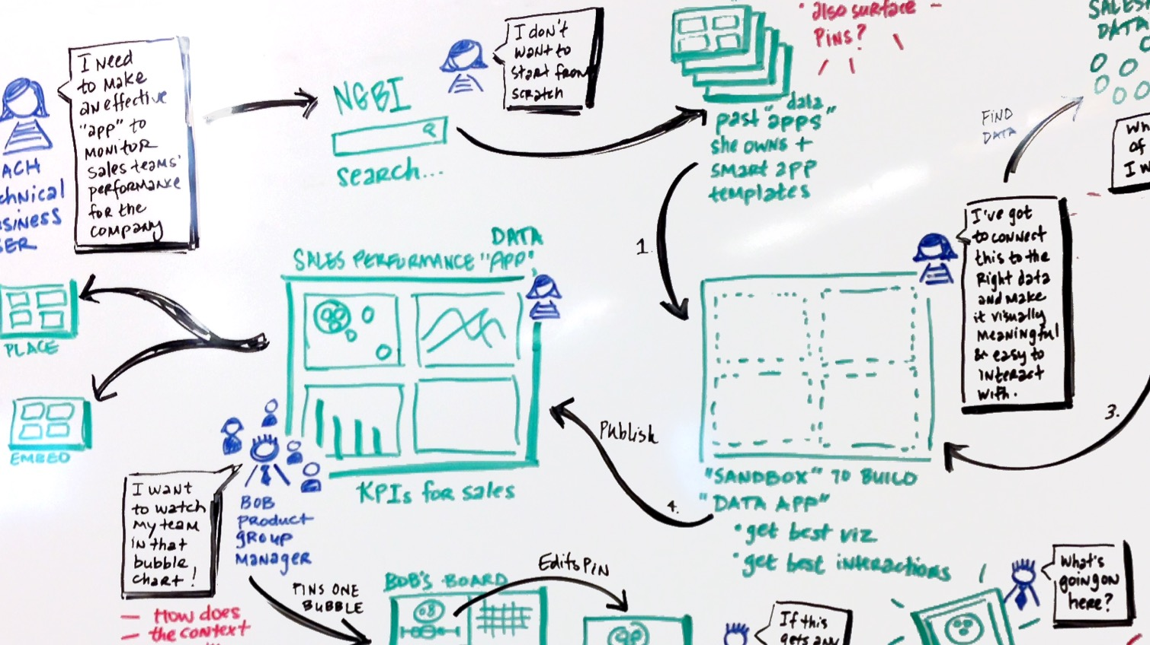
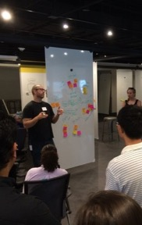
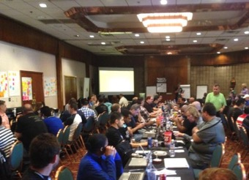
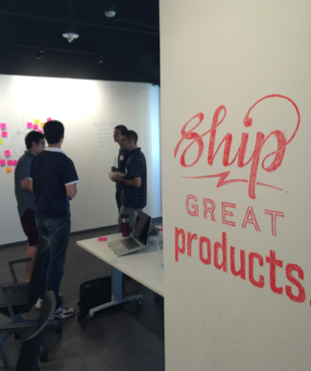

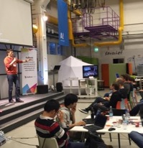


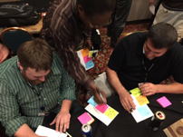
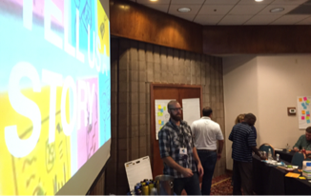
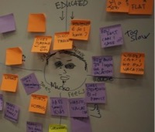
New Methodologies
Beyond the technology, IBM helps customers of all sizes with the needed cultural change as well.
The Bluemix Garage Methodology:
Bluemix
Hypothesis Testing
Lean Startup
devOps
MVP
Dev/Test
Idea
Design
Deploy
Design Thinking
eXtreme Programming
Notes:
IBM will assist in the education of customer and partner personnel in new devOps tools and techniques through a network of bricks and mortar classrooms known as Bluemix Garages.

Slide 32
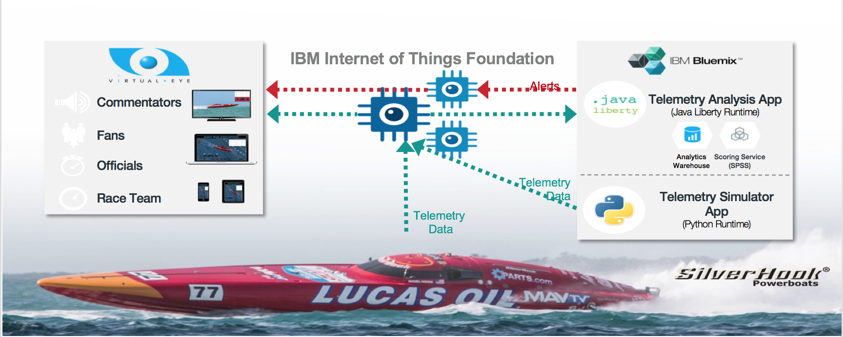
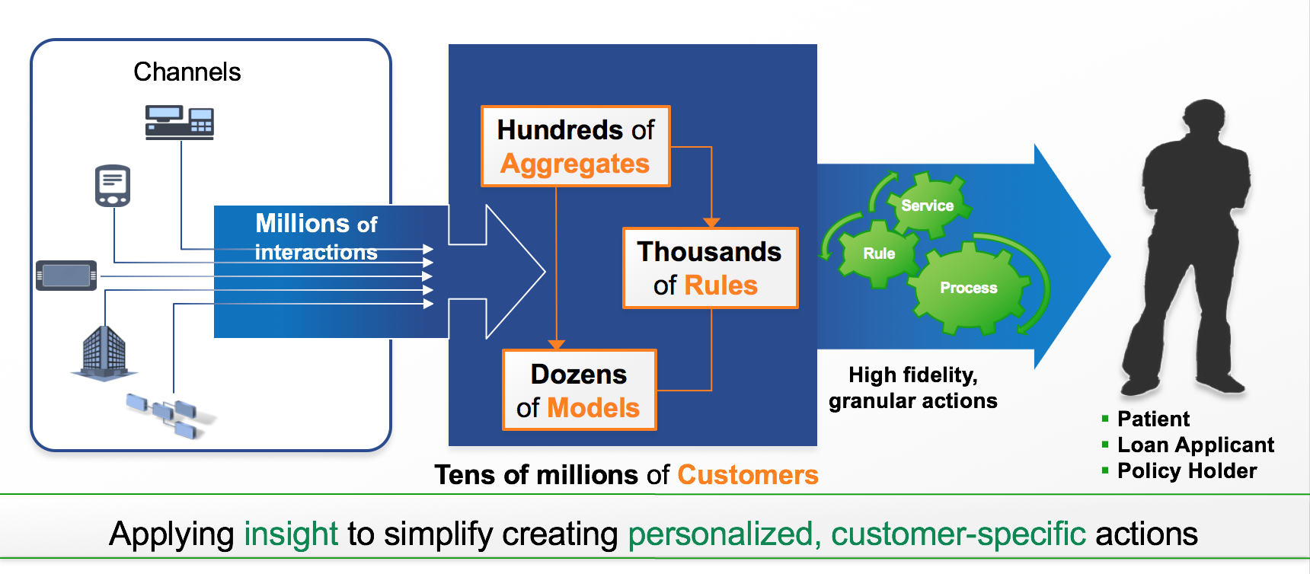
Looking Forward ….
Cloud of Clouds
Cloud Integration
Portable Microservices
Evolution of Analytics
Context Computing
Mobilizing Business Processes
Digital Payments and Currencies
Security and Privacy
Cognitive Computing Everywhere
Transforming Engagement

Slide 33
A New Way to Build
Notes:
Please note: Presenter notes are on every slide. Written as a suggested script to help with messaging.

