Slide 1
Digital Guardianship of Mobile Era
Christopher Hockings
IBM Master Inventor

Slide 2
Notes:
DASCOM invented Internet Security. Today they would probably be a unicorn start up. We were the first acquisition for IBM to get into today’s security market.
Apprenticeship served through the growth to Internet scale

Slide 3
Objectives
Describe Digital Guardianship as a corporate security responsibility, framed against a
Threat Landscape where your customers are
those that fund you
those that you employee
and they expect a mobile and cloud experience that challenges
corporate security governance policies and competitive speed to market
Framed from a company renowned for global innovation leadership

Slide 4
Ironically an Invention I submitted back in 2010
http://getbuttonedup.com/category/work-everyday-life/page/2/
Notes:
Human laziness recognized
METHOD AND SYSTEM FOR CREDENTIAL CLASSIFICATION AND REUSE WITHIN IT SYSTEMS
Implemented in Trusteer

Slide 5
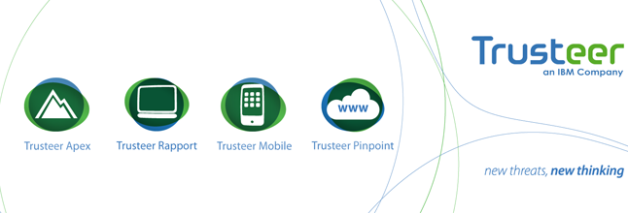
Implemented in IBM product in 2014

Slide 6
A lack of skill…

Slide 7
Security is a global intelligence war
Incident forensics
Advanced fraud protection
Secure mobile management
Cloud-enabled identity management
Identity governance
IBM Security is created
Security intelligence
1976 | 1999 | 2002 | 2005 | 2006 | 2007 | 2008 | 2009 | 2010 | 2011 | 2012 | 2013 | 2014
Mainframe and server security
Identity management
Directory integration
Security services and network security
Enterprise single-sign-on
Endpoint management and security
Information and analytics management
IBM Security Investment
6,000+ IBM Security experts worldwide
1,700+ IBM security patents
4,000+ IBM managed security services clients worldwide
25 IBM Security labs worldwide
Access management
SOA management and security
Application security
Risk management
Data management
Database monitoring and protection
Application security
Notes:
For over 50 years, since the introduction of the mainframe, in 1970s, IBM has been committed to providing comprehensive security that meets evolving technological needs. We have invested substantially in inorganic growth to supplement and enhance our organically developed security solutions to build a comprehensive portfolio that can help clients move up the maturity model from basic to proficient to advanced.
This progression was formalized in 2012 with the creation of the IBM Security Systems Division that brought the multiple solutions together to increase the focus and help drive long term strategy for the organization.
2013 continued to be an active year for acquisitions with the announcement that IBM acquired Trusteer and Fiberlink Maas360.
And this year, IBM announced its intent to acquire CrossIdeas for its identity governance capabilities and also Lighthouse Security Group for their cloud-enabled identity management services.
<PRESENTER: See below for a more detailed background…>
1976
IBM introduces Resource Access Control Facility (RACF), to provides access control and auditing functionality for applications on the mainframe eliminating the need for each application to imbed security
1977
The IBM develops Data Encryption Standard (DES), a cryptographic algorithm, adopted as the national standard by the US National Bureau of Standards
1978
IBM announces the 3624 automatic teller machine, utilizing DES
1995
IBM starts contributing to Java Security technologies
1996
IBM launches Cryptolope containers to seal intellectual property in a digital package so that content transactions are secured over the Internet
IBM launches the SecureWay Key Management Framework, a collection of applications, services and cryptographic engines that help make the Internet safe for e-commerce
IBM begins pilot program with MasterCard using Secure Electronic Transaction (SET) technology which secures credit card transactions over the Internet
IBM develops and certifies the IBM Secure Crypto Co-processor (4758) at FIPS 104-1 Level 4, the highest level of FIPS
IBM releases its first enterprise-grade LDAP Directory Server (now known as Directory Server)
1998
IBM extends Secure Electronic Transaction (SET) standard support which secures payments over the Internet and is largely based on technology developed at IBM Research and adopted by major credit card companies
1999
IBM acquires Dascom, the basis for IBM's Access Manager portfolio
IBM Research's breakthrough paper on Side Channel Cryptanalysis Attacks and Countermeasures (1999 – 2004)
2000
IBM patents a system and method for alerting computer users to digital security intrusions
IBM appoints Harriet Pearson its first Chief Privacy Officer
2002
IBM acquires Access 360, the basis for IBM's Identity Manager portfolio
IBM acquires MetaMerge for meta-directory and directory synch capability (now known as Directory Integrator)
2005
IBM debuts the first ThinkPad with an integrated fingerprint reader, at the time offering an unmatched level of data protection through a new biometric capability and embedded security subsystem
2006
IBM acquires Internet Security Systems, Inc, the basis for today’s IBM X-Force® IT security research team and the IBM network protection product family
Smart cards, highly efficient JavaCard™ technology developed at IBM Research – Zurich, is licensed by a leading smart card manufacturer for secure multi-application smart cards and is used in many JavaCard™ projects The technology is used today in 10s of millions of VISA credit cards
2007
IBM acquires Consul, to help accelerate data and governance strategy
2008
IBM patents a secure system and method for enforcement of privacy policy and protection of confidentiality
IBM acquires Encentuate, the basis for 'IBMs Enterprise Single-sign-on (ESSO) product
Zone Trusted Information Channel: Plugs into the USB port of any computer and creates a direct, secure channel to a bank’s online transaction server, bypassing the PC which could be infected by malicious software (malware) or susceptible to hacker attacks
2009
IBM acquires Ounce Labs, a provider of software that analyzes software code for security vulnerabilities, today’s AppScan family
IBM acquires Guardium, a market leader in real-time enterprise database monitoring and protection
Pioneers the use of Big Data analytics to cybersecurity problems (FAA, USAF)
2010
IBM acquires Big Fix, helping organizations extend security and compliance to endpoints, today Endpoint Manager
IBM Research’s breakthrough on Fully Homomorphic Encryption
2011
IBM Security Systems division is created
IBM acquires Q1 Labs, with its QRadar security intelligence portfolio, to strengthen its offerings around advanced security analytics
IBM launches Cloud-based Mobile Security Services, IBM Hosted Mobile Device Security Management
2012
IBM delivers next-gen Intrusion system, new access appliance and privileged identity technology
IBM announces 25 new product releases in security, a record year of innovation
IBM extends its market leading static application security testing (IBM Security AppScan) to native Android applications, which allows clients to conduct their own testing for mobile applications
2013
IBM announces breakthrough with combination of Security Intelligence and Big Data
IBM acquired Cybertap for their incident forensics technology.
IBM announces new QRadar Vulnerability Manager software to help organizations identify and predict security risk
IBM announces MobileFirst security software (IBM AppScan Source 87 for iOS) to improve security quality without sacrificing time-to-market of mobile app projects
IBM announces acquiring Trusteer for mobile and application security, counter-fraud and malware detection
IBM announced acquiring Fiberlink. Fiberlink’s MaaS360 offering expands IBM MobileFirst solutions with new cloud-based capabilities to deliver a comprehensive mobile management and security solution for global organizations of all sizes. This acquisition supports IBM’s expanding vision for enterprise mobility management, which encompasses secure transactions between businesses, partners and customers.

Slide 8
Security and Mobile Apps in the wild

Slide 9
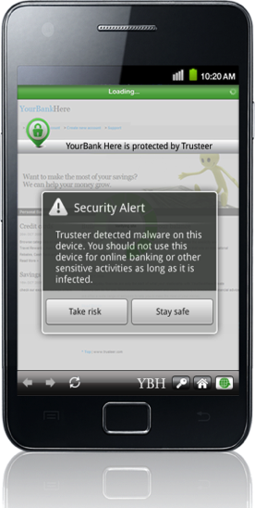
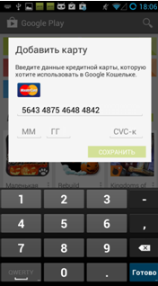
Your own Apps are being owned
Confidentiality Risk
(Reverse Engineering)
Bad Apps are on your customer devices:
SMS Interceptors
Device rooters
Data stealers
Generic downloaders
Key-loggers
Your business App has been inspected:
Hackers have modified code
They’ve discovered how your system works
Integrity Risk
(Code Modification)
Notes:
Multiple techniques are used to detect the malware
Public keys
Signatures
Suspicious Apps – (White list)
True File Type Detection (Road Map)

Slide 10
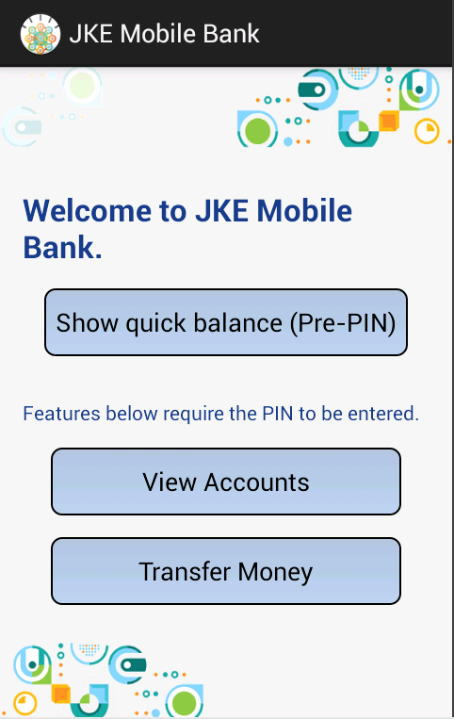
Securing a mobile app is a multi-faceted problem
The user is performing a transaction, on a device that’s known to be theirs, using an App that we built and delivered through a reputable App Store

Slide 11
Behavioral Authentication using Wearable(s)
Device 1
Authentication
Sequence management
Device management DB
Output
(display)
Input
(thatch pad)
refer
Authentication sequence control
Result (similarity)
Motion data
Motion data acquisition
Motion data validation
Motion data management
Device 2
Output
(display)
Input
(thatch pad)
Motion data from device 1 during authentication
Authentication sequence control
Motion data
Motion data from device 2 during authentication
Motion data management
Notes:
Invention

Slide 12
Security and bring your own Apps

Slide 13
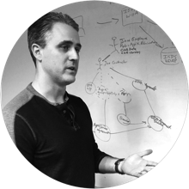
Security and IT leaders face new challenges
“My team is not equipped to manage the increased employee usage and demand for cloud”
CISO / CIO:
How does my organisation?
Uncover “Shadow IT”
Gain visibility of all cloud app usage
Simplify connecting to approved apps
Remove mobile blind spots
Stop risky user behavior
Quickly react to cloud threats
Address compliance and governance concerns

Slide 14
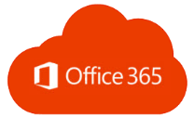
Connecting Employees with SaaS services
Notes:
Andy to present the hill…
Who: CISO (Cohort 7), with CEO and IT
What: Help their business quickly and securely adopt Cloud (SaaS) applications across their organization
Wow: Industry’s first solution to detect unauthorized Cloud usage. Connect users to Cloud apps in seconds. Protects against advanced threats using analytics and IBM's massive network of threat intelligence <or>
The only SaaS solution to combine cloud discovery, user analytics, identity and access management, and threat prevention
Speeds cloud adoption, making your employees more productive
Increases the efficiency of your IT operations and security teams
Protects your business against threats – internal and external
Main Message
Enables enterprises to apply safeguards, policies, and visibility required for broader cloud adoption
Securely connects enterprise users to approved cloud applications in minutes
Monitors activity and enforces policy to address compliance and security requirements for cloud
Global Marketing Activities
Signature Moment activities including significant press outreach, digital and social campaigns on the 15th
Research survey detailing cloud usage of 1,000 full-time employees at Fortune 1,000 companies
Paid analyst webcast, new launch materials and more

Slide 15
What about mobile use whilst roaming
Notes:
Andy to present the hill…
Who: CISO (Cohort 7), with CEO and IT
What: Help their business quickly and securely adopt Cloud (SaaS) applications across their organization
Wow: Industry’s first solution to detect unauthorized Cloud usage. Connect users to Cloud apps in seconds. Protects against advanced threats using analytics and IBM's massive network of threat intelligence <or>
The only SaaS solution to combine cloud discovery, user analytics, identity and access management, and threat prevention
Speeds cloud adoption, making your employees more productive
Increases the efficiency of your IT operations and security teams
Protects your business against threats – internal and external
Main Message
Enables enterprises to apply safeguards, policies, and visibility required for broader cloud adoption
Securely connects enterprise users to approved cloud applications in minutes
Monitors activity and enforces policy to address compliance and security requirements for cloud
Global Marketing Activities
Signature Moment activities including significant press outreach, digital and social campaigns on the 15th
Research survey detailing cloud usage of 1,000 full-time employees at Fortune 1,000 companies
Paid analyst webcast, new launch materials and more

Slide 16
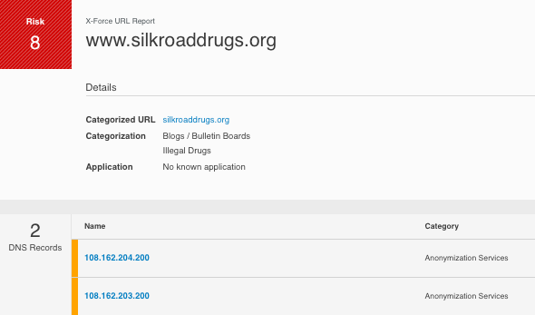
IBM knows and have classified the threats

Slide 17
IBM Cloud Security Enforcer – “Blue Ocean” innovation
IBM Cloud Security Enforcer
DETECT
Usage of cloud apps and actions
CONNECT
Users to approved cloud apps
PROTECT
Against cloud-related threats
Notes:
Maybe edit some of the cloud labels

Slide 18
In closing….
Successful security programs will require a collaborative approach
IBM is the #3 security company (by revenue) in the world
Innovation is at the forefront of Security investment

