Slide 1
Connecting the Internet of Things
Chris Howard FBCS CITP
Chief Analytics Architect
Analytics Platform - IBM Asia Pacific
Notes:
Some I am assuming many of you have heard of Moore’s Law - The observation made in 1965 by Gordon Moore, co-founder of Intel, that the number of transistors per square inch on integrated circuits had doubled every year since the integrated circuit was invented.
What about the The Law of Accelerating Returns?
Back in 2001 a chap know as Ray Kurzweil came up with The Law of Accelerating Returns.
An analysis of the history of technology shows that technological change is exponential, contrary to the common-sense “intuitive linear” view. So we won’t experience 100 years of progress in the 21st century — it will be more like 20,000 years of progress (at today’s rate).
20 years – a million times more advanced.

Slide 2
We live in a time of enormous transformation and opportunity
Cloud
Analytics
Mobile & Social
Notes:
Over last decade we have significant transformation across a whole heap of technologies, so with profound consequences.
From an enterprise context, as we have heard already this morning this nexus around the areas of cloud, analytics, mobile and social is driving enormous transformation and opportunity.
Our CAMS as we refer to internally (not SMAC or SCAM)

Slide 3
Big Data and the IoT
A match made in heaven
Notes:
Two technologies trends that are explicably linked are Big Data and the Internet of Things – something that you cannot fail to have noticed
Symbiotic in nature – each fueling the other yet neither are necessarily that new a phenomena

Slide 4
Notes:
In 2014 Gartner Displaced Big Data to become #1 – currently at the peak of inflated expectations. With big data roller coasting downhill to join cloud computing in the trough of disillusionment
But do we really believe that?
The hype cycle is pegging the IoT as being 5-10 years out and I would argue that yes indeed there is plenty of hype but the IoT is with us now and part of our daily lives.

Slide 5
An exploding market
9Billion
devices around the world are currently connected to the Internet, including computers & smart phones
In 5 years,
1Million
new devices will come online every hour.
The worldwide market for Internet of Things solutions is expected to grown to $7.1
Trillion by 2020
Notes:
According to Gartner, spending on IoT hardware will exceed $2.5 million every minute in 2016

Slide 6
IoT value creation is being led by makers & operators
Makers
Operators
The creation of smarter, connected products will redefine every industry with new capabilities that improve functionality, reduce costs, and deliver new value
The operation of old and new systems, now integrated with intelligent things, can become interactive, reactive, and adaptive; to each other, people and places
Powered By
Enabled By
Insight
Changes the way we design, secure, and operate
Analytics
Cloud
Notes:
The Makers – inventors / innovators / tinkerers
The Operators – the service providers, providing the connectivity hub to weave these devices together around new and novel business models
To deliver insight and value - Under pinned by Analytics and Cloud
Some weird and wacky ideas –
MIT dorm – instrumented the shower areas and the laundry room
Christmas tree lights
Dog collar with inbuilt thermister to monitor the dogs temperature and spot over heading
Wearables – shoes, socks, shirts, babies nappies
Even underwear – One Microsoft project instrumented the ladies bra – perfectly placed to pickup ECG signals from the heart to detect stress.
Did look at mens underwear but found it was too far from away to reliably pickup heart signal, but did find that boxer shorts we perfectly placed to pick up EEG brain wave data. Proving that men do indeed thing with their…..

Slide 7
What can you do with IoT data?
Monetise
Charge for usage that is tracked by things. Enable Pay-per-use models of things.
Optimise
Improve efficiency of activities with data from things. Anticipate & predict optimal actions and responses.
Extend
Provide more value through connected things. Deliver data, content, services through things.
Control
Remotely affect behaviour by controlling things. Make remote adjustments to optimize things.
Notes:
Where it gets really interesting is round the Internet of Moving Things

Slide 8
IBM and the IoT
A strategy by a different name.

Slide 9
Smarter Planet & the three l’s
Digital technologies (sensors and other monitoring devices) are being embedded into many objects, systems & processes.
In the globalised, networked world, people, systems, objects and processes are connected, and they are communicating with one another in entirely new ways.
Leveraging the data generated by digital technology provides intelligence to help us do things better, improving our responsiveness and ability to predict and optimize for future events.
Notes:
IBM has been delivering Internet Of Things solutions for a Smarter Planet even before the campaign launch in 2008
Instrumented – datafication of the world. Miniaturization and cost has been a significant factor here. Now less than $1 for a simple wireless device – main cost is still battery but this is getting better.
Interconnected – leveraging ever cheaper connectivity options to bring these devices together across a connected web
Intelligent – Apply Big Data and analytics to help us understand what has happen in the past, learn from these experiences, apply predicative models, drive prescriptive direction and ultimately improve outcomes

Slide 10
5 Steps for Capturing IoT Value
Run
Manage
Connect
Collect
Assemble

Slide 11
FerryMan
The Internet of things in action
Notes:
Example of how easy it is to assembly or compose and deploy a new IoT application with a couple of simple building blocks
In this case I looked at Sydney Harbour ferries

Slide 12
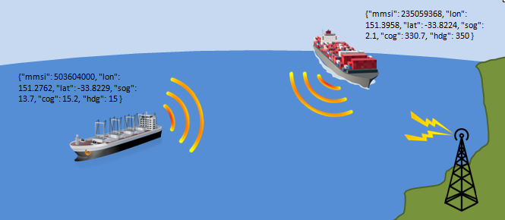
Building Blocks
Vessel Automatic Identification System (AIS)
{"mmsi":503604000,"lon":151.2622,"lat":-33.8417,"sog":14.2,"cog":35.9,"hdg":36}

Slide 13
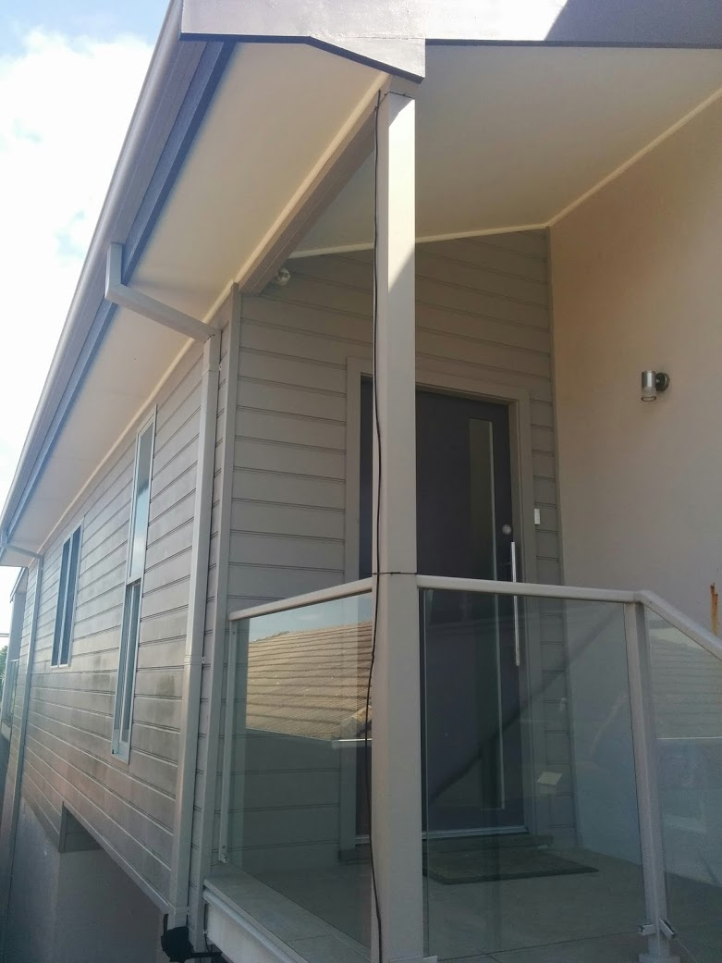
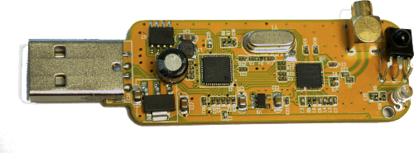
Building Blocks
Collinear Coax Antenna - multiple short coaxial cables, where the coax outer conductor is connected to the inner conductor in an alternating fashion.
RTL-SDR USB Receiver - software defined radio that uses a DVB-T TV tuner dongle

Slide 14
Building Blocks
Mobile Services
Watson Services
Bluemix An open-standard, cloud-based platform for building, managing, and running applications of all types (web, mobile, big data, new smart devices, and so on).
Cloud
Integration Services
Database services
Big Data services
Web and application services
Security Services

Slide 15
Building Blocks
Bluemix Geospatial service
Geofence
Geospatial Analytics Service
Entry
Exit
Notes:
Triggers
Entry
Exit
Dwelling
Who goes where and when – behavioural analytics.

Slide 16
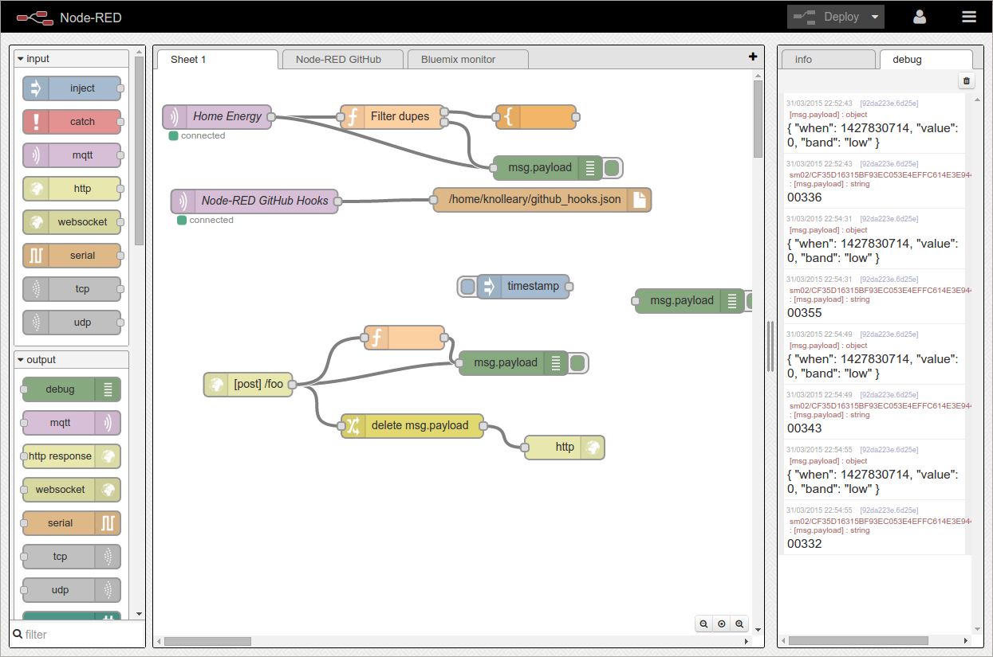
Building Blocks
Node-Red on Bluemix
Node-RED – Open source, browser-based editor for visually wiring the Internet of Things (hardware devices, APIs and online services) in new and interesting ways.

Slide 17
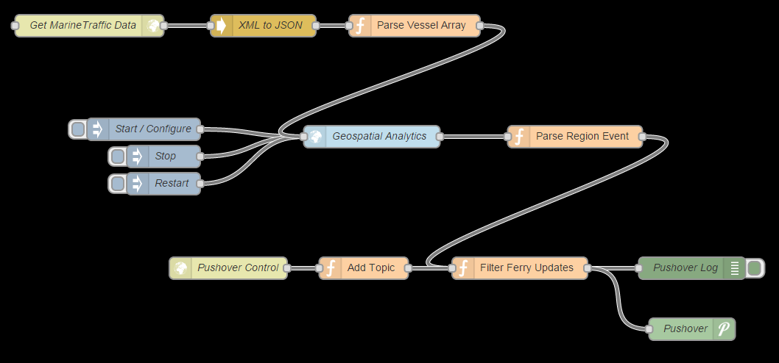
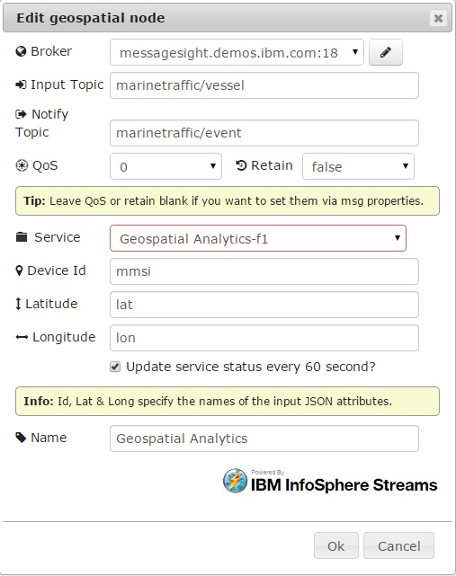
Geospatial with Node-Red
Wiring AIS feed to Geospatial Service
{"mmsi":503604000,"lon":151.2622,"lat":-33.8417,"sog":14.2,"cog":35.9,"hdg":36}

Slide 18
The big picture
AIS Receiver
Captures RF signal & converts to binary packet
Node-RED
Parse and filter AIS Messages
REST API
Secure API to define geofence regions and control the service
Geospatial Service
Triggers geofence entry and exit events for each vessel
MQTT
Securely send AIS data to the cloud using the open, lightweight MQTT messaging protocol
Pushover / FerryMan
Arrival / Departure alerts sent to smart device

Slide 19
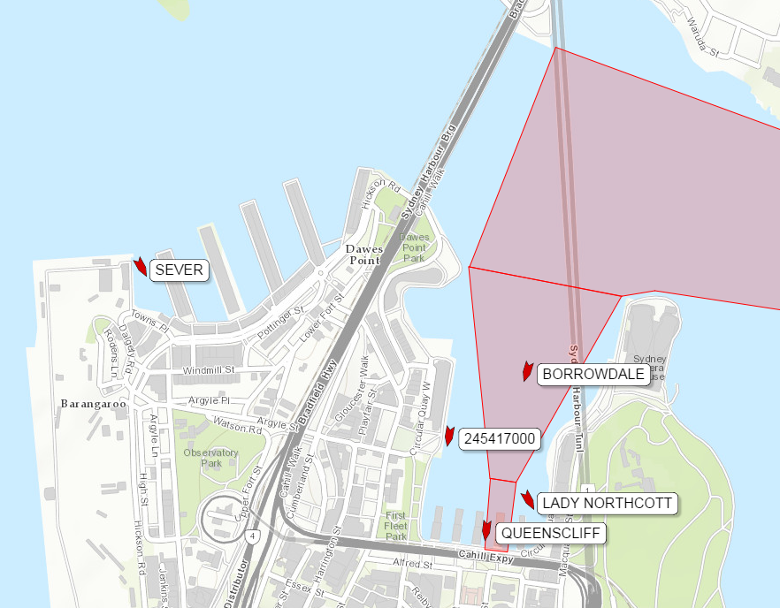
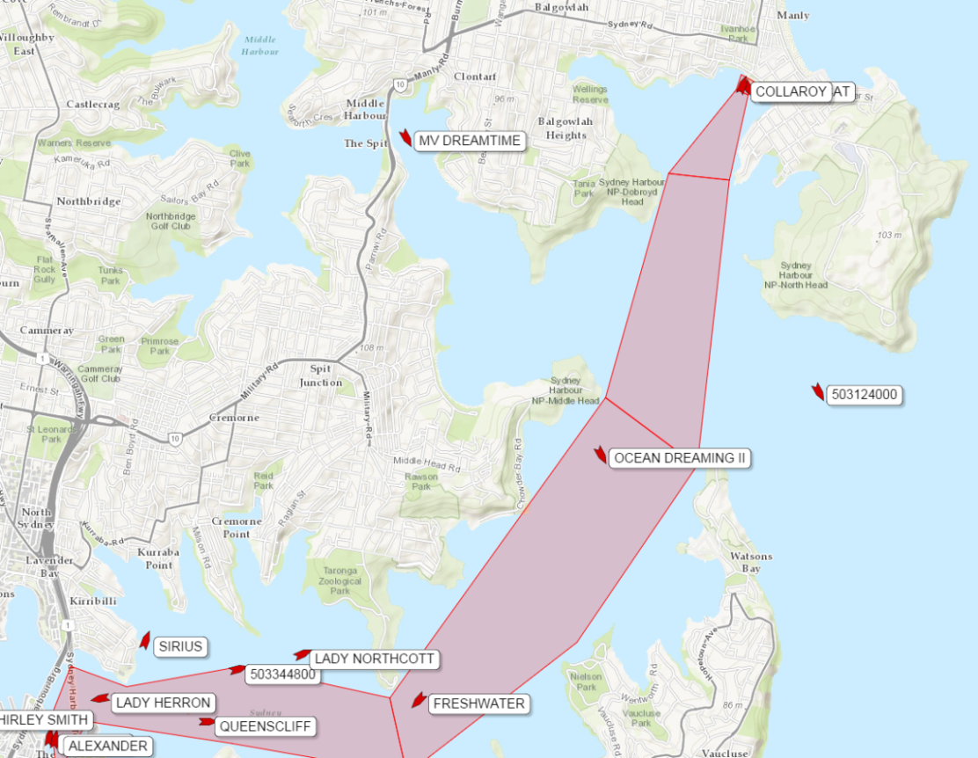
FerryMan Live Maps

Slide 20
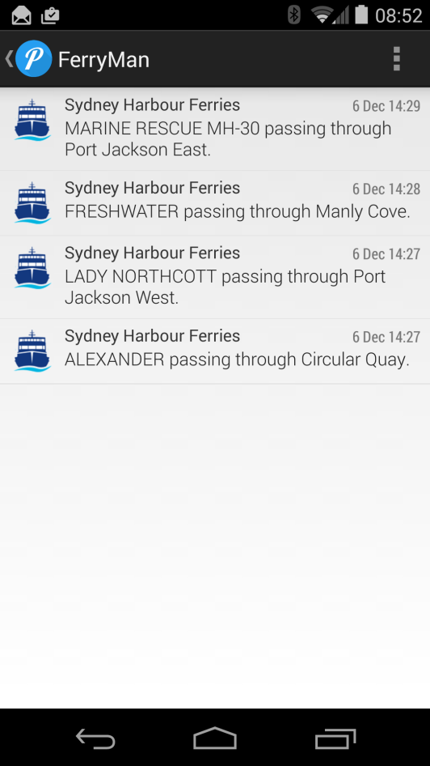
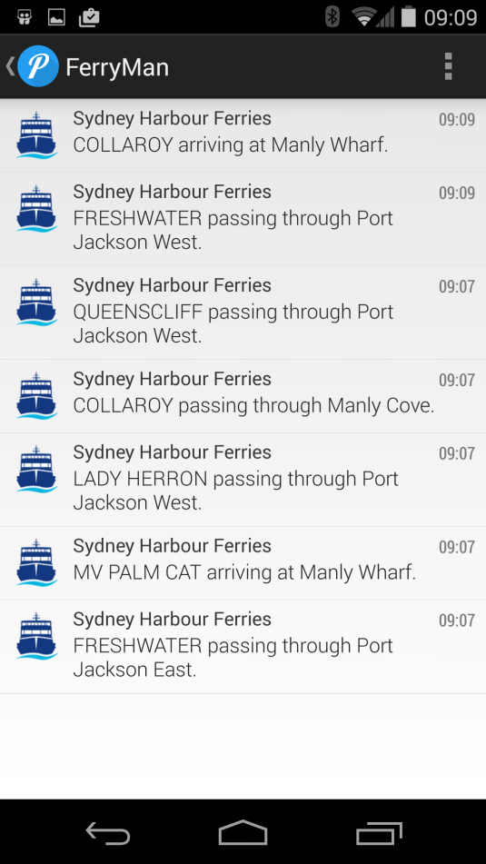
Pushover Integration

Slide 21
Questions ?

Slide 22
Start today
Resources to get started with your loT project today!
IoT Zone in Bluemix https://bluemix.net/solutions/iot
Explore the Recipes https://developer.ibm.com/iot/ Bluemix Blog https://developer.ibm.com/bluemix/2014/12/17/find-bluemix-geospatial-analytics/
Follow the community on Twitter @IBMIoT

