Slide 1
The API Economy
David Bell
IBM Master Inventor
Test Lead, IBM API Management

Slide 2












Journey to the API Economy
Connected Cars
APIs
Partners
Cloud
Branch / Store
Toll-Free / Tele
eBusiness / Web
Smartphones
Websites/Sensors
Tablets
Connected Appliances
Internet TVs

Slide 3
What is an API?
API = Business API = Web API
Expose key data and services as APIs to open new markets.
Part of the enterprises public persona.
Simple for developers to find, understand and use.
Rapidly innovate and update.

Slide 4
Enterprises built on APIs
Expedia
eBay
Twitter
90%
of revenue through APIs
60%
of revenue through APIs
75%
of traffic through third party apps

Slide 5
The challenge of two speed IT
Digital Ecosystem
Fast Speed
Speed & Agility
Core Enterprise
Steady Speed
Integration & Scale

Slide 6
APIs and API Management
Digital Ecosystem
Fast Speed
Speed & Agility
APIs
API
Management
Core Enterprise
Share, Manage & Control
Steady Speed
Integration & Scale

Slide 7
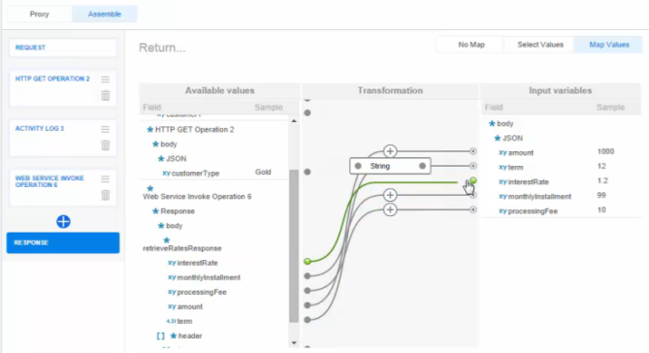
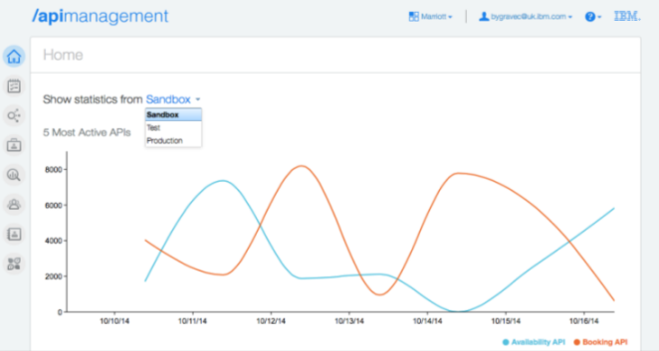
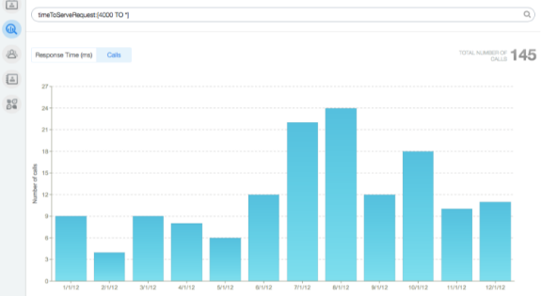
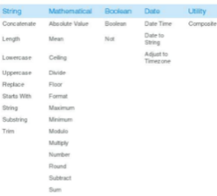
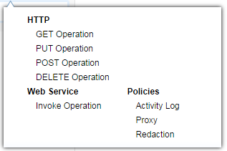
API Management
Compose, Innovate,
Enforce
Developer
Communities,
Self Service.
Management, Scaling, Analytics

Slide 8
API Providers Journey
Partner
developers
Internal
developers
3rd Party APIs
PartnerAPIs
Public
developers
Private APIs
Public APIs
Consumer Apps
Partner Apps
Partner Integration
Consumer Apps
Employee Apps
Enterprise Assets
Consumer Apps
Innovation

Slide 9
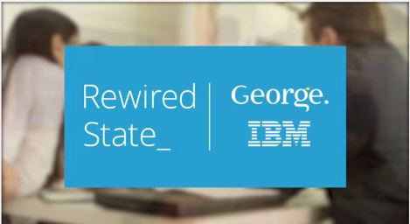
Case Study
Hackathon
Get started quickly, promote innovation, rapidly iterate
1 brief
48 hours
25 developers
Over 400,000 API calls
13 innovative apps
George Go
Clothing Shake
Virtual Fitting Room

Slide 10

Case Study
M2M Technologies
Constant demands for enhanced customer experience
  Support for constantly evolving IoT data
  Business Partners requiring customisation
Fragile existing system
  Complex system hard to change quickly
  Changes cause frequent shutdowns and performance issues
  Scaling and network concerns
Selected strategy of APIs with API Management
  Sharing of specific customer and device data as APIs
  Enhanced ability to provide changed and new data
  Simplified administration, analytics and support of future growth

Slide 11
Are you ready?
What are your most valuable assets?
Maximise the return on those assets
Get started today

Slide 12
Questions?
David Bell
david.bell@uk.ibm.com

