Slide 1
IBM Research and the
Square Kilometre Array Radio Telescope Project
Bruce Elmegreen, PhD Astrophysics
IBM T.J. Watson Research Center
Notes:
30 min total + QA for lunch, 35-40 min for tuesday

Slide 2
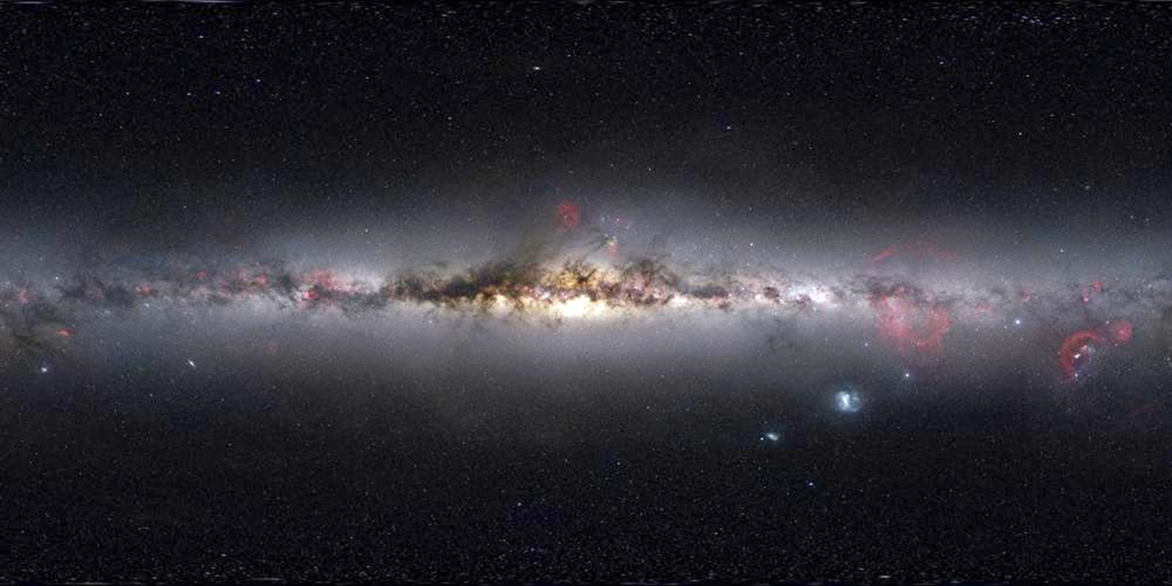
The optical sky
Nick Risinger: 5000 Megapixel image

Slide 3
oops… your optical sky
Nick Risinger: 5000 Megapixel image

Slide 4
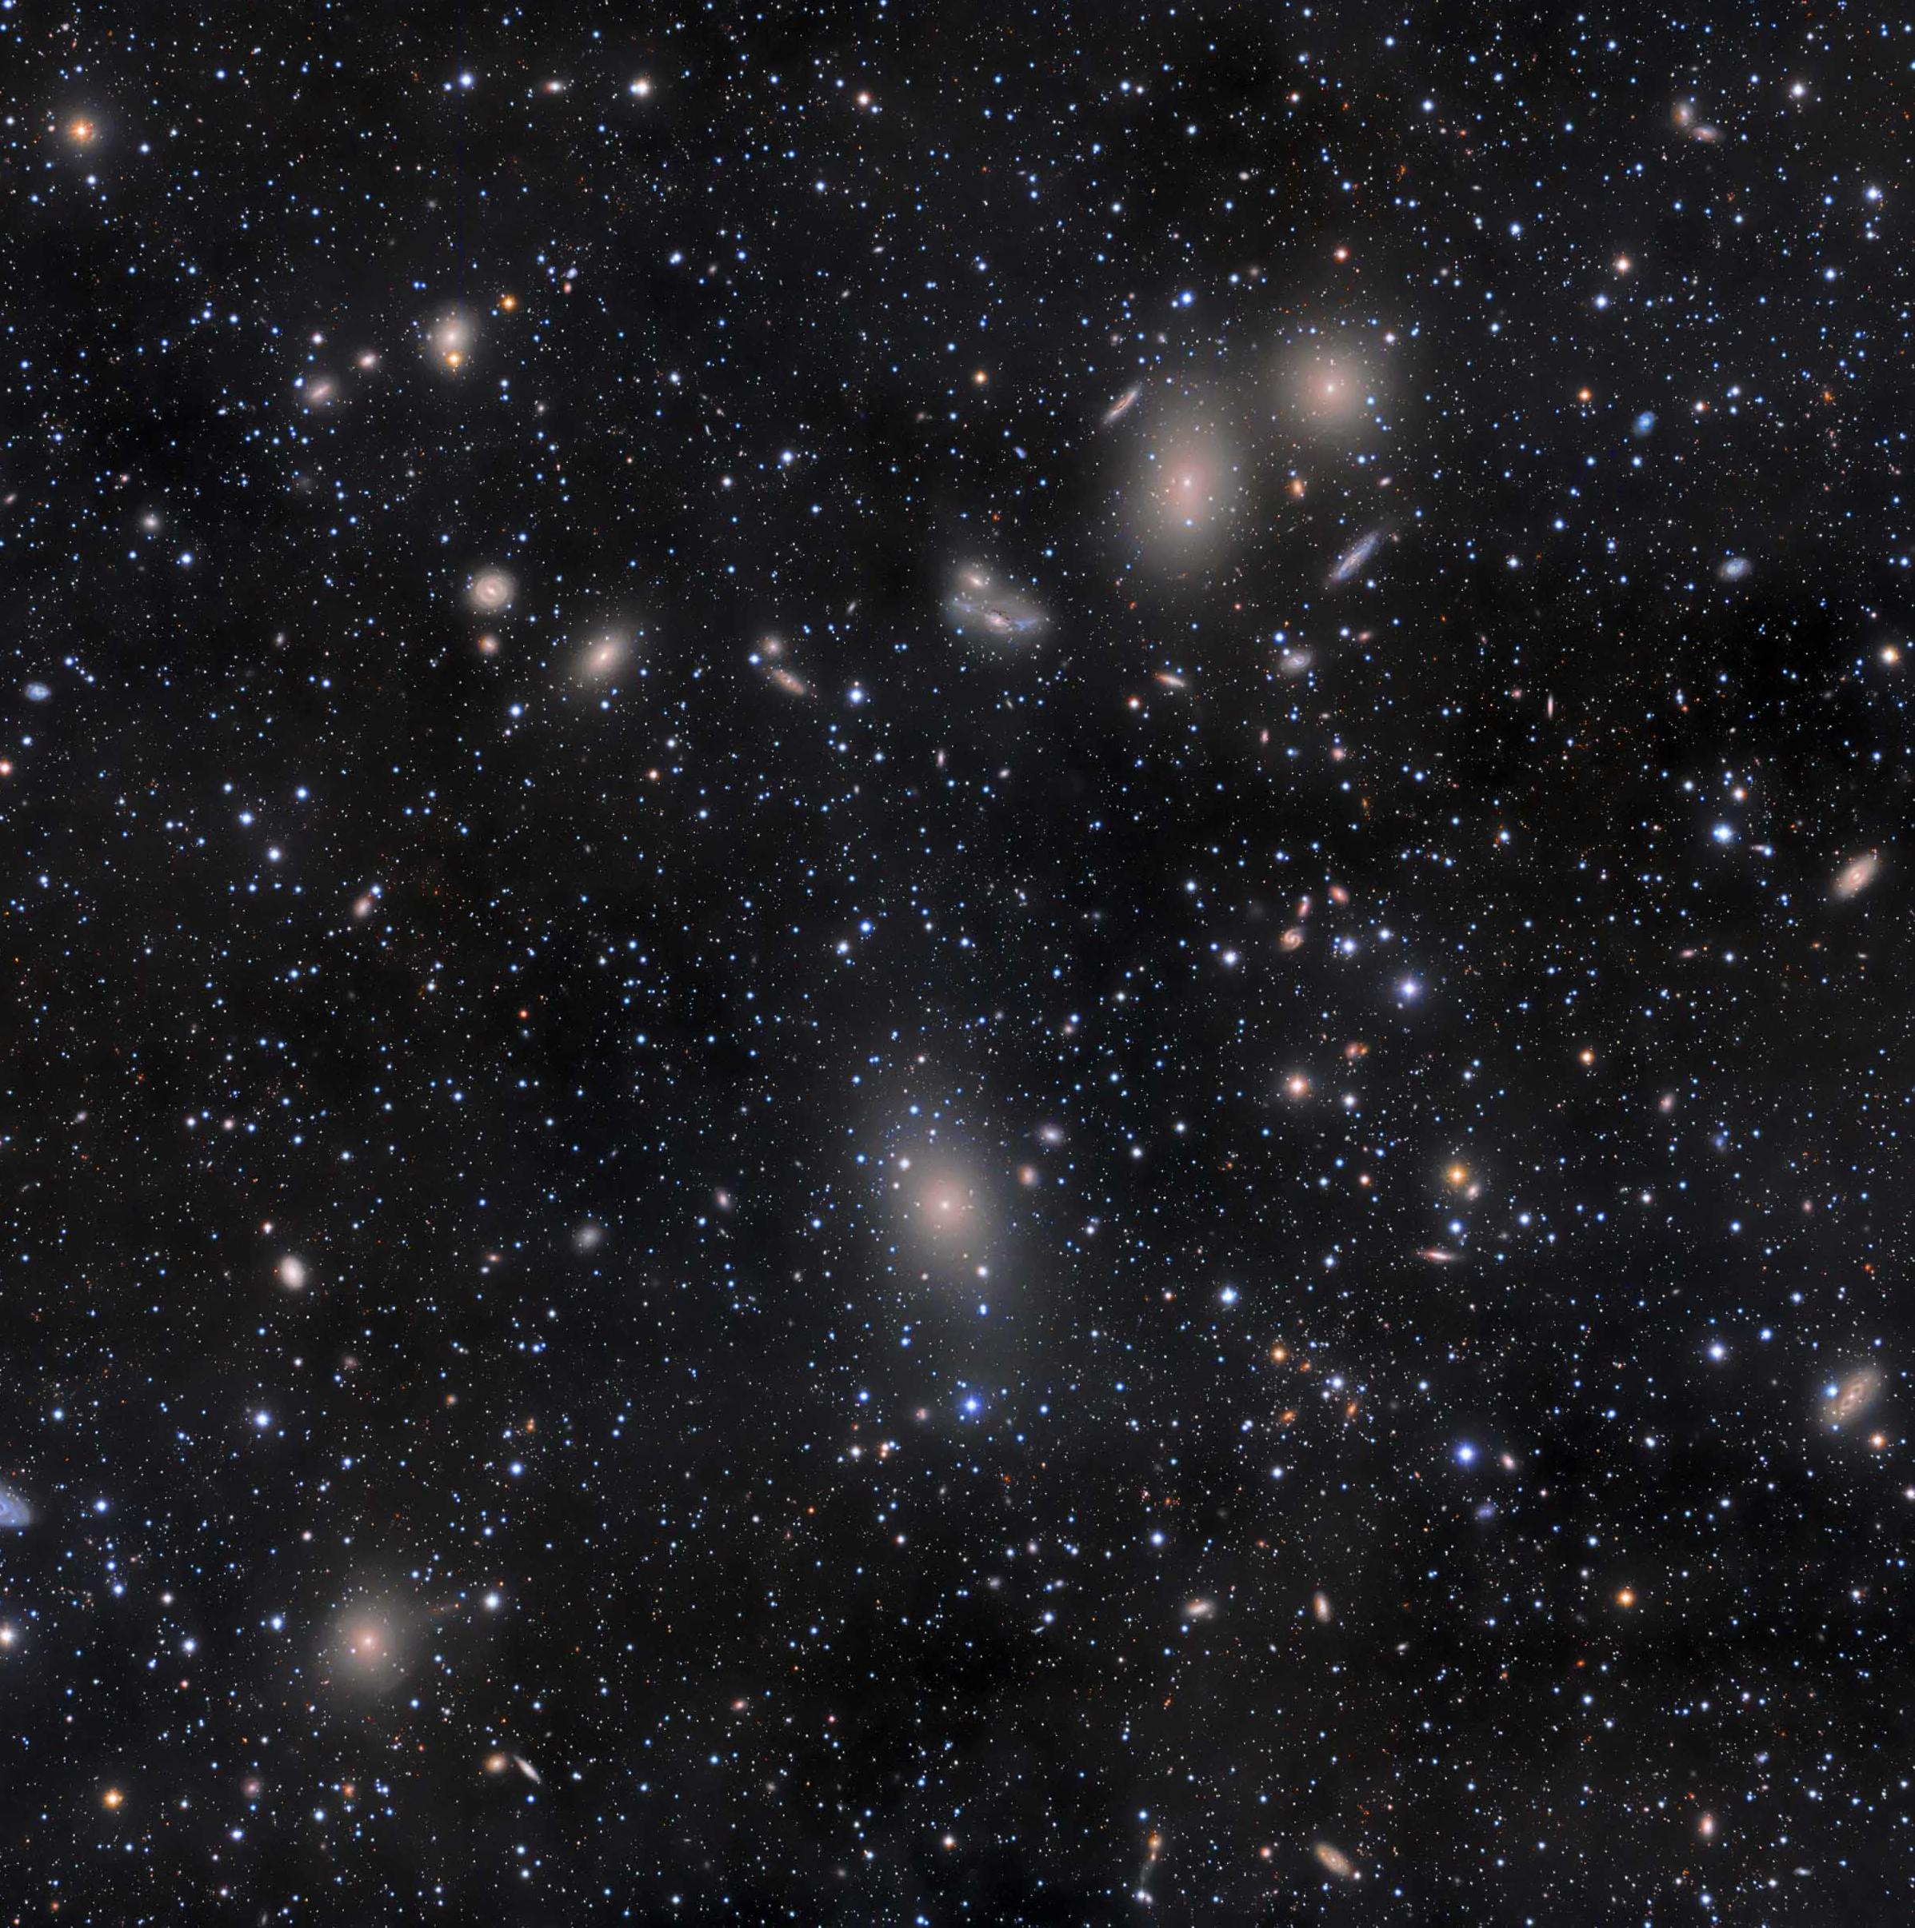
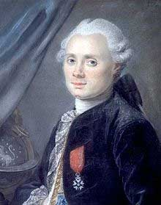
Messier 87
The Virgo Supercluster
Charles Messier
(1730-1817)
Rogelio Bernal Andreo

Slide 5
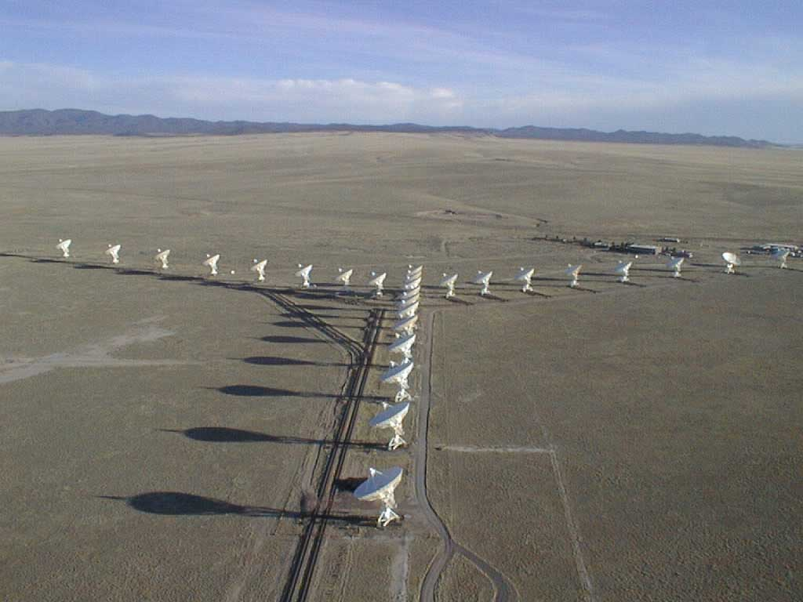
Jansky Very Large Array
Socorro, NM

Slide 6
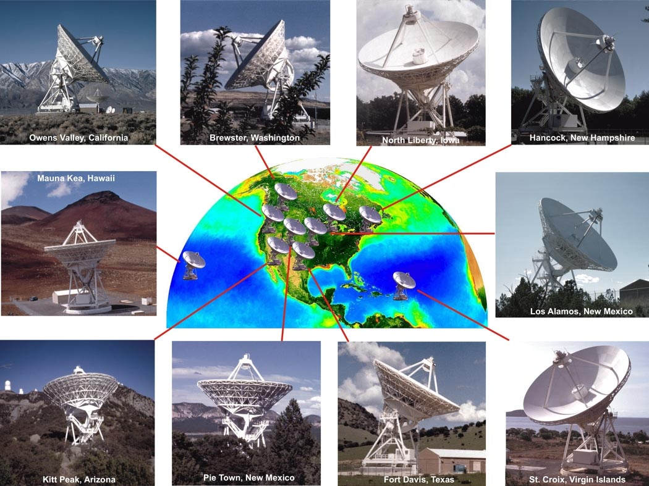

Slide 7
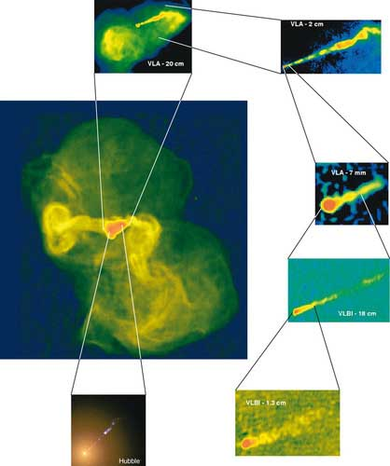
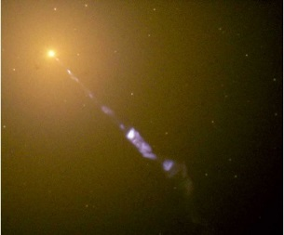
M87 in optical and radio, zoomed in with Very Long Baseline Interferometry
Galaxy is 200x Milky Way mass 3 Billion Sun black hole in nucleus
Optical image: Hubble Space Telescope
National Radio Astronomy Observatory
Notes:
50 M LY from earth, radio disc 1947; xr source from nuc. ; gamma rays from nuc (short time var)

Slide 8
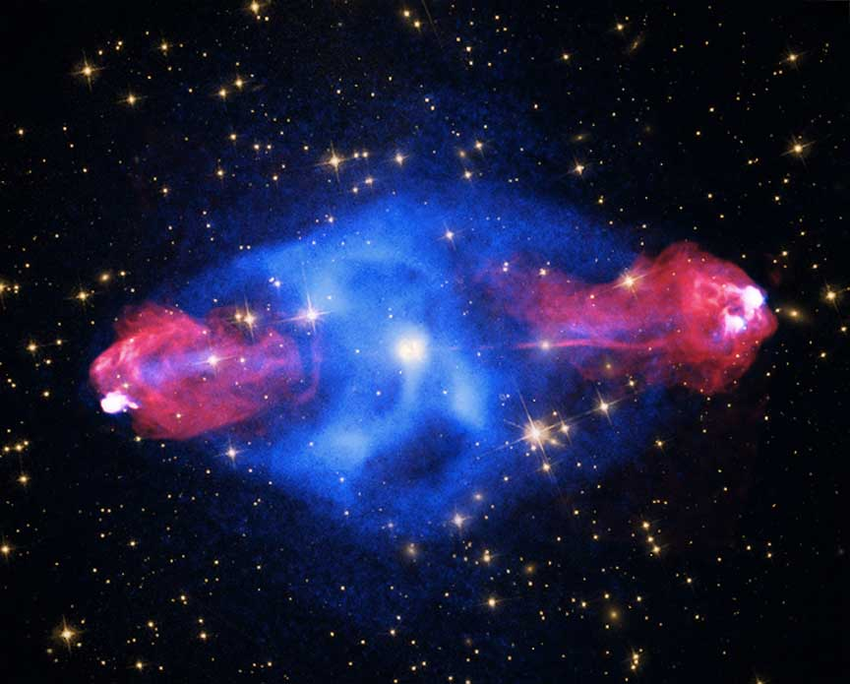
Cygnus A: radio (red) plus X-ray (blue) emission
2nd brightest radio galaxy in the sky;
1 Billion Sun black hole in nucleus
(NRAO/NASA)
Notes:
first radio gal and disc by grote reber 1939, 2nd strongest radio source in sky,

Slide 9
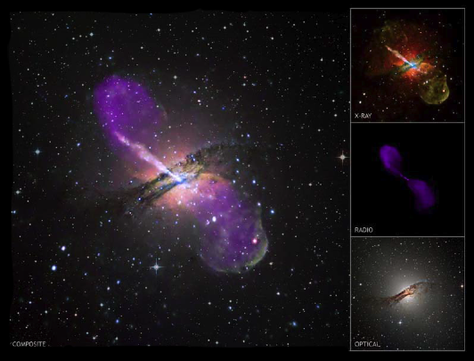
Centaurus A (NGC 5128)
5th brightest galaxy in the sky,
the nearest bright radio galaxy
50 Million Sun black hole in nucleus
NASA Chandra/NSF JVLA/ESO
Notes:
optical gal disc 1826 in Australia, distance 10 M Lt yrs, closest rad gal, 5th brightest gal in sky

Slide 10
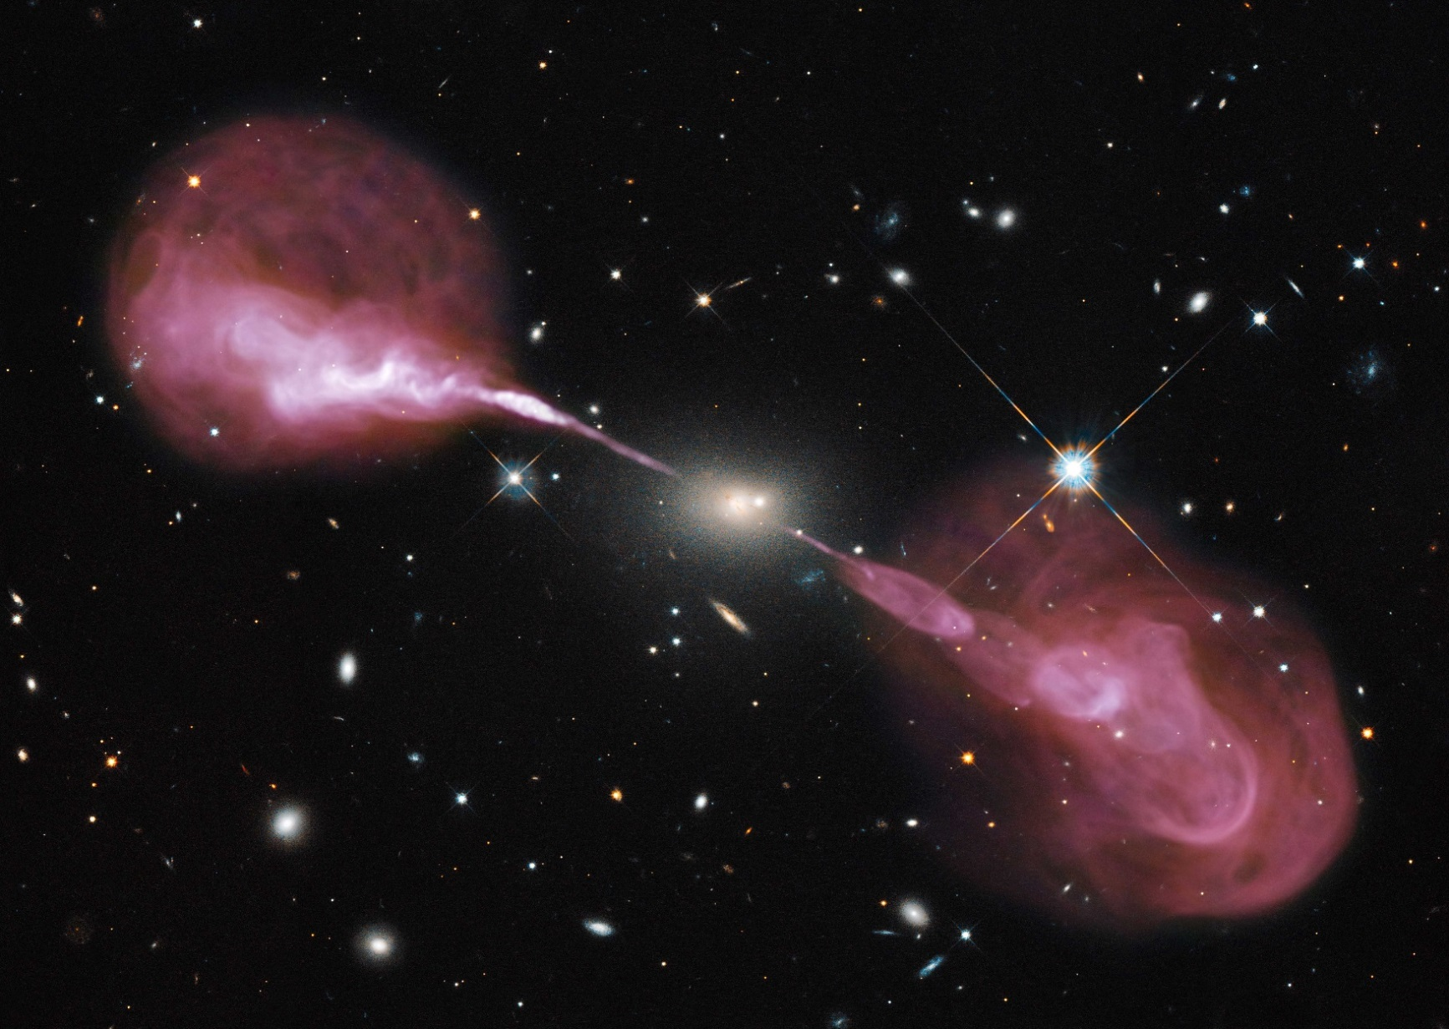
Hercules A
Brightest radio source in the sky,
1000x Milky Way mass
4 Billion Sun black hole in nucleus
Radio jet is 1 Million light years long
JVLA/HST

Slide 11
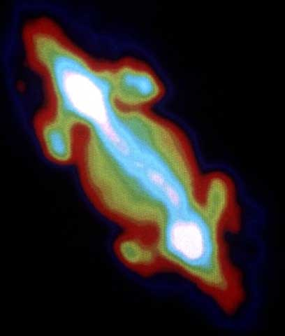
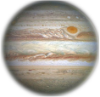
Jupiter!
NRAO, de Pater

Slide 12
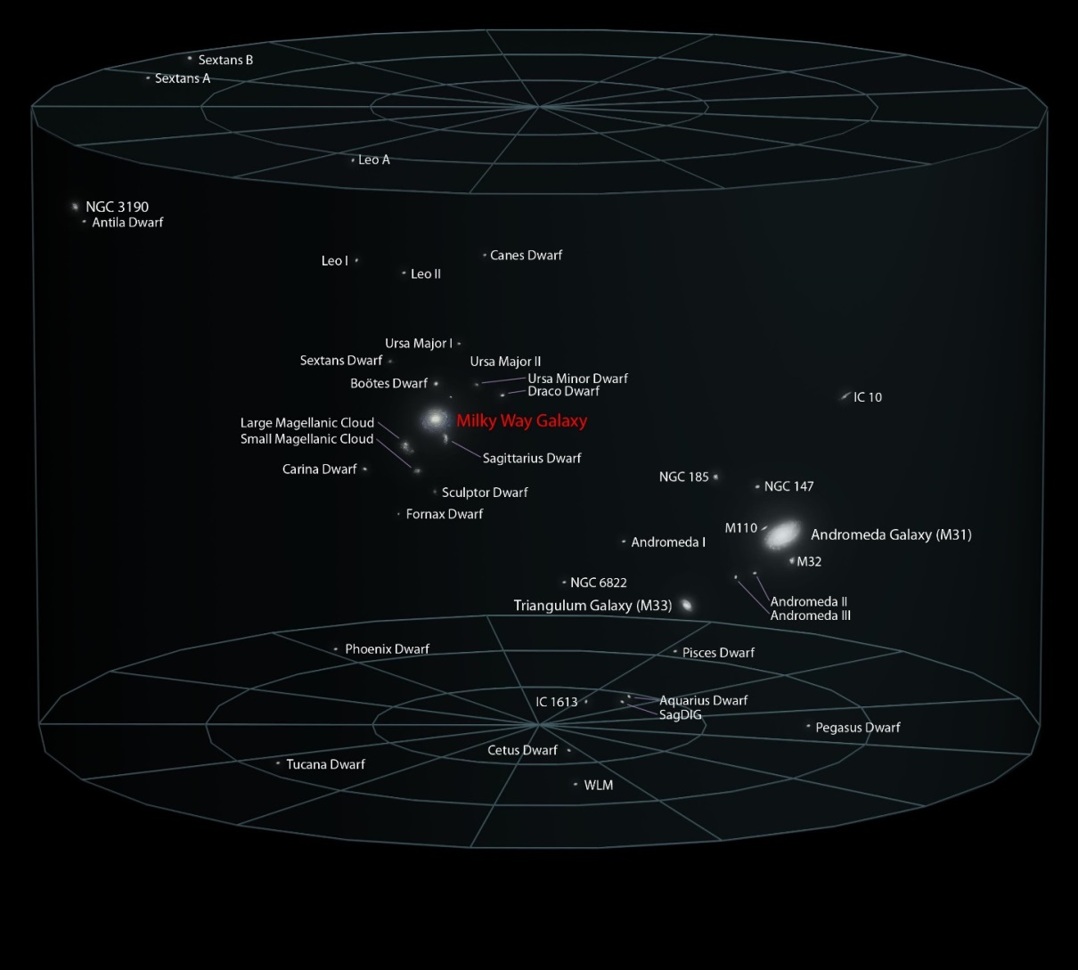
Local Galactic Group

Slide 13

Local Galactic Group

Slide 14
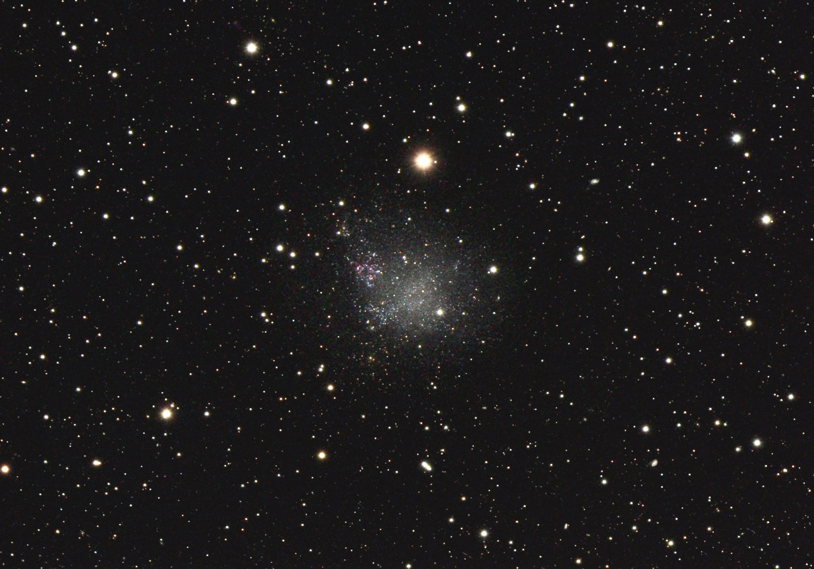
Dwarf galaxy IC 1613
2.4 million light years away
0.1% the Milky Way mass
Bernhard Hubl

Slide 15
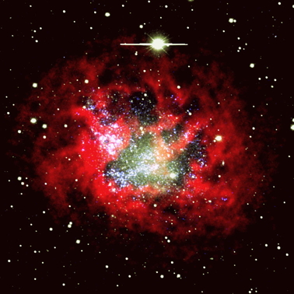
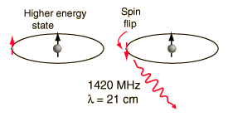
IC 1613
red = hydrogen gas
observed with the JVLA
Strong winds and
supernovae from massive stars rip apart the gas
Hunter et al. 2012

Slide 16

IBM Research and the Square Kilometre Array Radio Telescope Project
Thinking about The Numbers
Extreme Sensitivity
The energy of one photon of light from hydrogen is 20% that of a water molecule falling in a rain drop
The total energy of all the light from hydrogen in IC 1613 collected by all 27 dishes (25 m diameter each) of the JVLA in 8 hours is one-millionth the energy of a single mosquito flying
JVLA

Slide 17
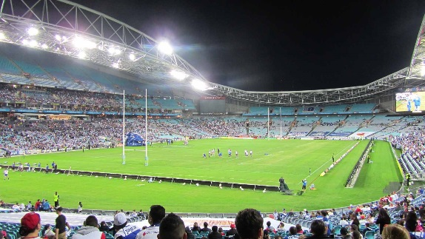
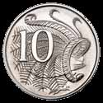
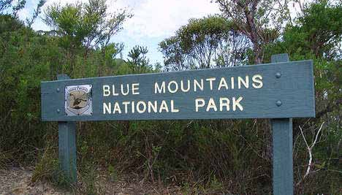
IBM Research and the Square Kilometre Array Radio Telescope Project
Thinking about The Numbers
Blurry vision:
The large size of a radio wave makes everything look blurry
Angular resolution = wavelength / diameter of aperture
  your eye: 40 arc seconds (10 cent piece at 100 meters)
  Hubble space telescope: 0.05 arcsecond … you could read this sign from Sydney:

Slide 18
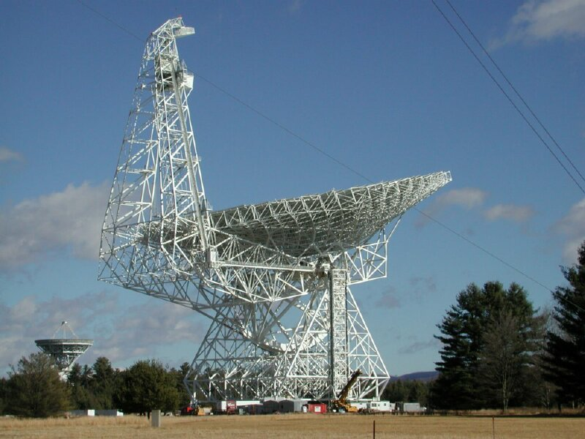
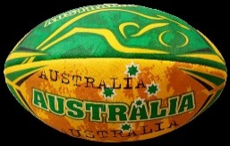
IBM Research and the Square Kilometre Array Radio Telescope Project
Thinking about The Numbers
Blurry vision:
The Green Bank Telescope, 100 meter diameter
Resolution for 21 cm waves: 430 arc seconds
Notes:
biggest land structure, 20:200 vision

Slide 19
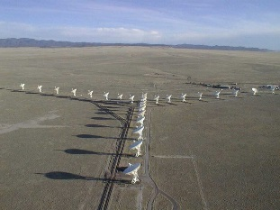

IBM Research and the Square Kilometre Array Radio Telescope Project
Thinking about The Numbers
An interferometer sharpens the image:
0.005”
40”

Slide 20
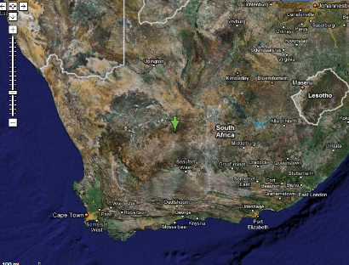
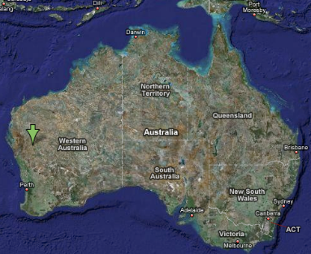
IBM Research and the Square Kilometre Array Radio Telescope Project
SKA: The Square Kilometer Array
What we need:
A square kilometer of collecting area
  2700 dishes in Africa for centimeter wavelength signals (~ 1 Ghz)
  100 dishes with 200 receivers each in Australia for wide field imaging at centimeter wavelengths
  1 Million dipole detectors in Western Australia for meter wavelengths (0.2 GHz)
Petabit/second data rates from the telescopes into the computers
Exaflop processing
ExaBytes/year archiving

Slide 21
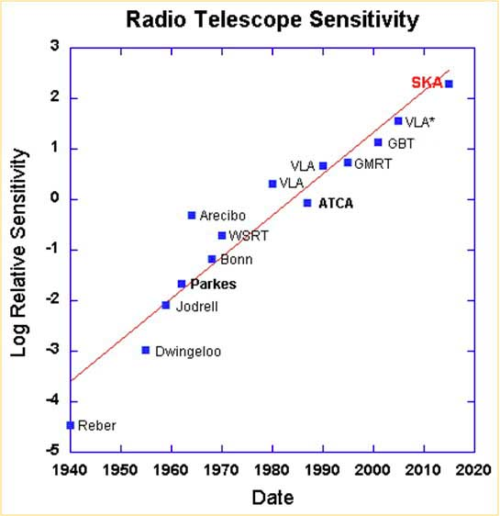
Evolution toward SKA is natural…
it follows the curve
sensitivity doubles
every 3 years
Ekers 2012

Slide 22
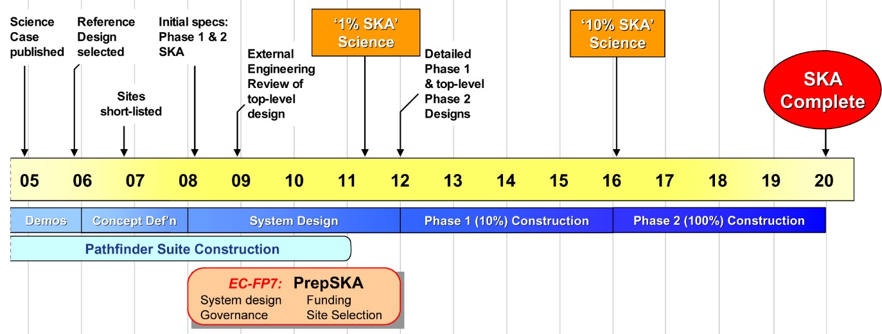
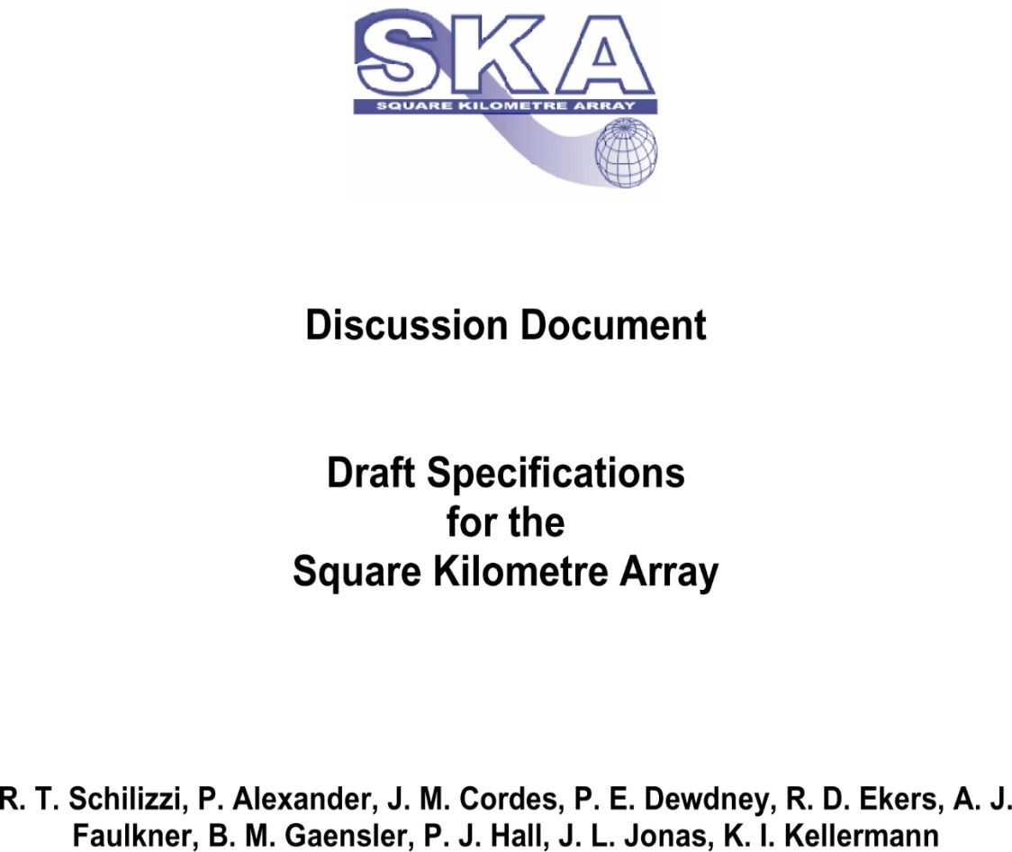

Prof. Richard Schilizzi Dir. SKA 2003-2011
Notes:
PhD Univ Sydney 1973

Slide 23
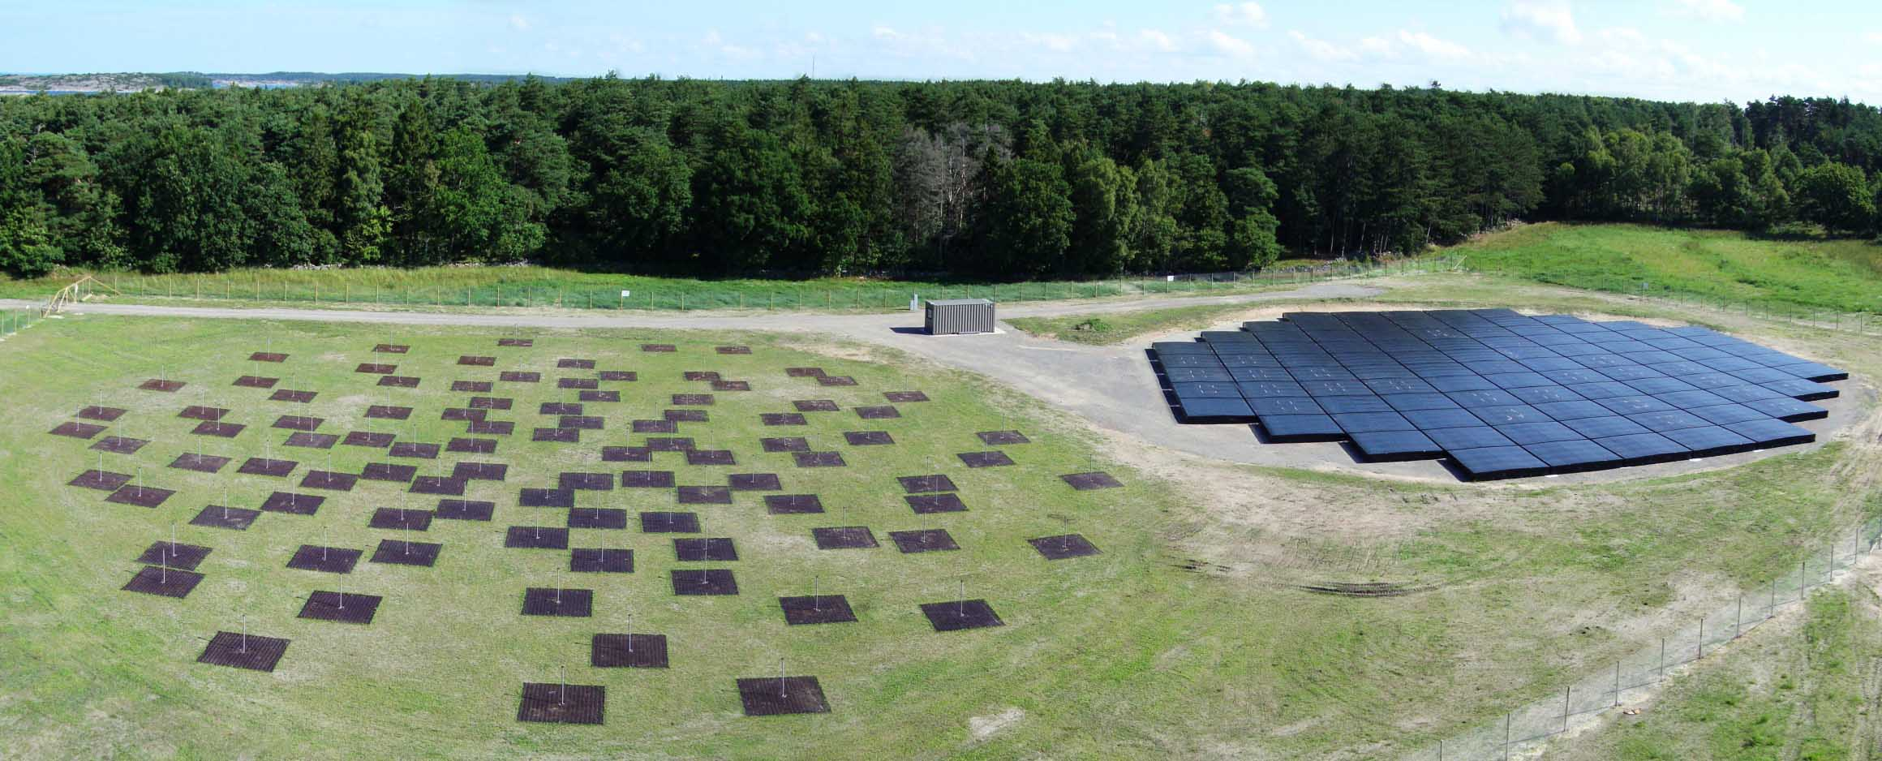
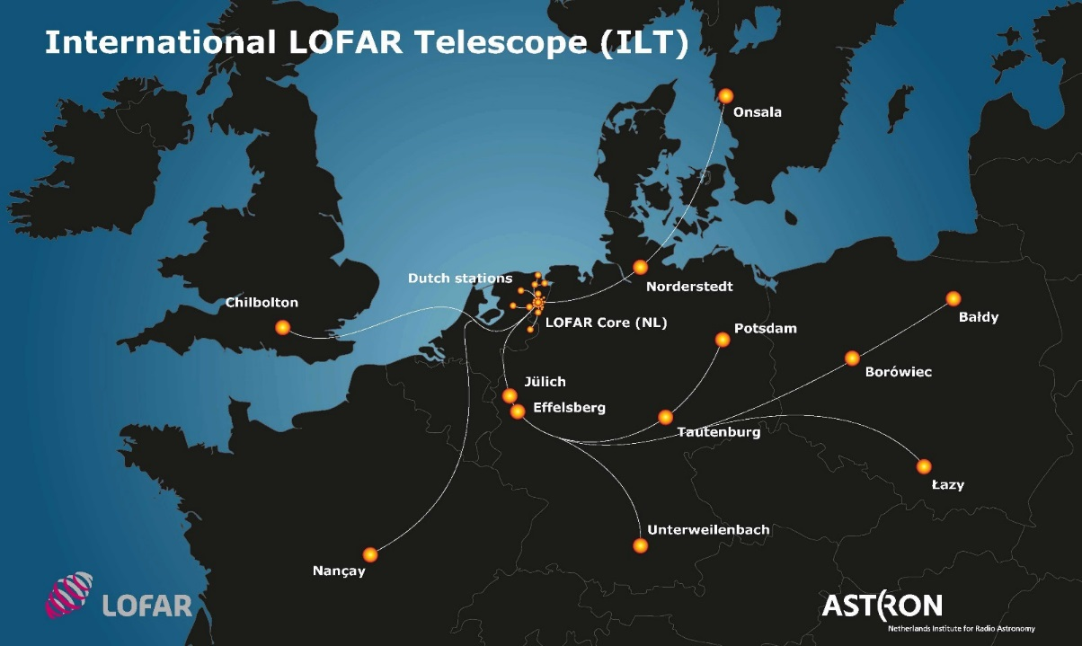
ASTRON, 2005 …
Netherlands

Slide 24
Look this way
Δt
Δt
Δt
Dipole array sums signals with chosen time delay to select pointing in the sky

Slide 25
Look this way
Δt
Δt
Δt
Sum differently

Slide 26
Look this way
Look this way
Δt
Δt
Δt
Sum both ways at the same time

Slide 27
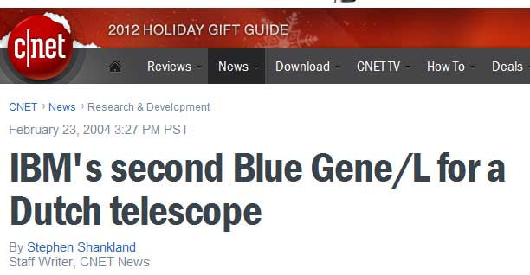
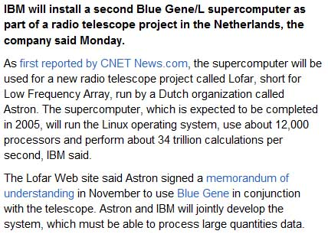
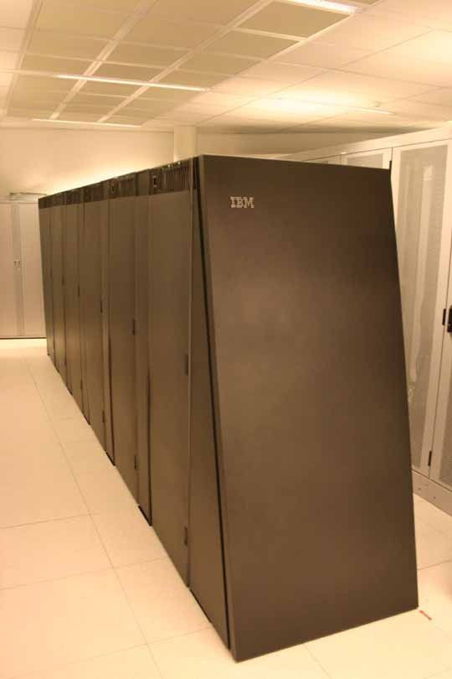
#6 Top 500, 2005

Slide 28
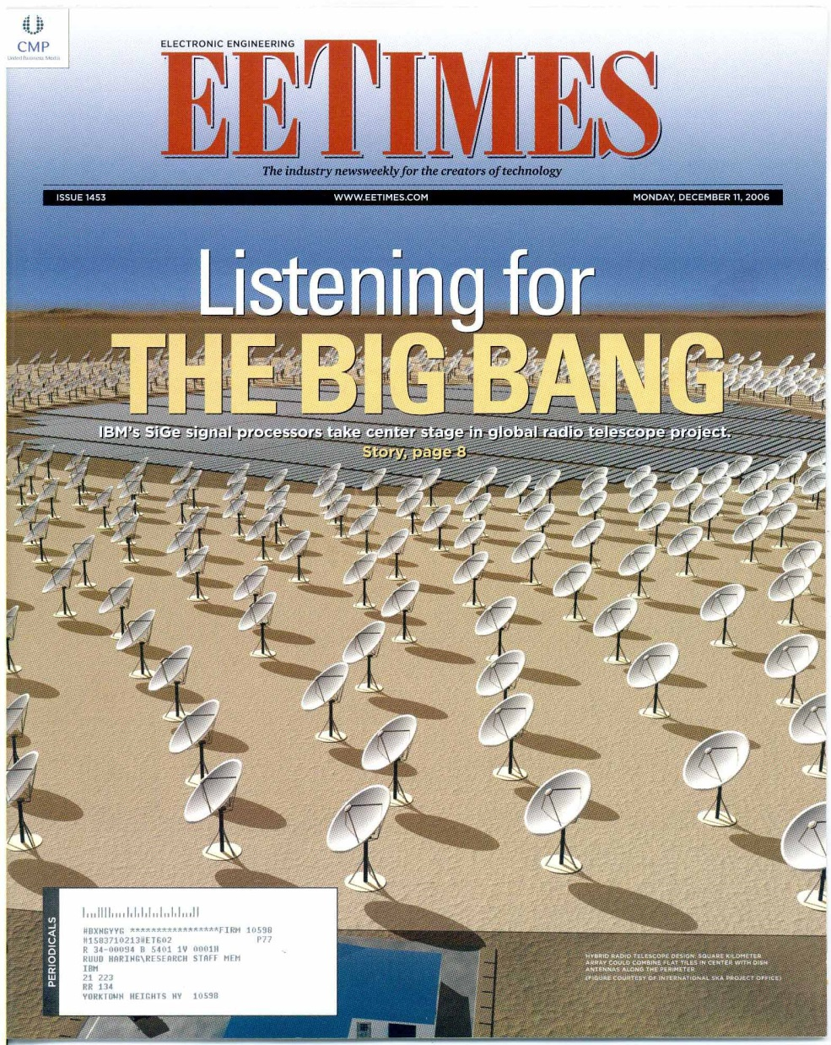


Slide 30

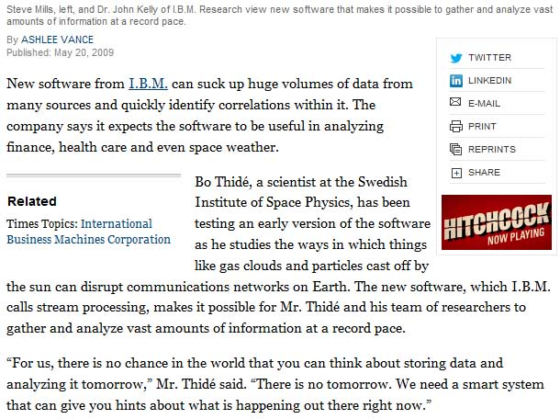
May 2009

Slide 32
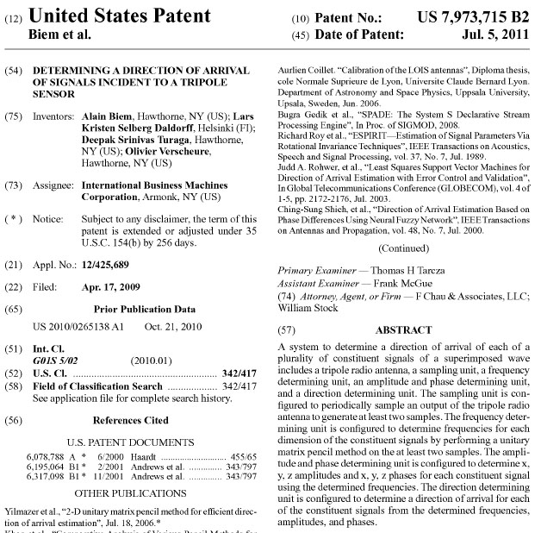
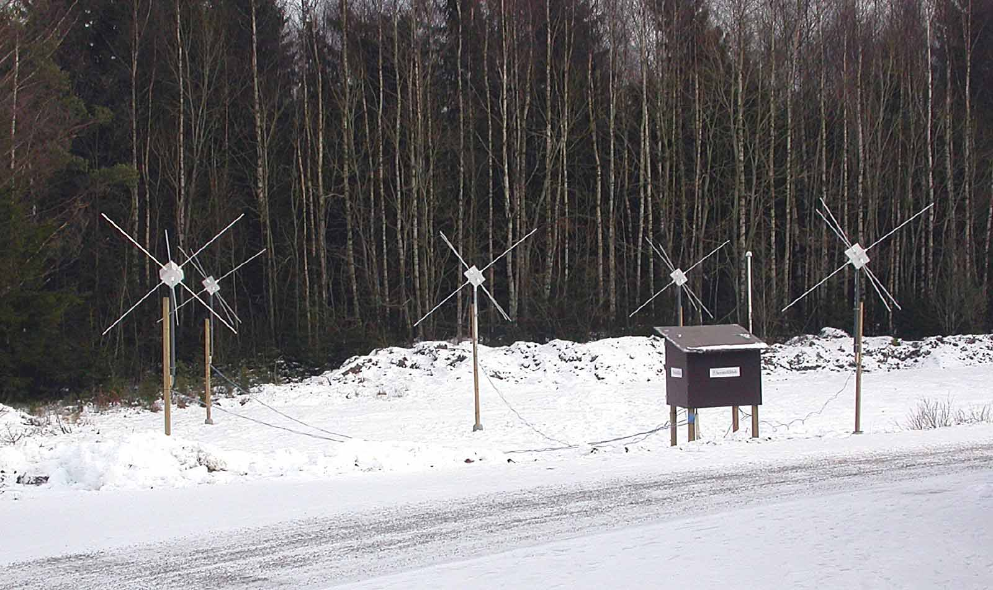
Lofar Outrigger
in Sweden, 2005,
Thide, Palmberg

Slide 33
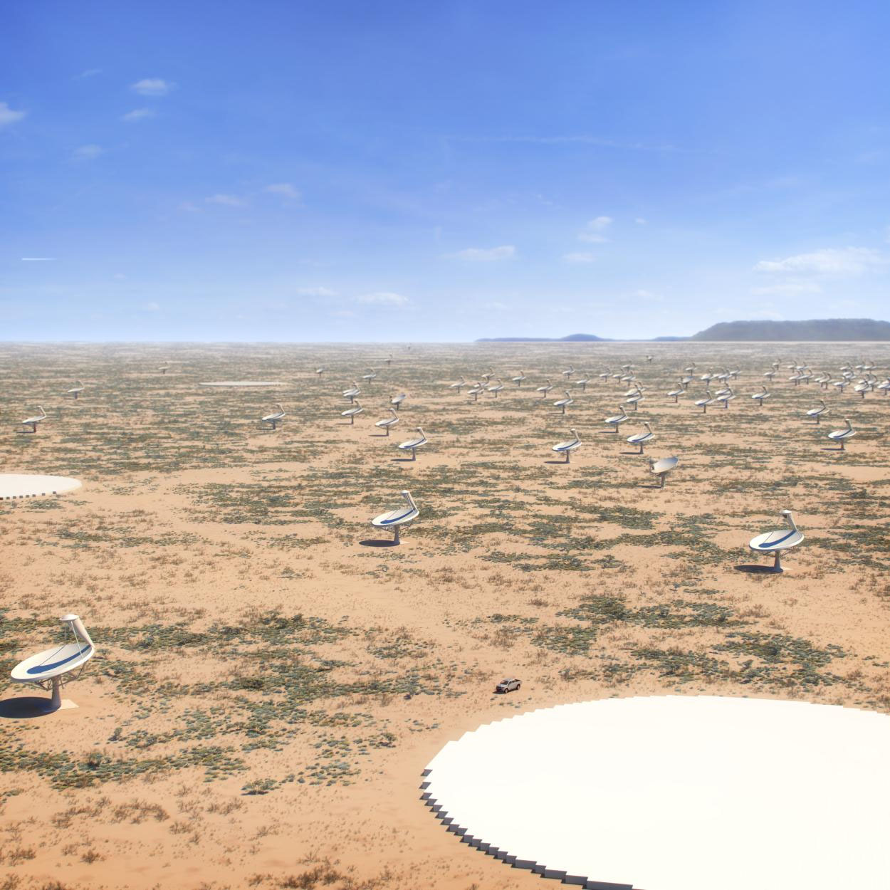

Slide 34
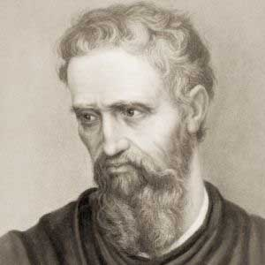
The greatest danger for most of us is not that our aim is too high and we miss it, but that it is too low and we reach it.
- Michelangelo

Slide 35
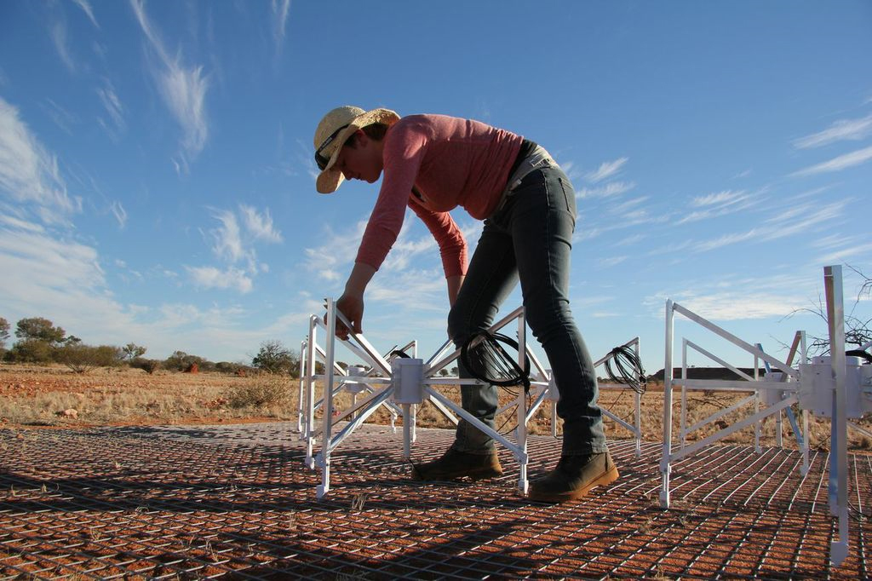
Kirsten Gottschalk, ICRAR

Slide 36
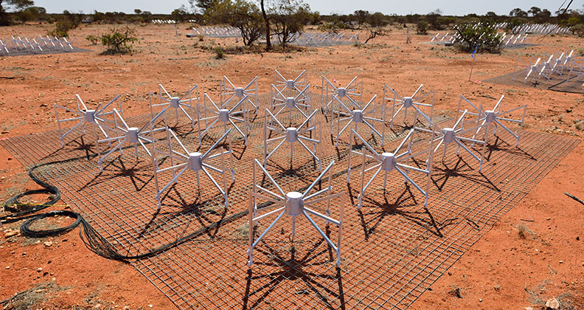
Murchison Widefield Array (MWA)
in Western Australia
2048 dipoles in 128 stations
http://news.curtin.edu.au/cite/in-pictures/pushing-the-envelope/

Slide 37
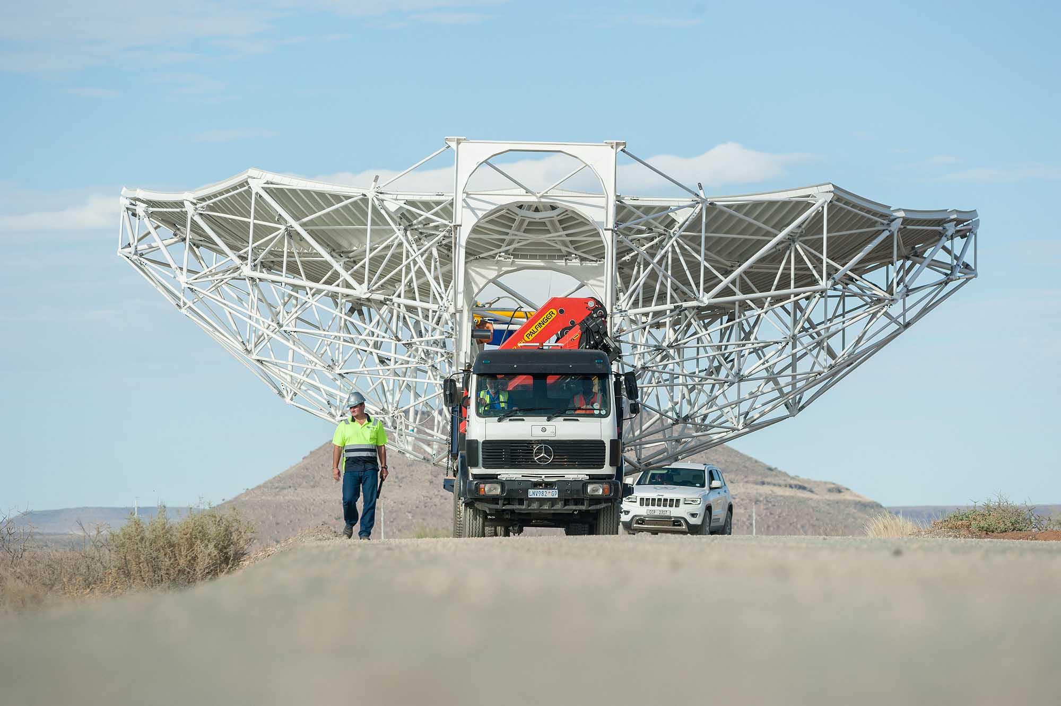
The first MeerKAT dish in South Africa
SKA South Africa

Slide 38
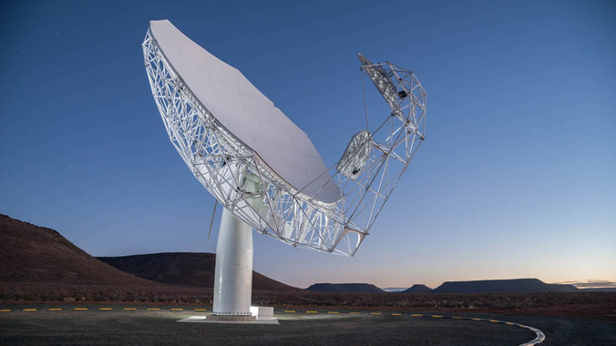
MeerKAT in
South Africa
2/64 are built
SKA South Africa

Slide 39
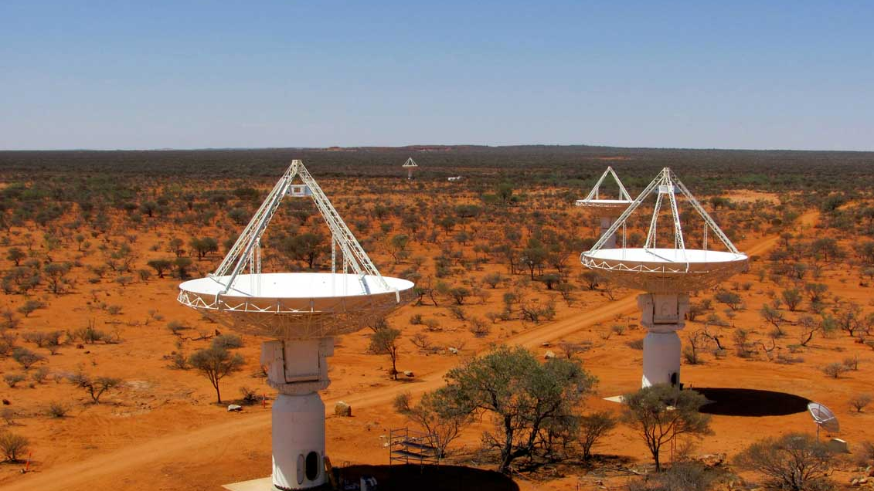
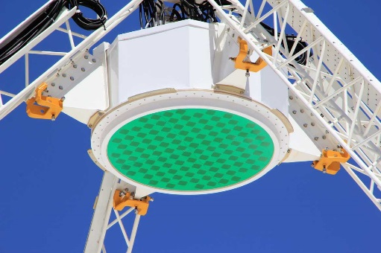
ASKAP in
Western Australia
6/36 antennae are built
“Phased Array Feed” makes 36 beams of
1 sq. degree
CSIRO

Slide 40
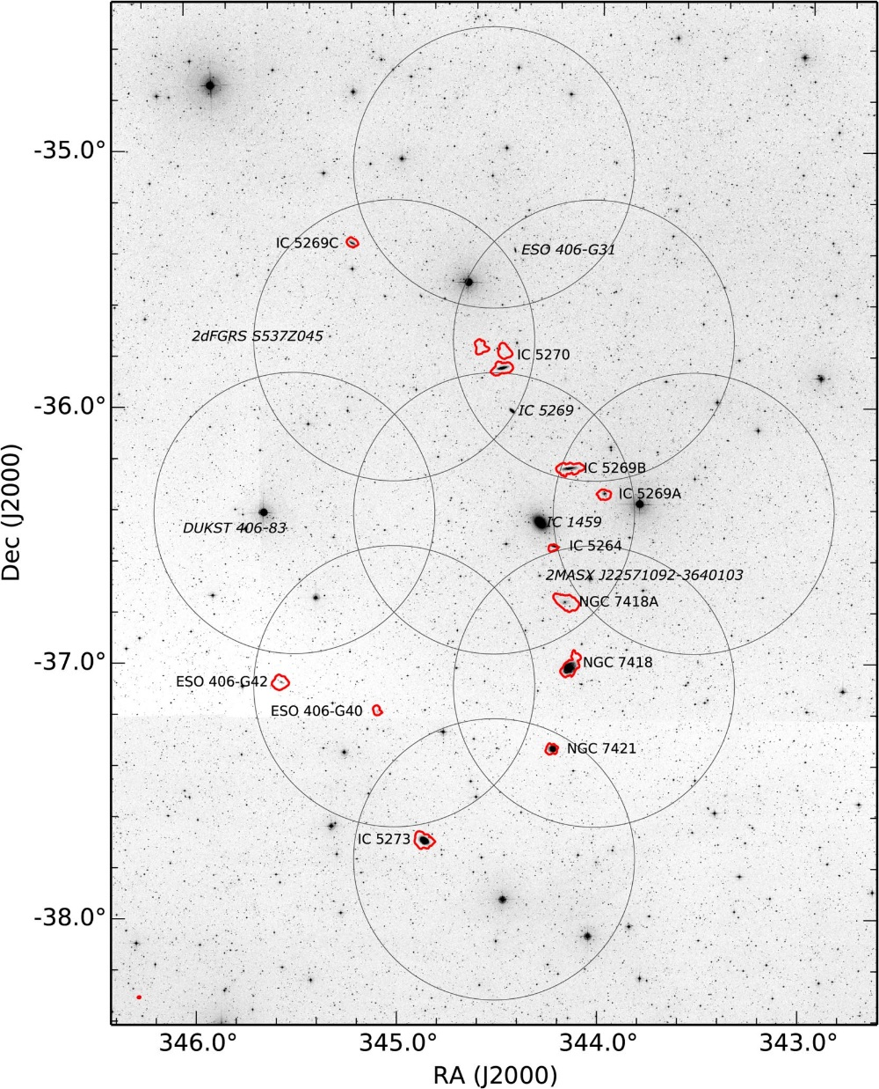
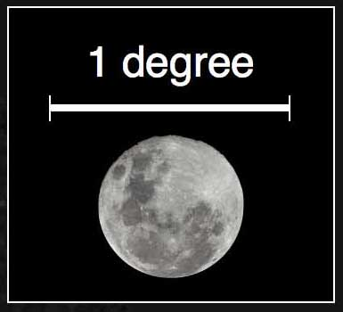
ASKAP discovery!
Starless hydrogen clouds in a galaxy group.
Serra et al. June 2015

Slide 41
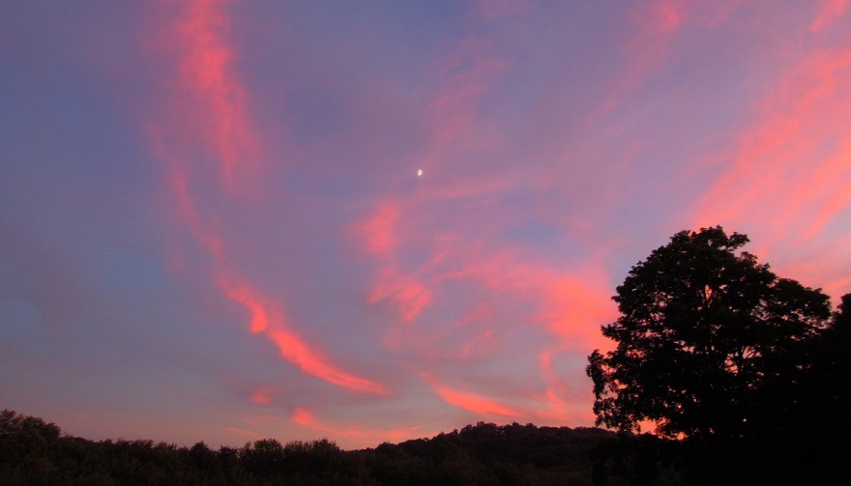
bge

Slide 42
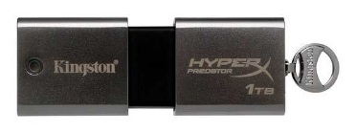
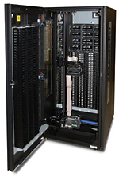
The sky is BIG: 100 billion galaxies out to the “edge”
Big for telescopes to observe: 1000’s of years
But not big for computers
A catalog of every galaxy would take a few TBytes.
A database of images (100x100 pixels) would take a few PB
IBM TS 4500
bge
Notes:
images x10^6

Slide 43
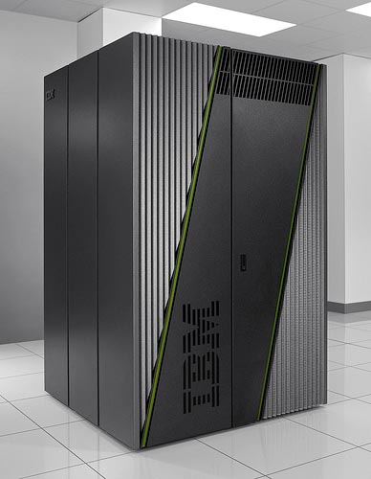
One rack of IBM’s BlueGene/Q supercomputer has 15 times more transistors than there are stars in the Milky Way (100,000,000,000)
Nick Risinger: 5000 Megapixel image
Notes:
1 chip =1.5B transistors, and 1024 chips/rack

Slide 44

The problem is here:
The capacity of the human brain is plenty big: 2.5 PBy.
But the time to get that data in (say with continuous video) would be 300 years
Paul Reber, prof. of psychology at Northwestern University, Scientific American

Slide 45
The new frontier is analytics

Slide 46
The new frontier is analytics
… and extremely low power computing

Slide 47

The DOME Project: photonics for high speed data transmission, data
compression, accelerators, 3D stacked chips, advanced storage techniques

Slide 48






IBM Research and the Square Kilometre Array Radio Telescope Project
“DOME” Technology for SKA
Beamforming at stations
Interferometry, cor-
relation of station beams
Reconstruction of sky image
Station
Central Signal Processor (CSP)
Science Data Processor (SDP)
Station
Archive
Algorithms and Machines
Access Patterns
Nanophotonics
Microservers
Accelerators
New Algorithms
Real-Time Communications
Engbersen 2015

Slide 49



IBM Research and the Square Kilometre Array Radio Telescope Project
“DOME” Microserver
  The integration of an entire server node motherboard* into a single microchip except DRAM, Nor-boot flash and power conversion logic.
This does NOT imply low performance! Measured 2x operations/Joule
139mm x55mm x 7mm
DEMO at SC15, Nov 2015
245mm
305mm
128 compute node boards
1536 cores / 3072 Threads
6 TB DRAM, 1.28Tbps Ethernet (@40Gbps)
→ Now possible: A datacenter-in-a-box
*without graphics
Weekly updates check: https://twitter.com/ronaldgadget
Luijten, Engbersen 2015

Slide 50


In 2012, IBM collaborates with Victoria University and Curtin University
using GPUs on iDataPlex for correlation on the Murchison Widefield Array.
Steven Tingay, Glenn Wightwick (IBM), Andrew Mattingly (IBM)

Slide 51


Slide 52

IBM Research and the Square Kilometre Array Radio Telescope Project
IBM and SETI
Allan Telescope Array
in California
60 Gb/s data rate
Notes:
jStart's unique mission within IBM is to leverage emerging technologies to address real and current business needs of our clients.

Slide 53
IBM Research and the Square Kilometre Array Radio Telescope Project
IBM and SETI*
Proof of Concept
Make a collaborative environment for analysis of SETI signals
Implement with IPython Notebooks on Apache Spark, using IBM Cloud Data Services
  a self-documenting repository of research that can be searched & shared
  IPython notebooks use “in-memory analytics” of the Spark environment
Managed within GitHub which also provides collaborative capabilities (wikis, bug tracking, etc.).
100 million events of ATA data was loaded into the CDS to remove RFI & Earth motions
*Team: Penn State Univ., NASA, SETI Institute, IBM Almaden, IBM Johannesburg
Notes:
jStart's unique mission within IBM is to leverage emerging technologies to address real and current business needs of our clients.

Slide 54



Four Nobel Prizes in Radio Astronomy
Sir Martin Ryle and Antony Hewish (1974)
Radio astrophysics aperture synthesis technique and pulsars
Notes:
Worked with Ernst Rutherford at the Cavendish lab in Cambridge

Slide 55


Joceyn Bell, 1968
co-discoverer of
pulsars.
Notes:
#4 on list of greatest british inventions. #1=universal machine, Turing, Bletchley Park, #2 = mini,

Slide 56
Joceyn Bell, 1968
co-discoverer of
pulsars.
unexpected!
Notes:
#4 on list of greatest british inventions. #1=universal machine, Turing, Bletchley Park, #2 = mini,

Slide 57


Four Nobel Prizes in Radio Astronomy
Arno Penzias and Robert Wilson (1978) … shared with Pyotr Kapitsa
Cosmic microwave background radiation
Proof of the Big Bang theory
and liquefaction of Helium at low temp.
Notes:
Worked with Ernst Rutherford at the Cavendish lab in Cambridge

Slide 58
Four Nobel Prizes in Radio Astronomy
Arno Penzias and Robert Wilson (1978) … shared with Pyotr Kapitsa
Cosmic microwave background radiation
serendipity!
Proof of the Big Bang theory
and liquefaction of Helium at low temp.
Notes:
Worked with Ernst Rutherford at the Cavendish lab in Cambridge

Slide 59


Four Nobel Prizes in Radio Astronomy
Russell Hulse and Joseph Taylor Jr. (1993)
Binary pulsar and gravity waves
Confirmation of gravity waves
predicted by general relativity
Notes:
Worked with Ernst Rutherford at the Cavendish lab in Cambridge

Slide 60
Four Nobel Prizes in Radio Astronomy
Russell Hulse and Joseph Taylor Jr. (1993)
Binary pulsar and gravity waves
prise!
sur
Confirmation of gravity waves
predicted by general relativity
Notes:
Worked with Ernst Rutherford at the Cavendish lab in Cambridge

Slide 61


Four Nobel Prizes in Radio Astronomy
John Mather and George Smoot (2006)
Blackbody form and anisotropy of CMB radiation
Seeing the first structures in the universe
Notes:
Worked with Ernst Rutherford at the Cavendish lab in Cambridge

Slide 62
The SKA Challenge:
Catalog and map cosmic radio emission in ExaScale data
using the most modern solutions for IT …
Discover something that no one even imagined.
- requires knowledge of all the phenomena and objects that are known (an IBM Watson engine) and then an Exascale search for anything that is not known …
… can a machine do this as well as humans?

Slide 63
IBM Research and the Square Kilometre Array Radio Telescope Project
Conclusions: Michelangelo’s SKA
If you aim high enough
… many others will follow
In an exponentially growing environment
… failure only means delay
The Universe contains far more than we can see
… the known objects are richer than we thought
… unknown objects are waiting to be discovered
Dozens of IBMers have worked on SKA technologies and found real world applications with long-term partners to open up new ways of using computers and solving the biggest problems.

