Slide 1
DESIGN-LED DEVELOPMENT FOR THE MOBILE ENABLED ORGANISATION

Slide 2
#deshi**ify
the enterprise

Slide 3
let’s talk about
What does being design-led mean, and why it matters
Leading with design…some examples
What are you going to do next?

Slide 4
being design-led means
1. Your culture is curious
2. Seeking cross functional empathy
3. Innovation is informed through ethnography
4. Design is a physical manifestation of the brand
Design-Driven Firms: Exploring What It Means To Be Design-Led: Michael B. Beverland, RMIT, Francis J. Farrelly, Monash University - 2007

Slide 5
curious culture

Slide 6
puzzles v mysteries

Slide 7
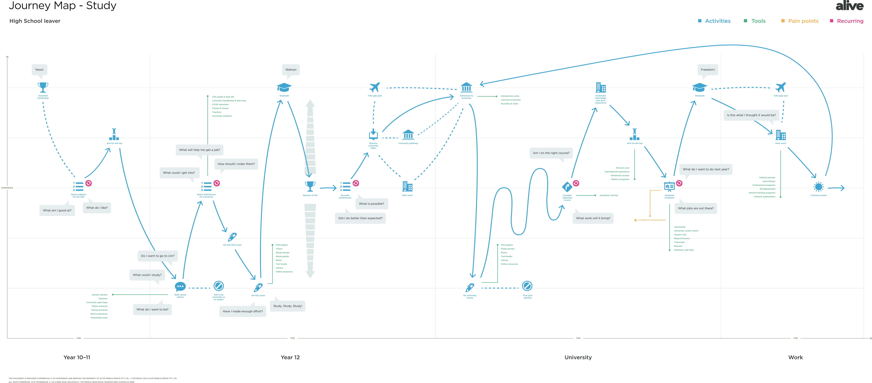
planning my career

Slide 8
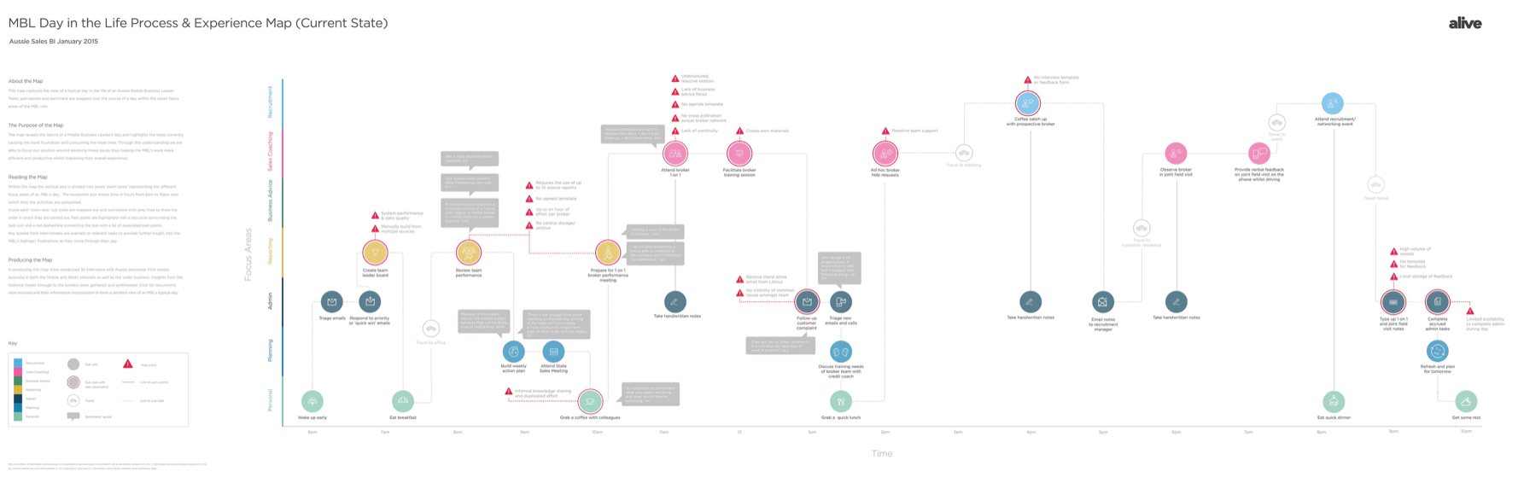
understanding my day

Slide 9
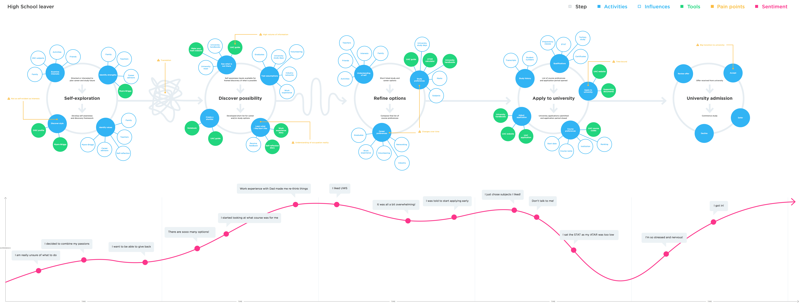
understandING decisions

Slide 10
Up to 210 more hours per week
Expected two hour saving per day per sales rep* to be redirected to trusted advisory, sales prospecting and pipeline management
Approx. 2 hours per day*
Typical activities
* Savings estimate based on average Day in the Life of (DILO) a blended sales resource based on quantitative and qualitative interviews with BDM and KASE team representatives (n= 9)

Slide 11
$109M in projected additional sales
Sales Baseline (last 12 months)
Sales Projection (12 months)
Note: Blended baseline of sales data and uplift projections provided by AGL (May 2014) of BDM and KASE team sales in previous 7 and 12 months respectively

Slide 12
cross functional empathy

Slide 13
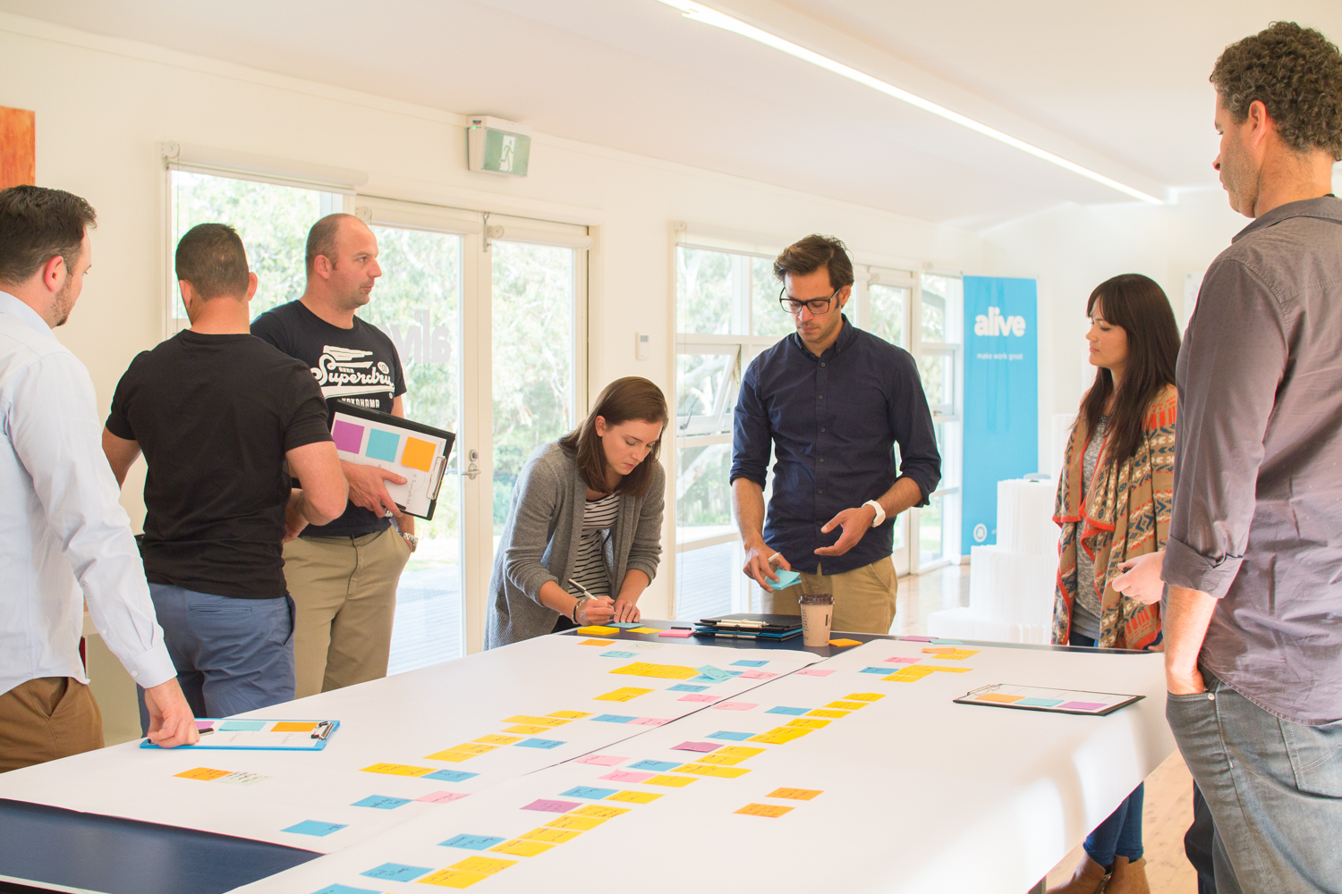

Slide 14
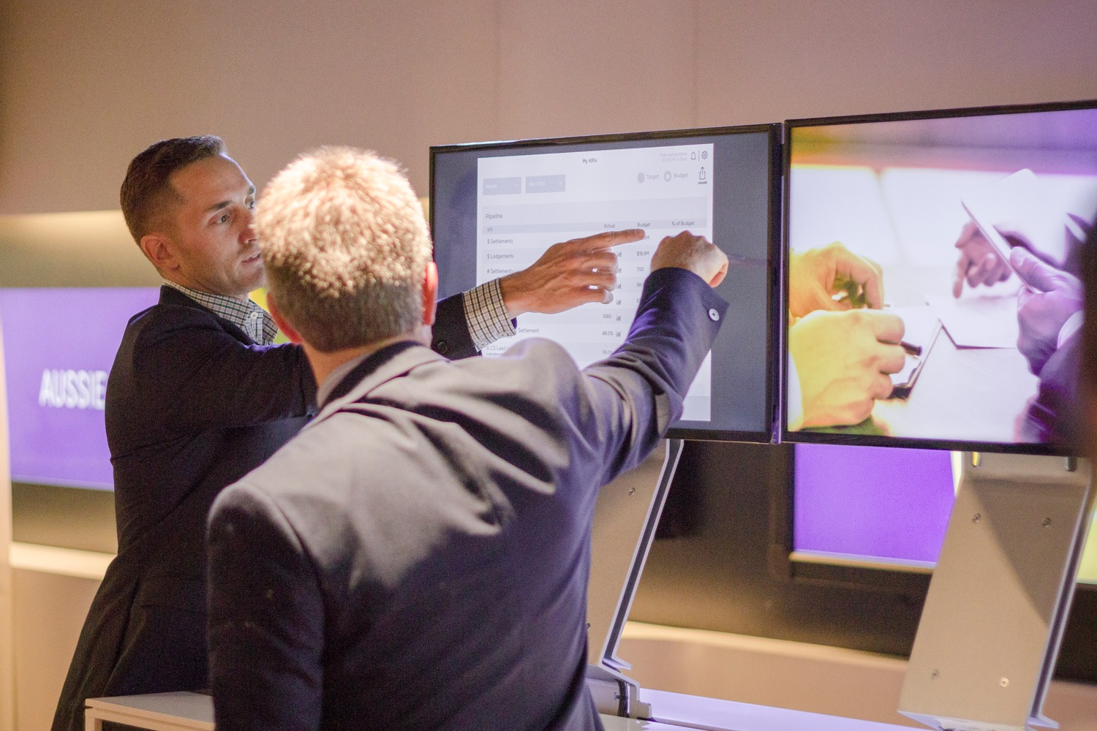

Slide 15
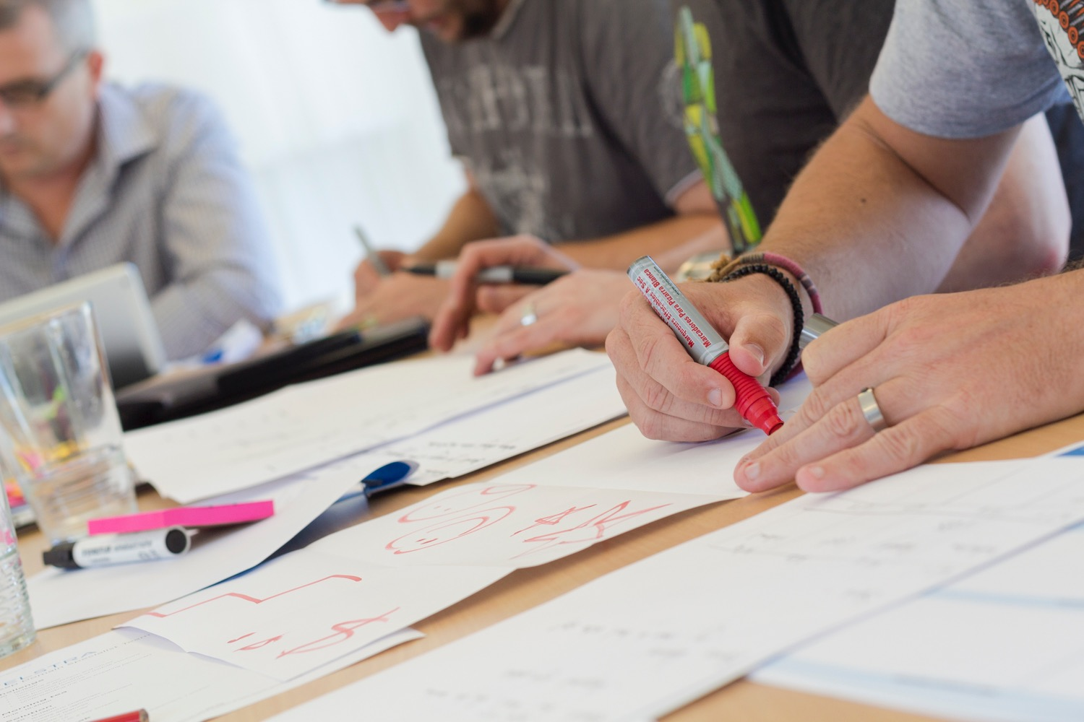

Slide 16
innovation and ethnography

Slide 17
“People don’t want a quarter inch drill, they want a quarter inch hole”

Slide 18
Consulting Giant McKinsey buys itself a top Design Firm (WIRED 14 May 2015)
MCKINSEY & COMPANY, the management consulting giant, is buying Lunar, the design consulting giant.

Slide 19
People don’t care about your solutions…
they care about their problems.

Slide 20
physical manifestation of the brand

Slide 21
Enterprise software used to be about making work more efficient - now it is about transforming the work itself -
Aaron Levie

Slide 22
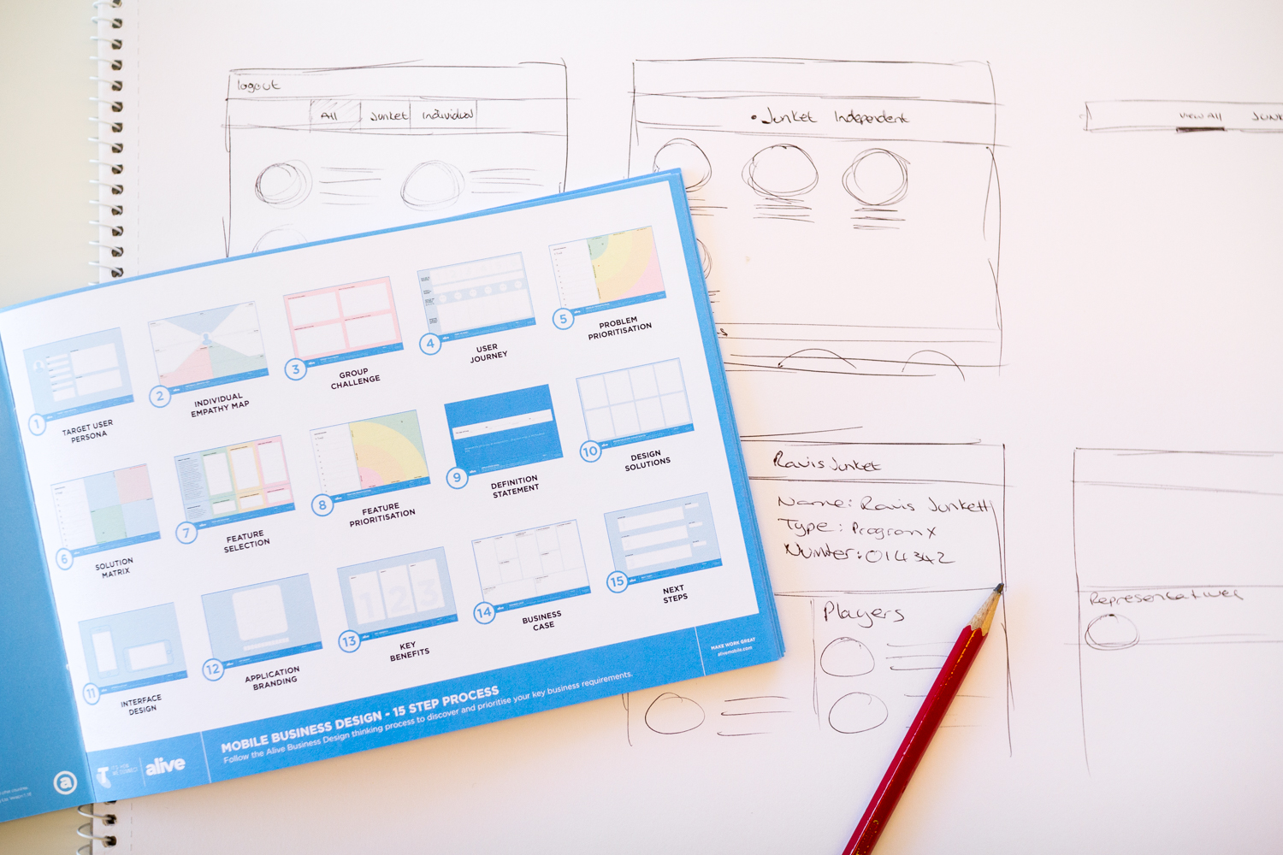

Slide 23
WHY DESIGN-LED MATTERS
Desirability - User Adoption
Viability - Return on Investment
Feasibility - it CAN be done

Slide 24
LEADING WITH DESIGN - EXAMPLES

Slide 25
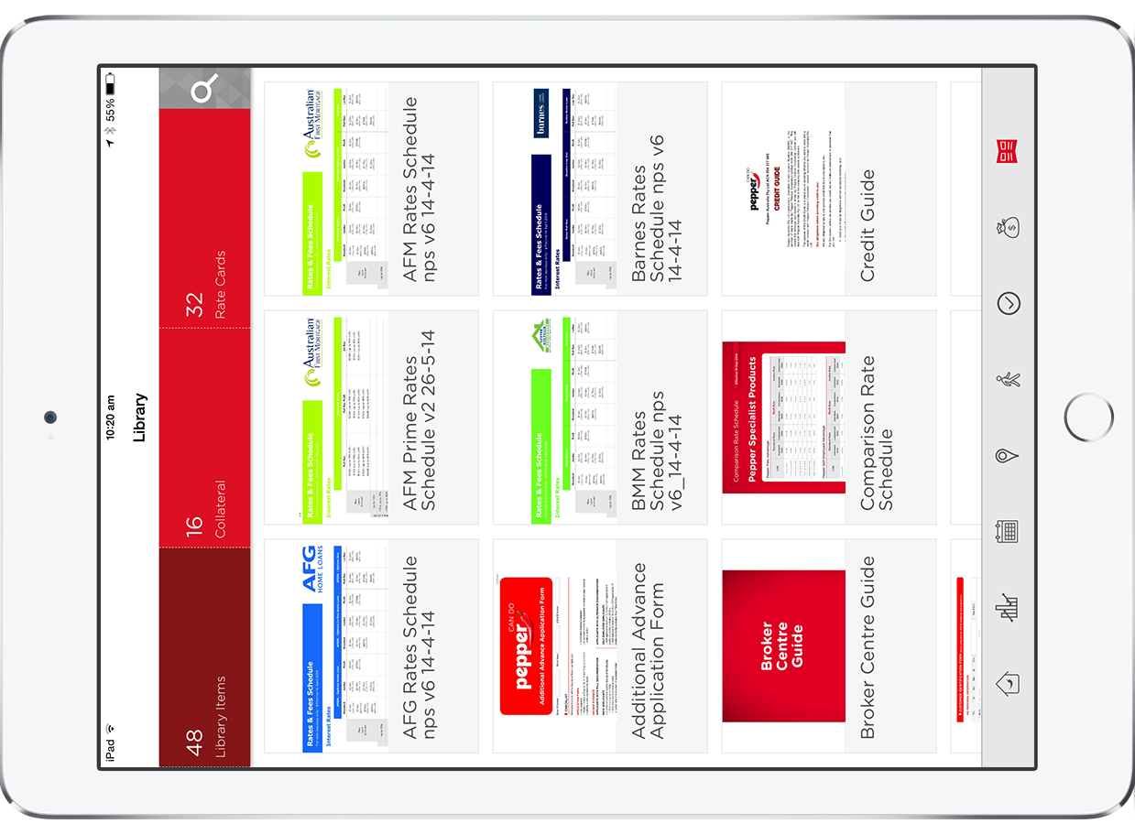
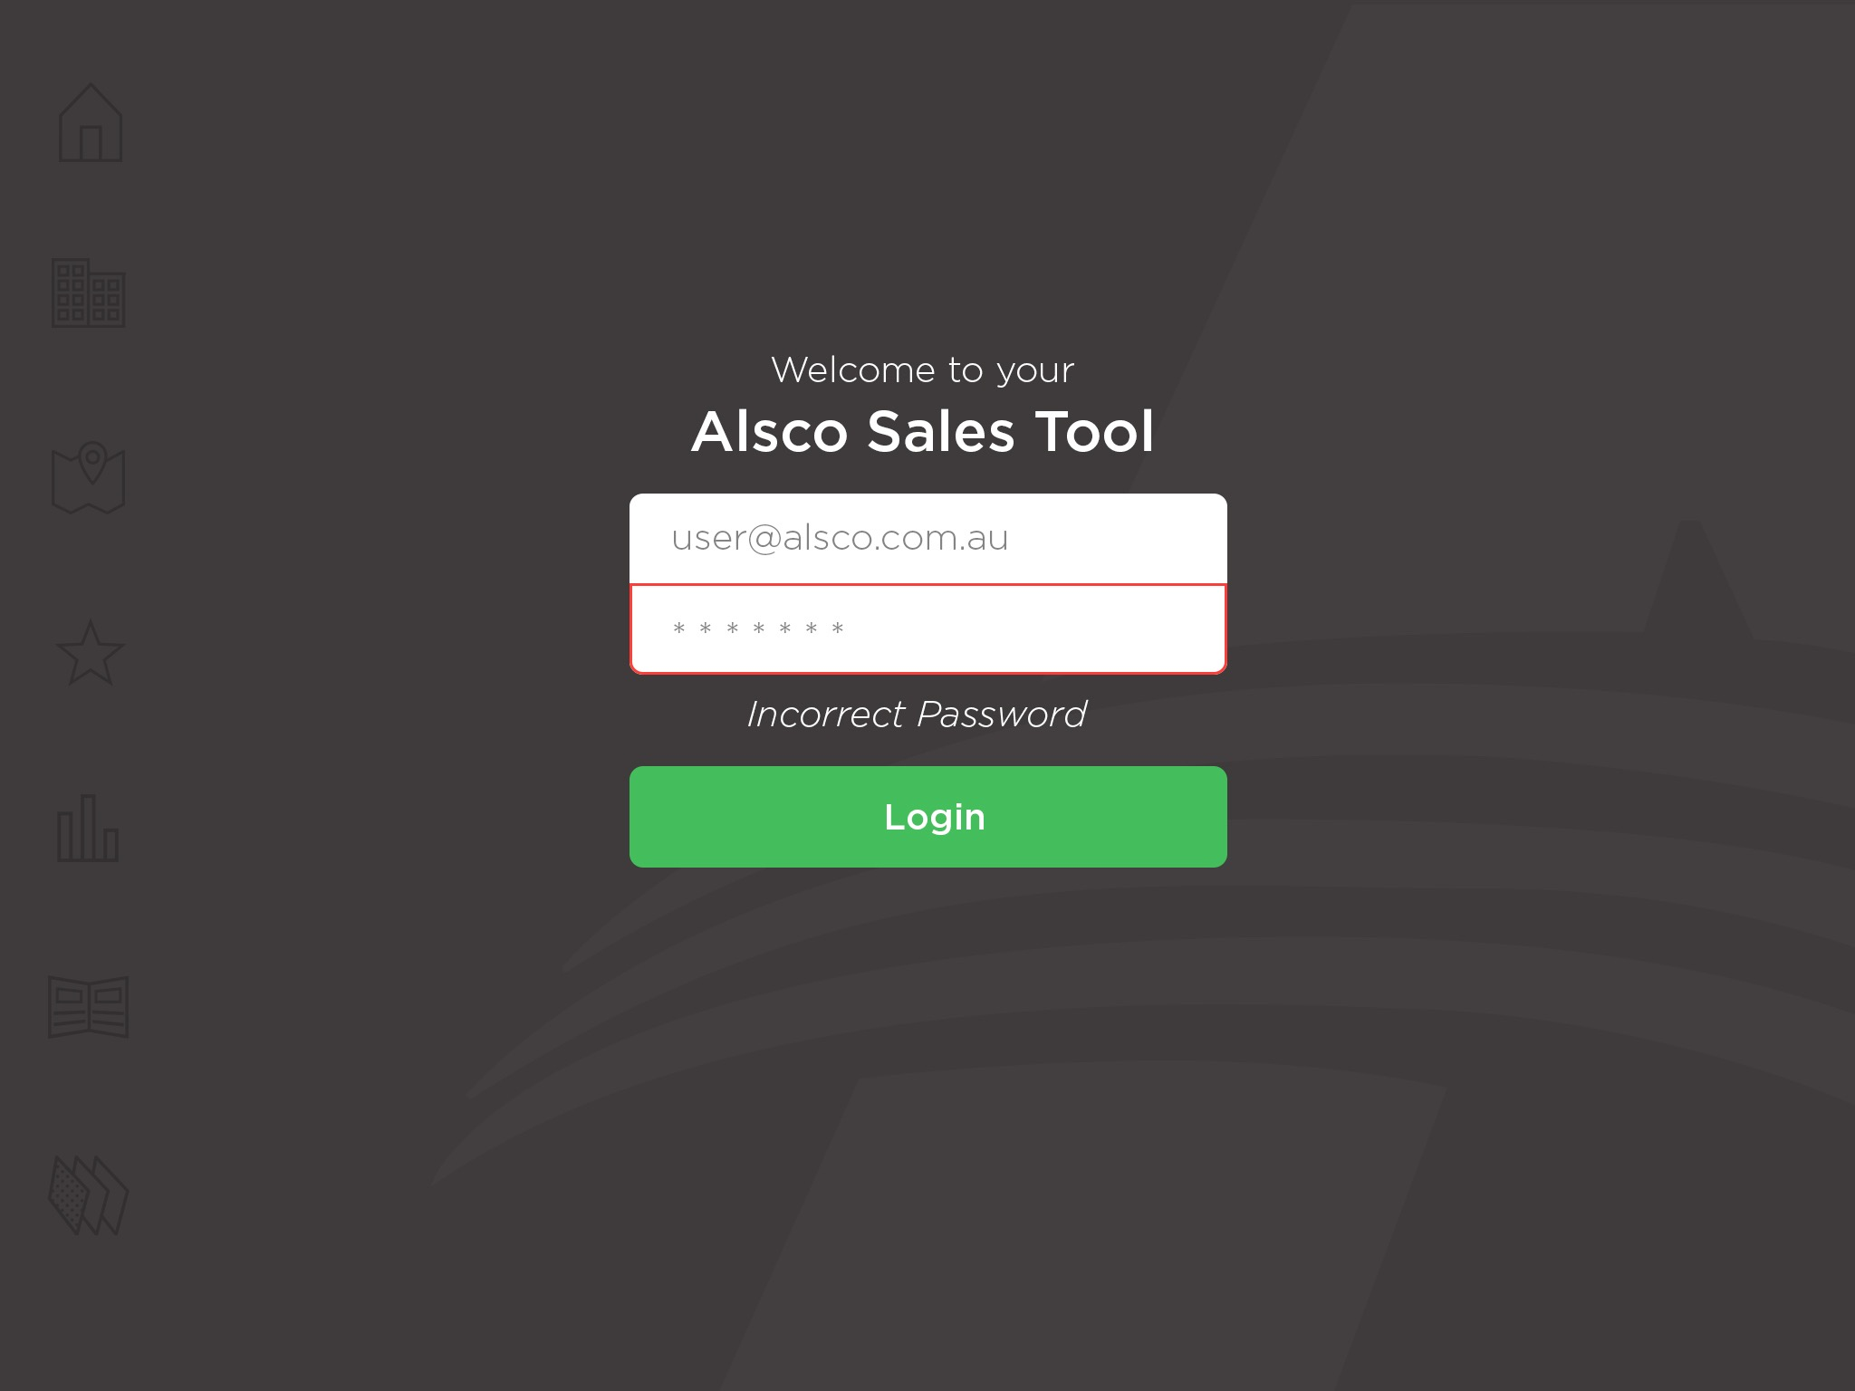
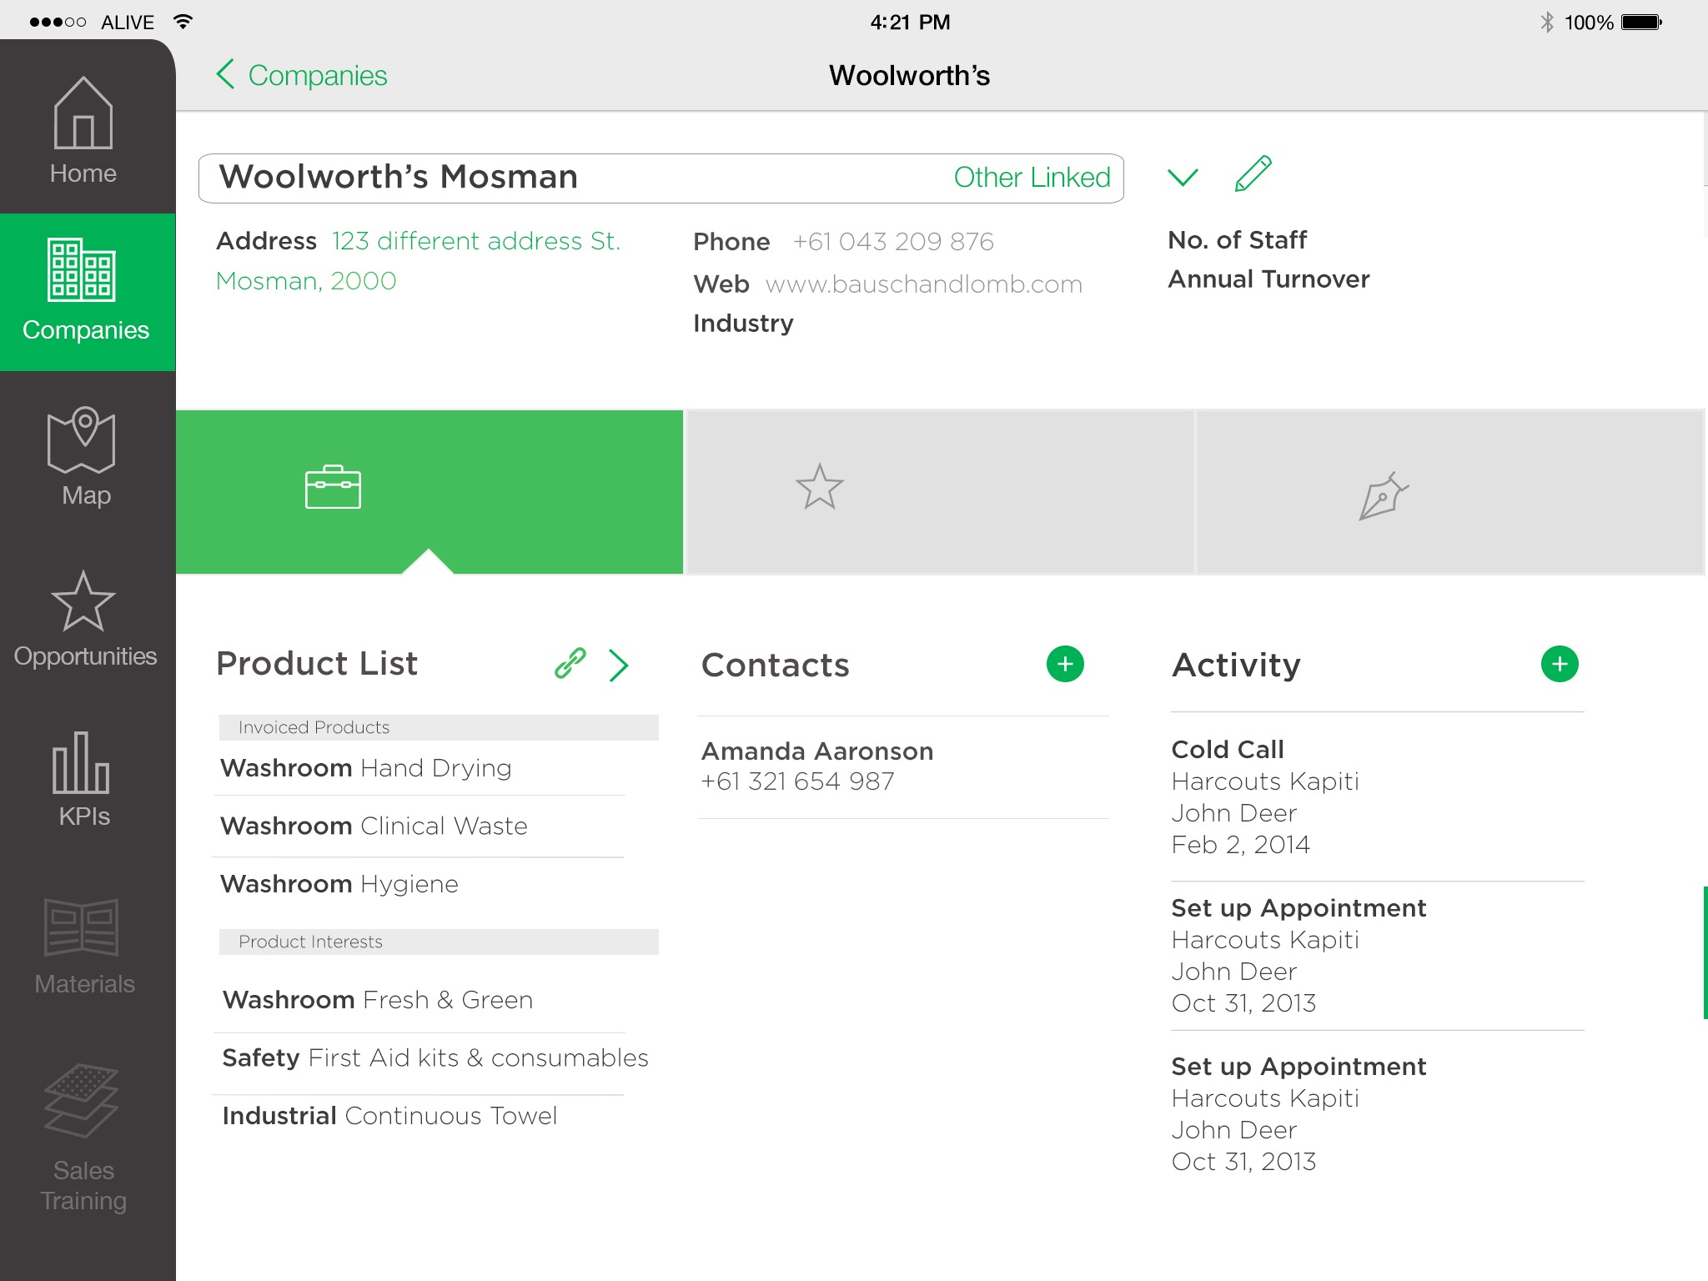
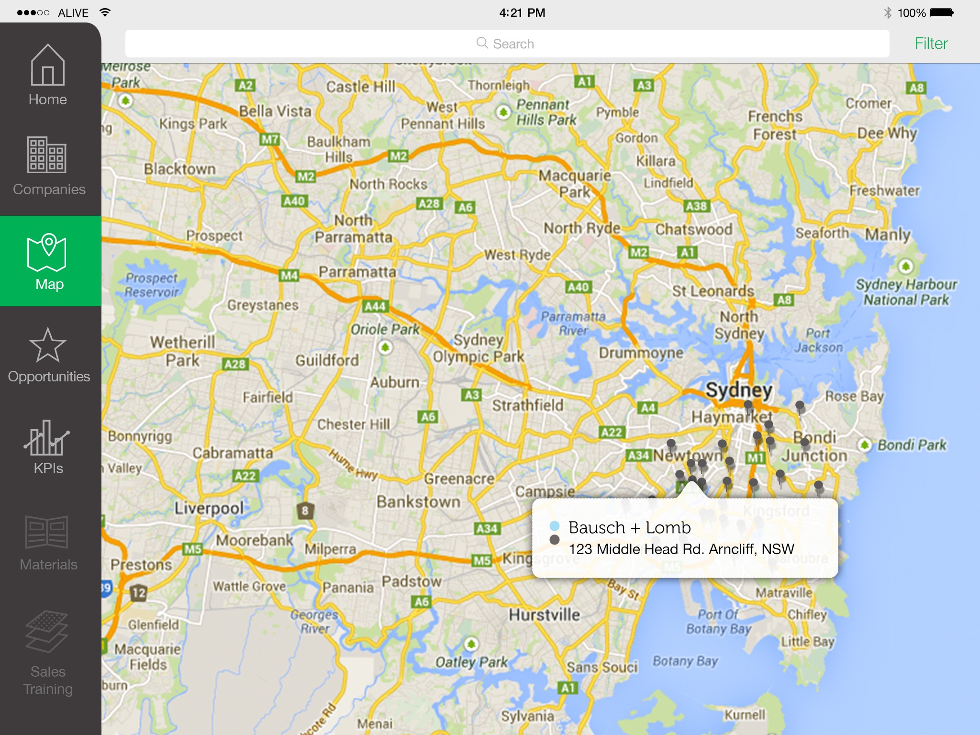
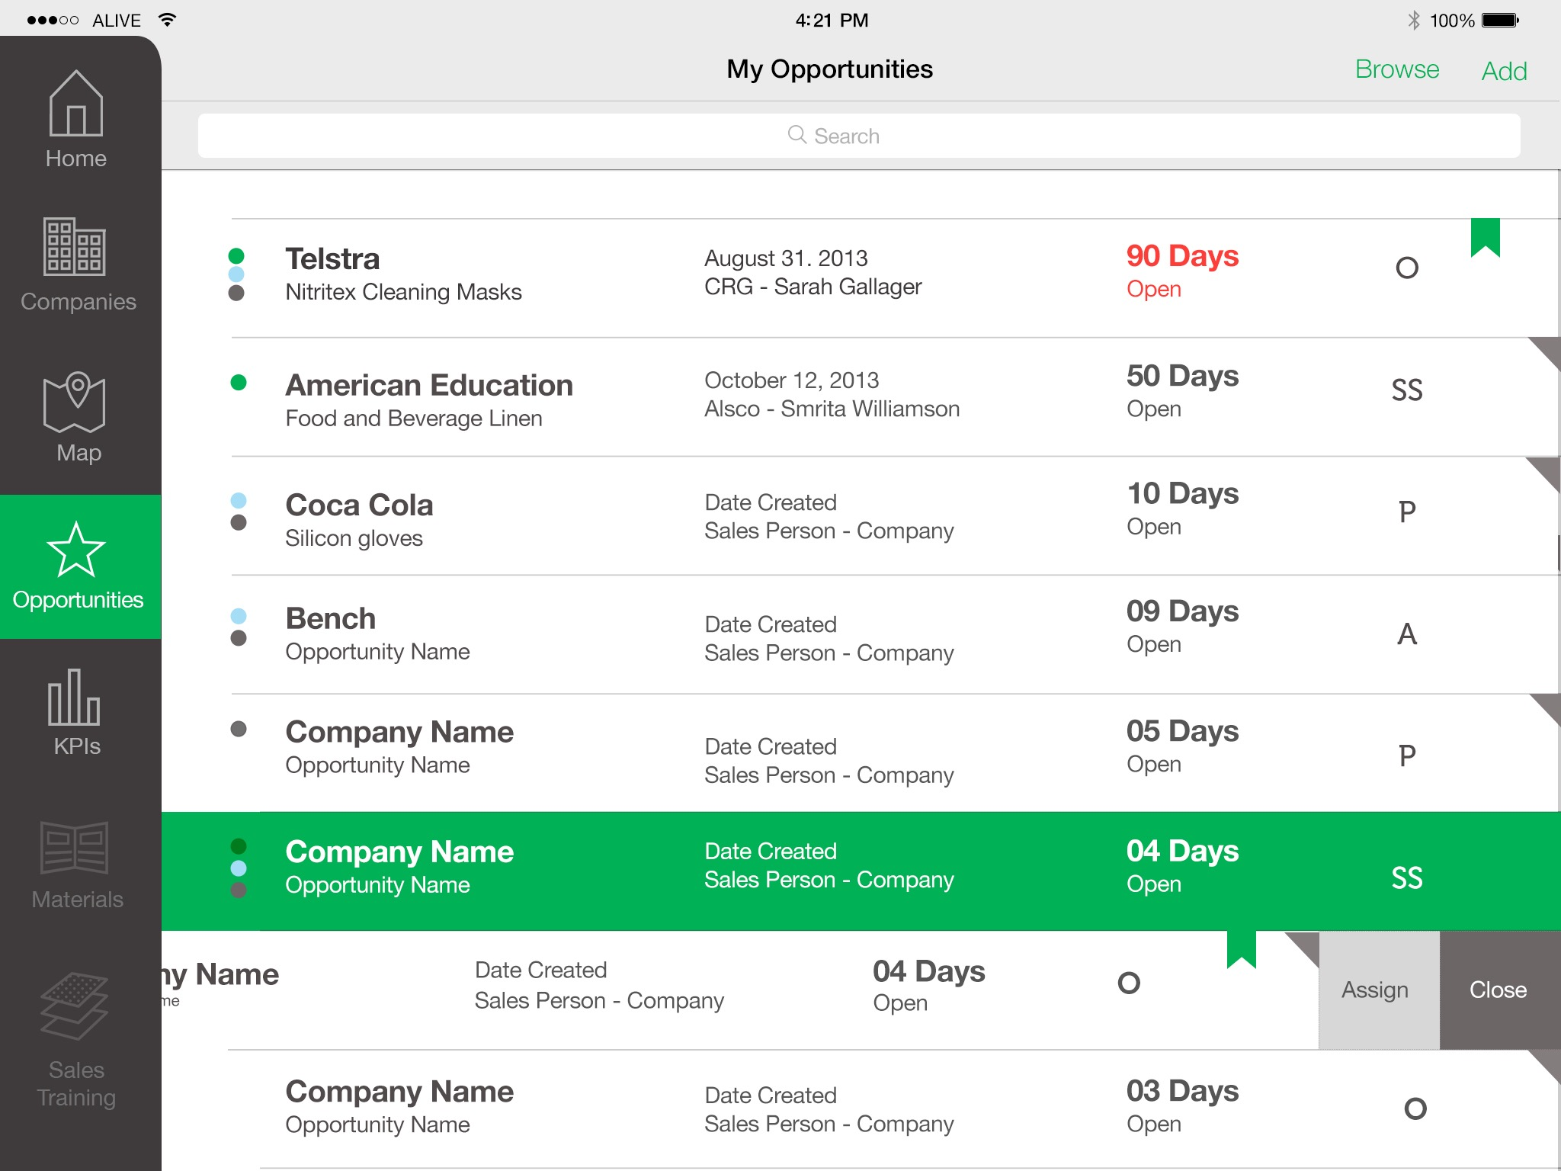
GETTING IN FRONT OF CUSTOMERS
Security & Privacy
Consolidated Dashboard
Directions & Maps
Contextual Awareness

Slide 26
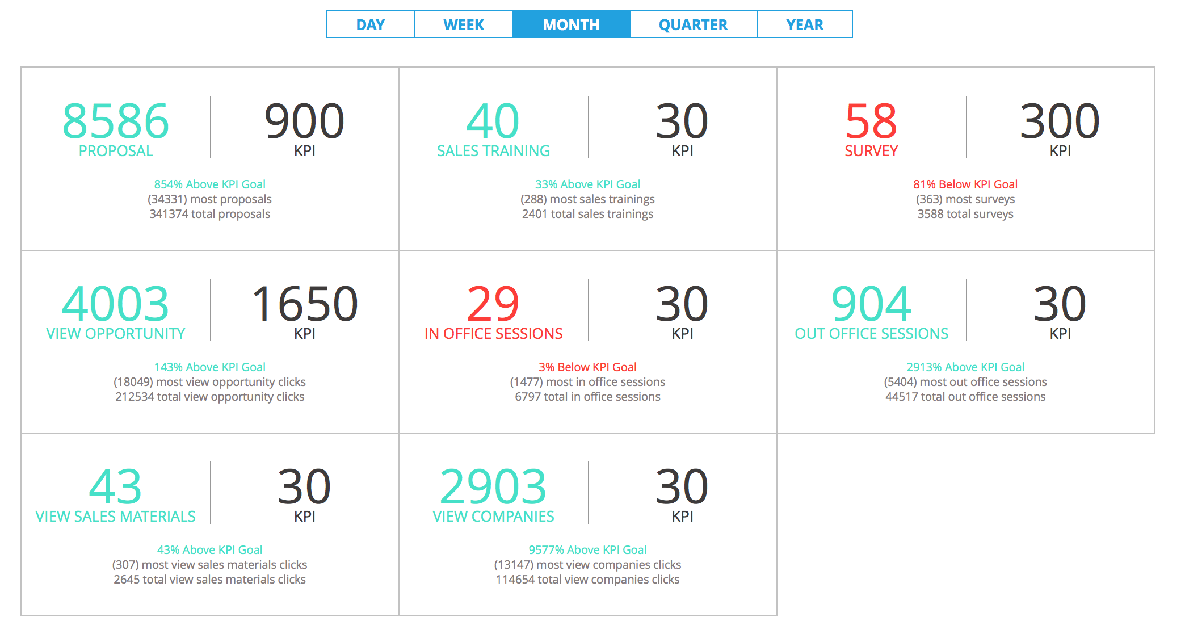
seeing the results

Slide 27
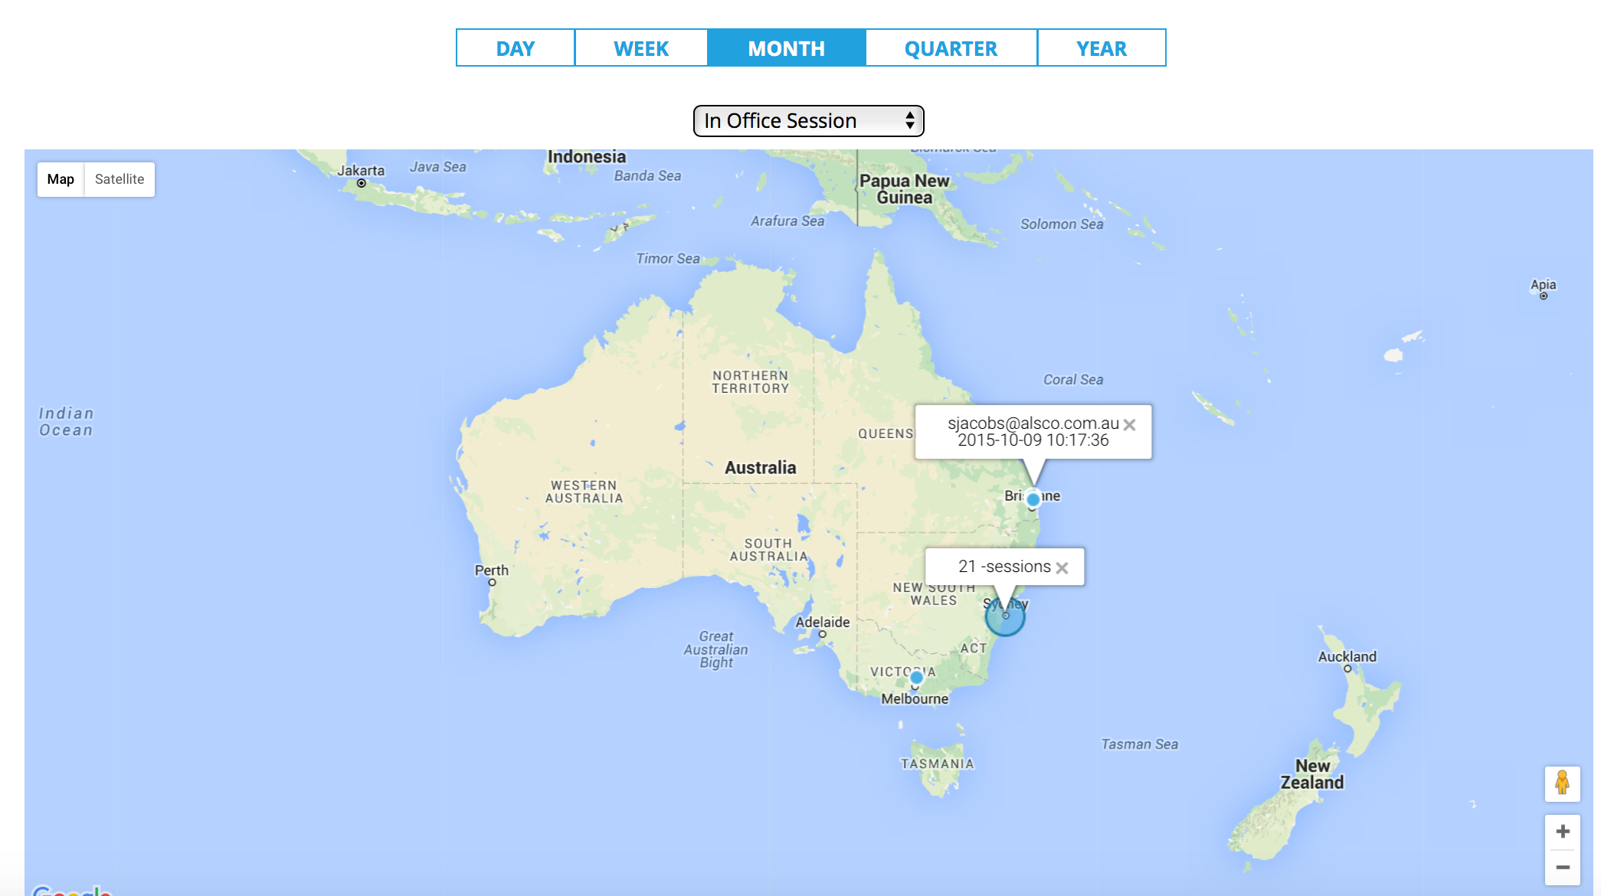

Slide 28
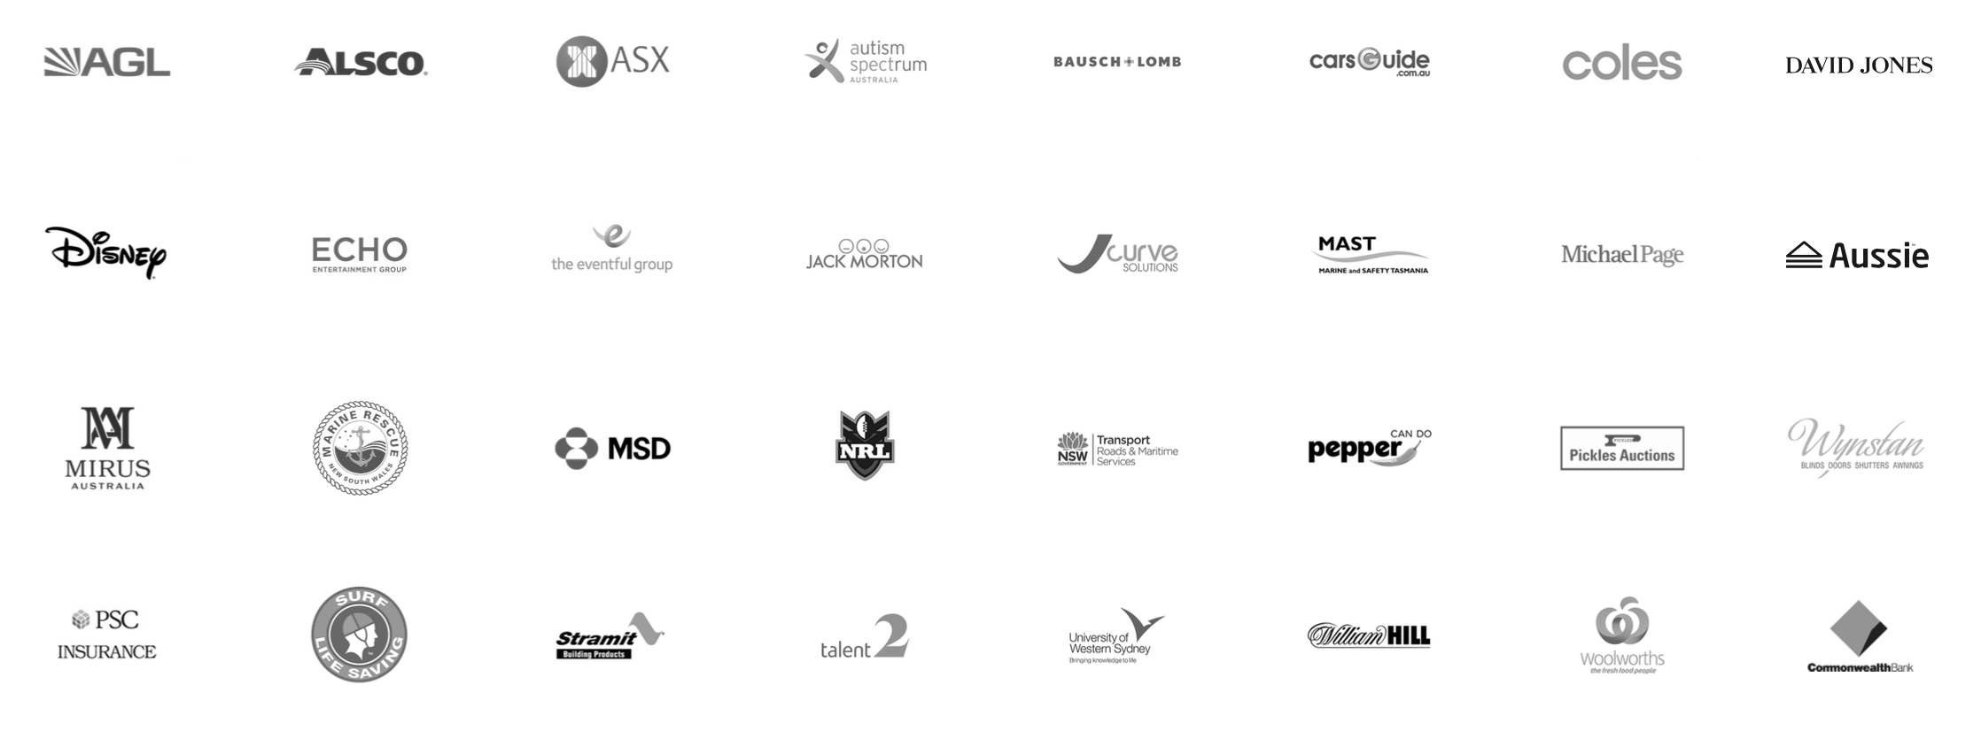
CLIENTS

Slide 29
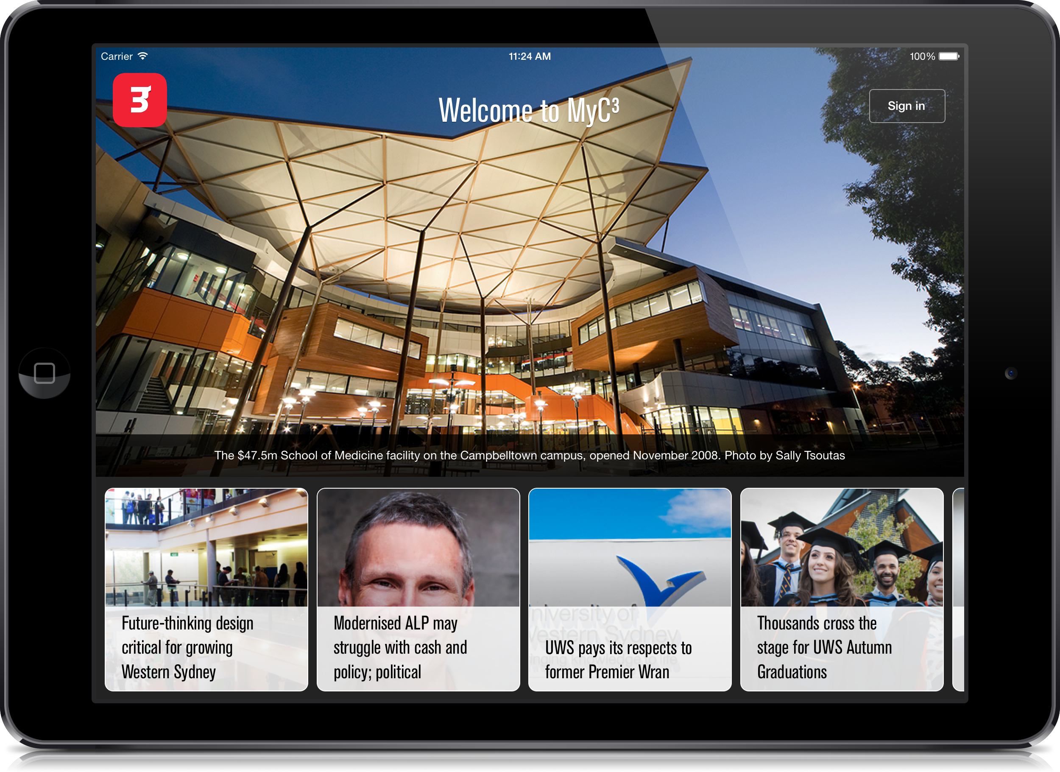
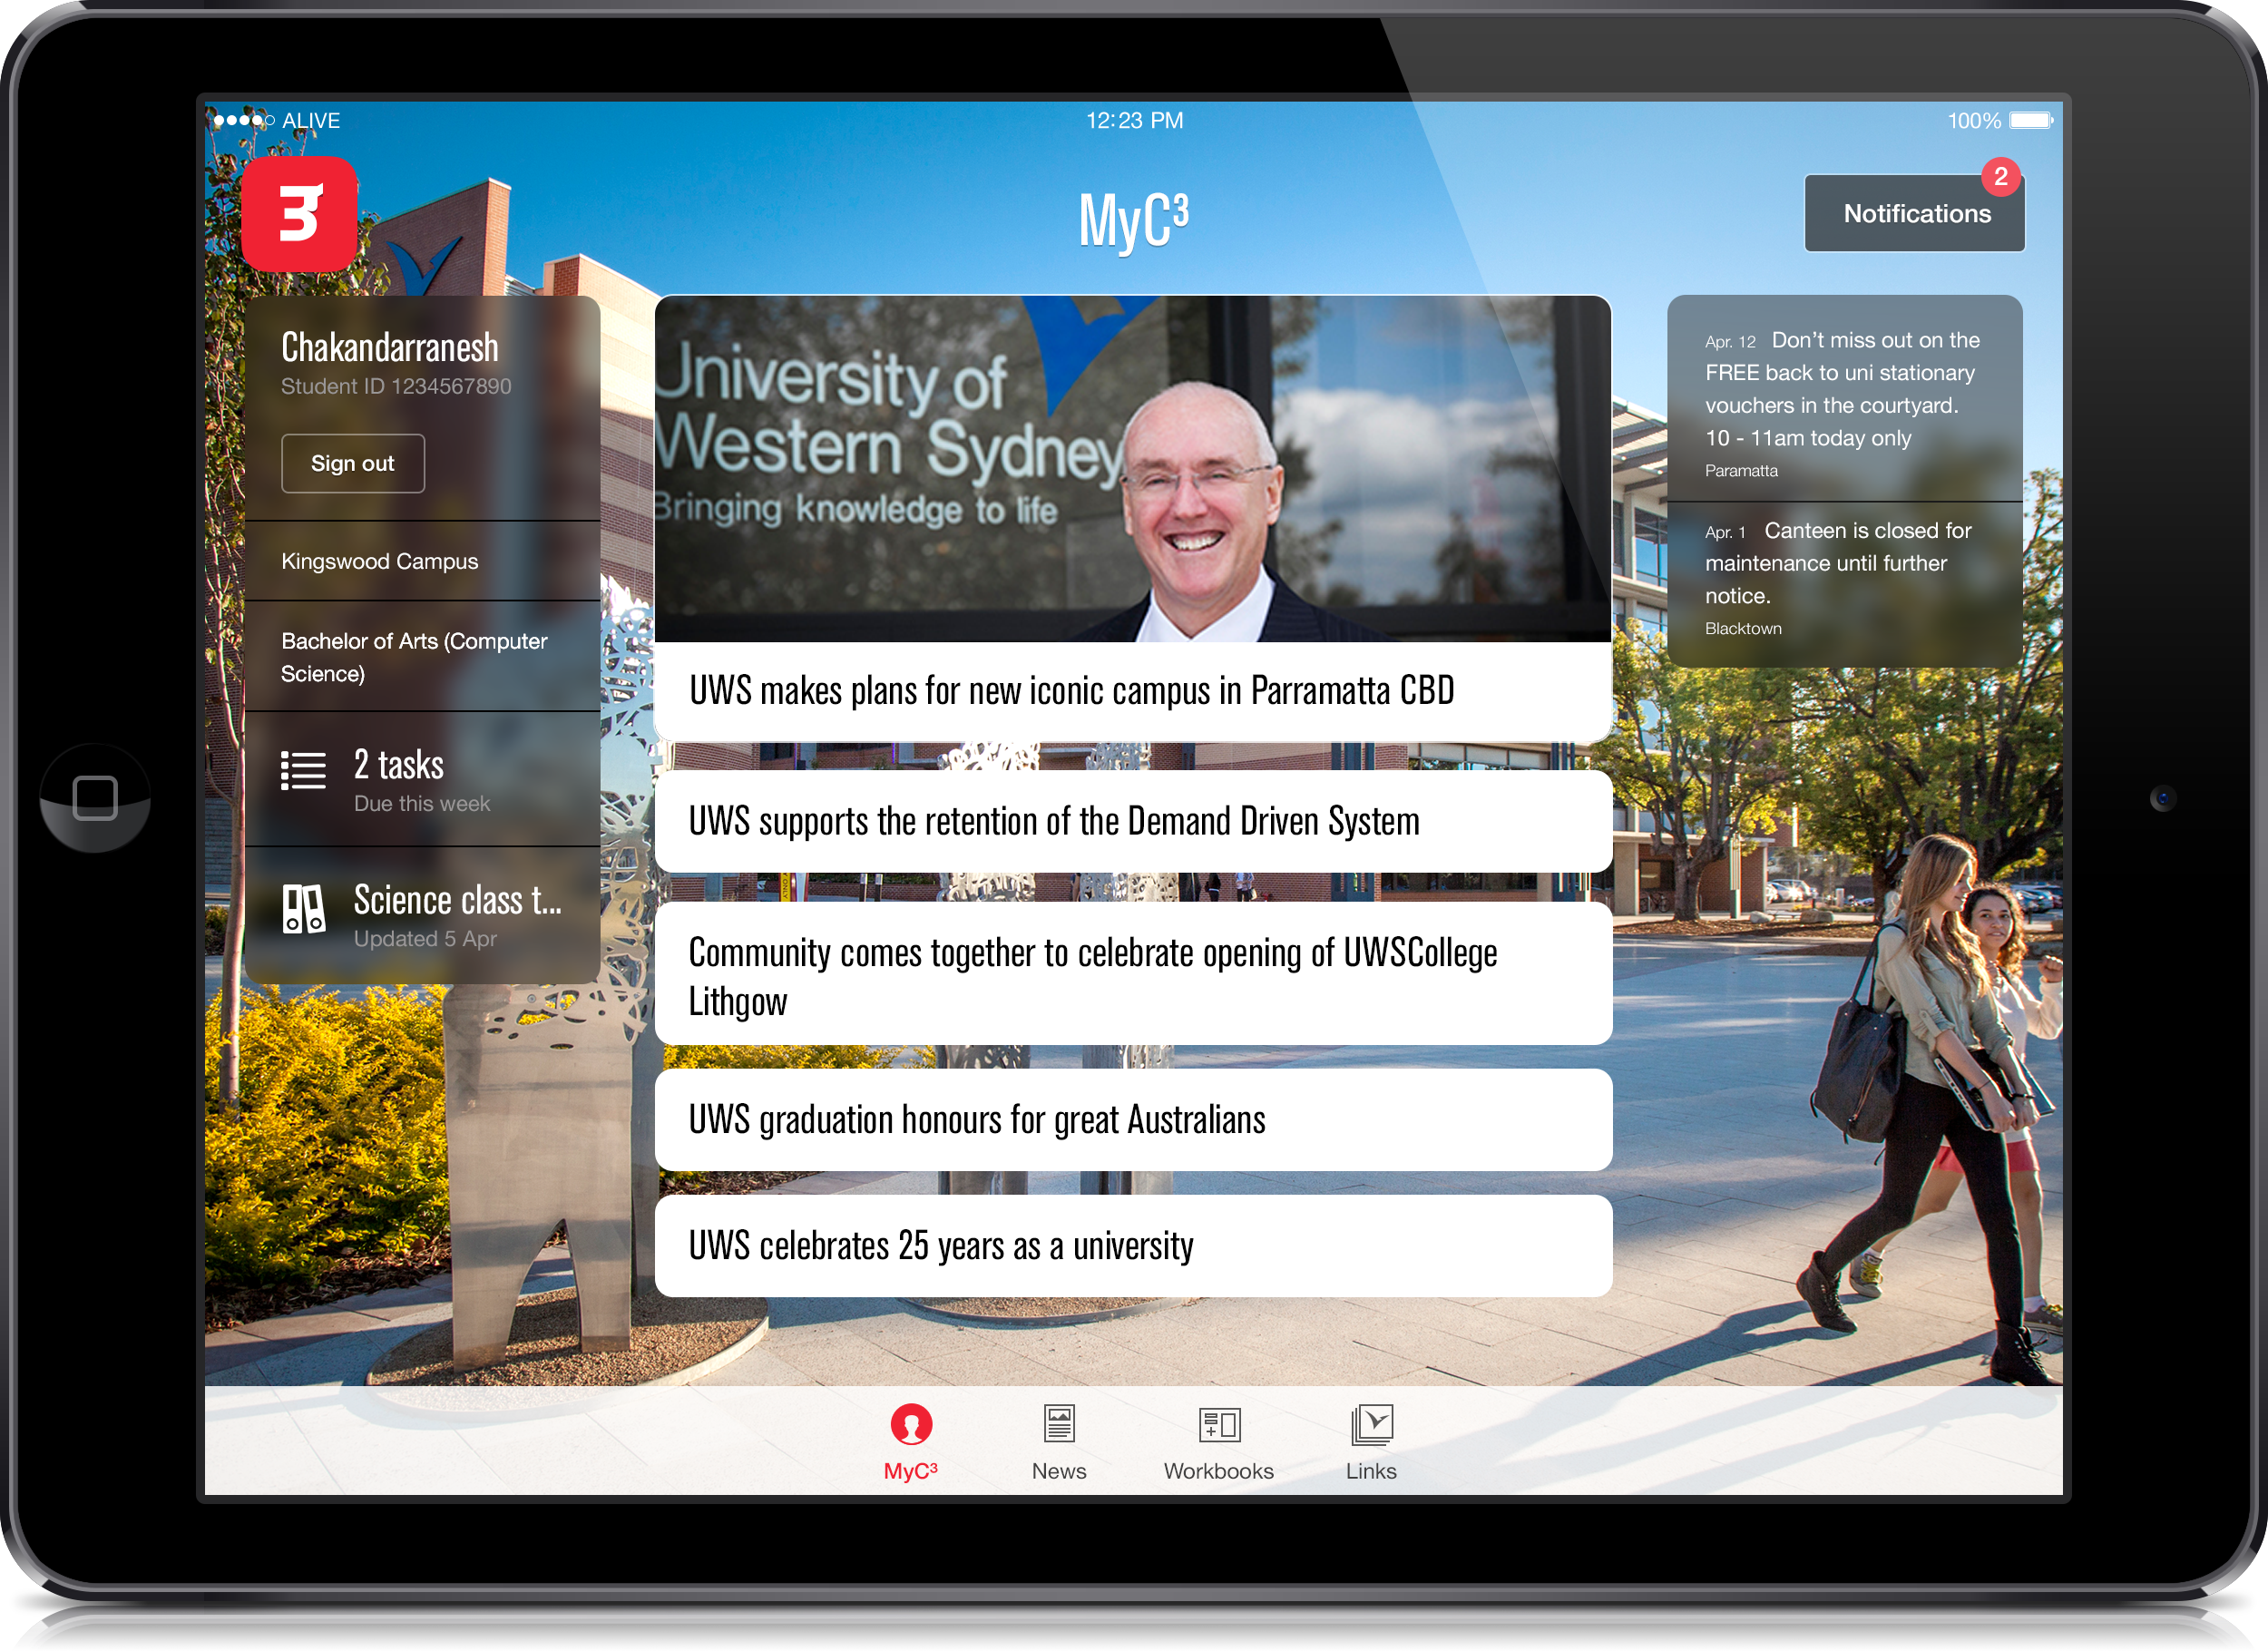
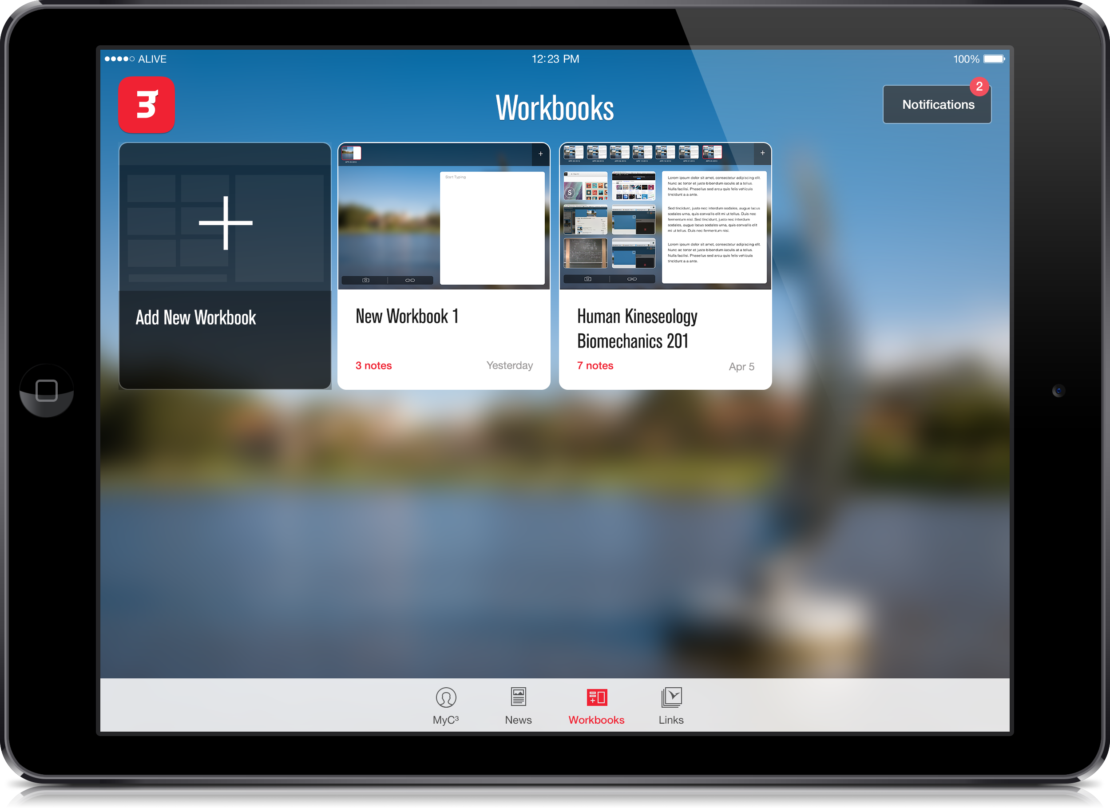
connecting students
Notes:
MBD Value:
Customer engagement:
Productivity/Resource Development:

Slide 30
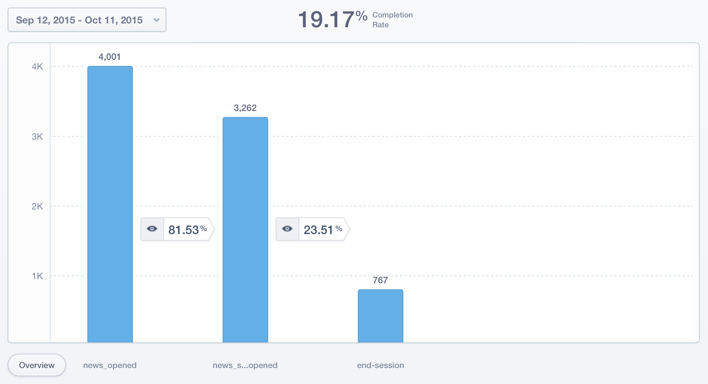

Slide 31
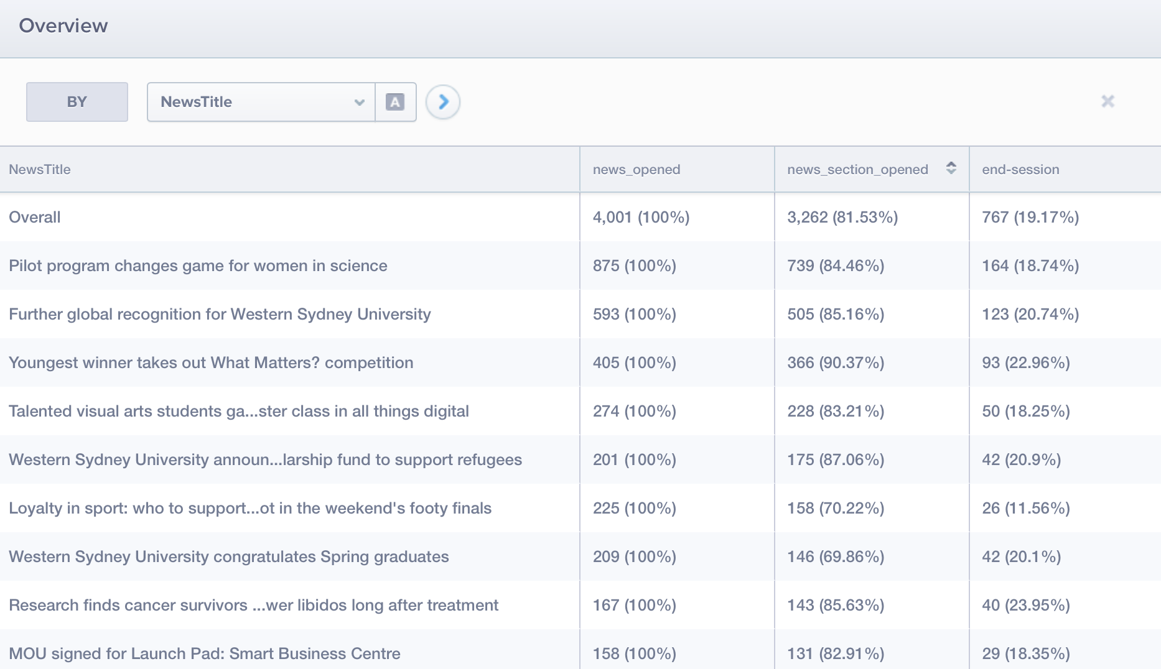

Slide 32
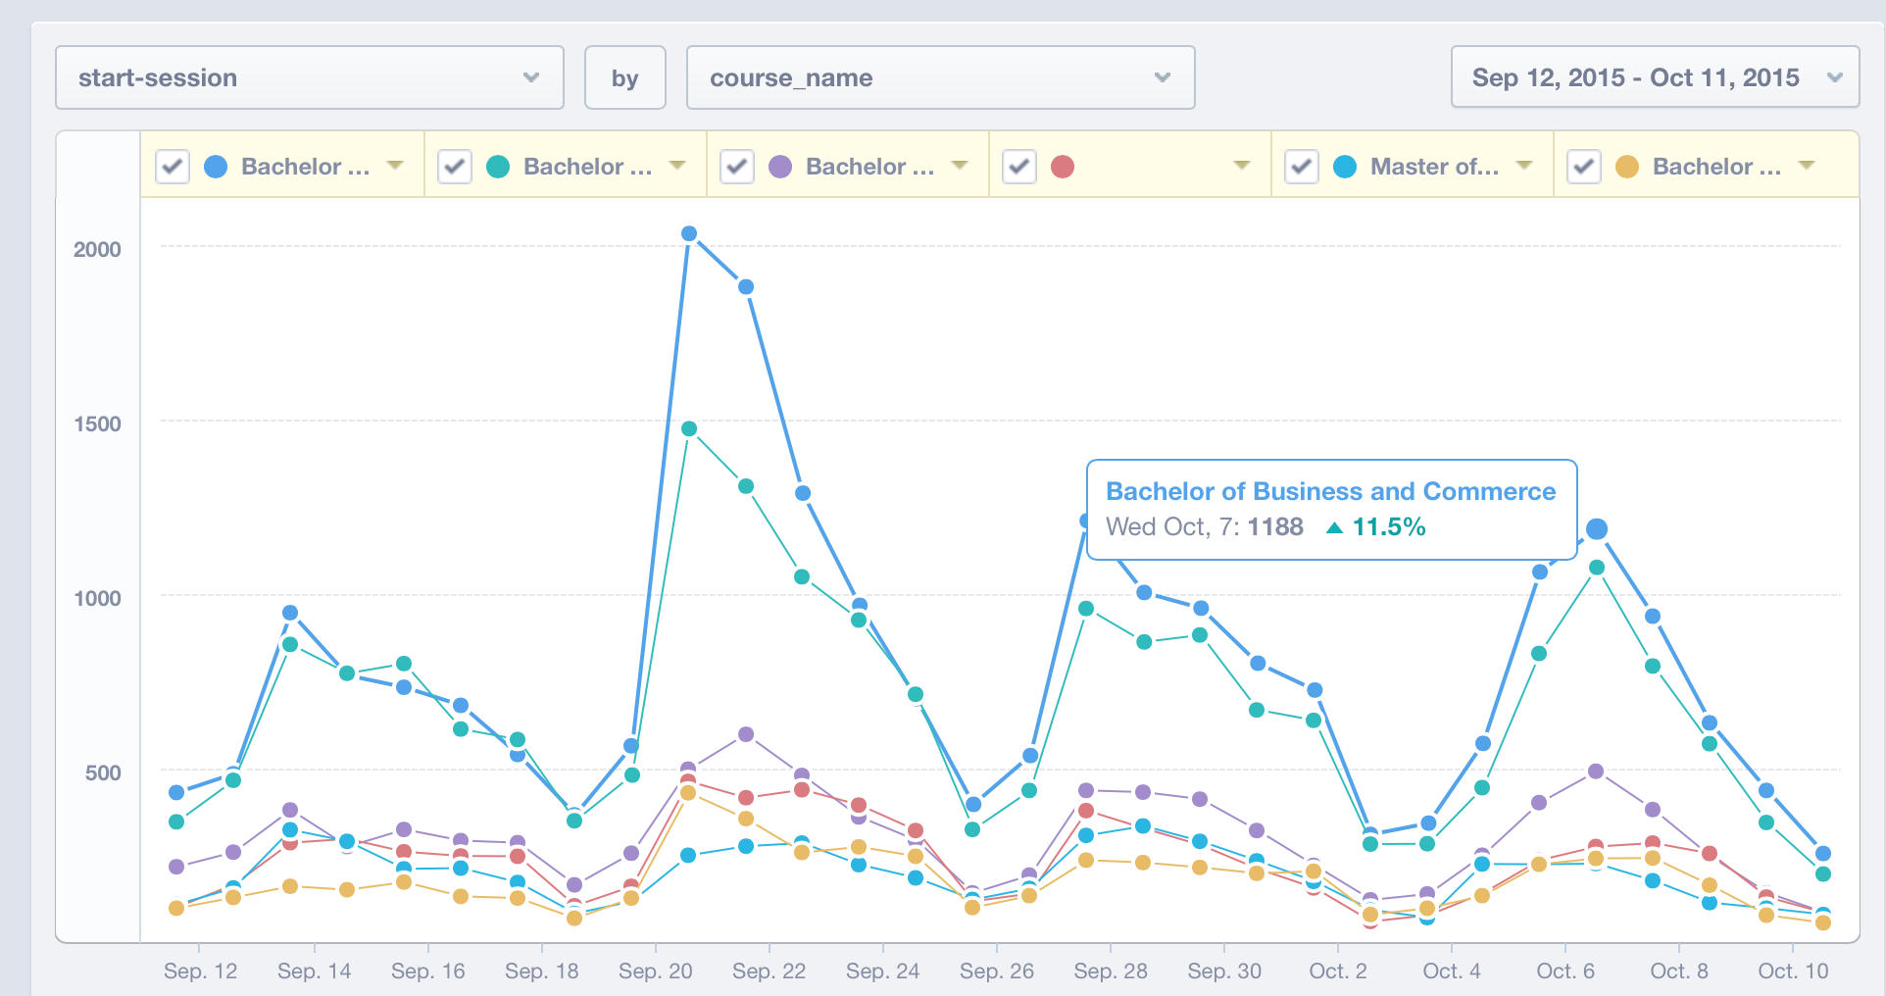

Slide 33
field force sales office

Slide 34
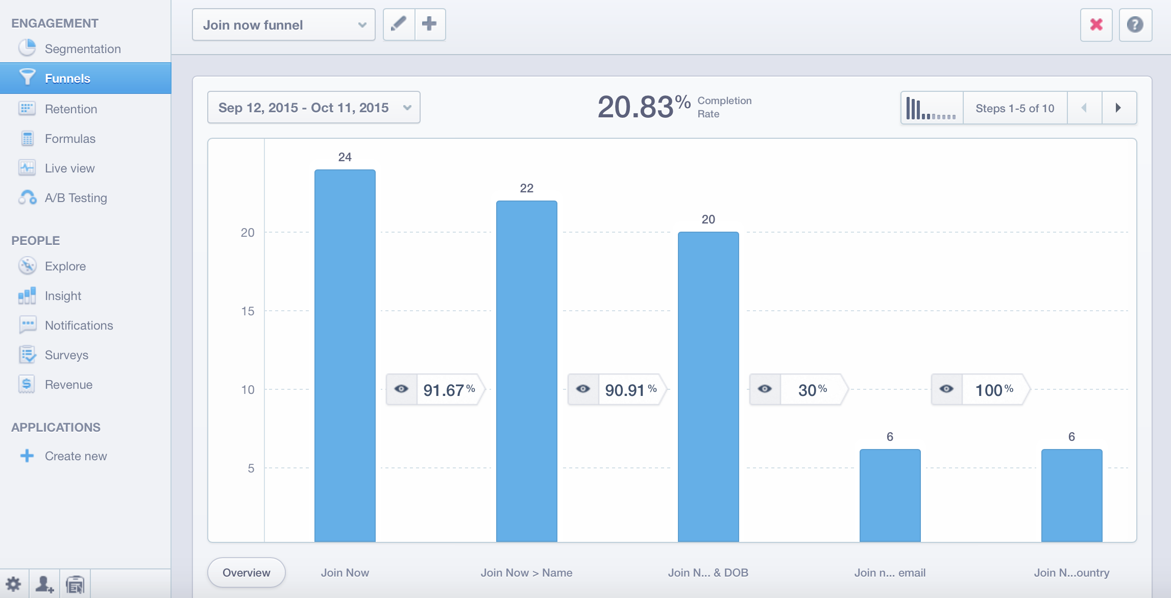

Slide 35
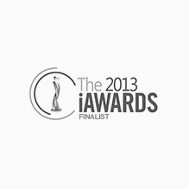
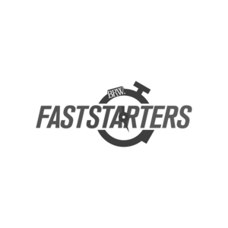
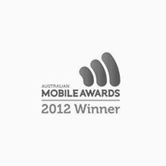
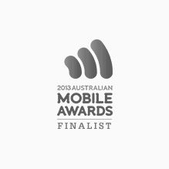
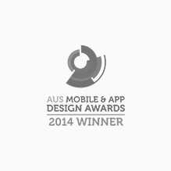
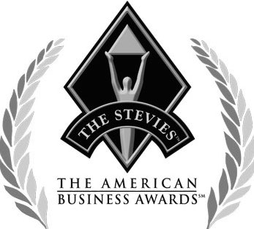
AWARD WINNING SOLUTIONS
Our clients' success underpins everything we do. We are extremely proud to have received the following industry awards recognising the work our amazing team has done on their behalf. Complementing these awards are our collective business achievements recorded in recent years.

Slide 36
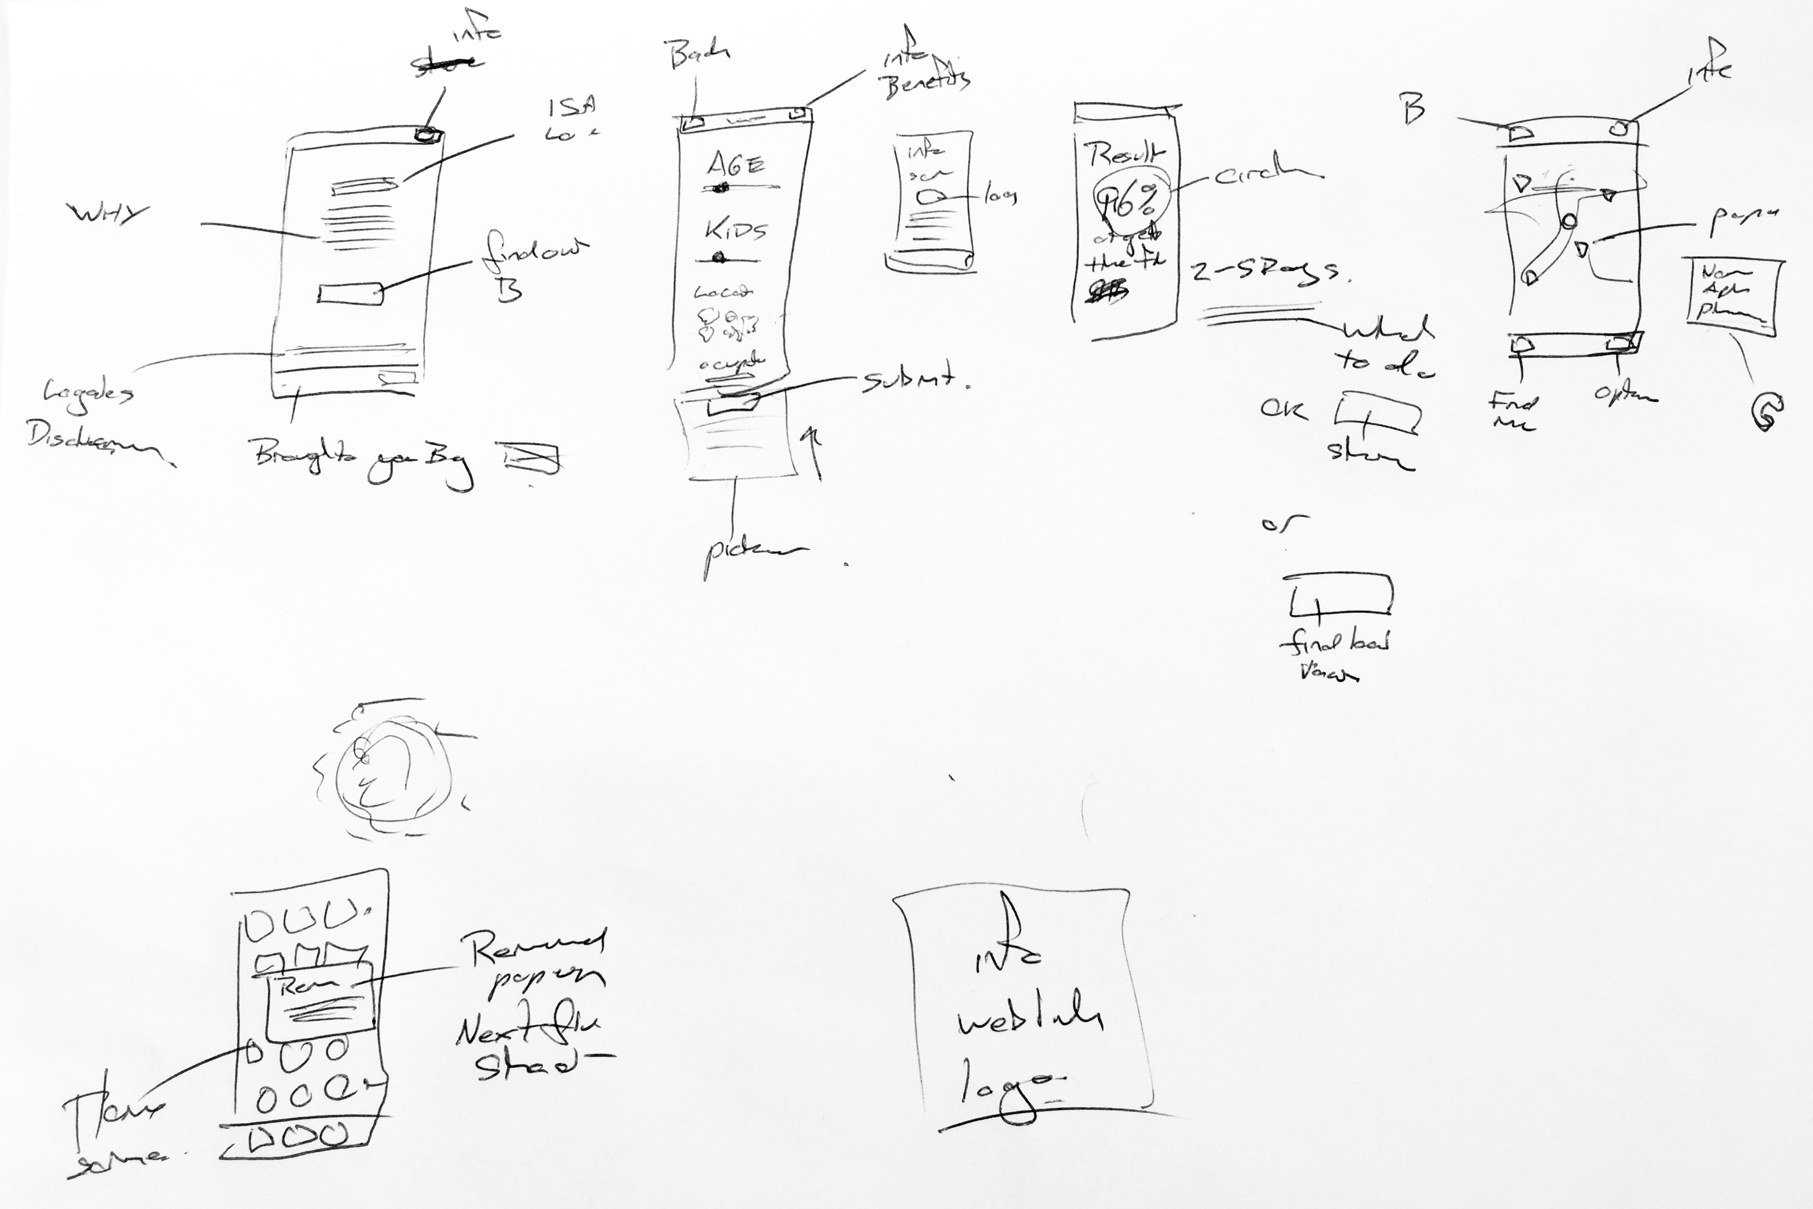
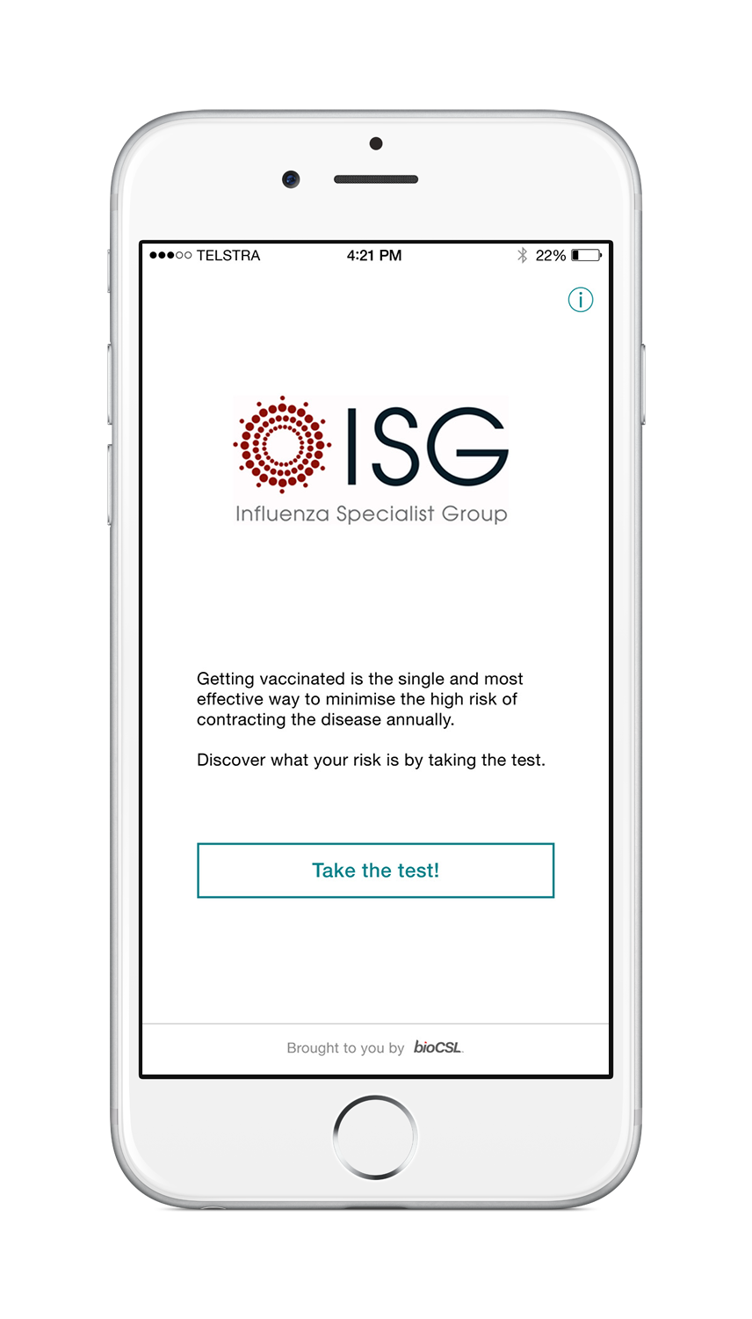
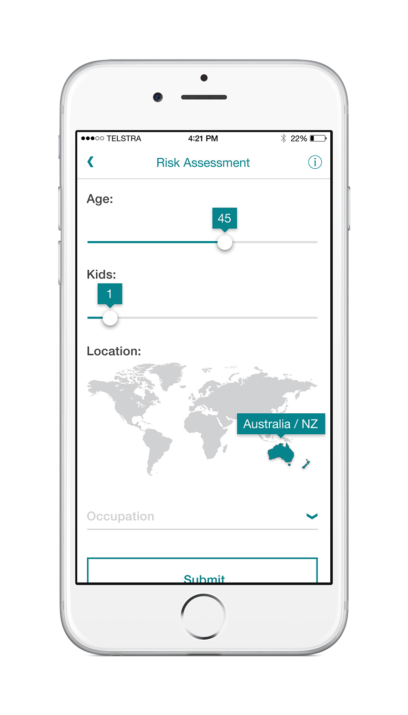
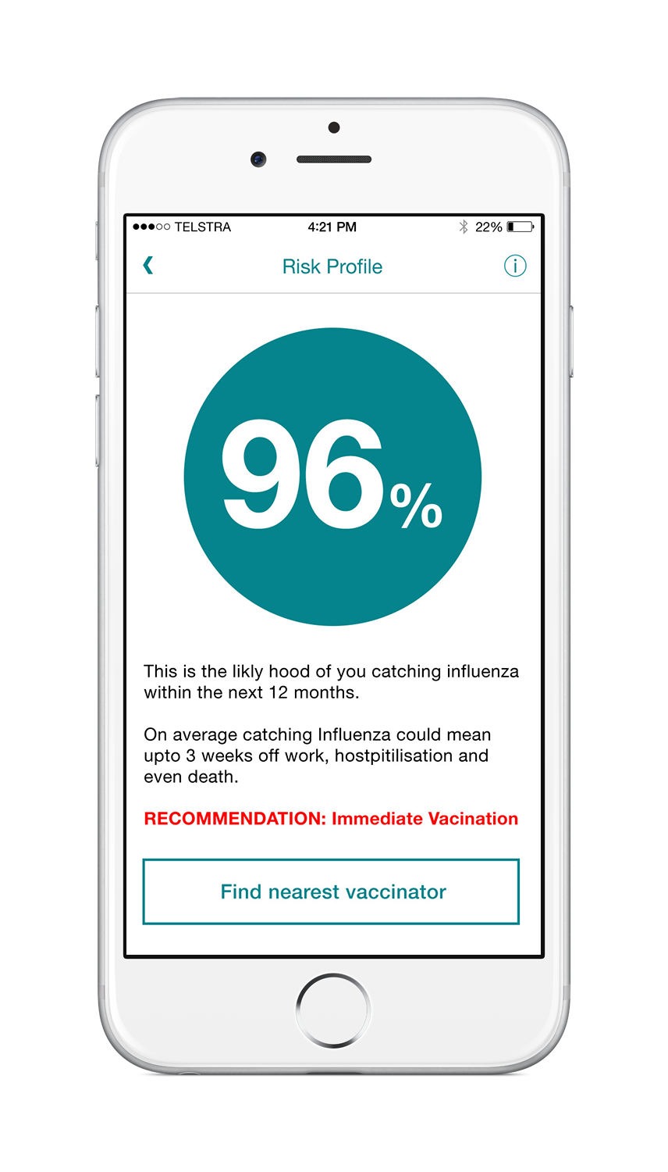
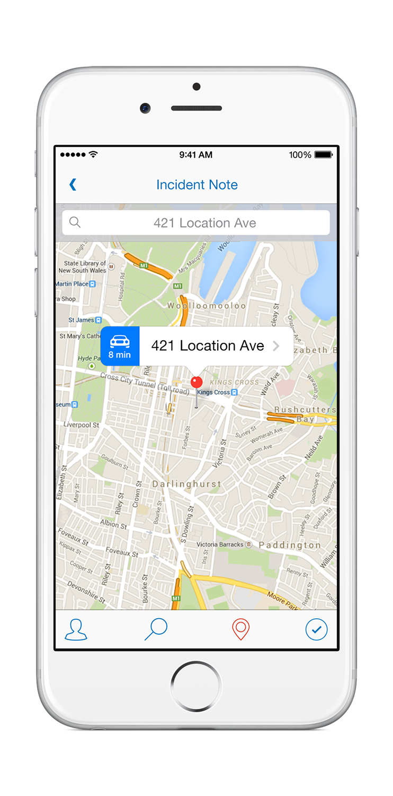
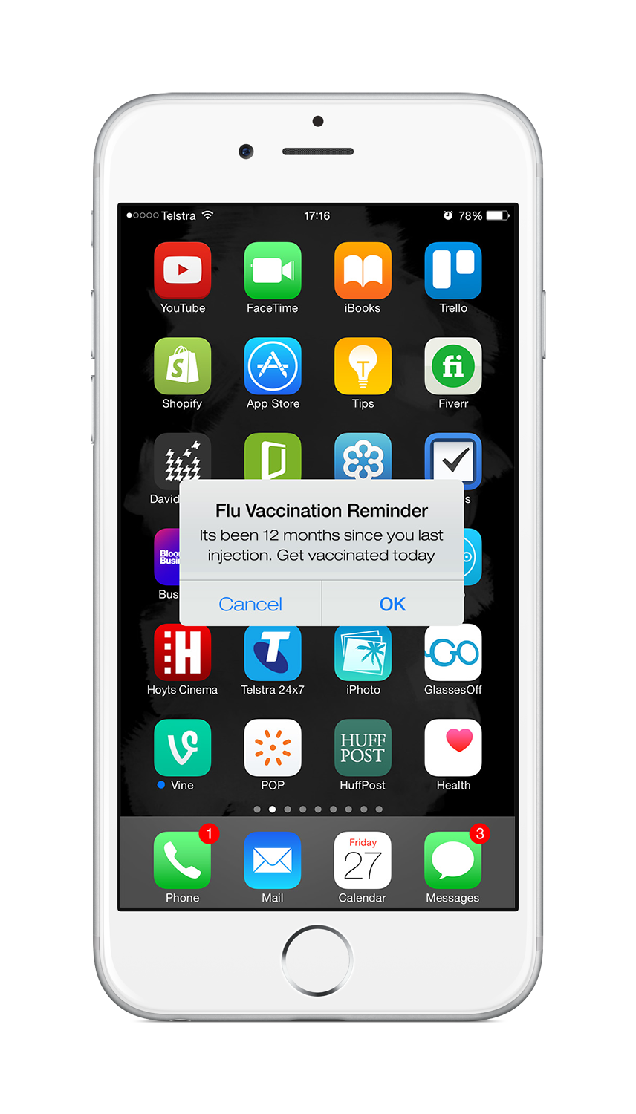
MOBILE HEALTH APP
“A dedicated mobile app that will increase influenza vaccination awareness and uptake”
WELCOME SCREEN
RISK ASSESSMENT
RISK PROFILE
VACCINE locationS
FLU-SHOT REMINDERS

Slide 37
WHAT NEXT…

Slide 38
tools, techniques and tactics
Business
Strategy
User & Market Research
Design
Studios
Sketching
Qualitative
Testing
Discovery
Workshops
Stakeholder
Interviews
UX Design
Wireframes
Quantitative
Testing
Capabilities
Business
Prioristation
Analysis
& Insights
UI Design
Prototyping
Technical
Feasibility
Journey
Mapping
Financial
Modelling
Visual Design
Branding
Identity
Design
Education
Journey
Maps & Personas
Prioritisation
Assessment
High Fidelity Prototype
App Map
Information Architecture
Outputs
Insights & Recommendations
Solution
Roadmap
User Guides
Style Guide
& Toolkit
Functional
Specification

Slide 39
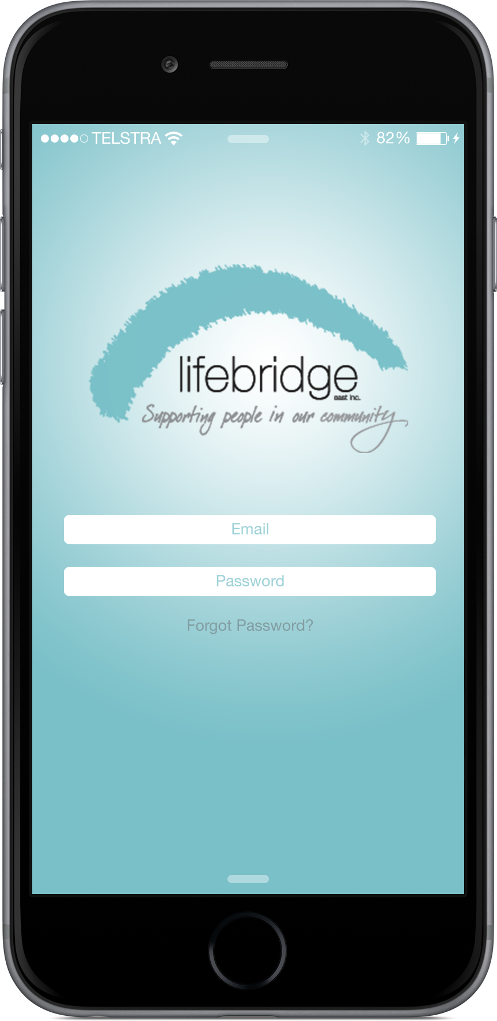
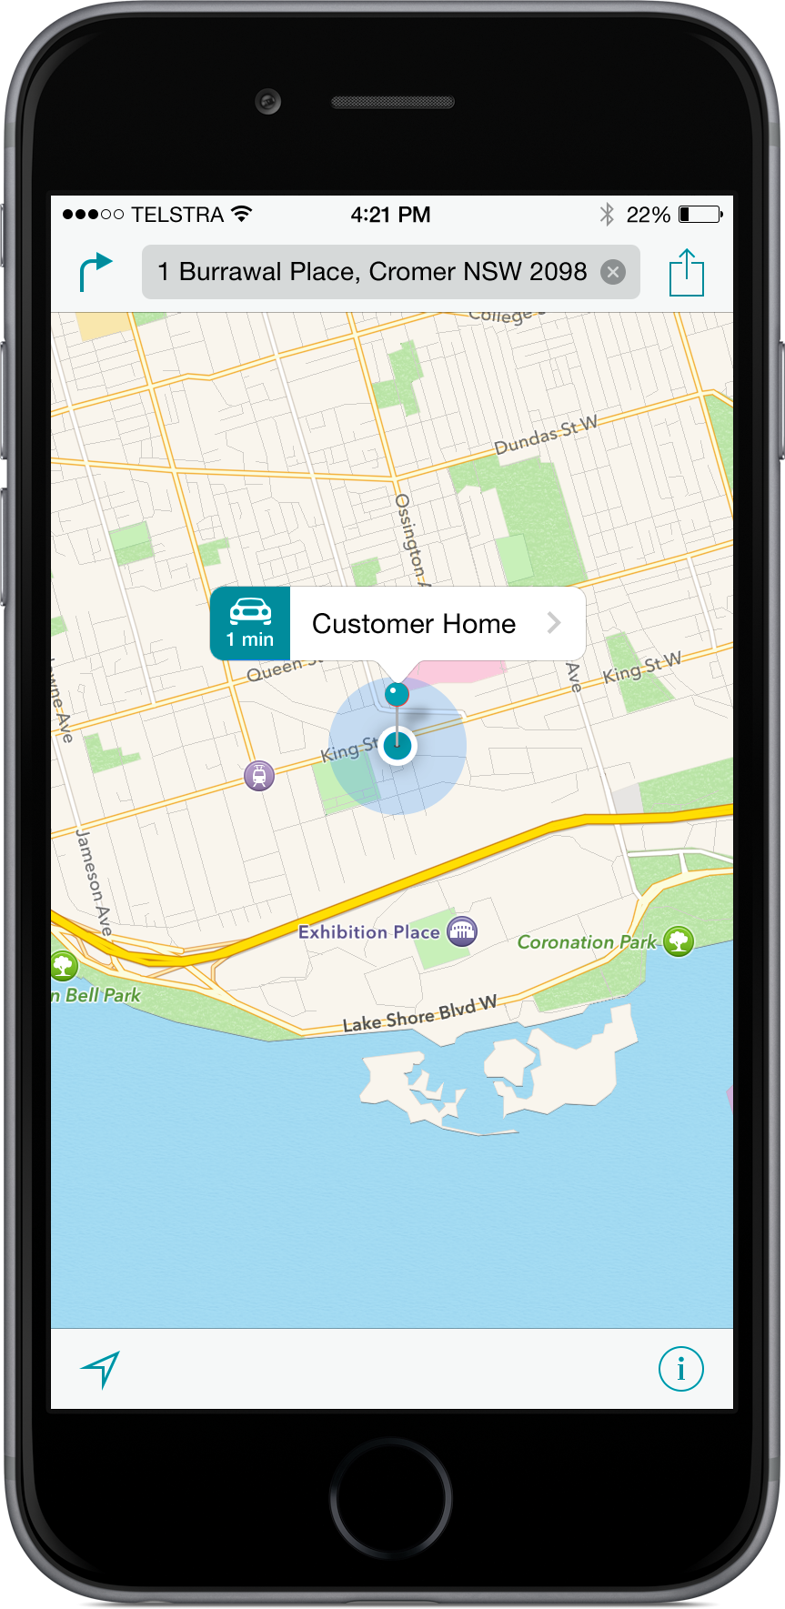
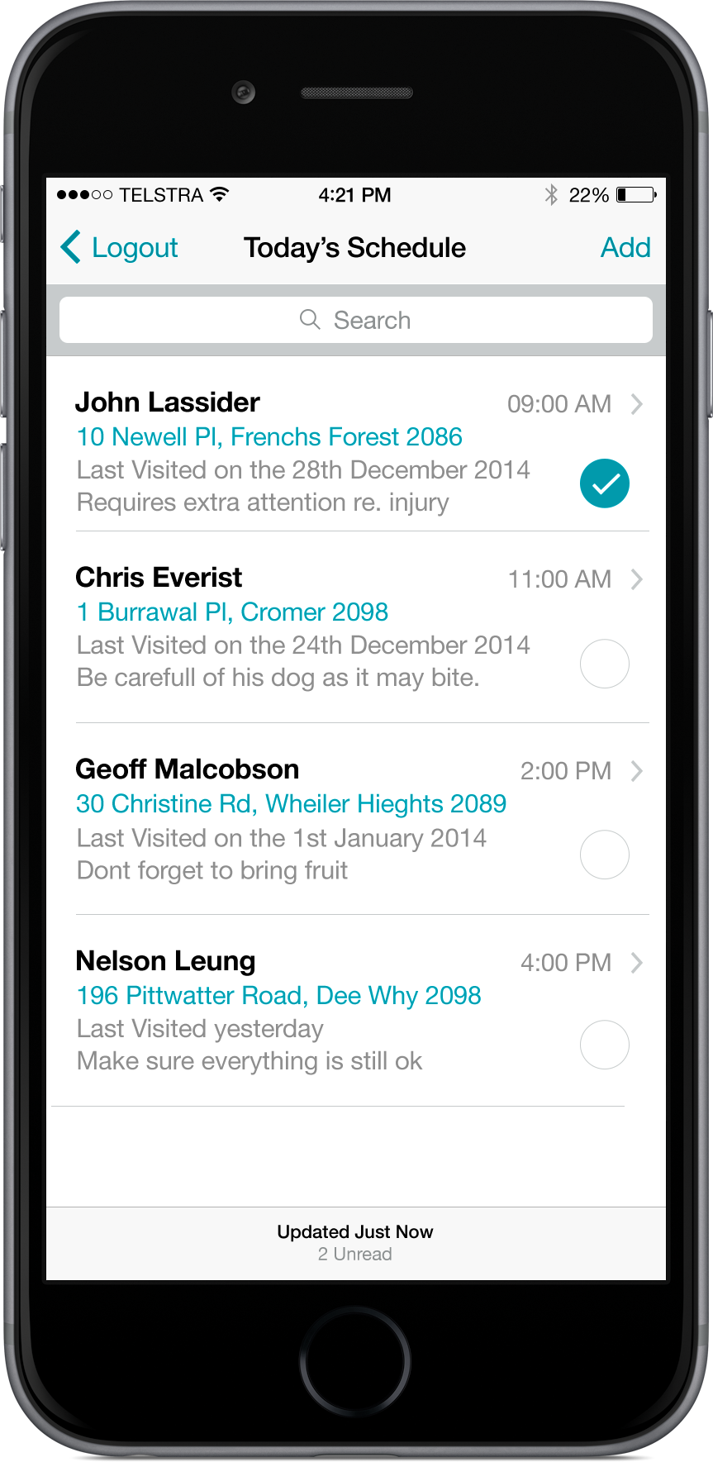
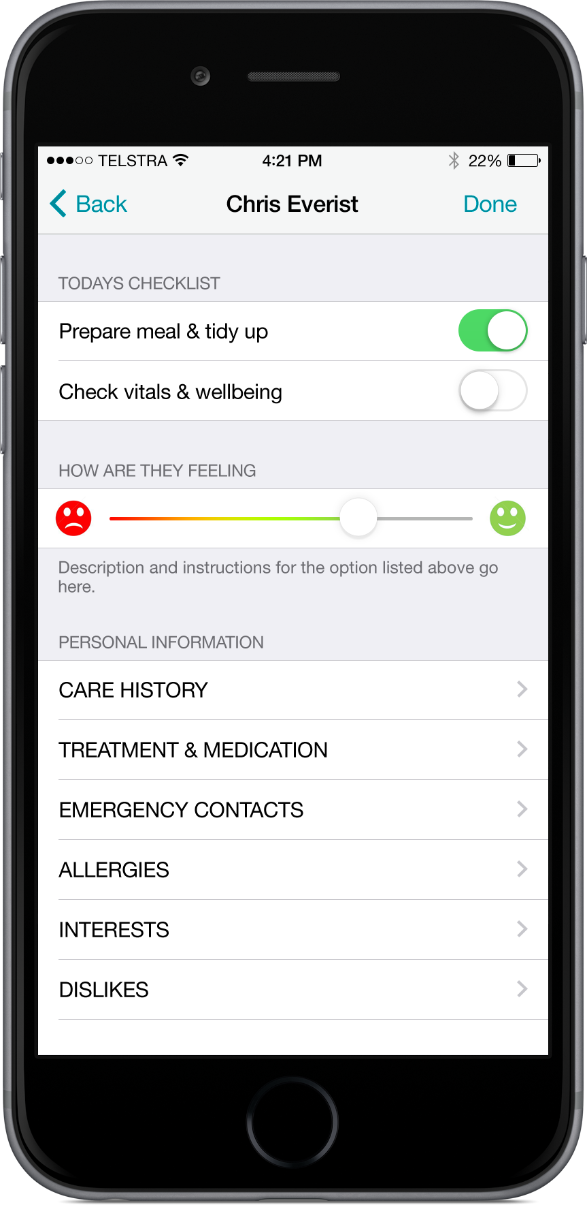
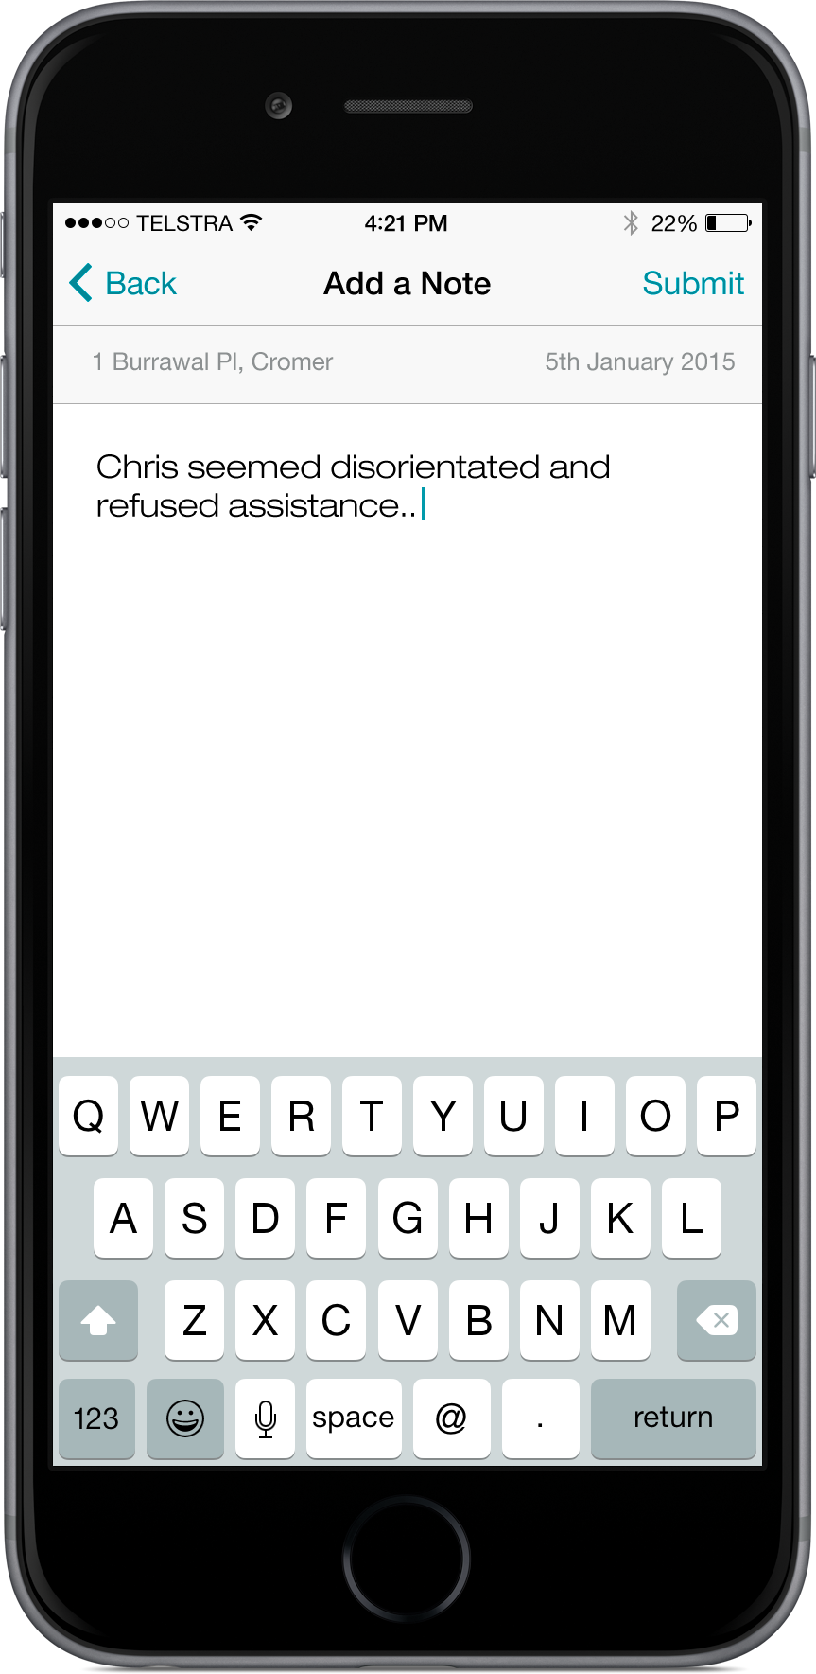
NDIS SOLUTION
Lifebridge provides a broad range of disability and aged-care services to its customers in the northern NSW area. Lifebridge's focus is on individualised services that empower their customers to live their most meaningful life. Alive was engaged by Lifebridge to conduct a market scan to identify innovative products designed to address a wide range of assistive care needs.
Alive has extensive experience working with organisations that provide disability and aged-care services, and the Alive team was able to build upon their knowledge of the industry by conducting a thorough investigation of the latest assistive care products. As a result, Alive recognised a number of emerging trends driving innovations in not only in assistive care, but also in the broader healthcare industry. These findings highlight opportunities to utilise a design-led approach create innovative applications across all areas of the healthcare industry.
LOGIN
LOCATION
CALENDAR
ACTIVITY
FEEDBACK

Slide 40
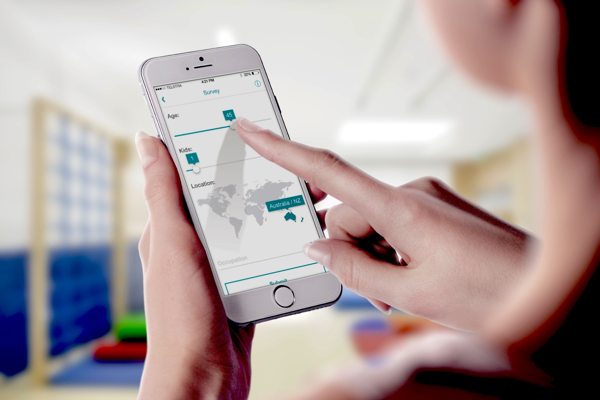
RISK SURVEY SCREEN
Please note, this is a visual concept only and does not reflect the interface design nor feature functionality of the final application
© 2015 ALIVE MOBILE GROUP PTY LTD ALL RIGHTS RESERVED. ABN 70 159 398 446. This document is provided commercially in confidence and remains the property of Alive Mobile Group Pty Ltd.

Slide 41
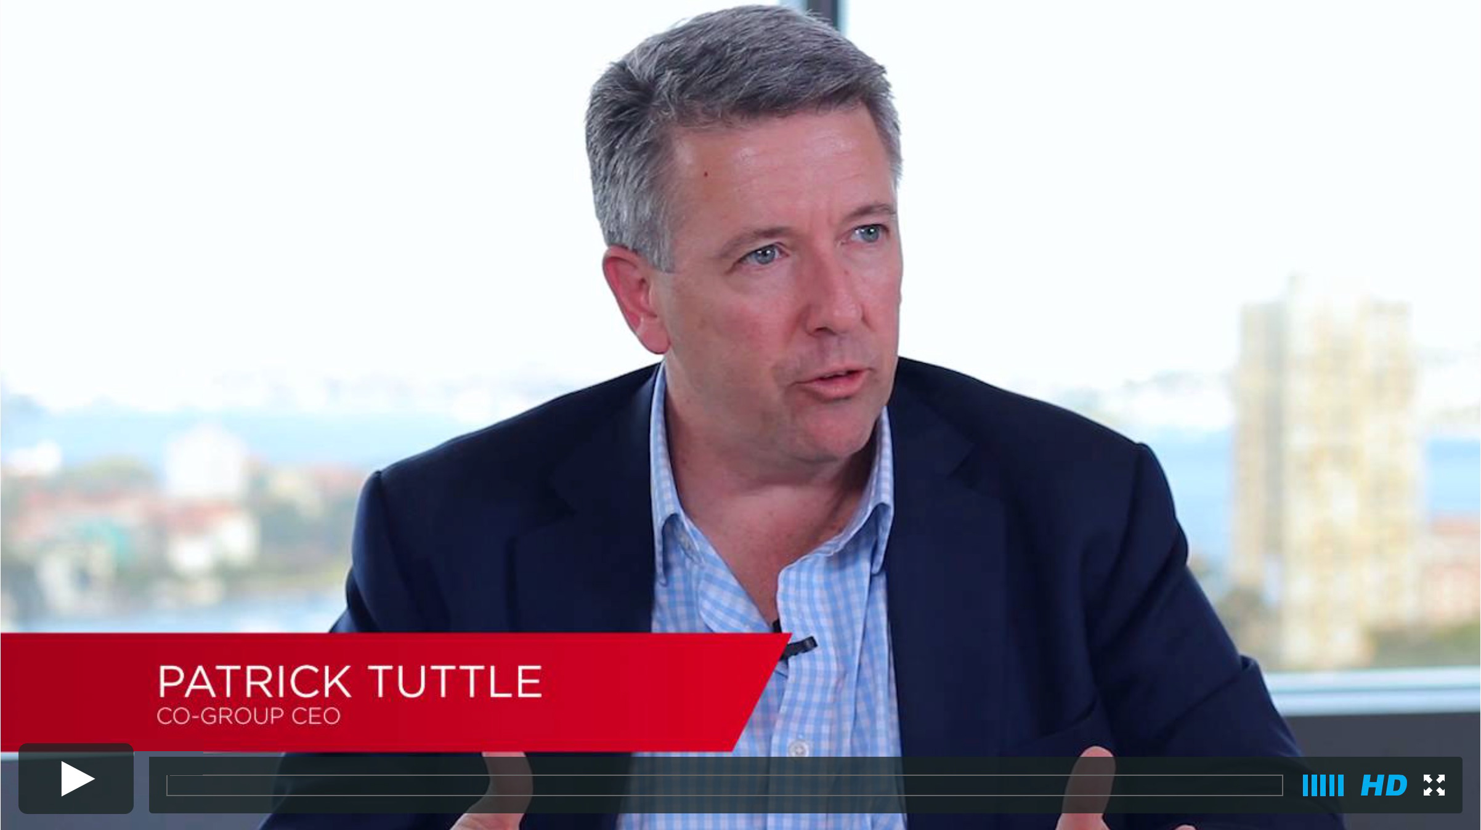
FINANCIAL SERVICES CASE STUDY
CHALLENGE
Pepper Co-Group CEO Patrick Tuttle identified the opportunity to employ mobile technology, because existing information systems were stored on platforms that were not designed to be used simultaneously by multiple users in varying locations. The data was being captured, but it wasn’t accessible when and where it was required.
As a result, Pepper’s business processes were being dictated by the limitations of its systems. Maintaining up-to-date and accessible information proved a challenge, and as a result was impacting the productivity of the sales staff. Pepper wanted to give its sales teams access to all the relevant internal systems in one simple interface, in order to grow the business through better customer engagement and increased productivity.
SOLUTION
Alive’s Business Design team immersed itself in the Pepper business, interviewing staff and customers, as well as going on the road with its sales teams. This allowed Alive to witness first-hand the challenges faced by Pepper’s teams when they needed to access business-critical data, gaining invaluable insights into the Pepper business processes.
Alive took a mobile-first approach, redesigning the business process to allow remote access to all the data via a bespoke Customer Relationship Management (CRM) system. The iPad CRM app — named Pepper Peak — provides sales teams with a holistic view of customer interactions, sales leads and opportunities as well as KPIs and targets. This allows them to better engage with their customers and provide a more complete and professional service.
OUTCOME
The Pepper Peak app provides sales teams with an accurate and meaningful source of information to enhance customer service, drive sales and increase productivity. The app is expected to provide a saving of two hours per day, per sales person, through reduced administration and travel time.
Pepper Peak represents the first of several apps the organisation plans to develop with Alive, with each solution focused on improving performance and business growth. Pepper’s willingness to embrace mobile technology, supports their innovative approach and importantly positions the organisation as one of the leading mobile-enabled financial institutions in Australia.
“It’s all about efficiencies and productivity. Alive’s solution ensures our sales teams have everything they need at their fingertips to be their best”
Patrick Tuttle
Pepper Co-Group CEO
VIEW INTERVIEW HERE

Slide 42
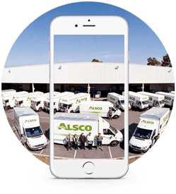
logistic services case study
CHALLENGE
Since 1962 Alsco has been providing professional textile rental services throughout Australasia. Their sales teams spend a significant time on the road, engaging with prospective customers and putting together proposals based on a wide range of services in Alsco’s diverse portfolio.
However, Alsco field teams had a major mobility issue. There was no reliable CRM solution available to sales executives and there were increasing gaps in their product knowledge. This often led to confusion over customer ownership, and caused Alsco to miss opportunities and lose business — resulting in poor customer engagement and a negative impact on sales figures.
Alsco needed to streamline their operations, unify their teams and make breakthrough gains in user engagement, in order to maximise sales output.
SOLUTION
With advances in Apple’s iOS, iPhone and iPad technology and the power of mobility, Alive saw an opportunity to improve productivity and significantly enhance the quality of data available.
The Alive team conducted a comprehensive consultation process in which they interviewed and work-shopped with 20 Alsco staﬀ members and went on the road with field teams. Through this process, Alsco’s fundamental challenges were uncovered and invaluable insights were gained.
Alive were subsequently able to design a dedicated mobile CRM iPad application, with fully customised features tailored to the Alsco sales process such as customised tool, automated proposals, cloud migration etc all of which were integrated within a mobile device that Alsco staff could take with them anywhere.
OUTCOME
The Alsco iPad application has revolutionised the way field teams operate. Team members have all the data they need on hand, in order to offer their customers more and to seize new business opportunities as they arise. The Alsco CRM also significantly reduces downtime, leading to greater efficiency of resources.
Individually, the Alsco team members have become more confident and subsequently more productive. They are capable of presenting a professional service and a seamless sales process, through complete product knowledge and increased customer engagement.
“We expect to get per sales person, somewhere between 10 – 14 hours per week of productivity gain, which is significant”
David Petrie
Alsco National Sales and
Marketing Manager

Slide 43
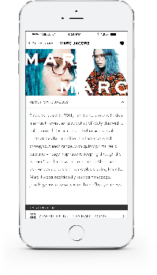
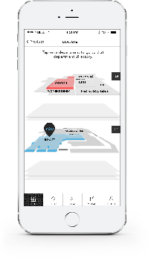
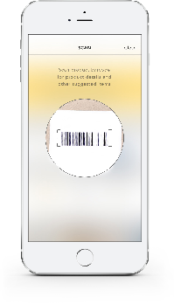
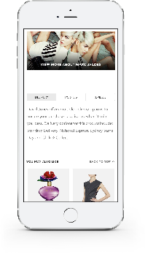
CASE STUDY: RETAIL
Prototype iPhone Application
Notes:
MBD Value:
Customer engagement:
Productivity/Resource Development:

Slide 44
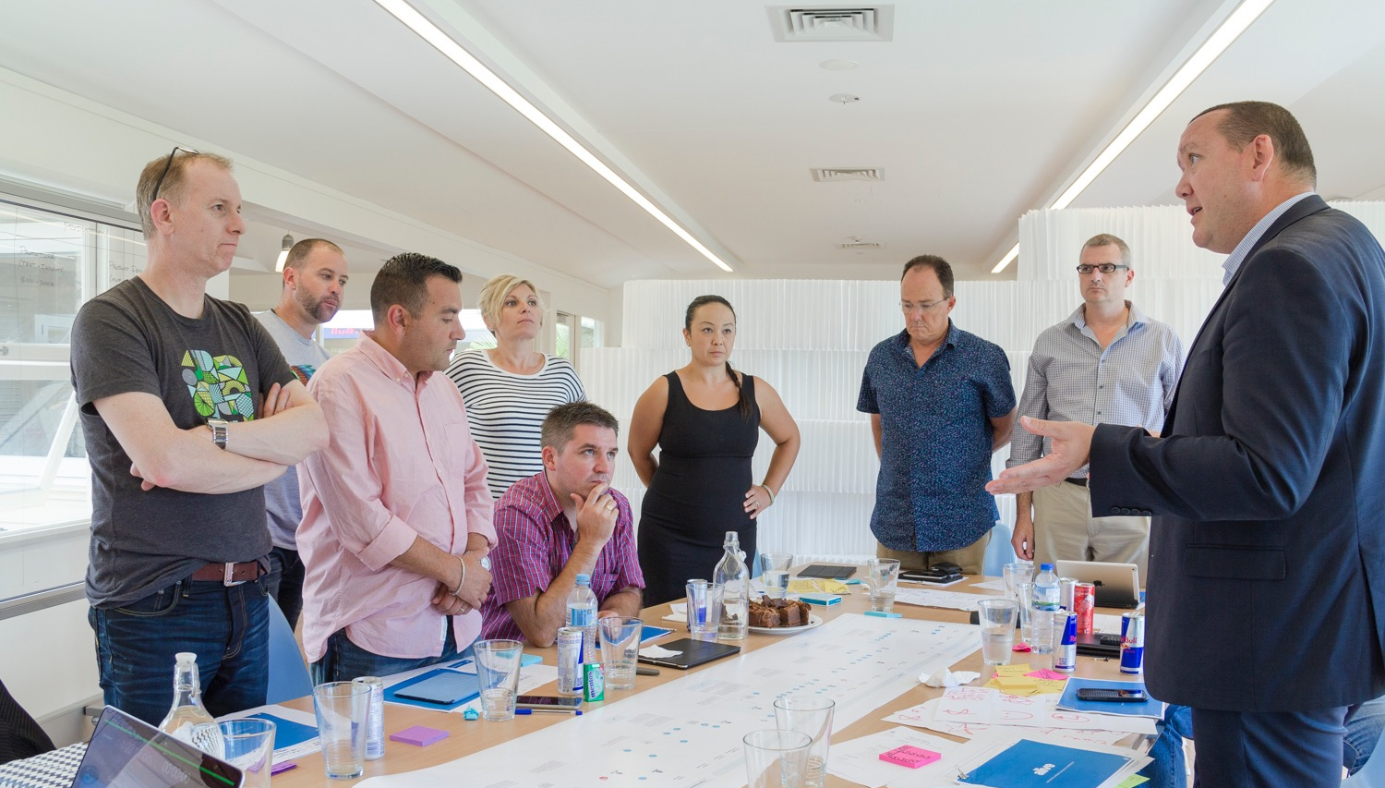
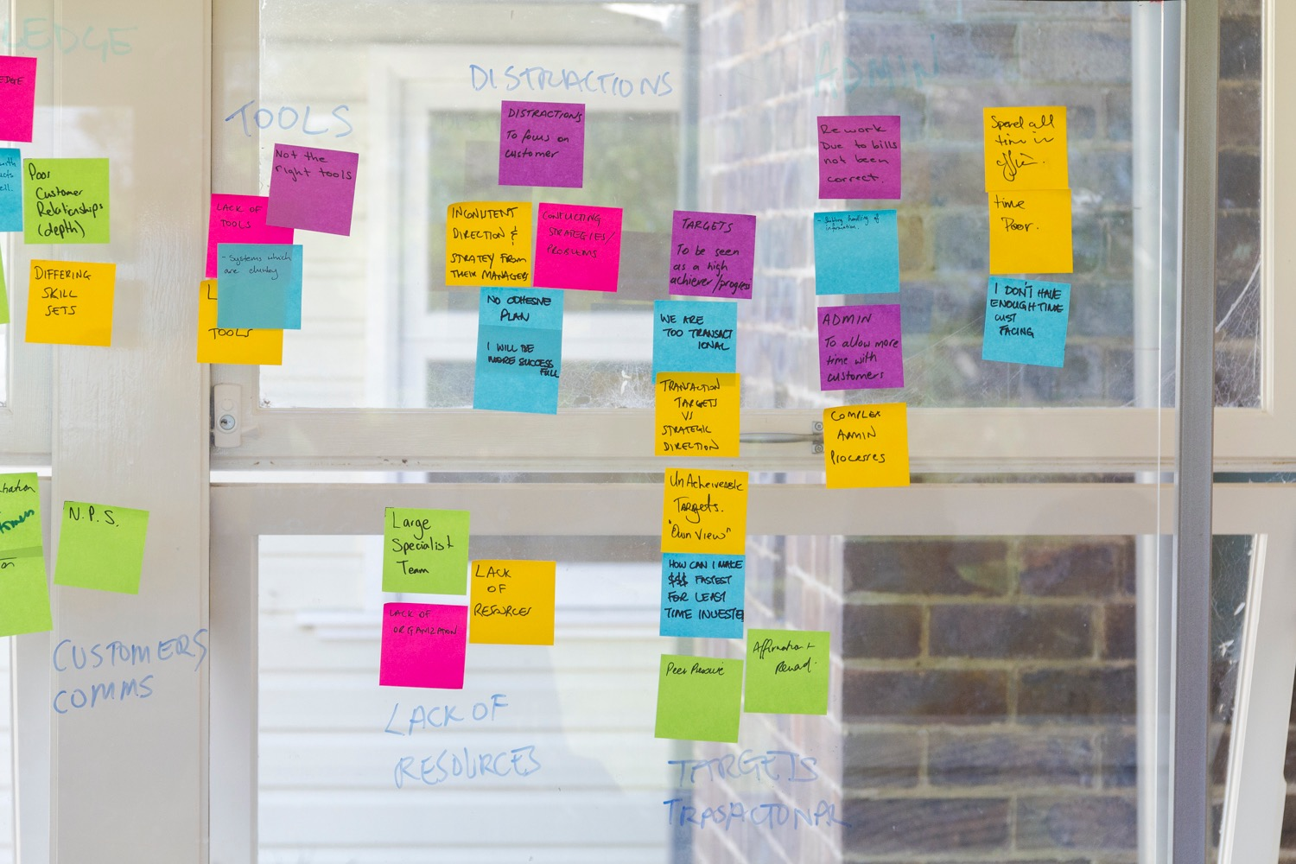
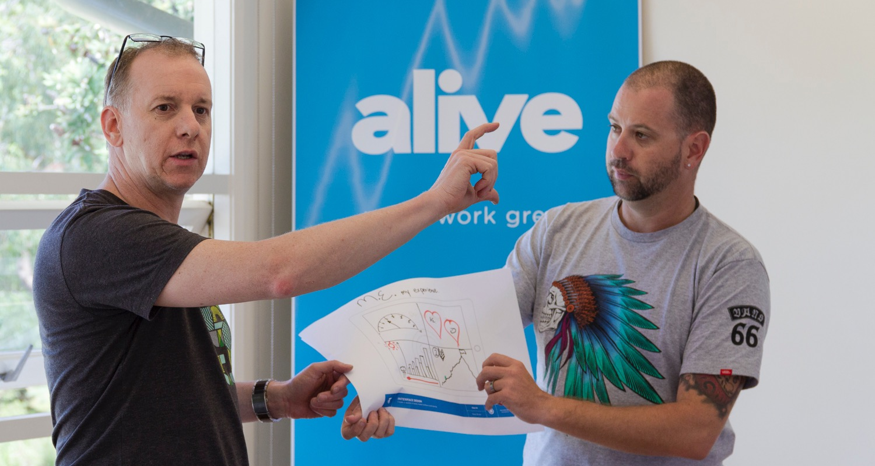
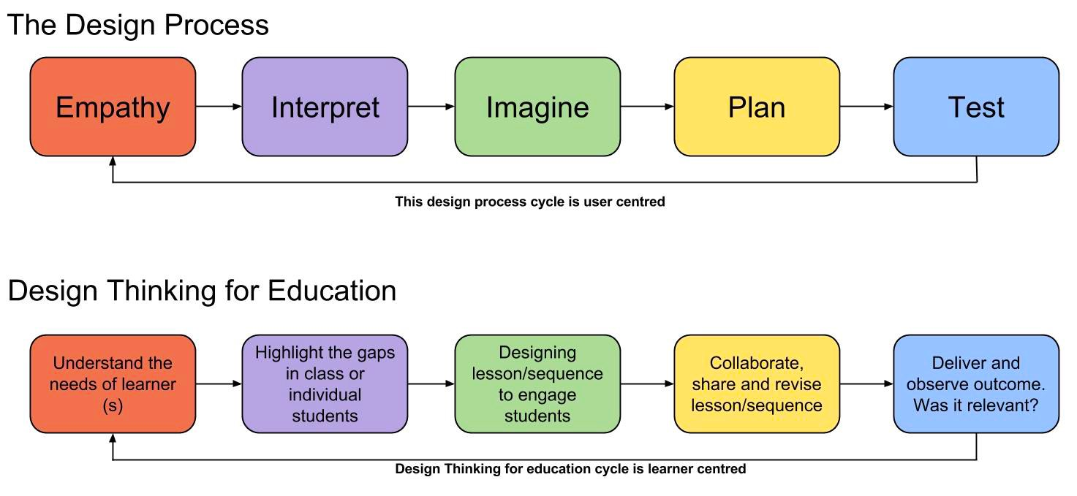
business design tools
DISCOVERY & PRIORITISATION
The following tools are a sample of the techniques that underpin every Alive Business Design engagement we complete with tertiary institutions. This approach ensures we develop a detailed understanding of students needs, and importantly demonstrates the value a dedicated mobile solution will return to the business.
SAMPLE OUTPUT
SAMPLE OUTPUT

Slide 45
approach PRINCIPLES
Design Thinking
Design thinking is a formal method for practical, creative resolution of problems and creation of solutions, with the intent of an improved future result. In this regard it is a form of solution-based, or solution-focused thinking – starting with a goal (a better future situation) instead of solving a specific problem. By considering both present and future conditions and parameters of the problem, alternative solutions may be explored simultaneously

Slide 46
design sprints
Design Sprints are fixed 10 day engagements, during which a capability brick, comprising of Business and Experience Designers work closely with stakeholders to answer questions pertaining to the agreed initiatives through design, prototyping and testing.
The design-sprint engagement is an outcome-oriented design thinking process, and provides a shortcut to learn and test assumptions of selected initiatives without the need to build and launch a final solution. In all, it is a process that provides a rock-solid validation of a chosen concept.

Slide 47
TESTING & VALIDATION
Feature Prototypes
What are they?
Sketches, wireframes and prototypes confirm a common vision among users and stakeholders by bring the idea and design to life. They also provide valuable user interface feedback within the proper context and reduces overall development time by acting as a useful reference tool for developers.
Why are they important?
Testing early and often using low and high fidelity prototypes to demonstrate the key functionality of an application in development, positively impacts final design as well as the overall project.
SAMPLE OUTPUT

Slide 48
Hive builds
Hive Builds are highly-collaborative engagements, which see stakeholders from work together in real-time to design solutions. The Hive Model has several very distinct features and benefits:
An approach that can be employed for all products - mobile, digital or analogue rich in real-time feedback
5 days of in-store interaction, design and build to collect and validate designs and product ideas
Highly collaborative - across client and customers
Very visible, which generates deep goodwill across your client base,
people, and customers - and this leads to greater advocacy
Real-time activity, that generates considerable interests and involvement from all stakeholders
Facilitates deeper engagement of the Mulraneys team, and customers by involving them early in the product and service design process

Slide 49
working prototype
A working prototype sees Alive’s Business and Product Design teams come together to build an interactive representation of what a mobile solution, when mobilised, would look like in it’s final state. Prototyping allows stakeholders to review a solution and put it to the test with users before spending time or money on developing it.
• Prototypes are interactive
• They model the user experience
• They enable extensive user testing

Slide 50
in closing
Design-led means being curious, having cross-functional empathy, innovating through ethnography, and making design part of your brand
Any industry can be transformed through design-led development
Change starts with us…

Slide 51
Luke Harvey-Palmer - CEO, Alive
@lukerides
lukeharveypalmer
luke@alivemobile.com

Slide 52
this slide is intentionally blank

