Slide 1
Systems of Engagement: Insights Discovered through Design Thinking
Matthew Mackay
Digital Experience Specialist

Slide 2
Innovation
flickr photo by tableatny http://flickr.com/photos/53370644@N06/4976519944 shared under a Creative Commons (BY) license
Notes:
Innovating rapidly and continually starts with cloud.
In fact, cloud enables the other technologies we mentioned, as well – data, social and mobile. As the delivery mechanism they use, it’s the equalizer that gives organizations of all sizes the ability to innovate at speed. It’s the way in which data, mobile and social are delivered in the moment.
So, how do you leverage cloud? By and large, it depends on your role.
Business leaders are tapping into IBM cloud services for marketing, finance, HR, sales, supply chain, operations, and other areas. With no fixed costs and incredible scalability, it enables near instant business innovation at low risk.
Developers are rapidly assembling and scaling new cloud apps and services in the cloud to find new ways to rapidly innovate and engage with customers. The result is a fluid, flexible business model ready for change and growth.
Of course, these new apps and services need to integrate with existing data and processes, through a hybrid cloud environment. Simply put, this allows cloud services to dynamically access other apps, data, services and infrastructure regardless of where they reside – in the cloud or on-premises. It maximizes choice and flexibility while protecting your existing investments.
That’s the essence to innovating with Cloud

Slide 3
Commercialisation
flickr photo by basti_voe http://flickr.com/photos/bastivoe/15582346468 shared under a Creative Commons (BY-SA) license
Notes:
Innovating rapidly and continually starts with cloud.
In fact, cloud enables the other technologies we mentioned, as well – data, social and mobile. As the delivery mechanism they use, it’s the equalizer that gives organizations of all sizes the ability to innovate at speed. It’s the way in which data, mobile and social are delivered in the moment.
So, how do you leverage cloud? By and large, it depends on your role.
Business leaders are tapping into IBM cloud services for marketing, finance, HR, sales, supply chain, operations, and other areas. With no fixed costs and incredible scalability, it enables near instant business innovation at low risk.
Developers are rapidly assembling and scaling new cloud apps and services in the cloud to find new ways to rapidly innovate and engage with customers. The result is a fluid, flexible business model ready for change and growth.
Of course, these new apps and services need to integrate with existing data and processes, through a hybrid cloud environment. Simply put, this allows cloud services to dynamically access other apps, data, services and infrastructure regardless of where they reside – in the cloud or on-premises. It maximizes choice and flexibility while protecting your existing investments.
That’s the essence to innovating with Cloud

Slide 4
Design Thinking
flickr photo by Ewan McIntosh http://flickr.com/photos/edublogger/8461818529 shared under a Creative Commons (BY-NC) license
Notes:
Innovating rapidly and continually starts with cloud.
In fact, cloud enables the other technologies we mentioned, as well – data, social and mobile. As the delivery mechanism they use, it’s the equalizer that gives organizations of all sizes the ability to innovate at speed. It’s the way in which data, mobile and social are delivered in the moment.
So, how do you leverage cloud? By and large, it depends on your role.
Business leaders are tapping into IBM cloud services for marketing, finance, HR, sales, supply chain, operations, and other areas. With no fixed costs and incredible scalability, it enables near instant business innovation at low risk.
Developers are rapidly assembling and scaling new cloud apps and services in the cloud to find new ways to rapidly innovate and engage with customers. The result is a fluid, flexible business model ready for change and growth.
Of course, these new apps and services need to integrate with existing data and processes, through a hybrid cloud environment. Simply put, this allows cloud services to dynamically access other apps, data, services and infrastructure regardless of where they reside – in the cloud or on-premises. It maximizes choice and flexibility while protecting your existing investments.
That’s the essence to innovating with Cloud

Slide 5
Customer Experience
flickr photo by SGPhotography77 http://flickr.com/photos/guzzphoto/11372199184 shared under a Creative Commons (BY-ND) license
Notes:
Innovating rapidly and continually starts with cloud.
In fact, cloud enables the other technologies we mentioned, as well – data, social and mobile. As the delivery mechanism they use, it’s the equalizer that gives organizations of all sizes the ability to innovate at speed. It’s the way in which data, mobile and social are delivered in the moment.
So, how do you leverage cloud? By and large, it depends on your role.
Business leaders are tapping into IBM cloud services for marketing, finance, HR, sales, supply chain, operations, and other areas. With no fixed costs and incredible scalability, it enables near instant business innovation at low risk.
Developers are rapidly assembling and scaling new cloud apps and services in the cloud to find new ways to rapidly innovate and engage with customers. The result is a fluid, flexible business model ready for change and growth.
Of course, these new apps and services need to integrate with existing data and processes, through a hybrid cloud environment. Simply put, this allows cloud services to dynamically access other apps, data, services and infrastructure regardless of where they reside – in the cloud or on-premises. It maximizes choice and flexibility while protecting your existing investments.
That’s the essence to innovating with Cloud

Slide 6
Digital Experience
flickr photo by GotCredit http://flickr.com/photos/jakerust/16639993497 shared under a Creative Commons (BY) license
Notes:
Innovating rapidly and continually starts with cloud.
In fact, cloud enables the other technologies we mentioned, as well – data, social and mobile. As the delivery mechanism they use, it’s the equalizer that gives organizations of all sizes the ability to innovate at speed. It’s the way in which data, mobile and social are delivered in the moment.
So, how do you leverage cloud? By and large, it depends on your role.
Business leaders are tapping into IBM cloud services for marketing, finance, HR, sales, supply chain, operations, and other areas. With no fixed costs and incredible scalability, it enables near instant business innovation at low risk.
Developers are rapidly assembling and scaling new cloud apps and services in the cloud to find new ways to rapidly innovate and engage with customers. The result is a fluid, flexible business model ready for change and growth.
Of course, these new apps and services need to integrate with existing data and processes, through a hybrid cloud environment. Simply put, this allows cloud services to dynamically access other apps, data, services and infrastructure regardless of where they reside – in the cloud or on-premises. It maximizes choice and flexibility while protecting your existing investments.
That’s the essence to innovating with Cloud

Slide 7
Design Thinking
flickr photo by Pete Reed http://flickr.com/photos/petereed/496392956 shared under a Creative Commons (BY-NC) license
Notes:
Innovating rapidly and continually starts with cloud.
In fact, cloud enables the other technologies we mentioned, as well – data, social and mobile. As the delivery mechanism they use, it’s the equalizer that gives organizations of all sizes the ability to innovate at speed. It’s the way in which data, mobile and social are delivered in the moment.
So, how do you leverage cloud? By and large, it depends on your role.
Business leaders are tapping into IBM cloud services for marketing, finance, HR, sales, supply chain, operations, and other areas. With no fixed costs and incredible scalability, it enables near instant business innovation at low risk.
Developers are rapidly assembling and scaling new cloud apps and services in the cloud to find new ways to rapidly innovate and engage with customers. The result is a fluid, flexible business model ready for change and growth.
Of course, these new apps and services need to integrate with existing data and processes, through a hybrid cloud environment. Simply put, this allows cloud services to dynamically access other apps, data, services and infrastructure regardless of where they reside – in the cloud or on-premises. It maximizes choice and flexibility while protecting your existing investments.
That’s the essence to innovating with Cloud

Slide 8
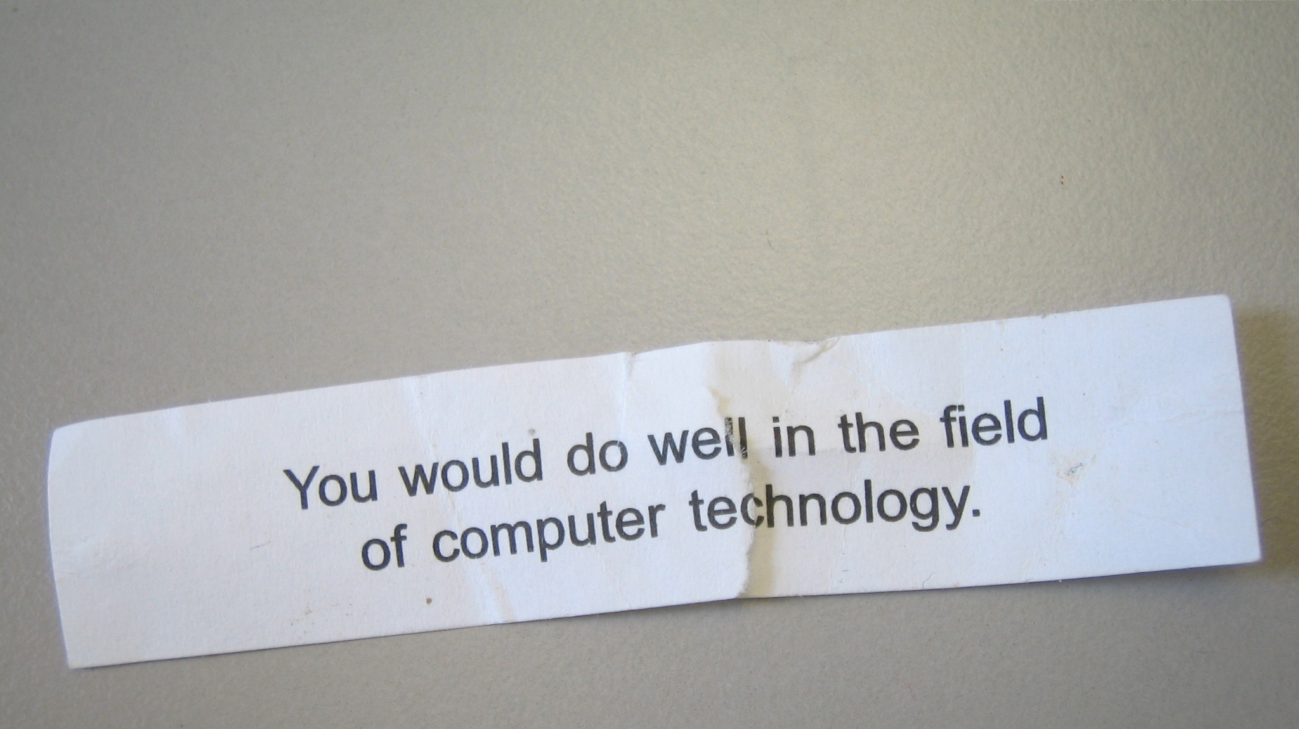
Where do you fit in?
flickr photo by deanj http://flickr.com/photos/deanj/2398424227 shared under a Creative Commons (BY) license
Notes:
Innovating rapidly and continually starts with cloud.
In fact, cloud enables the other technologies we mentioned, as well – data, social and mobile. As the delivery mechanism they use, it’s the equalizer that gives organizations of all sizes the ability to innovate at speed. It’s the way in which data, mobile and social are delivered in the moment.
So, how do you leverage cloud? By and large, it depends on your role.
Business leaders are tapping into IBM cloud services for marketing, finance, HR, sales, supply chain, operations, and other areas. With no fixed costs and incredible scalability, it enables near instant business innovation at low risk.
Developers are rapidly assembling and scaling new cloud apps and services in the cloud to find new ways to rapidly innovate and engage with customers. The result is a fluid, flexible business model ready for change and growth.
Of course, these new apps and services need to integrate with existing data and processes, through a hybrid cloud environment. Simply put, this allows cloud services to dynamically access other apps, data, services and infrastructure regardless of where they reside – in the cloud or on-premises. It maximizes choice and flexibility while protecting your existing investments.
That’s the essence to innovating with Cloud

Slide 9
Insight
flickr photo by Sam Howzit http://flickr.com/photos/aloha75/8165692802 shared under a Creative Commons (BY) license
Notes:
Innovating rapidly and continually starts with cloud.
In fact, cloud enables the other technologies we mentioned, as well – data, social and mobile. As the delivery mechanism they use, it’s the equalizer that gives organizations of all sizes the ability to innovate at speed. It’s the way in which data, mobile and social are delivered in the moment.
So, how do you leverage cloud? By and large, it depends on your role.
Business leaders are tapping into IBM cloud services for marketing, finance, HR, sales, supply chain, operations, and other areas. With no fixed costs and incredible scalability, it enables near instant business innovation at low risk.
Developers are rapidly assembling and scaling new cloud apps and services in the cloud to find new ways to rapidly innovate and engage with customers. The result is a fluid, flexible business model ready for change and growth.
Of course, these new apps and services need to integrate with existing data and processes, through a hybrid cloud environment. Simply put, this allows cloud services to dynamically access other apps, data, services and infrastructure regardless of where they reside – in the cloud or on-premises. It maximizes choice and flexibility while protecting your existing investments.
That’s the essence to innovating with Cloud

Slide 10
Thank You
flickr photo by Capture Queen ™ http://flickr.com/photos/uaeincredible/1105071723 shared under a Creative Commons (BY) license
Notes:
Innovating rapidly and continually starts with cloud.
In fact, cloud enables the other technologies we mentioned, as well – data, social and mobile. As the delivery mechanism they use, it’s the equalizer that gives organizations of all sizes the ability to innovate at speed. It’s the way in which data, mobile and social are delivered in the moment.
So, how do you leverage cloud? By and large, it depends on your role.
Business leaders are tapping into IBM cloud services for marketing, finance, HR, sales, supply chain, operations, and other areas. With no fixed costs and incredible scalability, it enables near instant business innovation at low risk.
Developers are rapidly assembling and scaling new cloud apps and services in the cloud to find new ways to rapidly innovate and engage with customers. The result is a fluid, flexible business model ready for change and growth.
Of course, these new apps and services need to integrate with existing data and processes, through a hybrid cloud environment. Simply put, this allows cloud services to dynamically access other apps, data, services and infrastructure regardless of where they reside – in the cloud or on-premises. It maximizes choice and flexibility while protecting your existing investments.
That’s the essence to innovating with Cloud

