Slide 1
SolutionsConnect 2015
Meet the Innovators
#IBMSolutionsConnect

Slide 2
How Digital Disruption Courts Innovation
Peter Tuton
Cloud Advisor
IBM Australia and New Zealand

Slide 3

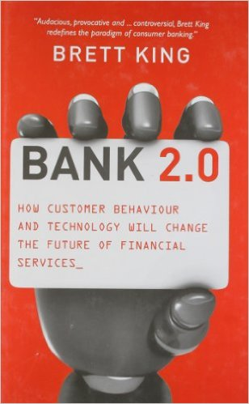
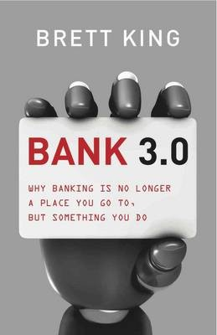
Industry disruption is driving an urgency to change
She’ll Be Right Drive
Proactive Drive
Camp
Kodak
Blockbuster
Retreat
Success City
Notes:
Steve Jobs Quote: If you’re not willing to cannibalize your own business, someone will do it for you.
relying on what has worked in the past will likely come at the cost of future success (and survival).
demise of iconic brands such as Kodak, Borders and Blockbuster leaves us with little doubt
In payments alone, Australian Banks stand to lose 30% of their business to non bank internet operators – $27 Billion
Financial services industry is in a period of great disruption
New entrants to the market
Customer lead disruption
Globalization disruption—the increasing connectivity of all the world's nations, economies and markets
Business wanting to ‘have a go’ and ‘try new things’
Brett King: Banking is a Technology

Slide 4
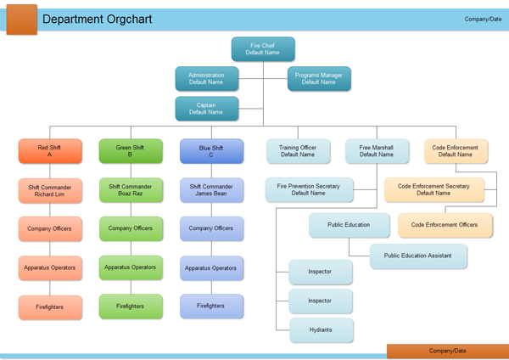
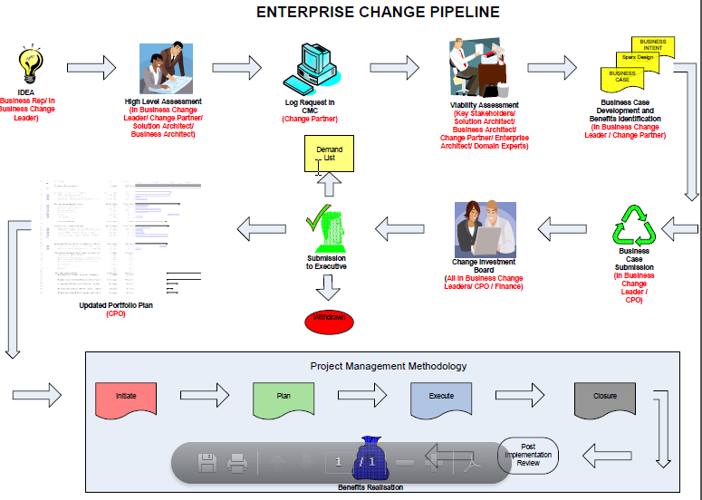











If banking is a technology, is this the bank we need today?
Notes:
If banking is a technology, and the technology your bank is built on is restrictive, monolithic, conservative, rigid & expensive, then so is your business.
EXAMPLE:
New mobile platform built on RoR -> we could not support this without significant investment in more technology
People: An IT Department structure based on role and technology
Process: A delivery capability built around heavy process
Technology: A very traditional technology environment

Slide 5
Building a technology strategy for the future
API Market place
Flexible Infrastructure
Open Source
Notes:
Build an ecosystem of financial services API’s
Attract the best talent by using the latest technologies
Allow the business to ‘have a go’ and ‘try new things’ - partner with anyone
Enabler for innovation, both internally and externally
Provide customers access to their data in new and exciting ways
Support the business vision to ‘have a go’ and ‘try new things’

Slide 6
Value points in the Cloud Computing spectrum
Traditional & Cloud
Native Workloads
Cloud Hosting (& aaS)
of Traditional Workloads
Cloud Native (aaS)
The Startup Zone
Traditional
Applications
Co-existence value
Cloud Native
Applications
SaaS
Monolithic Applications
Disruption value
Monolithic Applications
New business models,
products & services
Cloud
Native
via
software
defined
Cloud
Computing
Traditional
Platforms & Software
Composable value
Cloud Native
Dev Ops Platforms
PaaS
Non Cloud
Native
Middleware
Non Cloud Native
Middleware
IoT, Apps, APIs,
micro services &
Continuous Delivery
Cost value
Global elasticity
Traditional
Infrastructure
Cloud Native Ops
Infrastructure IaaS
Compute, Network
& Storage
Cloud
Compute, Network
& Storage
Cloud
Compute, Network
& Storage
On Premises Hybrid Cloud Off Premises (Public & Private)
Cloud orchestration, automation, policy, security and DevOps
Notes:
Cloud computing is key in helping us deliver on our strategy
We need to move from the left to the right (where it makes sense)
IBM Cloud offers a complete solution

Slide 7






The way we compose value is changing
Traditional
economy
Everyone to
Everyone economy
Differentiating Capability
+
-
Connected
Organisations,
People &
Things
in
situational &
dynamic
context
Cloud Computing is an equaliser
Small business can be global
Global business can be fast & personal
Notes:
Convergence of business models to create new and unexpected value offerings
Enable us to move from a traditional economy to a everyone to everyone economy
Traditional lines of business can be mixed and matched to derive new composite models
Innovation can occur outside the organization : spend $$$ developing internally, or nothing for others to do it for you
Short lived product lifecycles now possible
Empowering customers to access their data where and how they need it

Slide 8

Redy – Enabling communities to retain capital
Notes:
REDY launched in June 2014
A new approach to payments that aims to help communities keep capital in the community
In a typical VISA CC transaction a percent of the transaction is taken and distributed between Acquire, Issuer and VISA – No funds are retained
REDY Is different. It Allows a percentage from each transaction to be retained in the community
In Australia we have been at the forefront of the payments industry for a number of years.
From EMV chips in our cards to tap and go at point of sale we have continued to provide technology solutions to Australian consumers.
However we have not changed the fundamental approach to payments and this has meant that a % from every credit card transaction continues to leave our shores.
At redy we have developed a solution that is keeping this in Australia and even more providing it to charities or projects in the community.

Slide 9
Redy - video
Notes:
Demo of video
Introduce the business challenge – Redy Web Merchant
12 weeks to deliver into production
Enable a new channel
Extend the reach of Redy
No traditional business requirements document, instead iterative approach

Slide 10
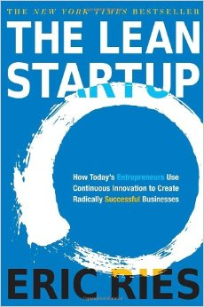




Building capability at start-up speed
Notes:
Team with .NET experience
No datapower or API manager experience
The Bluemix dedicated environment did not exist at the beginning of January
No formal business requirements
Challenged by the business to build new functionality into the Redy platform
A sense of urgency – we need it by March!
Keep costs and timeframes low
Ensure the solution can grow with success
A small functional team where everyone is aligned to the outcome
Only do the things that make sense

Slide 11
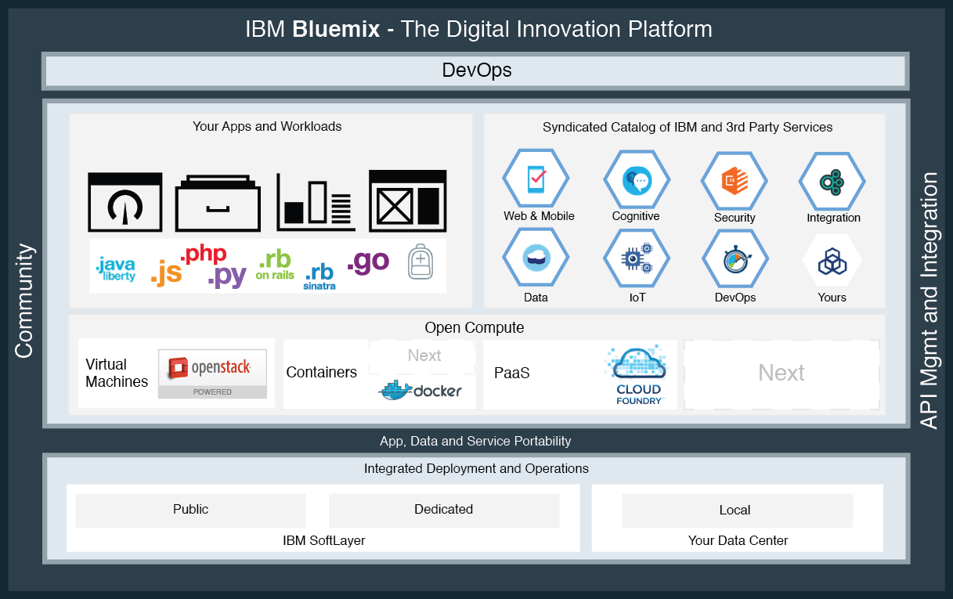
Your digital kitchen to compose and code
IBM provides an instant “enterprise start up zone”
Buy at
1. Business
2. Developer
3. Ops levels
use micro services
Choice of code
No Lock-in
Portability
Open Sourced Based
Off Premise
On Premises
Free data between SoftLayer Datacentres
Private
Cloud
Notes:
In Dec 2014 we signed a contract to partner with IBM who would establish a dedicated Bluemix service (first in world)
API Manager was critical to provide a Web Services gateway allowing access to system or record data
The decision was made to use Bluemix because of these key features:
Open Source Based – Cloud Foundry, Open Stack
A dedicated environment supported by Softlayer
A platform that would continue to grow and support new technologies and workloads
Supported by IBM – a long term partner
Provided us a path to move away from the data center business (Softlayer & ICOS)
A fully supported environment built on open source! The best of both worlds

Slide 12
Redy – Extending the reach with Bluemix and API Manager
How we implemented
Notes:
In under 12 weeks we delivered the business outcome for Redy Web Merchant
Syntegrity built the Internal and external API Managers
IBM team built the dedicated Bluemix environment
Bendigo team built the API’s and customer facing systems
Node JS
Meteor and MongoDB
Oauth security patters

Slide 13

Innovation at the speed of a start-up at Bendigo Bank
Digital Kitchen @ Bendigo Bank
New Products & Services
Application Composition
(Developers + aaS tech)
Software
Components
SaaS
Bluemix
PaaS
SoftLayer
IaaS
Notes:
We delivered in less than 12 weeks an unprecedented number of meaningful outcomes
We enabled the business to ‘have a go’ and ‘try something new’
The BM capability, and the way we have structured the team around the capability mean we can innovate in ways we never thought possible
We can deliver in hours and days rather than weeks / months or even years
We continue to leverage our investment – ICOS and Sloftlayer
Technology is no longer an inhibitor of innovation
The Bank has delivered to the global market its highly innovative and foundational payments & loyalty platform via APIs.
Created widgets for use by merchants to embed within their sites (like PayPal). Available globally.
A single code-base has eliminated the need to have 3 teams of developers across Apple, Android and Windows platforms. These developers are now missioned on new products & services.
The Bank can now innovate in ways they were simply not able to, or even imagine. At 1/20 of the cost and time (at least).
Embraced innovation across the Bank, testing new innovations with speed, low cost, and genuine business agility. We can deliver new innovative ideas in hours / days and also fail fast at negligible costs and test in production with a small group of customers.
What’s next?
Working with IBM global FSS Industry leads for payments and analytics with industry disruption ideas/plans in progress, incorporating Watson, SaaS offerings, Bluemix micro services, plus Bluemix garage services and cross-brand solution & service opportunities.
Moving 700+ existing workload instances to ICOS (SoftLayer).

Slide 14
Cloud native developers have created a paradigm shift
Disrupt or be disrupted
Example
Effort Ratio ~
Traditional
Enterprise
HW &
SW
20
months
dollars
Why
How
Deliver
Examples of 100 exist
Monolithic applications and middleware
Why
Cloud
Native
How
1
Deliver
month
dollars
Compose &
Code
Notes:
IBM is a full stack development and delivery capability
Using BM we have been able to shorten delivery time frames and deliver outcomes faster than ever thought possible
The business are now able to ‘try new things’ and ‘have a go’
The solution was presented to both board and the executive team and was viewed as a ‘finally’ moment

Slide 15
What advice would I give to others?
Don’t over analyse it – Barriers to entry are low, and much can be learned by ‘doing’
Partnerships are key – Get the best, and those committed to the outcome
Question everything you do today – Often processes are just not adding value
A small proactive team – outcome driven with no notion of ‘traditional roles’
Well defined outcome – Ensure everyone in the team is crystal clear on the purpose
Open source – Your cloud computing solution must be built on an open source framework

Slide 16


Innovation is the new currency
“Two guys in a Starbucks can have access to the same computing power as a Fortune 500 company.”
Jim Deters, Founder Galvanize
“Software is eating the world.”
Marc Andreessen, The Wall Street Journal
Notes:
Steve Jobs Quote ‘Talented resources are twenty-five times more valuable than average ones
Bill Gates – A great writer of software code is worth 10’000 times the price of an average software writer
Over the past 10-15 a bunch of new roles developed with titles such as Enterprise Architect, Systems Architect, Solution Designer, Business Analysis, Infrastructure Consultant etc etc
The function of ‘I.T’ has become something that requires co-ordination across many groups, each with a very specific purpose
Disturbingly, the role of software engineer has become less valued, and is often seen as the bottom of the food chain (at least in large Enterprise)
Cloud computing works best in flat functional teams
Software Engineers are quickly becoming the critical people to enable success. – They have a key role to play in the deliver of any strategy
Organisations should consider if many of the ‘roles’ we currently define in I.T departments are simply functions that all good Software Engineers can complete
To attract the best talent you need to offer an exciting work environment, with access to the best technology!

