Slide 1
IBM Cúram Child Welfare
Jeff Mann

Slide 2
IBM has a strong, long-standing commitment to social programs, which expanded with the acquisition of Cúram Software
Commercial off-the-shelf, software for line of business users in health and social programs, covering all types of organizations
More than 700 IBM subject matter experts in social programs:
40 subject matter experts in social programs policy
300 service professionals experienced in building social program management systems
320 dedicated software developers with expertise in social programs business processes
Social programs policy research center—the IBM Cúram Research Institute
On the Web at http://www-01.ibm.com/software/city-operations/curam-research-institute/index.html

Slide 3
The IBM Cúram application suite: modular and flexible to adapt to trends and challenges
Social assistance
Family services
Employment
Disability management
Pensions
Healthcare reform
Care management
IBM Cúram Solution Modules Configurable with best practices and industry expertise
IBM Cúram Child Welfare | IBM Cúram Verification | IBM Cúram Life Event Management | IBM Cúram Provider Management
IBM Cúram Income Support | IBM Cúram Appeals | IBM Cúram Social Enterprise Collaboration | IBM Cúram Outcome Management
IBM Cúram Income Support for Medical Assistance | IBM Cúram Evidence Broker | IBM Cúram Business Intelligence & Analytics | IBM Cúram Universal Access
IBM Cúram Application Modules
IBM Cúram Social Program Management platform
Administration suite and application development platform
Funded program management
Contribution management
Financial management
Supervisor workspace
Common intake
Evidence management
Participant management
Eligibility and entitlement
Business and technical services

Slide 4
IBM Cúram Child Welfare Solution
Mature and stable: released in 2007, additional product upgrades through 2014
Design Approach leveraging industry expertise and standards:
Partnership with industry leading Children’s Research Center (CRC)
Design team: former US child welfare caseworkers and others involved in US child welfare
Based on US child welfare practice, verified consistent with global practices
Supports regulatory requirements while making caseworkers significantly more effective
In United States, satisfies SACWIS product requirements
Notes:
4

Slide 5
IBM Cúram Child Welfare Solution
Based on a complete enterprise application:
Technical services: security (authentication, authorization), workflow, rules infrastructure, full read, write, view audit trail, services to call external systems
Child Welfare data model: Complete data model to support the data capture business process required to manage a child at risk
Pre-built workflows: pre-built workflow developed in conjunction with Children’s Research Center (CRC) to support the end to end child welfare business process from allegation to adoption
Made additionally specific to Child Welfare with specific capabilities
Only solution to package Children’s Research Center expertise: Structured Decision Making Risk Assessments are part of the verified product
Child Welfare specific planning and referral environment
Support for all Child Welfare roles (e.g. multi-disciplinary team, case worker, supervisor)

Slide 6
IBM Cúram for Child Welfare Detailed features
Case Management
Intake | Investigation | On-Going Case Mgmt | Adoption | Court/ Legal | Collaborative Case Mgmt
Multi-channel Support | Add/ Manage Allegations | View Allegations | Adoption Subsidy | Legal Actions | Social Enterprise Collaboration
Capture Type & Participant | Override Allegation Disposition | Service Planning/Authorization | Visitation Plan | Agreements | Multi-Disciplinary Team (MDT)
Extended Search | Milestones/ Waivers | Inter-jurisdictional Agreements | Prospective Parent Recruitment & Mgt | Legal Status | Case & Participant Index
Record Allegations | Service Referrals | Outcome Management | Adoption Finalization | Petitions and Orders | Meeting Scheduling & Tracking
Screen in/out | Submit/ Recommend | Foster Care IV-E Determination | IV-E Elig. Rules for Adoption Subsidy
Contact Logs |  |  |  | Hearings | MDT Portal
Core Functionality
Workflow Automation | Correspondence Mgmt | Participant Management
Rules Engine | Notifications | Workload Management
Task Management | Calendaring Functionality | Audit Trails
Security | Web Services | On-line Help
Person Management
Merge & Unmerge Person | Person Details: Indigenous; Medical; Physical; Gang Affiliation | Citizen Context Viewer
Performance Management
Caseload Dashboard | Work Queue Mgt | Reassign Tasks & Cases | Real-time KPI’s
Report Templates | Data marts | AFCARS Batch Extracts
Placement/Provider Management
Removals | Service Provider Financials | Foster Care Matching
Days in Care | Placement Request | Services
Financial Management
Decision History | Eligibility Determination | Change in Circumstances
Adoption Subsidies | Foster Parent Board Payments | IV-E Eligibility
Structured Decision Making®
Screening Criteria | Response Priority Assessment | Safety Assessment | Family Risk Assessment
Caregiver Strengths and Needs Assessment/ Reassessment | Child Strengths and Needs Assessment/ Reassessment | Family Reunification Assessment Risk Reassessment
Notes:
6

Slide 7
Integrating best practices & technology across processes
Decision
Structured
Decision Making ®
Cúram for
Child Welfare
Does a report meet the agency criteria
for investigation?
Screening
Criteria
Case Management
Intake
How quickly does the agency initiate
an investigation?
Response
Priority
Dynamic Scripting
Configurable Rules
Is the child in immediate danger?
Safety
Assessment
Investigation
Workflow Automation
What is the likelihood of future harm?
Risk
Assessment
Service Planning
What services are required for the child?
Child Strengths
& Needs
Multi-Disciplinary Team Mgmt
Ongoing Case Management
What services are required by the family?
Caregiver Strengths & Needs
KPIs
Reporting
Can child be returned to home?
Family Reunification & Risk Assessment
Provider Management

Slide 8
Focus on Outcomes & Collaboration
Operational
Process Support
Intake &
Investigations
Placements
On-Going Case
Management
Service
Delivery
Outcome
Management
Assessment
Service
Planning
Outcome Evaluation
Multi-disciplinary Approach
Family
Shared
Case & Client Info
Multi-Disciplinary
Teams
Notes:
8

Slide 9
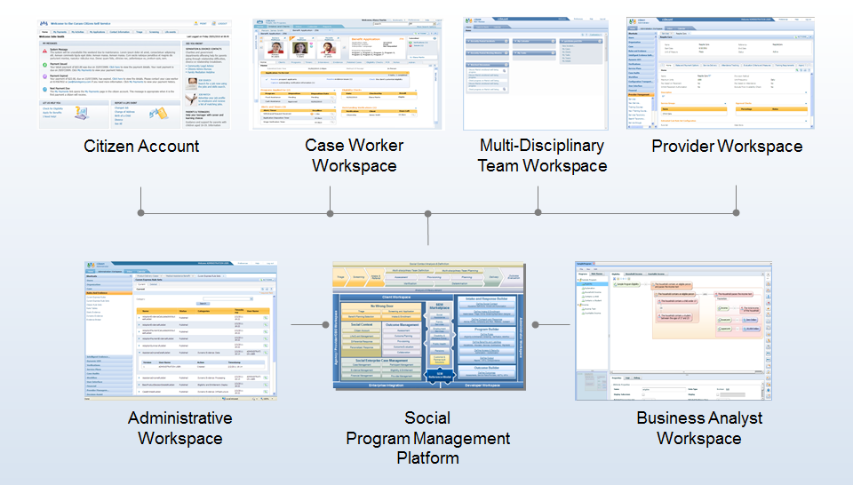
Role-based portal workspaces

Slide 10
A Canadian social services ministry increases worker productivity while improving outcomes for children and families
Quality
Improved outcomes for children and families
Security
Enabling data sharing and collaboration across organizations
Business Challenge: A social services ministry in Canada administers programs that protect children, help low-income families become economically independent and assist individuals with intellectual disabilities. They needed a solution that would:
Establish an integrated electronic repository to securely capture, track, and report on data
Provide an automated workflow
Providing secure access to updated placement and other provider-related information
Easily integrate with incumbent systems and be implemented without delay.
The Solution: By implementing and upgrading a blend of IBM Cúram software, the Ministry increased case worker and supervisor productivity while improving the quality of outcomes delivered to vulnerable children and families. The solution provides an intuitive workflow and comprehensive visibility of client data enabling the management of cases in a more timely, efficient manner.
Low Risk
Seamlessly integrated with existing systems for a fast, phased implementation
Solution components
Cúram;
Cúram Child Welfare;
Cúram Child Welfare Structured Decision Making Add-on;
Cúram Outcome Management

Slide 11
A German social services organization implements social program management solution to help protect children
Collaboration
Child-specific information, financial data, service plans and case status are all readily available to support caseworker collaboration
Integrated
All relevant social services and case management data are aggregated in a single warehouse
Business Challenge: The social services organization for a German city was facing challenges in managing child welfare services as demand grew in size and complexity. Much of its case management work was still paper-based so if a child moved, or a case manager left the organization or went on vacation, paperwork might not be transferred, or the case could be lost. Service provider selection was based on case manager experience and intuition rather than on systematic matching of providers with children’s needs. A lack of integration between case management and provider payment systems meant that payments might continue long after service provision stopped or after a child had moved or left the system.
The Solution: A suite of IBM Cúram software solutions was implemented to manage child welfare cases from the moment children come to the attention of authorities until their case is successfully resolved. The solution integrates provider information and case data in a centralized data warehouse and presents it to the case manager on a single dashboard.
Intelligent
Provider services are matched to the child’s individual needs
Solution components
IBM Cúram Appeals
IBM Cúram Child Welfare
IBM Cúram Provider Management
IBM Cúram Social Enterprise Collaboration
IBM Cúram Social Program Management Platform
IBM Cúram Verification Engine

Slide 12
IBM Cúram Social Program Management value proposition
Enables rapid, lower-risk implementation by leveraging prebuilt and configurable Child Welfare service elements and business processes
Empowers the business to define and deploy new programs with configuration tools in a runtime environment
Protects current investments and provides flexibility to address new and emerging service delivery trends
Reduces overall costs and the time needed to deploy new programs
Notes:
12

Slide 13
Thank you.
Jeff Mann
Strategy and Market Development
IBM Cúram Social Program Management
jmann@us.ibm.com
On the Web:
http://www-03.ibm.com/software/products/en/child-welfare

Slide 14
Trademarks and notes
© IBM Corporation 2015
IBM, the IBM logo, ibm.com, and Cúram are trademarks or registered trademarks of International Business Machines Corporation in the United States, other countries, or both. If these and other IBM trademarked terms are marked on their first occurrence in this information with the appropriate symbol (® or ™), these symbols indicate U.S. registered or common law trademarks owned by IBM at the time this information was published. Such trademarks may also be registered or common law trademarks in other countries. A current list of IBM trademarks is available on the Web at “Copyright and trademark information” at ibm.com/legal/copytrade.shtml.
Other company, product, and service names may be trademarks or service marks of others.
References in this publication to IBM products or services do not imply that IBM intends to make them available in all countries in which IBM operates.

