Slide 1
Capacity Management Analytics V2.1
October 2015
Ann Dowling – adowling@us.ibm.com
Offering Manager – IBM Capacity Management Analytics

Slide 2

Agenda
IBM Capacity Management Analytics (CMA)
  Overview
  What is CMA?
    Product
    What’s new
    CMA Application Features
  Resources

Slide 3

We’ll see you at Insight!
Expo
Advanced Analytics Zone
& z Systems Zone
1. Enterprise Analytics for IT & Business Ped
2. Lightning Talks @AA Zone Engagement Centers:
Mon, Oct. 26, 3:30pm
Tue, Oct. 27, 11:30am
Get your (customers’) hands dirty
Invite your customers to test drive CMA
Hands-On-Lab Session #2113
Wednesday, October 28th at 2:00 PM - 5:00 PM
We drink our own Champagne
Invite your customers to learn how IBM uses CMA:
Session #2486
Wednesday, October 28th, 10:30 AM-11:30 AM
Mandalay Bay North Convention Center Level - Islander H

Slide 4
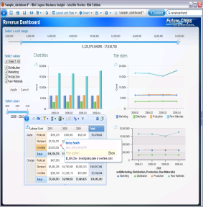
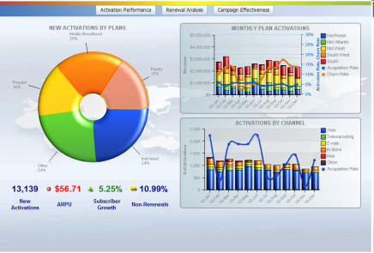
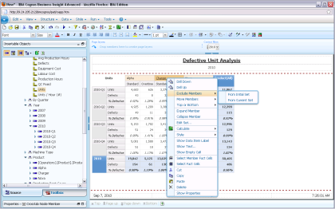
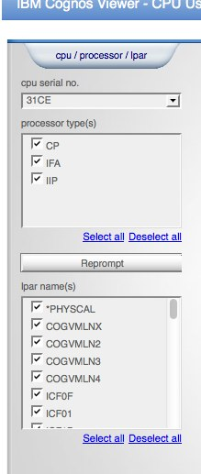

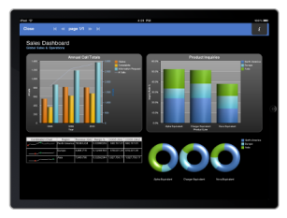
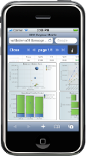
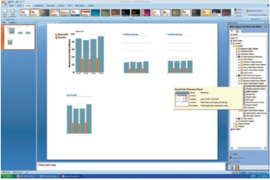
CMA Built on IBM’s ease-of-use analytics solution
A workspace with greater power, intuitive navigation & cleaner look
Pixel perfect reporting
Advanced Filtering
Seamlessly shift to more advanced analysis interaction
Analytics on the go with Mobile devices and disconnected interaction
Communicate your analysis using Microsoft Office

Slide 5
What is Capacity Management?
Definition from ITIL (IT Infrastructure Library) V3:
Capacity Management considers all resources required to deliver the IT service, and plans for short, medium and long term business requirements.
Capacity Management aims to ensure that the capacity of IT services and the IT infrastructure is able to deliver the agreed service level targets in a cost effective and timely manner.
Notes:
Describe what itil is

Slide 6





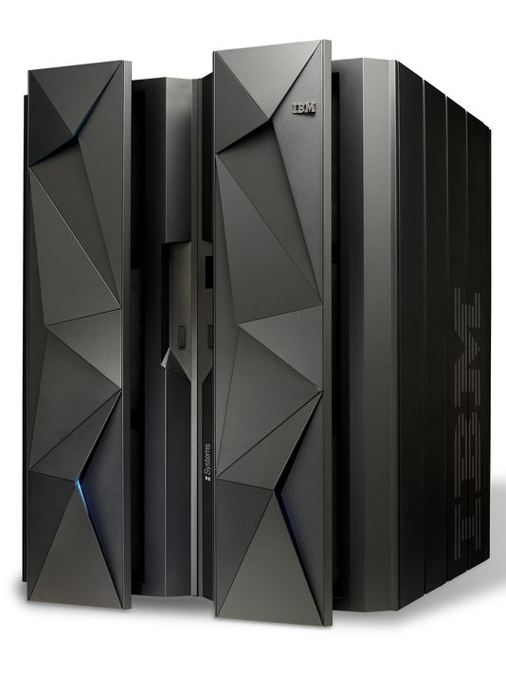

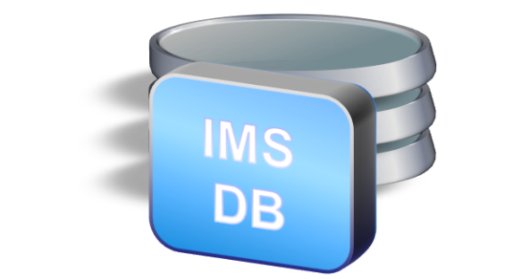

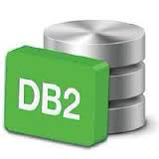


Capacity Management Analytics
USE CASES
Manage capacity of the entire Data Center
Determine Future Capacity Requirements
Manage Software Costs
Support LOB /application Chargeback
Detect Transaction Anomalies
Capacity Planner
System Administrator
IT Manager
Discover | Forecast | Optimize
Capacity Management Analytics (CMA)
DATA CENTER
Linux Servers
AIX Servers
z Systems
Windows
Z Software Middleware Stack

Slide 7








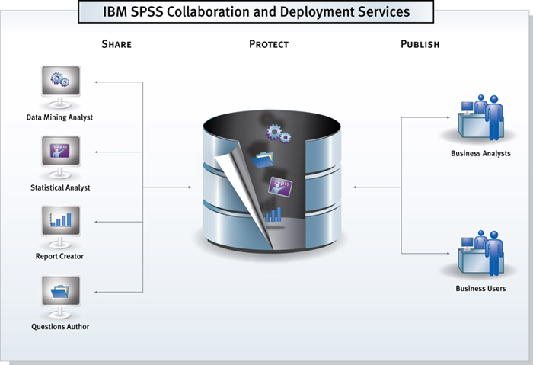




Capacity Management Analytics V2.1
CMA Solution
Systems Management & Optimization
Software Cost Analysis
Capacity Planning and Forecasting
Problem Identification
Application Analytics
User
Defined
Report Templates
CMA Platform
IBM DB2 Analytics Accelerator
Cognos BI
SPSS
CPLEX
DB2
TDS for z/OS
SPSS Model
IBM Confidential until Sept 1, 2015
Notes:
Customers get all of the areas when you buy CMA.
Customers has access to pre-built solutions.
Templates are provided to make report development even easier.

Slide 8
Capacity Management Analytics V2.1
CMA Solution
Systems Management & Optimization
Software Cost Analysis
Capacity Planning and Forecasting
Problem Identification
Application Analytics
User
Defined
Report Templates
Multiplatform
PIDs:
D11AYLL (Lic+12m S&S)
&
D11AZLL (S&S)
CMA Platform
Cognos BI
SPSS
CPLEX
DB2
TDS for z/OS
z/OS PIDs:
5698-CMA (Lic+12m S&S) &
5698-AA7 (S&S)
SPSS Model
IBM Confidential until Sept 1, 2015
Notes:
Customers get all of the areas when you buy CMA.
Customers has access to pre-built solutions.
Templates are provided to make report development even easier.

Slide 9
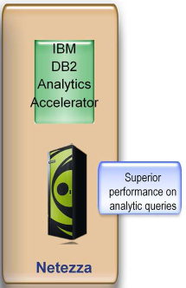




Recommended CMAplex deployment
Clustering
Cognos: Active/Active SPSS: Active/Standby TDSz: Active/Standby
z13
z13
TDSz v1.8.2
(Active)
z/OS
z/OS
TDSz v1.8.2
(standby)
DB2 V11
DB2 V11
Cognos 10.2.
Cognos 10.2.2
DQM
Engine
CMA DW
Coupling facility
DQM
Engine
CMA DW
dispatcher
dispatcher
Content
Manager
(ACTIVE)
Content
store
DRDA Protocol
Content
Manager
(standby)
Content
store
CPLEX
Modeler
Server
zLinux
Modeler
Client
Cognos Configuration:
Cognos 64bit
DQM JVM: 2048MB
Report Processes: 8
Thread High/Low Affinity: 2-8
Tomcat:
maxThreads="150“ minSpareThreads="4"
Cognos
Framework
Manager
LPAR Configuration:
Engines: 2CPs, 2zIIPs
Memory: 32GIG
Cognos – 16G
DB2 – 8G
TDSz – 2G (~10 concurrent jobs)
Safety buffer – 6G
TDSz Configuration:
Buffer Size: 200M – 600M
Commit After 25000 records
Tables Partitioned by Range
MVS_SYSTEM_ID
Row Level Locking: DRLSYS.DRLLOGDATASETS
Tablespaces: Non-logged, Locking: ANY

Slide 10
Data Used in CMA Solution Reports, Forecasting and Optimization

Slide 11
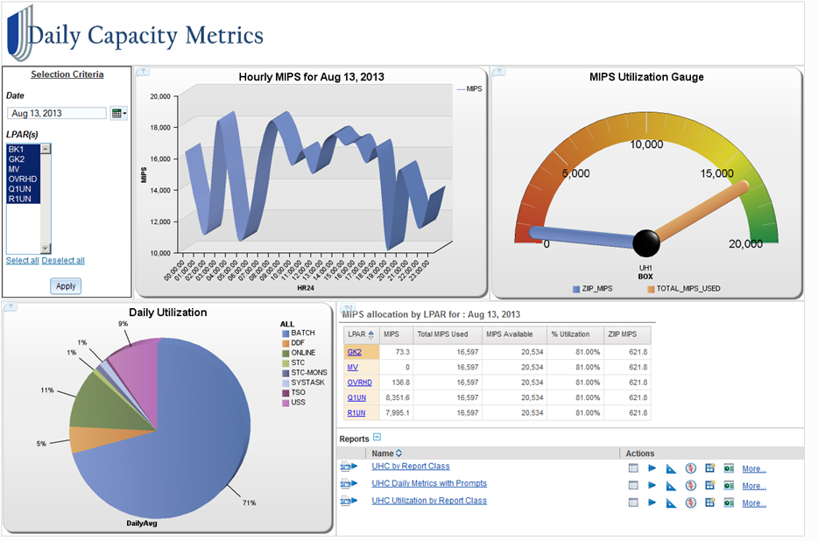
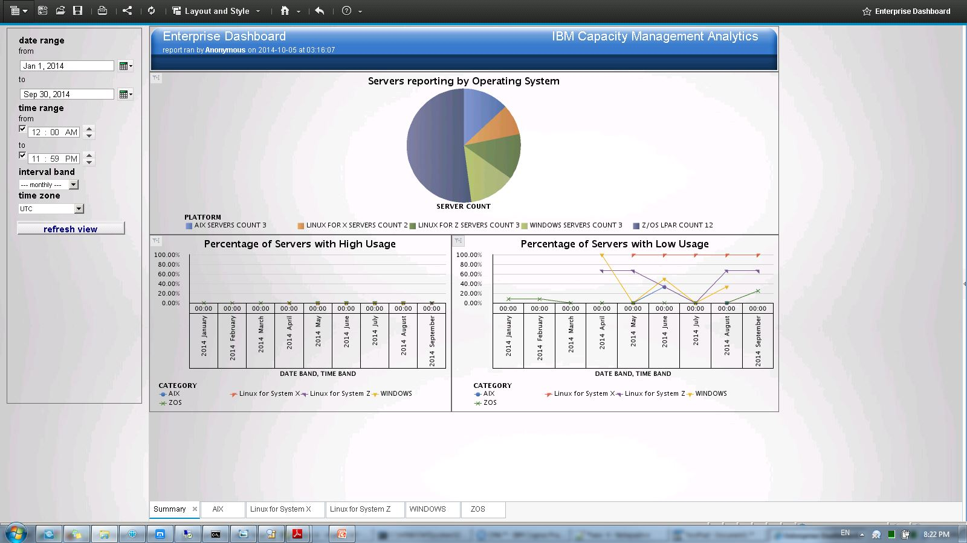
IBM Capacity Management Analytics
Systems Management & Optimization
Executives and managers – level dashboards
End-to-end view of your enterprise landscape: mainframe AND distributed
Role-based customized views to analyze, visualize and make informed decisions.
Question: Do you have 24x7 visibility on your enterprise capacity?
Notes:
Paint how easy it is to use

Slide 12
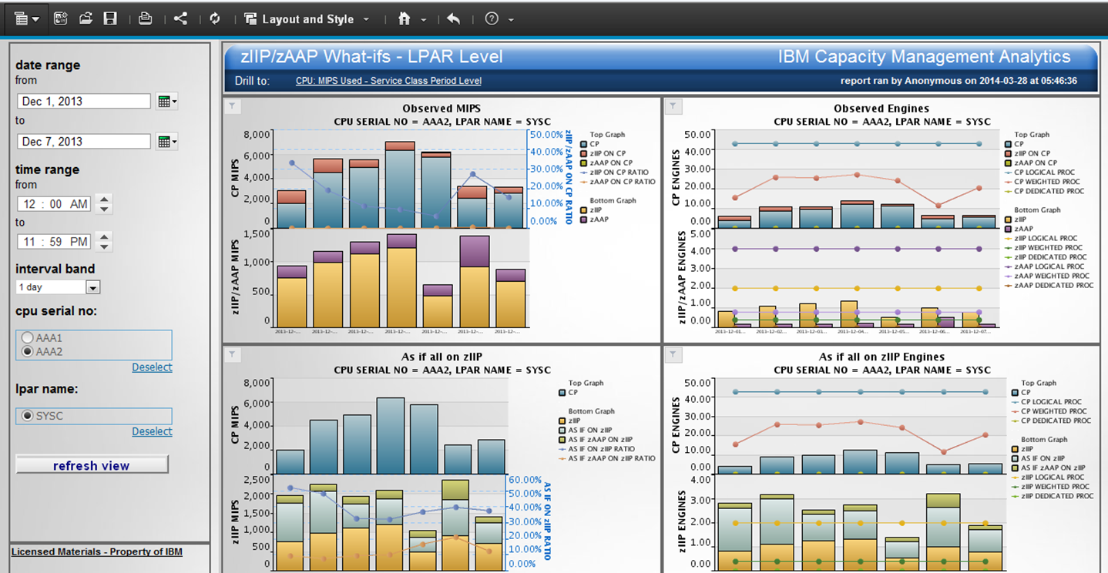
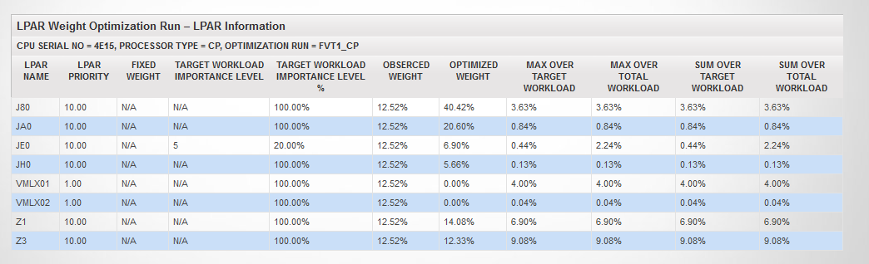
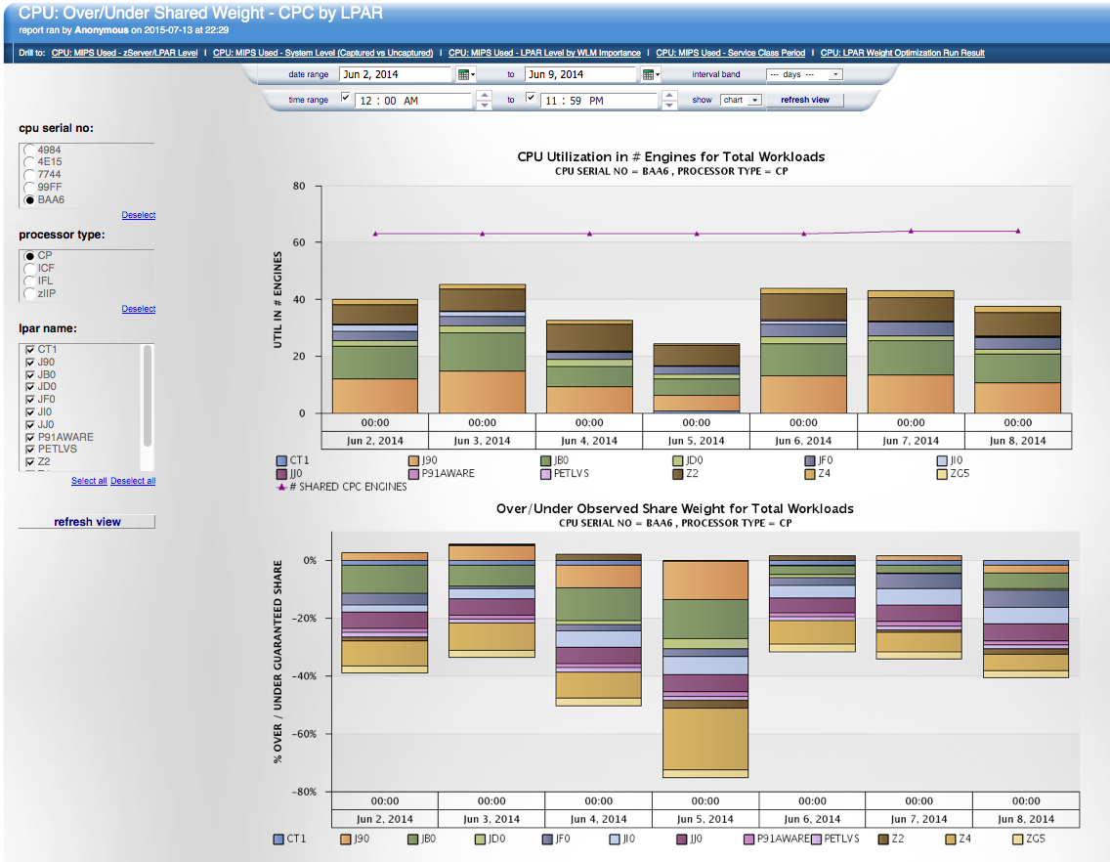
IBM Capacity Management Analytics
Systems Management & Optimization
System z Integrated Information Processor (zIIP) & System z Application Assist Processor (zAAP)
Specialty processors have lower hardware acquisition costs and zIIP’s & zAAP’s don’t impact software pricing based on capacity
Question: Are you getting the most out of your zIIP engines?
Question: Are you getting the most out of your mainframe ?
Prescriptive recommendation of LPAR Policy.
Monitor how well the specified LPAR Policy is working

Slide 13
LPAR Weight Optimization
Systems Management & Optimization
Overview
  Prescribe more effective LPAR policy (weight values) optimized for the “demand” workload - work that must run on the LPAR based on priority (importance levels)
Scope
  Input data can be 2-5 days (does not need to be continuous) which best represent the peak and competing “demand” workloads among LPARs
  Supports optimization of multiple date periods (one size does not fit all)
  Results shown in report (CPU:LPAR Weight Optimization Run Result).
  Use other CMA reports to determine the input information to do the optimization
    (CPU:MIPS Used –Service Class Period Level, CPU:MIPS Used –LPAR Level by WLM Importance, CPU:Over/Under Share Weight – CPC by LPAR)
Restrictions
  Only support certain process type (CP, zIIP, zAAP, IFL)
  Importance level used for LPAR with z/OS only – customer supplied % “demand” workload used for all other LPARs
  The total weight percentage of LPARs is 100% which skews result
    Because of unknown workloads on the LPAR
Notes:
Input information for LPARs:
Target_Workload_Importance_Level if there’s SMF72 records (If null, then target workload = LPAR CPU usage * Target_Workload_Percent)
Target_Workload_Percent

Slide 14
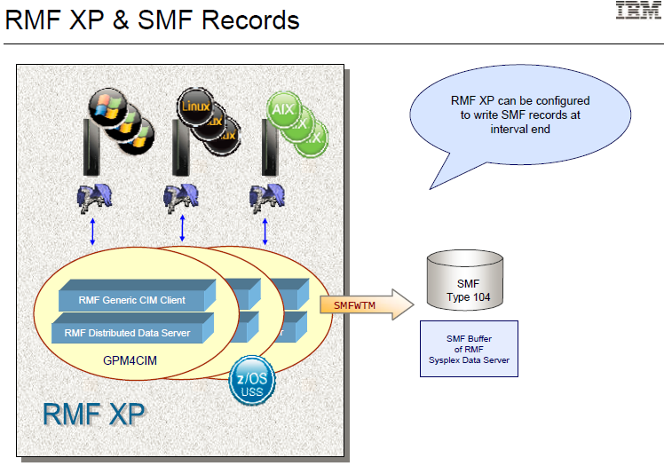
Distributed Components
Systems Management & Optimization
Linux for System z
  CPU Usage report
  Memory Usage report
Linux for System X
  CPU Usage report
  Memory Usage report
AIX
  CPU Usage report
  Memory Usage report
Windows
  CPU Usage report
  Memory Usage report
Enterprise Dashboard workspace
  Shows high level information for all the supported servers across the enterprise.

Slide 15
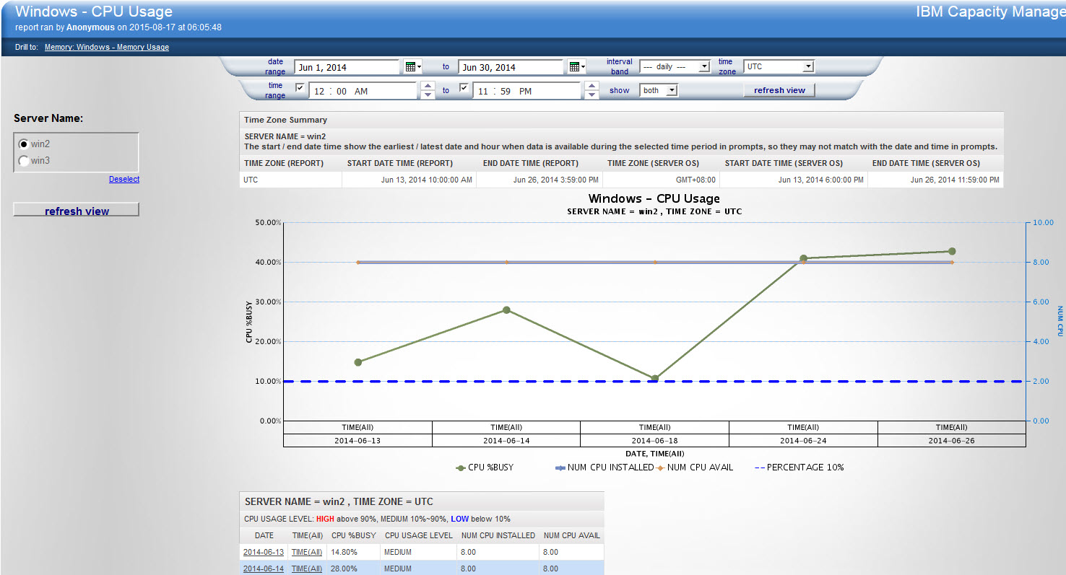
Windows – CPU Usage

Slide 16
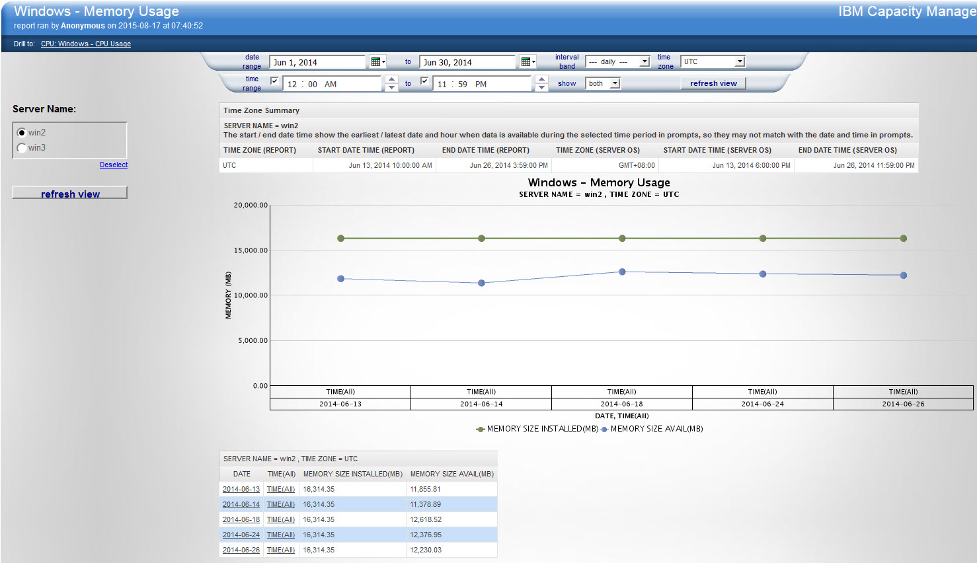
WINDOWS – Memory Usage

Slide 17
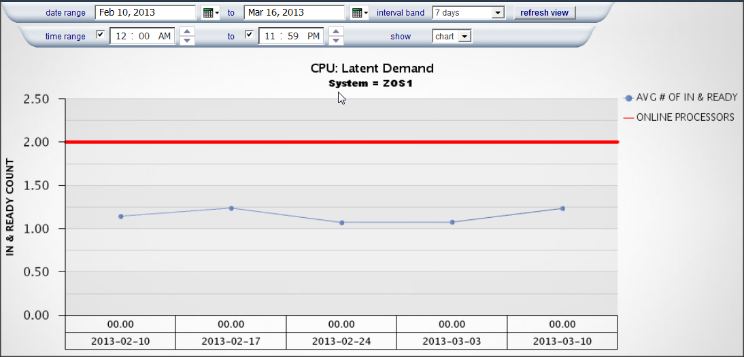


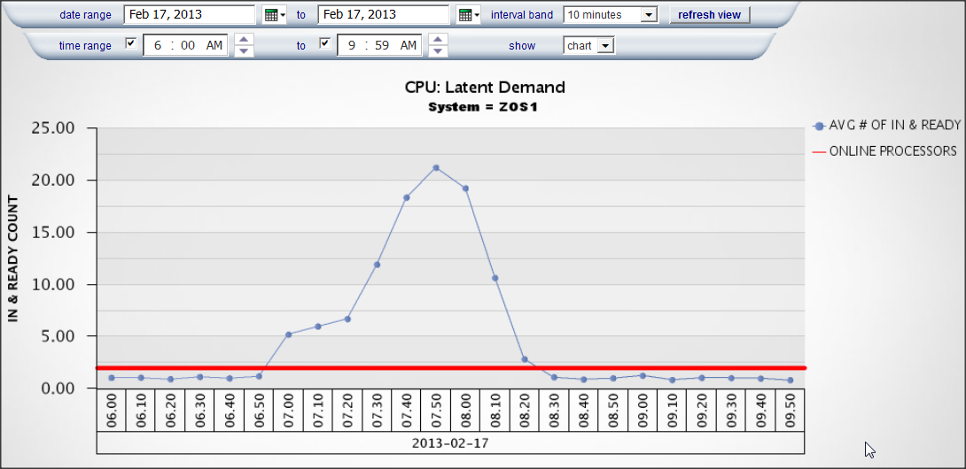
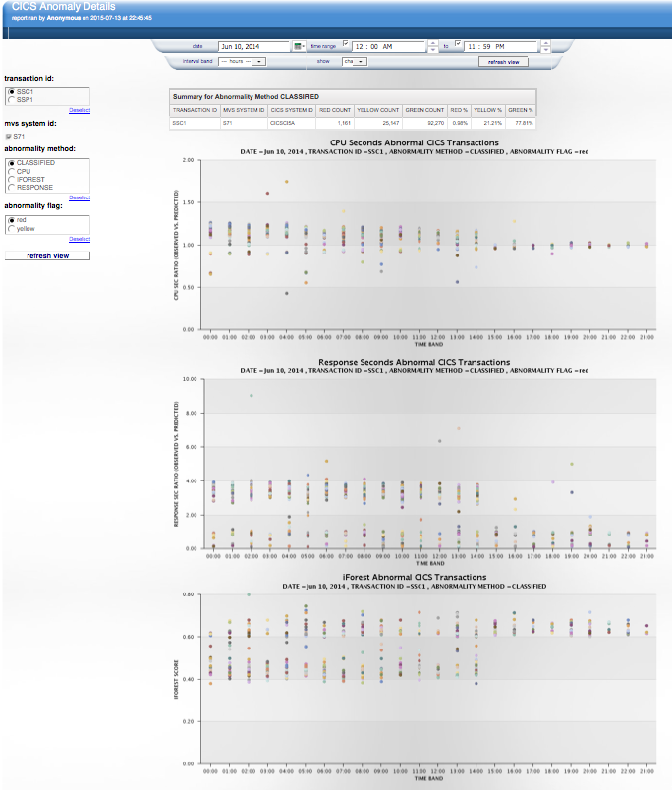

IBM Capacity Management Analytics
Problem Identification
Question: Can you quickly identify where problem might happen?
Perform simple ad hoc analysis to predict potential issues before they impact the business
Week Aggregation
Week Aggregation
Start with a top-down, big picture view
Then drill down
to greater detail to identify potential capacity problem
10 Minute Aggregation
10 Minute Aggregation
Detect potential problems before they happen and take action to prevent them
SMF data
Real Time Scoring
Notes:
First picture is SF skyline, second pic: TransAmerica building, third: the inside of the tip of TransAmerica building
A user can start with a “big picture” view at the year/month/week/day levels and then drill into greater detail at the 12 hour /4 hour/
1 hour/ 10 min levels in order to identify and resolve capacity management issues.
IBM CMA provides the ability to perform simple ad hoc analysis to get to the "why", create system alerts and monitor performance in near real-time to predict potential issues before they impact the business.

Slide 18



Near real-time Anomaly Detection
Problem Identification
Provides anomaly detection analysis on CICS transaction data. Helps customer find out which CICS transaction is anomaly. And customer can use our result to tuning or fix problem of their production environment.
Based on transaction CPU utilization and elapsed time
17

Slide 19
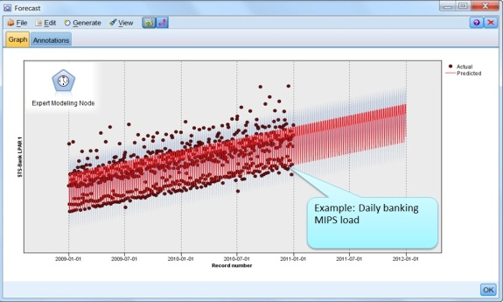


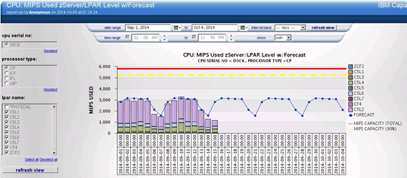
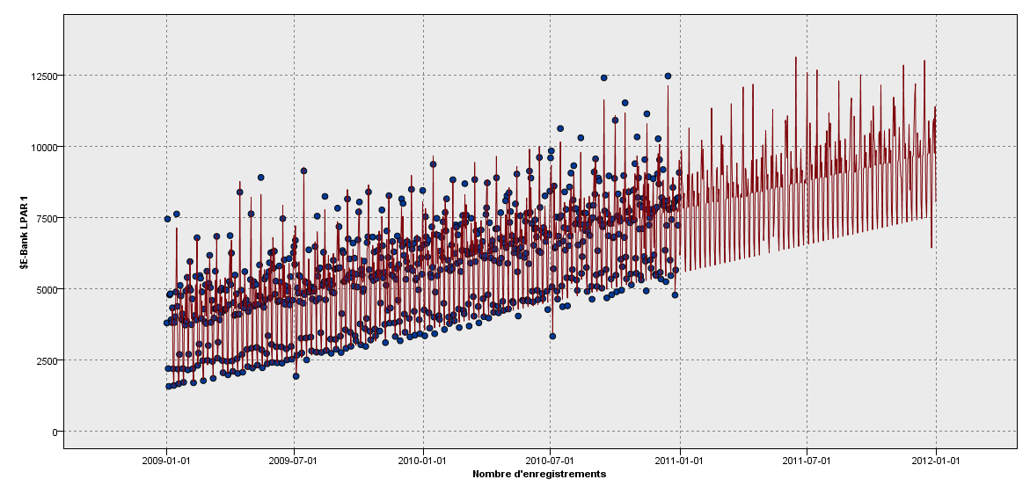
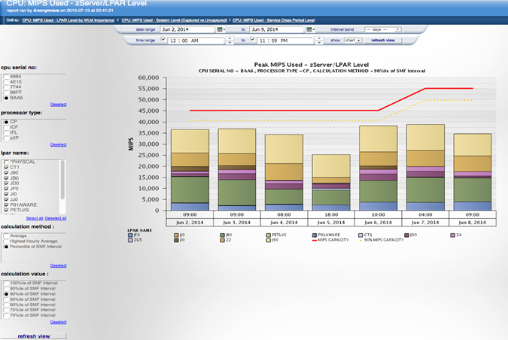

IBM Capacity Management Analytics
Capacity Planning and Forecasting
Question: Would I have enough capacity to handle my business growth in the next three months?
CMA uses predictive analytics to help organizations use their data to make better decisions by drawing reliable, data-driven conclusions based on past and current events.
Future capacity requirements can be forecasted to help ensure that sufficient capacity is available when the business needs it.
Dynamically select your standard formula for capacity planning or compare between formulas to find the one that best fits your requirements.

Slide 20

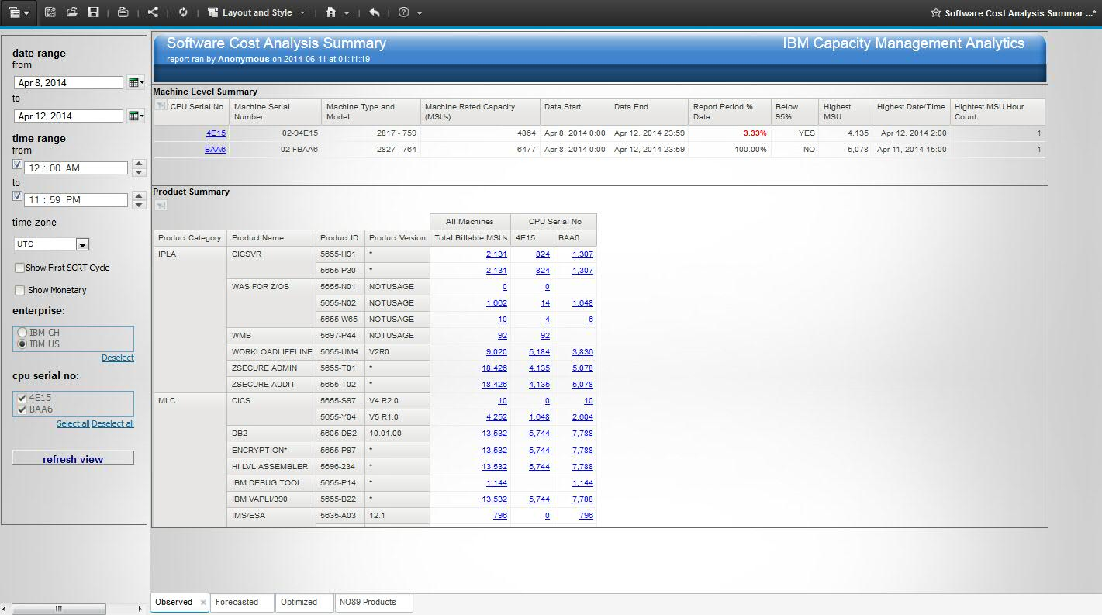
IBM Capacity Management Analytics
Software Cost Analysis
Better manage z/OS software costs
Identify where and when workloads need to be adjusted
Determine when additional capacity is required
Answers cost questions such as:
How much MSU is consumed in LPAR(s) and where is the billable peak? Which products contribute to the peak and by how much MSU?
How much should be billed on the whole z machine (CEC) for SCRT cycles? or other date ranges?
What is the total billable MSU and cost for all z machines in an enterprise?

Slide 21
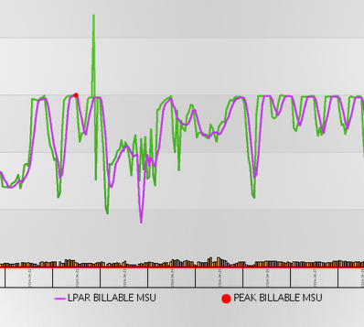

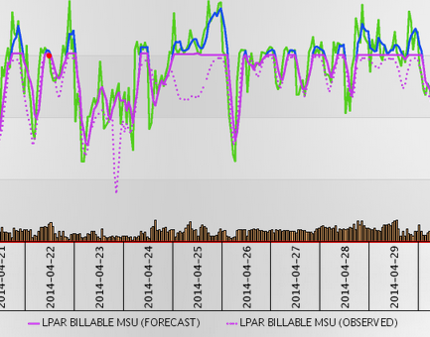

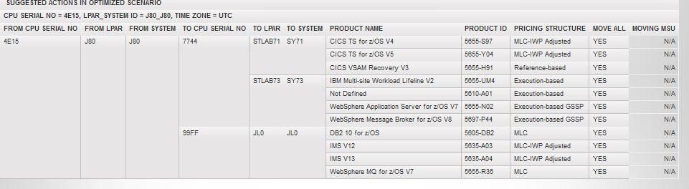

Software Cost Analysis – Three Scenarios
Software Cost Analysis
Observed: Track product MSU usage and costs at LPAR and Server level, identifying peak intervals and tracking 4 hour rolling average (4HRA).
Forecasted: Predict future MSU and cost usage based on forward utilization model.
Optimized: Suggest alternative LPAR / product configurations to take advantage of white space and reduce billable MSU where possible.

Slide 22

Health Warning
Software Cost Analysis
Moving Workloads is not so simple…
  There are often application dependencies hidden from products like CMA
  e.g. CICS transaction affinities
CMA allows users to specify which products must be kept on same LPAR
Traditional methods for reducing MIPS are still important
  e.g. application tuning, SQL optimization

Slide 23
Software Cost Analysis – Additional Notes
Software Cost Analysis
Does NOT replace SCRT
Uses the same data & same rules
Needs the SCRT NO89 listings
Pricing Structures Supported
  MLC
  IPLA: Execution Based, Reference Based, zOS Based
  IWP
  GSSP
License Charges Supported
  AWLC, AEWLC, MWLC, VWLC, EWLC, zNALC,
  VUE001, VUE007, VUE020,
Monetary Value
Forecasting MSUs at the LPAR & Product level
Looking into Optimizations & Recommendations

Slide 24
Application Analytics
Application Analytics
We know what you(r applications) did last summer
… and this summer
… and how much
… and where
  Overview
  Provides the ability to track, predict and improve utilization of existing server resources (CPU) by defined applications or lines of business.
    May help with developing a charge back process
  Scope
  Hierarchical and Flexible mapping to either to Report Classes or Jobnames
    Functions of Application that run in an environment
  Mapping occurs during report execution, not hardened in the data
  Utility (stream) provided to determine transaction capture ratio for CICS and IMS
  Restrictions
  Assumes distributed server runs a single application
  Does not show application spread across distributed and mainframe
  Forecasting available only at application function level

Slide 25
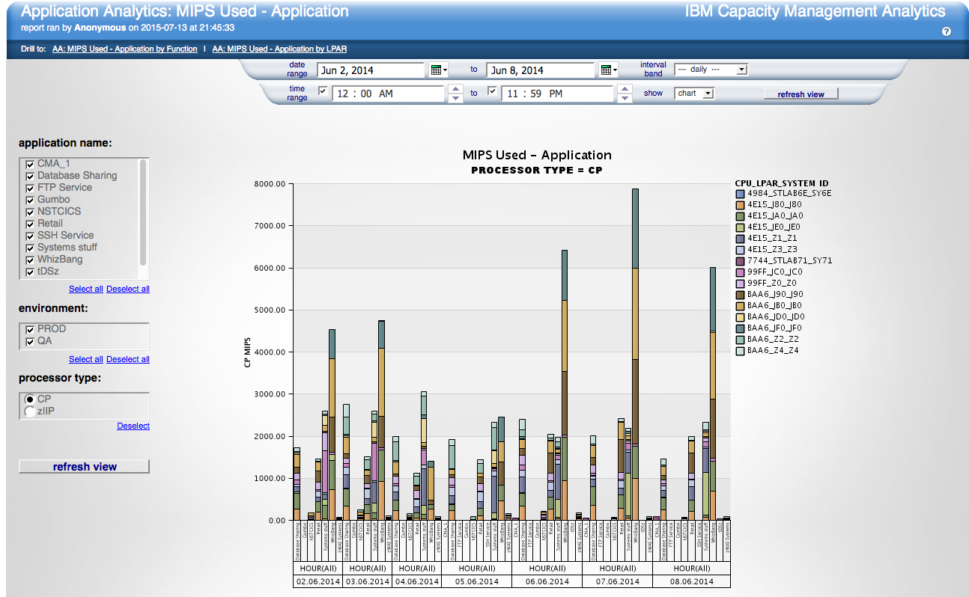
Application Analytics
Application Analytics
Answers questions such as:
How much MIPS do your applications consume?
How do they compare month to month?
Which applications are growing? How much should I charge back?

Slide 26
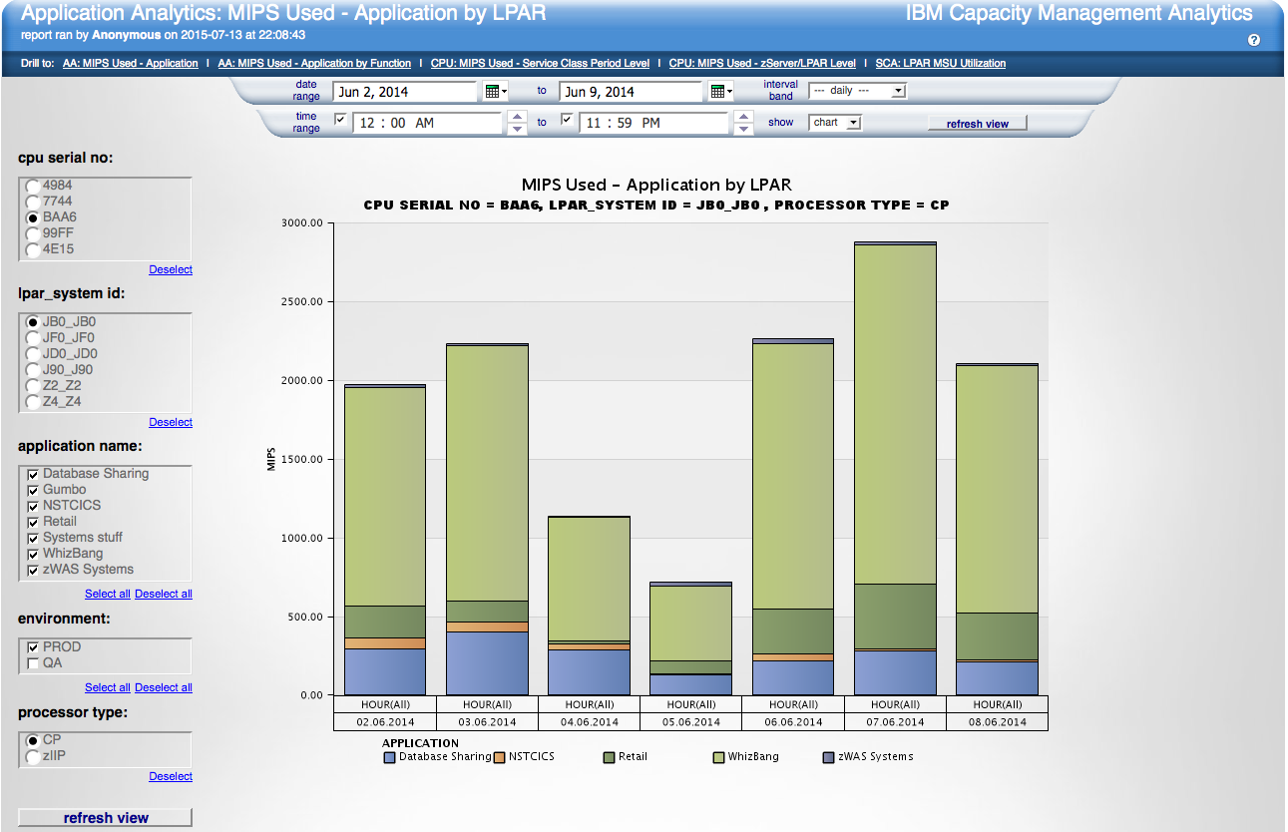
Application Analytics
Application Analytics
MIPS Used by Applications in an LPAR by day

Slide 27
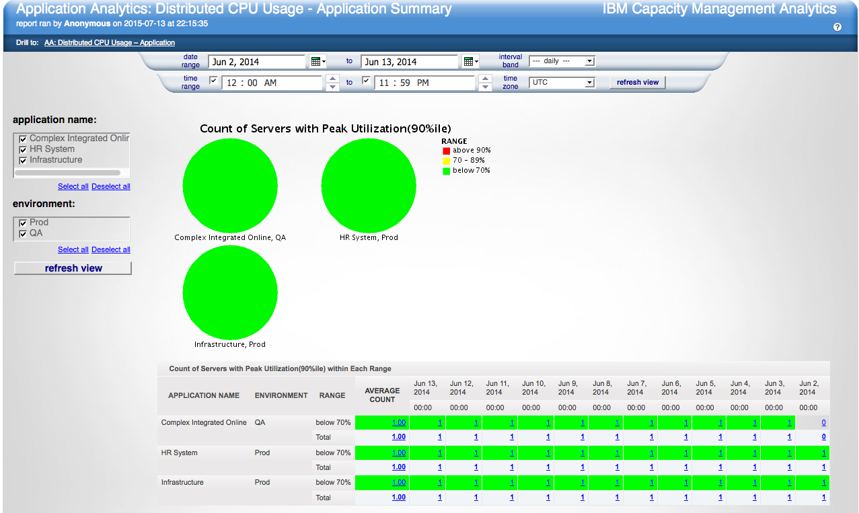
Application Analytics
Application Analytics
Application Summary CPU usage

Slide 28

Resources

Slide 29
IBM Capacity Management Analytics - Services & Education
Highly Recommended
Quick Win Services
To ensure fast time-to-value and lower risk, enables customers to quickly and efficiently deploy the solution with IBM proven practices. Experienced IBM specialists work closely with the customer to install and tailor the CMA solution.
Customized Report Creation Services
Beyond the CMA Quick Win Implementation service and training options, IBM also offers comprehensive customization services for additional reporting and predictive analytics requirements unique to your customers needs.
Education
IBM offers a variety of training options ranging from instructor-led to self-paced virtual classes to suit your needs and budget. This includes training on Cognos Business Intelligence for introductory and advanced reporting skills and SPSS for predictive modeling.

Slide 30
Education Services
Recommended SPSS and Cognos Business Intelligence (Baseline Training for 1 User)
SPSS Modeler (4 days – Self Paced Virtual Course)
  Introduction to IBM SPSS Modeler and Data Mining (v15) - 0E004: 2 days
  Advanced Data Preparation using IBM SPSS Modeler (v15) – 0E054: 1 day
  Clustering and Association Modeling with IBM SPSS Modeler (v15) – 0E042: 1 day
Cognos Business Intelligence (10 days - Self Paced Virtual Course)
  IBM Cognos Framework Manager: Design Metadata Models (v10.2) – J2252: 5 days
  IBM Cognos Report Studio: Author Professional Reports Fundamentals (v10.2) – J2258: 3 days
  IBM Cognos Report Studio: Author Professional Reports Advanced (v10.2) – J2259: 2 days
  Note:
  Additional Self Paced Virtual Course cost per user additional
  BI Training can be taken based upon user role: Administrator, Report Writer, etc
Tivoli Decision Support (Knowledge Transfer Session)
  Introduction and Installation
  Log Collector and the Reports
  Database Overview
  Component Details and Advanced Topics

Slide 31

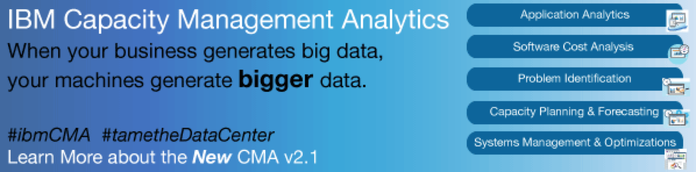
NEW!

Slide 32

© Copyright IBM Corporation 2010 All rights reserved. The information contained in these materials is provided for informational purposes only, and is provided AS IS without warranty of any kind, express or implied. IBM shall not be responsible for any damages arising out of the use of, or otherwise related to, these materials. Nothing contained in these materials is intended to, nor shall have the effect of, creating any warranties or representations from IBM or its suppliers or licensors, or altering the terms and conditions of the applicable license agreement governing the use of IBM software. References in these materials to IBM products, programs, or services do not imply that they will be available in all countries in which IBM operates. Product release dates and/or capabilities referenced in these materials may change at any time at IBM’s sole discretion based on market opportunities or other factors, and are not intended to be a commitment to future product or feature availability in any way. IBM, the IBM logo, Cognos, the Cognos logo, and other IBM products and services are trademarks of the International Business Machines Corporation, in the United States, other countries or both. Other company, product, or service names may be trademarks or service marks of others.

