Slide 1
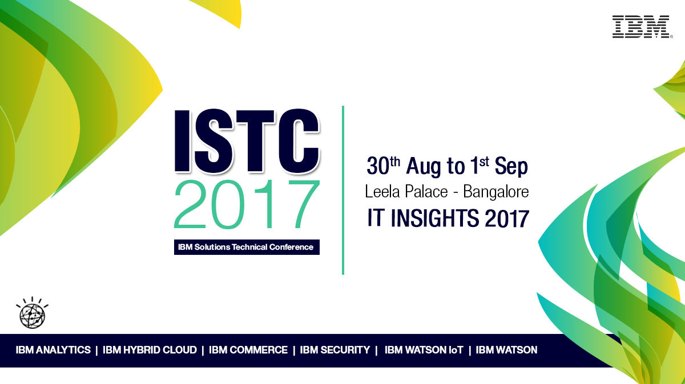

Slide 2



IBM Event Readiness
Alleviate your Peak Period Fears
Manas Senapati Program Director, Customer Success & Support, AP
Rajiv Madassery Sr. Manager, Commerce Support AP
Ibm.biz/EventReadiness

Slide 3





Agenda
When is your next event?
Potential Risks from not preparing
Are you prepared?
What is Event Readiness?
How IBM can help?
Success through Event Readiness
Offerings
Accelerated Value Program
Questions
Value to your Client!
Value to you!

Slide 4
When is Your Next Event?
Critical business events are common across industries using IBM Commerce solutions. Events typically have peak periods of sustained traffic or site activity requiring optimal performance and stability.
Site or brand launch
on new or migrated
platform
Peak Festival
sales like Diwali,
Akshaya Tritiya etc.
Seasonal promotion
activity peaks
End of season
/ mega sale
events
Traffic surge coinciding
with new product /
app launch
Year/Quarter end
peak processing
Tax statements,
payments, etc.

Slide 5

Potential Risks from not preparing
Site slowness, instability or downtime resulting in lost revenue
Poor conversion rates on critical processes due to gaps in analytics or data capture
Loss of customer loyalty due to poor experience or lack of engagement
Potential Risks from not preparing
Site slowness, instability or downtime resulting in lost revenue
Poor conversion rates on critical processes due to gaps in analytics or data capture
Loss of customer loyalty due to poor experience or lack of engagement

Slide 6



Are you Prepared?
Let IBM help you identify gaps or risks that may occur during your key event using IBM Commerce solutions, based on current preparations and skills
  Have you dedicated what your key KPIs are and how to monitor them?
  Do you have all the latest recommended settings & fixes installed?
  Are you confident in your site stability and performance?
  Are your staff prepared to detect, react and mitigate a crisis?
  Are you leveraging latest functionality that can add to a user experience?
Are you capturing all the available data through tagging?
Are you planning months in advance?

Slide 7




What is Event Readiness?
Enhanced level of support providing tactical preparation for critical events utilizing dedicated IBM resources. These IBM experts act as advocates on your behalf to:
 | Identify Risk | Leverage IBM field experience to identify potential exposures for critical events
 | Expedite Resolutions | With a deeper understanding of your contacts, environments, operations, and projects, your IBM Point of Contact effectively advocates on your behalf to gain more efficient issue resolutions
 | Expedite Response | Before, during and after your key event, your IBM Point of Contact will provide priority call handling throughout your critical period
 | Mitigate Risk | Prior to your key event, IBM experts help you understand, identify, and weigh risks, then provide suggestions for adopting best practices, product fixes, and enhancements

Slide 8




Success thru IBM Event Readiness
System and application Health Check
Product roadmap and upgrade path planning
Identifies Risk
Mitigates Risk
Subject Matter Experts provide skills enablement
IBM Subject Matter Experts for best practice discussions
Performance testing & tuning
(on-premise)
Call Audits ensure best practice compliance
Facilitate ability to capture, monitor,
analyze data
and reporting
Upgrade assistance to minimize risk of adding new functionality
Runbook review
ensures seamless execution
Monitoring strategy review
Event Readiness Workshop
Foundation Services to optimize segments, campaigns, offers
Maximize Value
Mobile app
re-launch
adds new functionality
Shared IBM Point of Contact provides account management
Personalized ticket review and trend analysis
POC advocates and escalates on your behalf
Assists with troubleshooting, education, enablement
Create understanding of environment and activities
POC acts as liaison into IBM Support & Development
Expedites Response
Expedites Resolution

Slide 9

Success thru IBM Event Readiness
Optimized site performance, stability, throughput
Maximized customer loyalty due to enhanced user experience
Seamlessly captured, monitored, summarized and
analyzed data
Increased conversion rates through deeper
understanding of data
Increased client success!
Optimized site performance, stability, throughput
Maximized customer loyalty due to enhanced user experience
Seamlessly captured, monitored, summarized and
analyzed data
Increased conversion rates through deeper
understanding of data
Increased client success!

Slide 10



IBM Event Readiness Can Help
Tiered Services offering enabling a proactive partnership with IBM Commerce Client Success to advise, implement, validate best practices and recommendations for peak or critical events
Client Success- AVP
Tactical Lab Services
Single point of contact who understands your environment to provide account management
Engage IBM subject matter experts for technical enablement
Personalized ticket review and trend analysis
On-site days (optional)
Priority call handling
IBM internal Watch List for streamlined communication
Executive Sponsor
Optimize site performance & stability
Validate monitoring strategy
Analytics & reporting best practices
Minimize impact of adding functionality
Facilitate ability to capture, summarize, monitor & analyze data
Optimize segments, campaigns, offers

Slide 11



Offerings Tier
Tiered services add Point of Contact account management along with tailored technical enablement and Services (from a product-specific catalogue of offerings)
Tier | Description | Effort
 | 20% of shared Point of Contact (POC) 3 Named Callers 6 Onsite days* Priority Call Handling Direct access to POC via live call and chat | 80 Hr of Product-centric Services* Event Readiness Workshop
 | 33% of shared Point of Contact (POC) 4 Named Callers 6 Onsite days* Priority Call Handling Direct access to POC via live call and chat | 120 Hr of Product-centric Services* Event Readiness Workshop
 | 50% of shared Point of Contact (POC) 5 Named Callers 6 Onsite days* Priority Call Handling Direct access to POC via live call and chat 1 Named Executive Sponsor | 160 Hr of Product-centric Services* Event Readiness Workshop
1
2
3
Assumptions & Exceptions:
Fixed price tier should be for a single product, but may be exceptions if a customer has multiple IBM Commerce products
* for OnPremise products
For Options and Pricing information reach out to the focals mentioned in Contacts slide

Slide 12



Event Readiness – Key Offerings
Expertise you and your clients can trust!
Delivered by IBM Experts
Health Check (WC or OMS)
Let our experienced performance engineers perform a comprehensive review of your client’s current implementation to find ways to enhance overall performance.
Event Readiness Workshop (WC or OMS)
Assess your client’s readiness for a holiday or specific sales event with a 2 day on site workshop that includes client business and IT professionals
Performance Testing Assistance (WC or OMS)
Change is constant and required to keep your client’s solutions efficient and effective. Let IBM experts help your client keep getting the most out of their solution.
Monitoring Strategy Review (WC or OMS)
Let the experience of IBM experts help improve how your clients are monitoring their system.
Capacity Sizing (WC or OMS)
Don’t let your client guess! Help make fact-based strategic growth decisions as their business expands.
Performance Testing (WC and/or OMS)
Getting ready to launch a new or migrated application requires extensive testing. Let our team provide that end to end testing service for your customer.
Performance Planning (WC and/or OMS)
Preparing a performance plan is critical to your client’s success.
Caching Review
Your client’s Caching design is critical for fast performance of their website.
Can be expanded to include WebSphere eXtreme Scale caching

Slide 13



Event Readiness – Key Offerings
Expertise you and your clients can trust!
Delivered by IBM Experts
Campaign Foundation
Empower your client's team with a core configuration to more efficiently and effectively perform segmentation and response attribution with at your client's finger tip reports.
System Health Check
IBM consultants will closely evaluate your client's Tealeaf system to assess readiness and help prepare for an upcoming peak activity.
Interact Foundation
The IBM Interact Foundation Offering fast tracks your client's marketers by showing them how to deliver the right offer at the right time to the right channel in real time.
System and Performance Tuning
Let IBM experts insure that your Tealeaf system is configured to optimize performance.
Tealeaf
Omni-channel Marketing (Unica)
Reporting & Analytics Best Practices
IBM analysts will review your current reporting model and provide best practices recommendations aimed at improving the value of your analytics and preparing you to capture key insights and alerts during your upcoming event.
Marketing Operations Foundation
Empower your team with a core configuration to more efficiently and effectively manage workflow and foster broader user adoption.
Application Re-Launch Services
IBM experts provide a 40-hour engagement for 'App (re-)launch' to effectively resolve any existing app issues and introduce new functionality.
Campaign Upgrade
Upgrade services efficiently assist your clients to upgrade their systems with minimal risk and impact to their business.
DA Event Readiness
Facilitate the ability to seamlessly capture, monitor, summarize and analyze IBM Digital Analytics data and reporting during periods of increased site activity
Xtify
Digital Analytics
Notes:
13
13

Slide 14
Accelerated Value Program (AVP)
Focuses on maximizing the client's return on their software investment through productivity savings, reduced risk, increasing in-house skills, and expedited time-to problem resolution.
Expertise you and your clients can trust
A single point of contact connecting across IBM for effective business delivery on my investment
AVP works with you
To provide clients maximum value for their IBM solutions by anticipating needs, advising solutions, and acting in the interest of their domestic and global business success.
For more information
To learn more about Accelerated Value Program, please contact your IBM marketing representative or IBM Business Partner, or visit the following Web site:
ibm.com/software/support/acceleratedvalue or contact us at software_accelerated_value@us.ibm.com

Slide 15
Accelerated Value Program (AVP)
Moving from reactive to proactive
Subscription & Support
AVP changes todays outcomes, to challenge and eliminate ripple affect of downtime to users, environments and clients.
Limited
interaction
& Daily Support
No Advocate
No Integration
No Project Readiness
No Risk Prevention
One IBM Contact
Resolution Trending = reduced TTR
Root Cause
Reactive
Proactive
Risk Prevention Upgrades = increased uptime
Priority
Support
Impact Management = user reduced issues
On Site/ Remote
Critical Escalation = less downtime
Daily/ Weekly Calls
Deployment
Management = integration prevention
Notes:
TTR = Time to Resolution

Slide 16

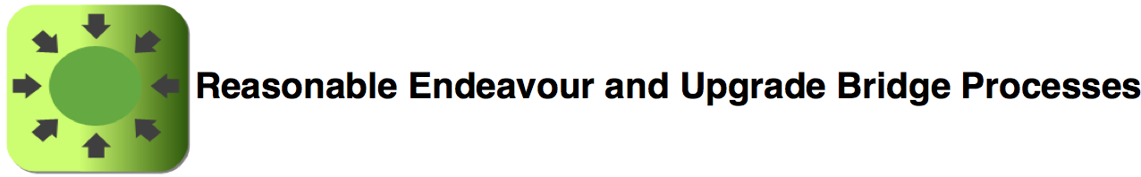

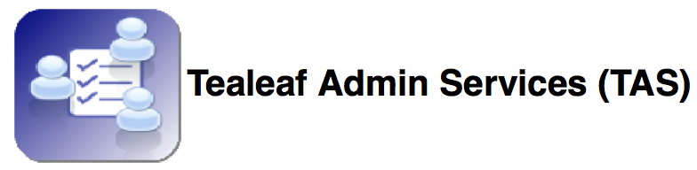

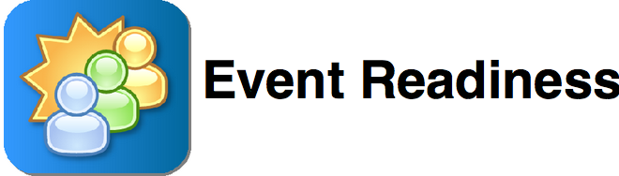
AVP – Key Offerings
Reasonable Endeavour support (RE)- provides best efforts to field PMR's, answer technical questions or provide known/published work arounds to issues encountered on End of Support (EOS)/End of Life (EOL) products. This does not include new software fixes. RE can only be offered to customers that are current/up-to-date on S&S and have an active plan to upgrade to a in-service product. The purpose for an RE offering is to assist in providing coverage as the customer upgrades to properly supported products that are having an issue meeting their EOS/EOL product deadlines. RE will provide: Remote Technical Support (RTS) IBM Software technical support for designated Named Callers 24x7 software support for business in critical outages
Upgrade Bridge support (UB) - will provide an Accelerated Value Leader (AVL) and/or Accelerated Value Specialist (AVS). The goal of UB support is to help provide guidance and advice on the product, upgrade plan, technical skills, potential obstacles, etc. Includes RE deliverables.
Accelerated Value Program (AVP) focuses on maximizing the client's return on their software investment through productivity savings, reduced risk, increasing in-house skills, and expedited time-to problem resolution. We deliver this value by: Providing a single point of contact for software technical needs Focusing on proactive support to help customers avoid known software defects, recommendations on avoiding known issues Delivering problem management and pro-active support when unexpected situations arise Partnering IBM resources with customers to become familiar with customer environment, infrastructure, people, and requirements
Products covered: Tealeaf CX on Cloud, Customer Experience Analytics
OnePoint focuses on enhance the clients experience with Support through personalized connections with a Single Point of Contact (SPOC) who understands the clients environments/infrastructure and needs, in which the SPOC can act as an advocate on behalf of the client to expedite the problem resolution. We deliver this value by: Single Point of Contact (SPOC) within IBM to help advise, escalate, and manage current/potential problems IBM expert knowledgeable of the customers environment Direct access via Live Call and Email Services Provide/review of monthly reports (Metrics and PMR/APARs)
Tealeaf Admin Services focus on increasing clients in-house skills to maintain a healthy environment that is clear of risk, minimizes negative affects on the systems stability and helps improve performance. Providing a Tealeaf Admin support to help clients sustain and optimize clients environment. Focusing on proactive support to help clients avoid known software defects, or best practices for implementing solutions. Researching and communicating new technotes and product features applicable to your business. Delivering problem management and reactive support for unexpected situations that arise. Partnering IBM resources with clients to become familiar with client environments, infrastructure, people, and requirements. Strengthens in-house skills by directly supporting or assisting with technical queries from clients and field personnel.
Go Live! Assistance will provide clients with the insurance of a trouble-free software implementation, time savings, cost reduction and increasing value in IBM software. Leads clients before, during, and following the critical phase of going live with IBM software deployment Expedites interruption-free deployments Maximizes client-specific utilization of product functionality Introduces a trusted technical advisor
Major projects/events in need of Go Live: Deploying a new system Changing an application Upgrading software Migrating a system or database Managing a critical event
&

Slide 17


Slide 18

Disclaimer
The information contained in this presentation is provided for informational purposes only.
While efforts were made to verify the completeness and accuracy of the information contained in this presentation, it is provided “As Is”, without warranty of any kind, express or implied.
In addition, this information is based on IBM’s current product plans and strategy, which are subject to change by IBM without notice.
IBM shall not be responsible for any damages arising out of the use of, or otherwise related to, this presentation or any other documentation.
Nothing contained in this presentation is intended to, or shall have the effect of:
Creating any warranty or representation from IBM (or its affiliates or its or their supplies and/or licensors); or
Altering the terms and conditions of the applicable license agreement governing the use of IBM software.

