Slide 2
Global Highly Available B2Bi Mailbox
Devendra Sahu – B2B Support
Balasubramanian Dhanavel – B2B Support

Slide 3
Agenda
What is Global Mailbox
Existing Challenges
Architecture Overview
High Availability Features
Topology
Global Mailbox Management Tool

Slide 4
Existing Challenges
Example: Automotive and retail value chains
Any order, anytime, immediate deliveries
No downtime opportunity
Constant document exchanges
Real need for high availability !!!

Slide 5
Highlights with GM
Provide a purpose built multi-data center mailbox architecture
Deliver a true geographically distributed mailbox capability
Eliminate the need for custom solutions, database replication or other approaches
Deliver a consistent view so you know exactly where your files are

Slide 6
High Availability for Disaster Recovery
Prevalent techniques
A data base driven strategy that utilizes the DR capabilities of their database vendor
Operating at a 3rd party hot site by transferring copies of their latest operations backup
Drawbacks
Typically downtime,
Latency to recover
Cost to your business
Benefits with GM
Active/passive disaster recovery architecture
Minimizes the outage impact
DB replication not needed
Cost reduction

Slide 7
What is Global Mailbox?
Global Mailboxes are the simple, robust, and reliable way to store message data from any partner in any geography. Global Mailboxes provide data storage across geographically distributed locations.

Slide 8
Guiding Principles
Global Mailboxes should always appear available for Trading Partners
Trading Partners always connect to the closest available data center
Improves performance of transfers
Trading Partners are unaware that there are multiple data centers
Appears as a single system
Can configure when replication to other data centers happens

Slide 9
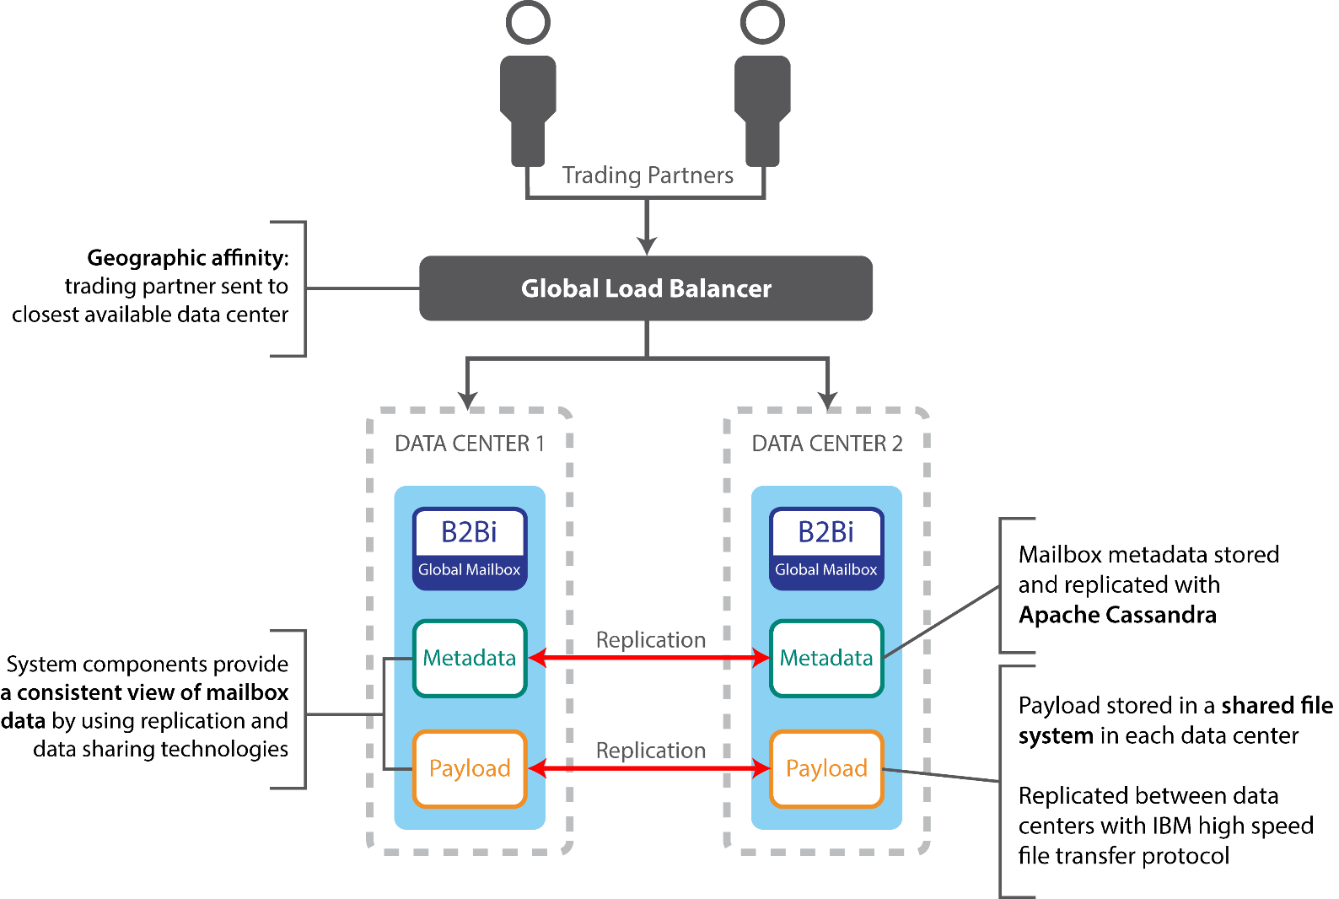
Architecture Overview

Slide 10
High Availability Features
Fault Tolerance
Data Redundancy
Survive the loss of:
Individual nodes in a data center
An entire data center
No single point of failure
Tolerate planned and unplanned outages
Replication of data to other data centers
Ensures data is not lost
Immediate or delayed replication

Slide 11
High Availability Features
Deployment Topologies
Active/Active deployments
Active/Passive deployments
Fixes & Fixpacks
Partner access available during software updates
Partners can still upload and download files when:
Individual servers are down
An entire data center is down

Slide 12
Supported Protocols
Protocol actions can be completed by using one of the following methods:
File Transfer Protocol (FTP)
Secure File Transfer Protocol (SFTP)
Connect:Direct
myFileGateway

Slide 13
Global Mailbox Deployment Consideration
Cassandra must have an equal number of nodes in each data center.
Replication setting – default is delayed (Asynchronous), or it can be synchronous
Run Cassandra repairs on a regular basis.
Cassandra nodes be kept in tight synchronization.
High speed disks for Cass and ZK
Reliable, high speed network between data centers

Slide 14
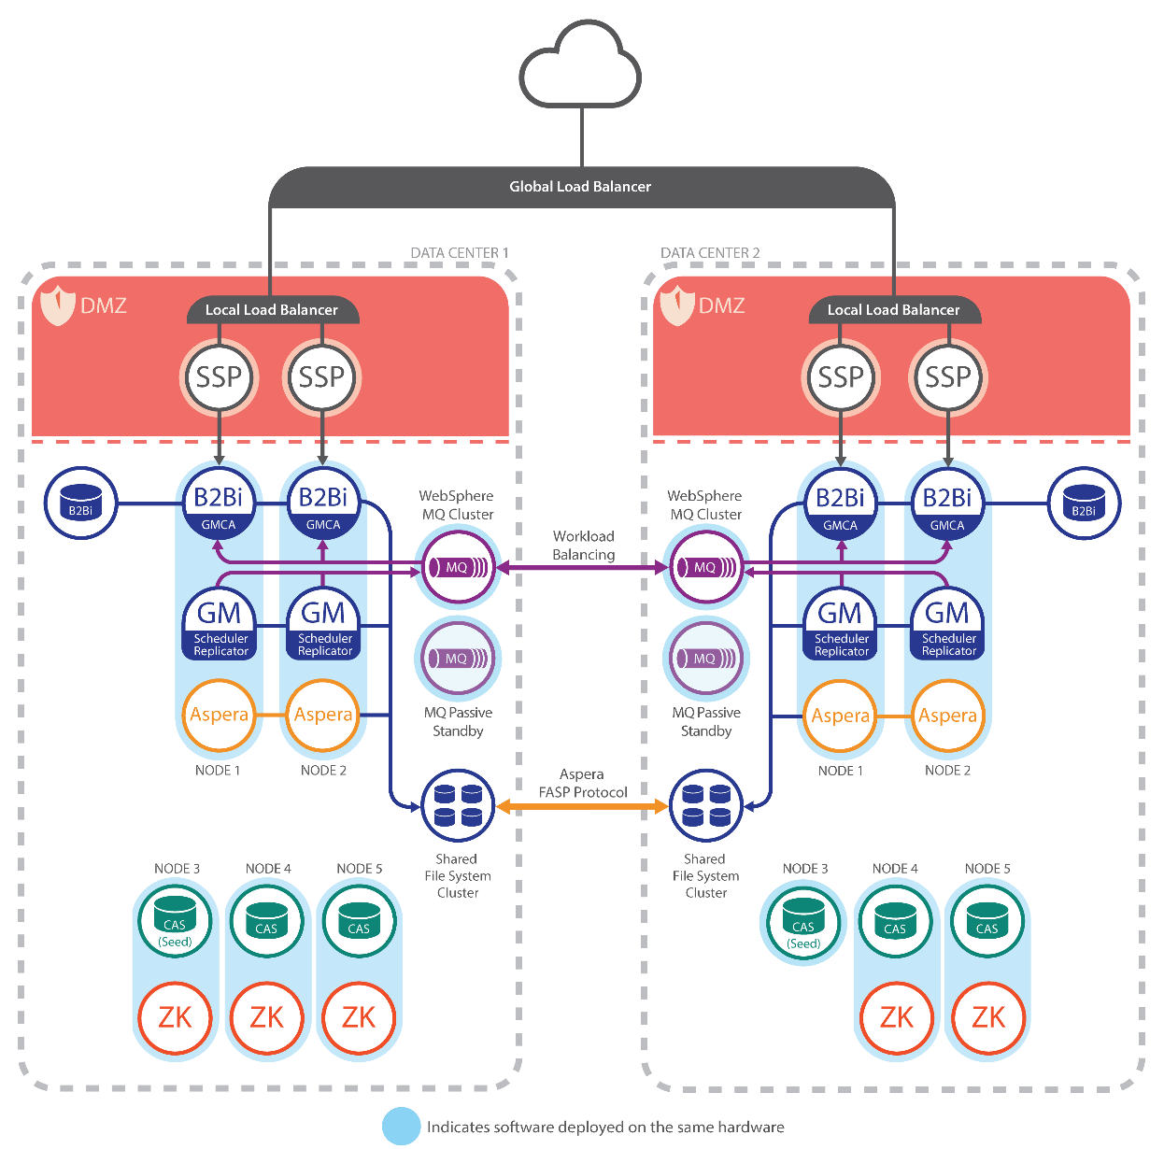
Topology

Slide 15
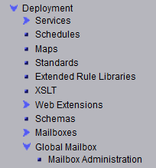
Global Mailbox Management Tool
Single sign-on from the B2Bi dashboard
Requires one of the following group permissions:
Sterling B2B Integrator Admin
Mailbox Administrator
Deployment
MAILBOX

Slide 16
Global Mailbox Management Tool
New graphical user interface for managing mailboxes, messages and related objects
Used by B2Bi mailbox administrators only, not trading partners or business users
SFG administrators continue to use SFG dashboard

Slide 17
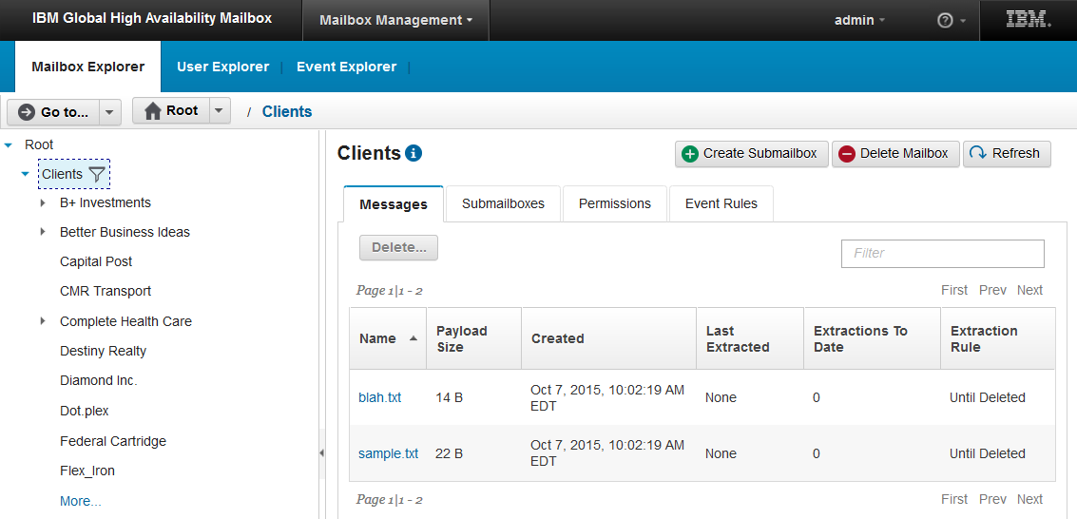
Mailbox Explorer

Slide 18
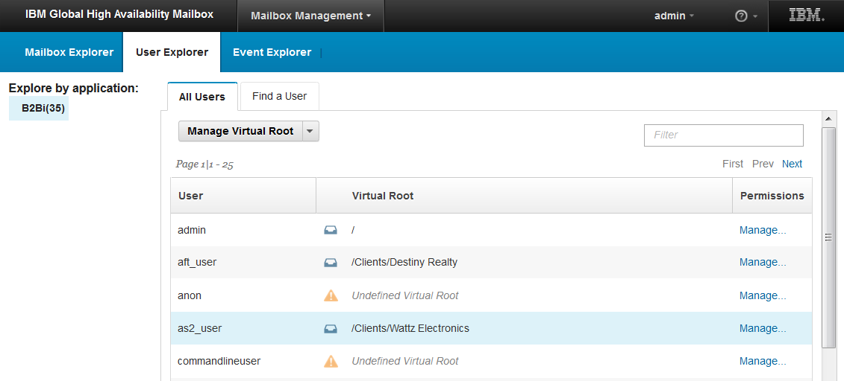
User Explorer

Slide 19
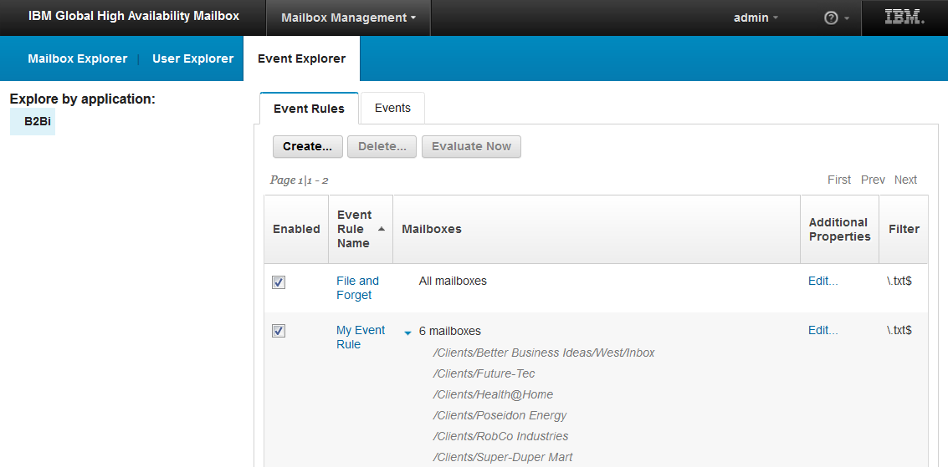
Event Explorer

Slide 20
Portfolio Integration
Products
Sterling B2B Integrator 5.2.6
Sterling File Gateway 2.2.6
Protocols
FTP, FTPS, SFTP, Connect:Direct, MyFileGateway
Trading Partner Conversion
Seamless conversion of SFG partners from traditional to global mailboxes

Slide 21
Co-existence of mailbox types
Traditional mailboxes
Current mailbox implementation that you know and love
Global mailboxes
New highly available mailbox
You can use both in the same system
You don't need to move all mailboxes to global mailboxes
Decide which partners you want to have global mailboxes
Use SFG convert tool for SFG Trading Partner

Slide 22
Bill
File Transfer Specialist
Responsibilities
On-boarding Partners
Managing File Transfers
Maintaining the systems
Pain Points
Difficult to troubleshoot the problem
Need to monitor multiple systems continuously
Issue can be found only when raised

Slide 23
Angela and Daniella
Trading Partners
Responsibilities
Transfers files (Uploads / Downloads files)
Pain Points
Unable to transfer files all the time

Slide 24
Narrative: As Bill, I want to onboards Angela (Producer) in to Global Mailbox. Also, converts Daniella (Consumer) from B2Bi traditional mailbox to Global Mailbox
User: Bill
User Story Introduction:
Bill can use SFG Partner Creation UI to onboard Angela in to Global Mailbox
Bill can convert Daniella from B2Bi Traditional Mailbox to Global Mailbox using SFG Partner screen
Scenario 1: Bill creates a Partner by enabling “Use Global Mailbox” checkbox
Scenario 2: Bill selects the existing Partner and use Convert button

Slide 25
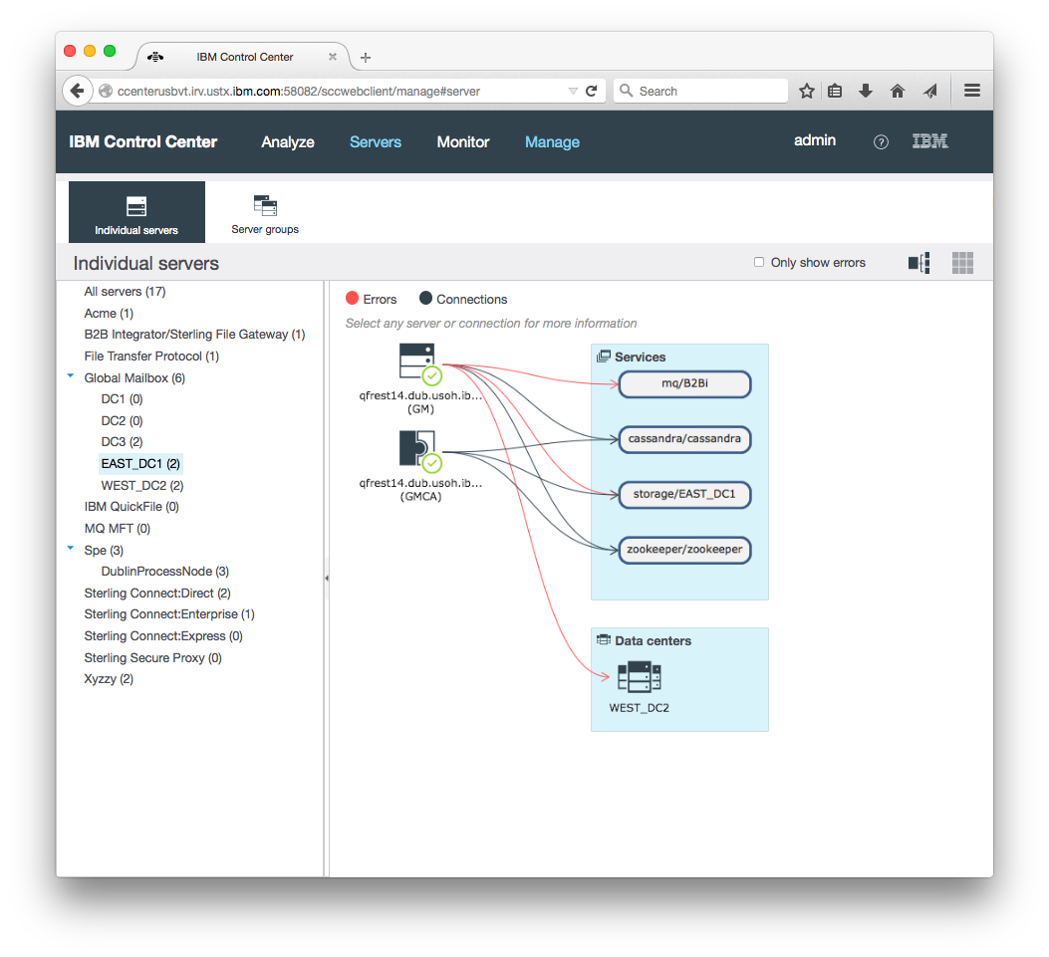
IBM Control Center Integration
Global Mailbox integrates with IBM Control Center V6.1
Monitors
Global Mailbox System Health
Global Mailbox Message Creation
Global Mailbox Payload Replication

Slide 26
Narrative: As Angela, I uploaded files to Global Mailbox to transfer to Daniella. Though the Data center goes down, Daniella is able to download the files successfully
User: Angela and Daniella
User Story Introduction:
Angela can upload file using myfilegateway URL
Data center where it is uploaded goes down suddenly
Daniella still can download the files successfully using myfilegateway URL

Slide 27
Key Points for GM
Provide data storage across geographically distributed locations
Create a highly available, high-performance solution
Provide advanced operational capabilities for the management of mailboxes and users
Have a consistent view across data centers of what files got processed and where, regardless of data center status
Extend and enhance existing deployments of IBM Sterling File Gateway & IBM Sterling B2B Integrator

Slide 28
Questions

Slide 29
Disclaimer
The information contained in this presentation is provided for informational purposes only.
While efforts were made to verify the completeness and accuracy of the information contained in this presentation, it is provided “As Is”, without warranty of any kind, express or implied.
In addition, this information is based on IBM’s current product plans and strategy, which are subject to change by IBM without notice.
IBM shall not be responsible for any damages arising out of the use of, or otherwise related to, this presentation or any other documentation.
Nothing contained in this presentation is intended to, or shall have the effect of:
Creating any warranty or representation from IBM (or its affiliates or its or their supplies and/or licensors); or
Altering the terms and conditions of the applicable license agreement governing the use of IBM software.

