Slide 1
IBM Digital Analytics
Introduction to Tracking Offsite and Onsite Links

Slide 2
Agenda
Track performance of your offsite links via MMC
Track onsite links via Site Promotion parameters
Track onsite links via Real Estate parameters
Generate Tracking Parameters for URLs
Diagnose and fix Invalid Tracking Parameters
Support Resources
Q & A

Slide 3
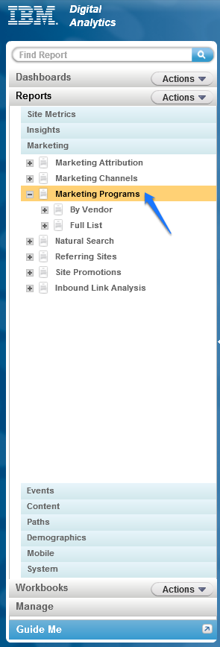
MMC: Marketing Management Center
MMC parameters allow you to track the performance of your offsite marketing campaigns.
MMC parameters are tracking codes appended to marketing destination URL’s.
MMC parameters define the hierarchy of your Marketing Programs Report
IBM Digital Analytics Tracking Codes is a tool that can be used to generate your new marketing links.
Marketing reports can be run on a Daily, Weekly, Quarterly, and Yearly basis.

Slide 4
MMC: Hierarchy
MMC parameters are comprised of four levels of hierarchical categorization
This allows for the ability to track the campaign at any level.
1. Vendor
2. Category
3. Placement
4. Item
Each one of these values is placed within the parameter, separated by the string -_-. All special characters need to be encoded via hex codes supported by IBM.
www.xyxyxy.com/?cm_mmc=Vendor-_-Category-_-Placement-_-Item

Slide 5
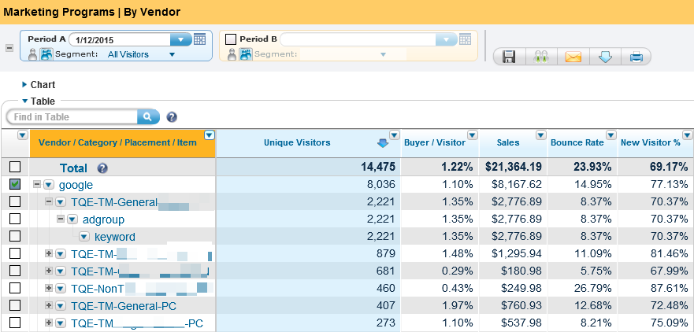
MMC: Hierarchy
Vendor
Category
Placement
Item
Use the expand feature to view both high and granular level comparisons

Slide 6
Where is your traffic coming from? Appending MMC parameters allows you to separate your paid traffic from your unpaid traffic
Marketing Programs
Destination URL contains an
mmc tracking parameter
Natural Search
Referral URL from recognized
search engine
Referring Sites
Referral URL not a recognized
search engine (all others)
Direct Load
No referral or destination URL is sent

Slide 7
How does MMC work?
Parameters must be in the destination URL
Ex: www.xyxyxy.com/?cm_mmc=vendor-_-category-_-placement-_-item

Slide 8
Email Example
Vendor - Email
Category – Spring Sale
Placement - 20150521
Item – Free Shipping
www.xyxyxy.com/?cm_mmc=Email-_-Spring%20Sale-_-20150521-_-Free%20Shipping
Paid Search Example
Vendor - Google
Category – Branded
Placement – Exact Match
Item – Keyword
www.xyxyxy.com/?cm_mmc=Google-_-Branded_-Exact%20Match_-Keyword

Slide 9
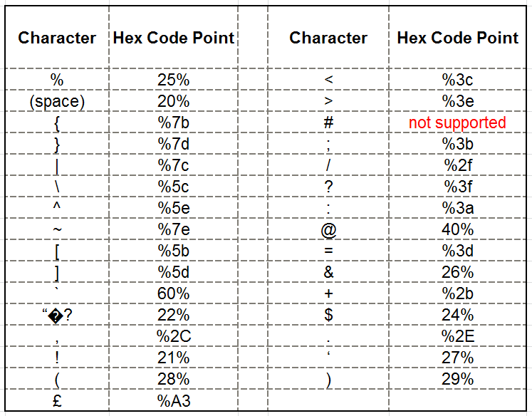
Hex Coding
If you must use other characters, IBM Digital Analytics supports hex encoding for these characters.
This list can be found in the Support Portal: support.coremetrics.com

Slide 10
Best Practices for MMC Parameters
Terms used within marketing parameter should use the naming conventions reflected in the reports so it is best to choose a naming pattern for your links and remain consistent to allow for historic analysis.
When using terms and descriptions be sure to use those that that are intuitive. For example: Vendor is Google NOT Vendor B613.
Terms used in these parameters will be visible in the URL unless you choose to obfuscate them.
MMC parameters must be present in the destination URL in order for a MMC to be tracked as a valid link. If you only need three parameters then ‘null’ or ‘NA’ can be passed to fill the fourth parameter
We recommend using the Tracking Code generator to create MMC links. You can access this by going to the left navigation pane and at the bottom and then click on Manage -> Marketing -> Tracking Codes.
Additional Information can be found in:
IBM Digital Analytics Implementation Guide
https://support.coremetrics.com

Slide 11
Site Promotion Parameters
What is a Site Promotion?
A site promotion can be one of the following;
Banner or a unique offer
Links to the same destination reside on multiple pages
Different links can be found throughout the site
All links from the same promotion lead to the same place

Slide 12
How does Site Promotion Parameters Work?
To create site promotions you should utilize the tracking code generator to create the parameters for you URL
A query string is placed on a URL:
cm_sp = promotiontype-_-promotion-_-link

Slide 13
Examples of Site Promotion Parameters
You have a Gift Guide on site, year round. During the Spring season, you run two gift guide promotions, each with different creative elements. One features kids playing in the park with their parents and the other features a boy eating ice-cream at the zoo. The site promotions tags for each of these would look like this:
Home page: cm_sp=gift_guide-_-spring_season-_-kids_play
Product page: cm_sp=gift_guide-_-spring_season-_-icecream_zoo
The example would change for different seasonal gift guides, like July 4th, or for different promotion types besides a gift guide, such as free shipping:
cm_sp=gift_guide-_-july4-_-outdoorfurniture
cm_sp=free_shipping-_-july4-_-ordersover70

Slide 14
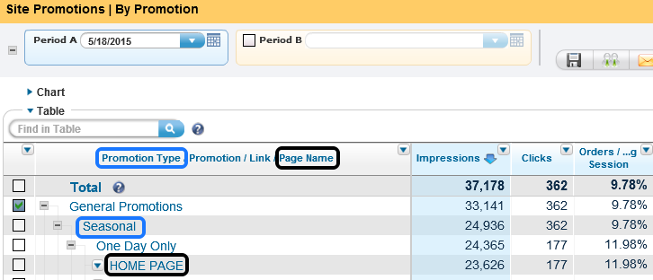
Site Promotion Reports
Site promotions reporting can be located in two places:
Marketing > Site Promotions > By Promotion or Full List
Content > Site Promotions > By Promotion or Full List

Slide 15
Real Estate Parameters
What is Real Estate?
Multiple links on one page that direct visitor to the same destination
The same offers can reside in different locations on the same page
Offers that are different formats on the same page
Some Examples
Email sign up
A link for Free Shipping offer that appears in multiple locations
A sales promotion or offer that appears in multiple locations

Slide 16
How does Real Estate Promotions work?
Activate your Real Estate pages via a technical support ticket.
Use the tracking code generator to build out the links.
Query String for a real Estate link: cm_re= Page_Version-_-Page_Area-_-Link_Name

Slide 17
Example of Real Estate Parameters
You decide to run a free shipping offer during Memorial Day on the home page. One link is text only, while the other link is an animation. The text only link resides in the header and the creative link is an image that appears in the main body of the page. The Real Estate tags for each of these links would look like this: cm_re= MemorialDay-_-Header-_-FreeShippingText
cm_re= MemorialDay-_-Body-_-FreeShippingCreative

Slide 18
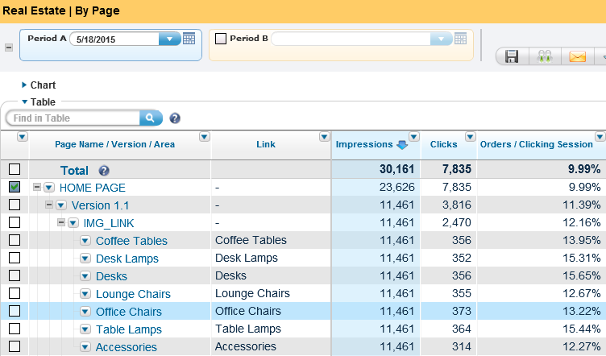
Real Estate Reports
Real Estate promotions reporting can be located within the
Content > Real Estate > By Page or Full List

Slide 19
Site Promotions and Real Estate Best Practices
Use SP and RE tags to track the performance of online offers and links that when clicked on take the visitor to the same destination.
SP tracking is used when links reside on multiple pages throughout the website, but not more than once on any one page.
RE tracking is used when links reside in multiple locations of the same page.
Measure performance of SP/RE parameters in the default Analytics reporting.
Dig deeper with Explore to get more details and insight into your visitor’s total experience.

Slide 20
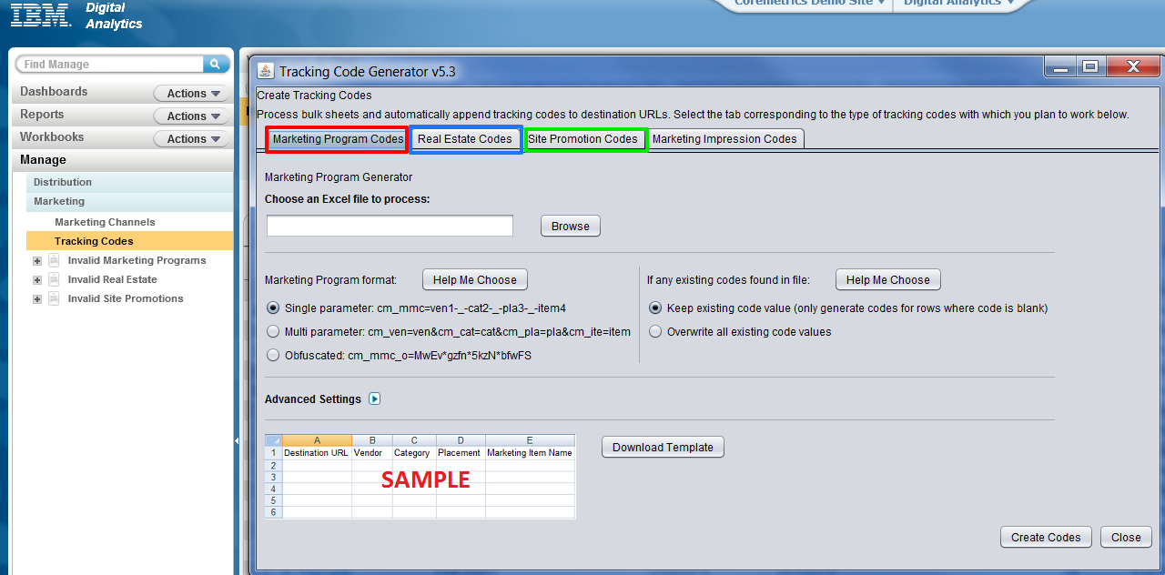
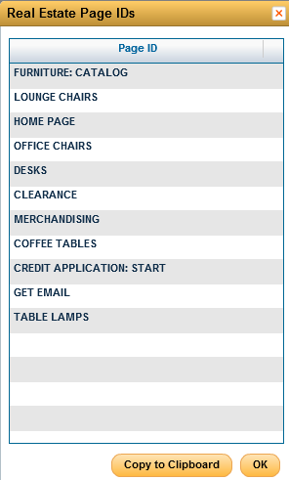
Generating Tracking Code Parameters

Slide 21
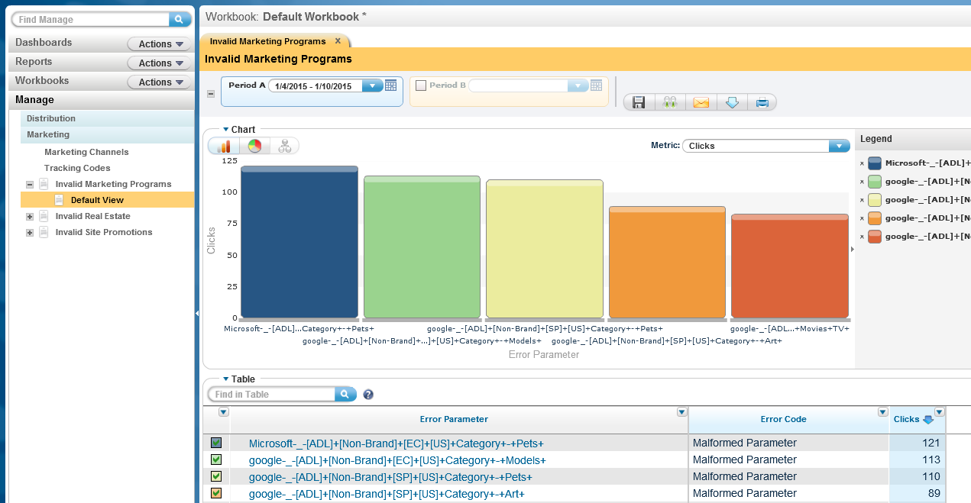
Invalid Marketing Programs Report (Chart)
Invalid Marketing Programs
Clicks
Reason for Rejection
Rejected MMC Marketing Programs

Slide 22
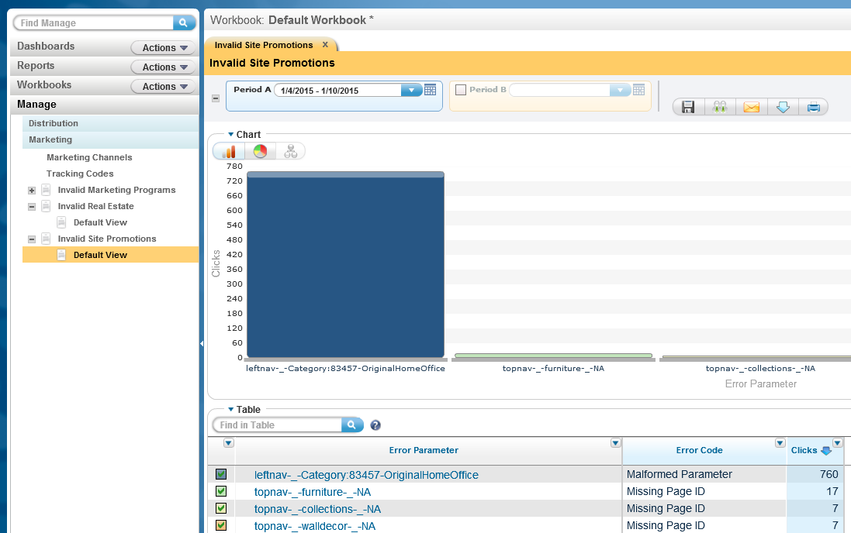
Invalid Site Promotions Report (Chart)
Invalid Site Promotions
Reason for Rejection
Clicks
Rejected Site Promotion Parameters

Slide 23
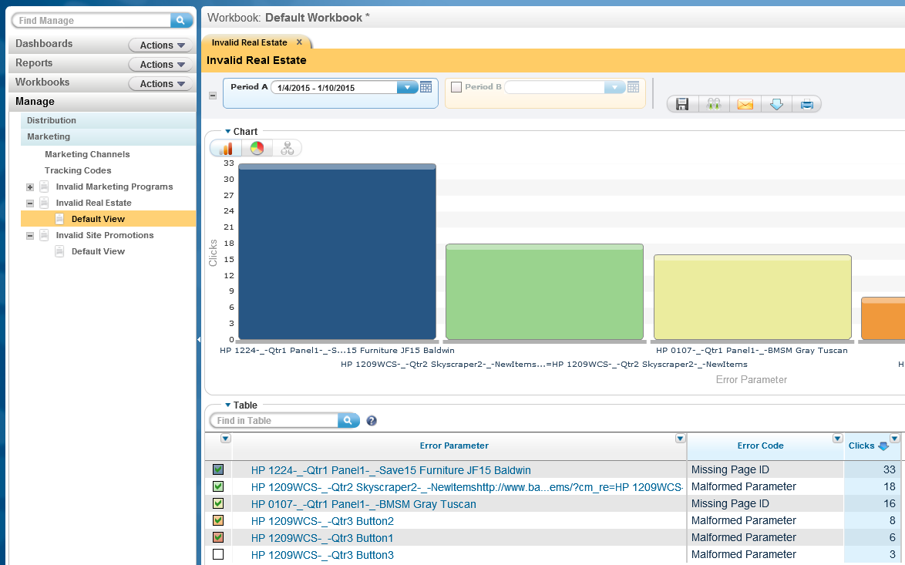
Invalid Real Estate Report (Chart)
Invalid Real Estate
Reason for Rejection
Clicks
Rejected Real Estate Parameter

Slide 24
Business Support - Resource Enablement
Business Support
Digital Analytics Consultant via chat or ticket
Resource Enablement – No Cost
Provides support for key areas a client may want to focus on.
Help clients answer business questions and expand their knowledge on topics of interest by pointing them to Support properties and resources under the guidance of a Digital Analytics Consultant (DAC).
Targeted at assisting clients who have a list of at least 5 business questions or 2 training topics or more and would need guidance on which resources to use.
To learn more or begin this enablement
Download the fact sheet posted to Support Site Knowledge Base
Email your Account Rep and copy - ccsprt@us.ibm.com

Slide 25
Q & A
The Customer Support team is available to provide support via the following channels:
E -mail: Sunday 8:00pm - Friday, 7:00 PM U.S. Central
Phone: Sunday 8:00pm - Friday, 7:00 PM U.S. Central
US: 1-866-493-2673
cm_support@us.ibm.com
Live Chat (for Business Support only): Sunday-Friday, 8:00 PM – 6:00 PM U.S. Central
Live Chat is available from the home page of the IBM Client Success Portal
https://support.coremetrics.com
IBM Client Success Portal: 24 x 7

Slide 26
Q & A

