Slide 1
Protecting Enterprise Endpoints against Advanced Malware
with Trusteer Apex
Dana Tamir
Director of Enterprise Security
Trusteer, an IBM Company

Slide 2
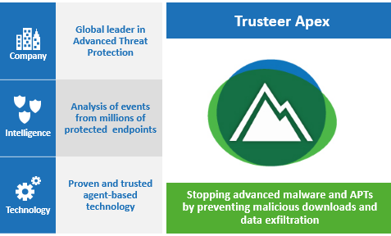
About Trusteer

Slide 3


APTs and Targeted Attacks
The Tool of Choice: Exploits and Advanced Malware
The Entry Point:
  Vulnerable User Endpoints
The Means:
  Exploits, Drive-by Download
  Advanced Malware
  Compromised Credentials

Slide 4
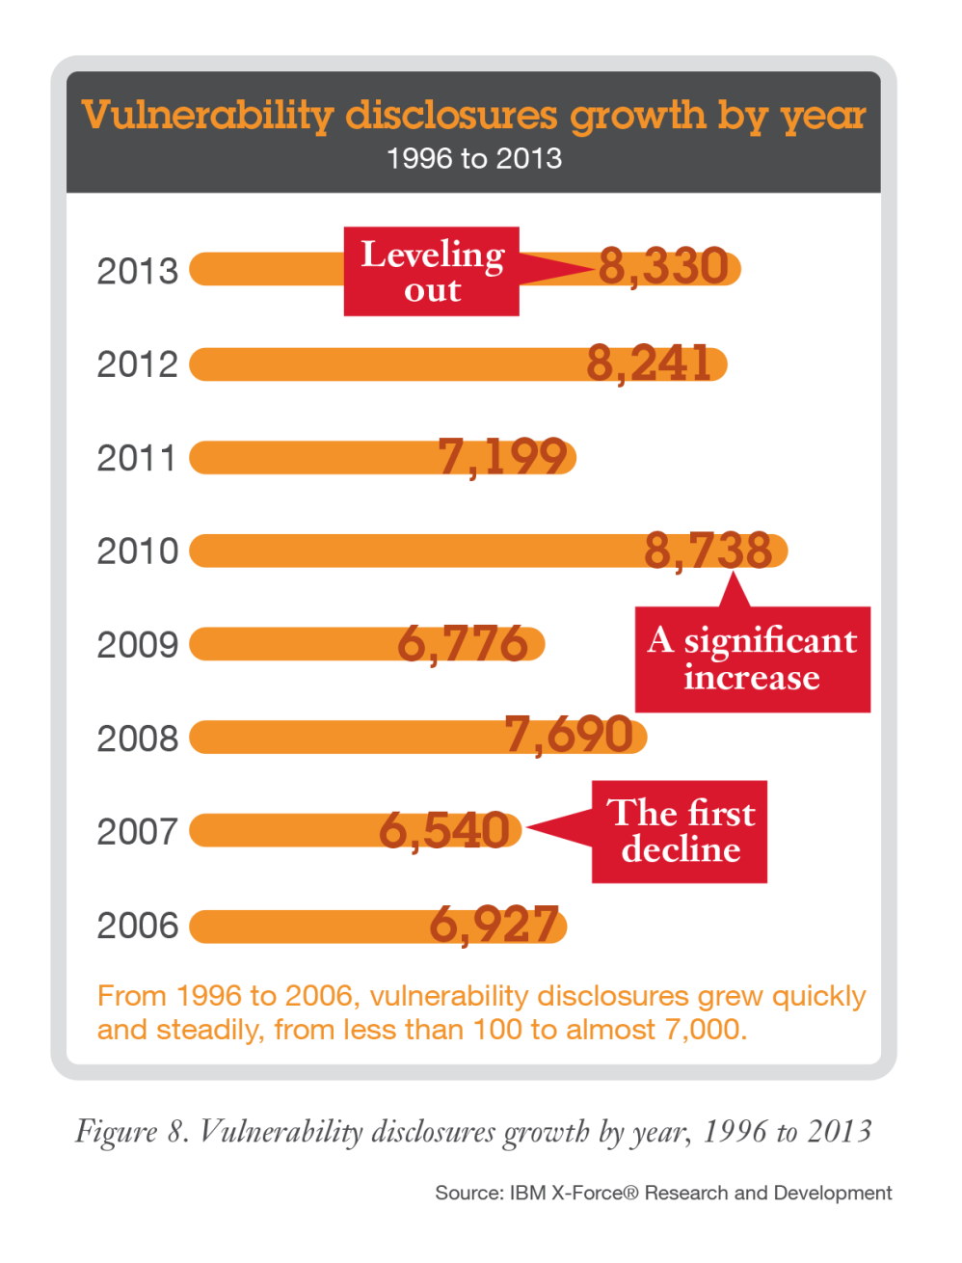
Vulnerability disclosures leveled out in 2013, but attackers have plenty of older, unpatched systems to exploit.
60% of the exploits target vulnerabilities that have been publicly known for over 12 months!!!
Notes:
MH already talked about this – Unpatched vulnerabilities are a bit problem. Did you know that 60% of exploits target 1-2yo vulnerabilities

Slide 5
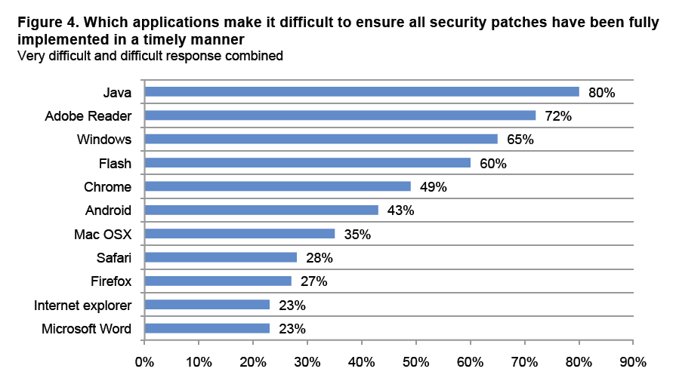
Do you patch applications?
Source: Ponemon

Slide 6
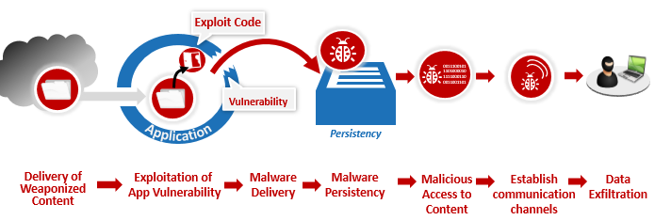
The Threat Lifecycle
Exploit Chain
Data Exfiltration
Exploit Chain Disruption
Data Exfiltration Prevention

Slide 7
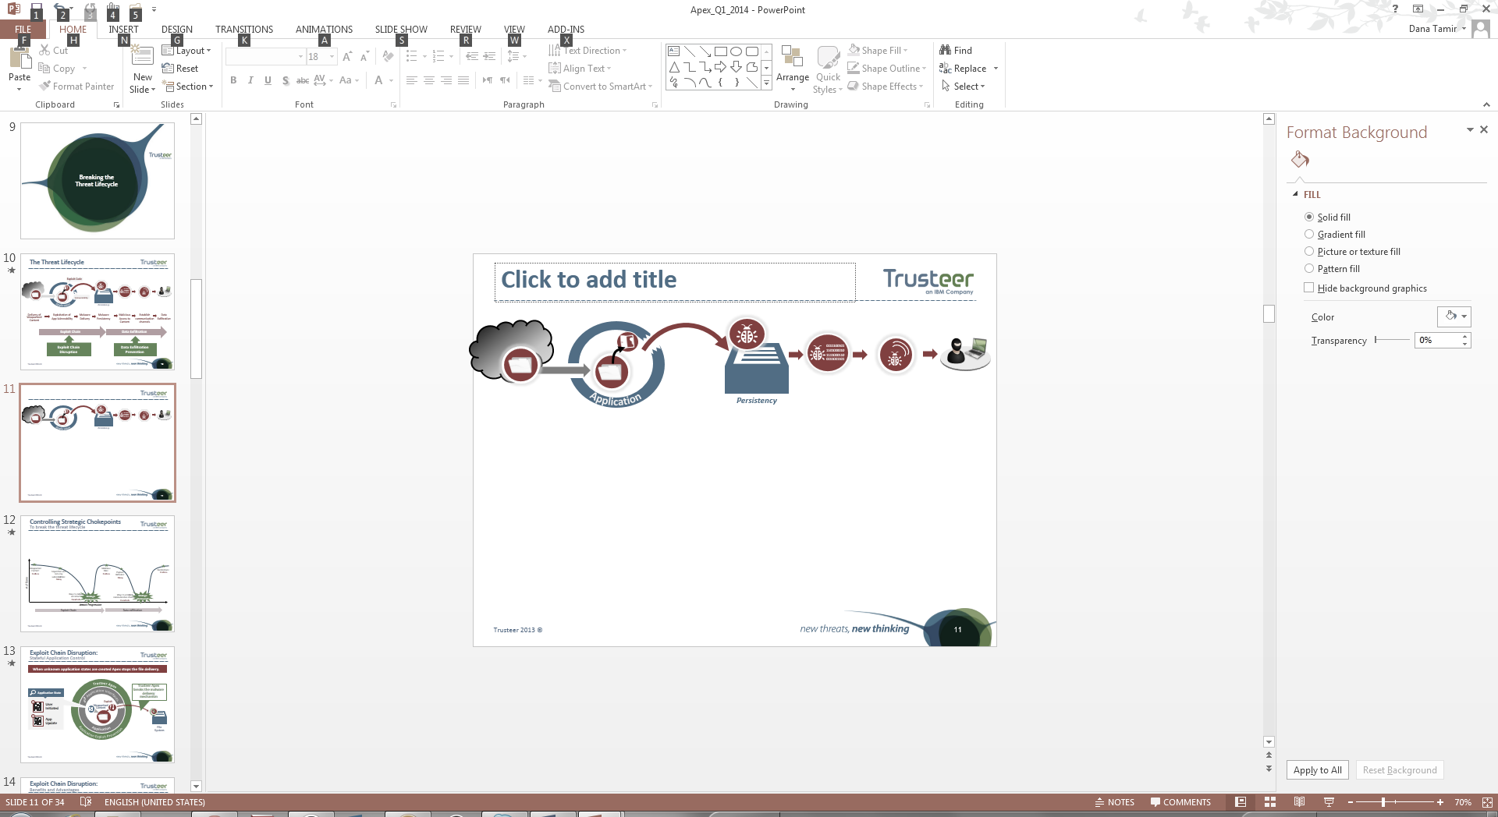
Controlling Strategic Chokepoints
To break the threat lifecycle
Weaponized Content: Endless
(IPS, Sandbox)
Malicious Files:
Endless
(AV, Whitelisting)
Destinations:
Endless
(C&C traffic detection)
# of Types
Unpatched and zero-day vulnerabilities:
Many
(Patching)
Malicious Behavior:
Many
(HIPs)
Ways to deliver and infect:
Hundreds
Strategic Chokepoint
Ways to establish communication channels:
Hundreds
Strategic Chokepoint
Attack Progression
Exploit Chain
Data exfiltration

Slide 8











Exploit Chain Disruption:
Stateful Application Control
Frame 2
When unknown application states are created Apex stops the file delivery.
Trusteer Apex
Trusteer Apex breaks the malware delivery mechanism
  Application State
Application Interfaces
Application Exploit Prevention
Exploit
User Initiated
Weaponized Content
Application
App Update
File
System

Slide 9




Data Exfiltration Prevention:
Block Malicious External Communication
Block suspicious executables that attempt to compromise other applications or open malicious communication channels
Pre-existing Infection
Direct User Download
Trusteer Apex
1
Exfiltration Prevention
Data Exfiltration Prevention
External Network
Information stealing malware
Direct Communication is Highly Visible
Evasion #2:
Communicate Over Legitimate Websites
Looks Like Legitimate Communication
2
Exfiltration Prevention
Evasion #1: Compromise Application Process
Notes:
Once malware infected the machine it tries to establish a communication channel with the attacker. The communication is essential for enabling data exfiltration.
If the malware directly communicates with the attacker that communication is very visible and can be easily blocked, even by solutions like personal firewall. Trusteer Apex blocks any attempts to establish direct communication channels.
In order to bypass such controls, advanced malware uses a few evasion techniques.
For example, it will compromise another legitimate application process like Internet Explorer – as process that is allowed to communicate externally, by injecting malicious code into the process and using it to mask the communication channel.
Another common technique is to communicate with the attacker over legitimate websites (like User Forums and Google Docs).
Trusteer Apex uses a few different techniques to identify unauthorized exfiltration states and malicious communication channels and blocks them. For the example above it will block the code injection, and prevent the malware from compromising the IE process.
Because Trusteer Apex monitors the activity on the host itself, it has better visibility and can accurately detect and block these exfiltration states.

Slide 10




Corporate Credentials Protection
Prevent Credentials Theft
Grabbing credentials from websites
WWW
WWW
Key
Logging
Phishing
Using Corp PWD on Public Sites
******
Keystrokes
Obfuscation
Password Protection
Grabbing credentials from users’ machine
*****
Notes:
Apex specifically protects employee credentials, which are a prime target for cyber criminals. If compromised, a hacker can use these credentials to log in and access sensitive business information.
Key loggers are often used for stealing user credentials. They often target VPN clients used by remote employees to access the enterprise network or specific enterprise applications. Trusteer Apex encrypts the keystrokes entered by the user to applications like: VPN clients like Citrix receiver, Browsers, Outlook and can be configured to protect custom applications [needs to be approved by PM].
Trusteer Apex prevents users from submitting credentials to phishing sites by validating the site to which they connect and blocking attempt to submit corporate credentials to unapproved sites.
In addition, Apex will prevent users from reusing enterprise passwords on public site like Facebook: public sites are constantly targeted by hackers attempting to steal lists of user credentials. Since users don’t want to remember many passwords, they tend to reuse passwords. But using enterprise passwords on public sites may expose your enterprise because public sties are also under attacks.
Apex detects and blocks enterprise password submission to an unauthorized web site and alert the user and the enterprise.
How is it done?
The admin configures in the Trusteer Management Application (TMA) a list of approved URLs for enterprise application login. The agent keeps a one-way-hash of the passwords locally and compares against it when the users tries to login to a webapp. If the login is to an approved URL, it is allowed. If the URL is not on the approved list, the user will not be allow to use that password.
Note that this feature is optional and does not have to be enabled.

Slide 11
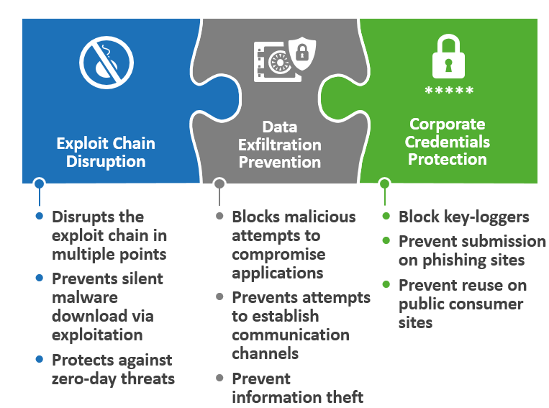
Trusteer Apex: 3 Security Layers

Slide 12
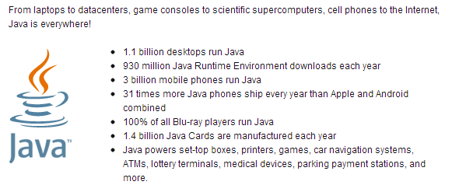
A few words about Java
A powerful yet dangerous application:
  Did you know that…
  Java is installed on ~85% of the desktop computers.
Google Analytics

Slide 13
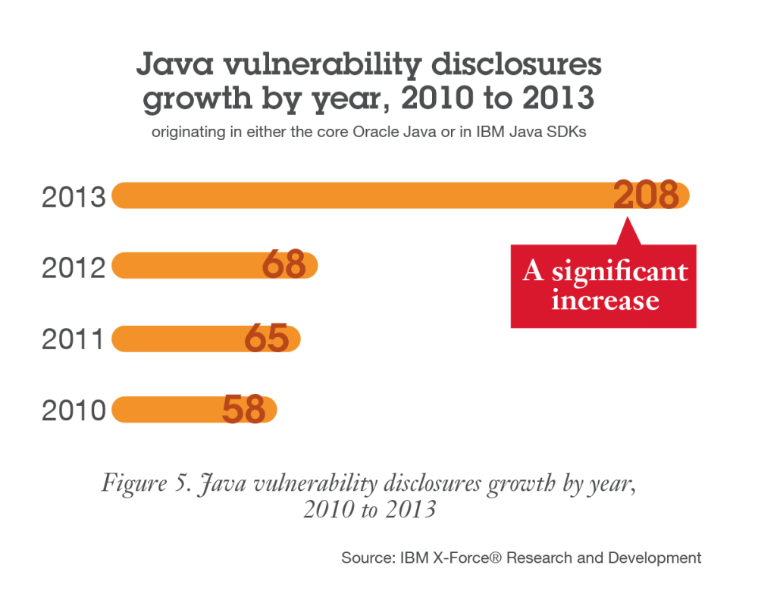
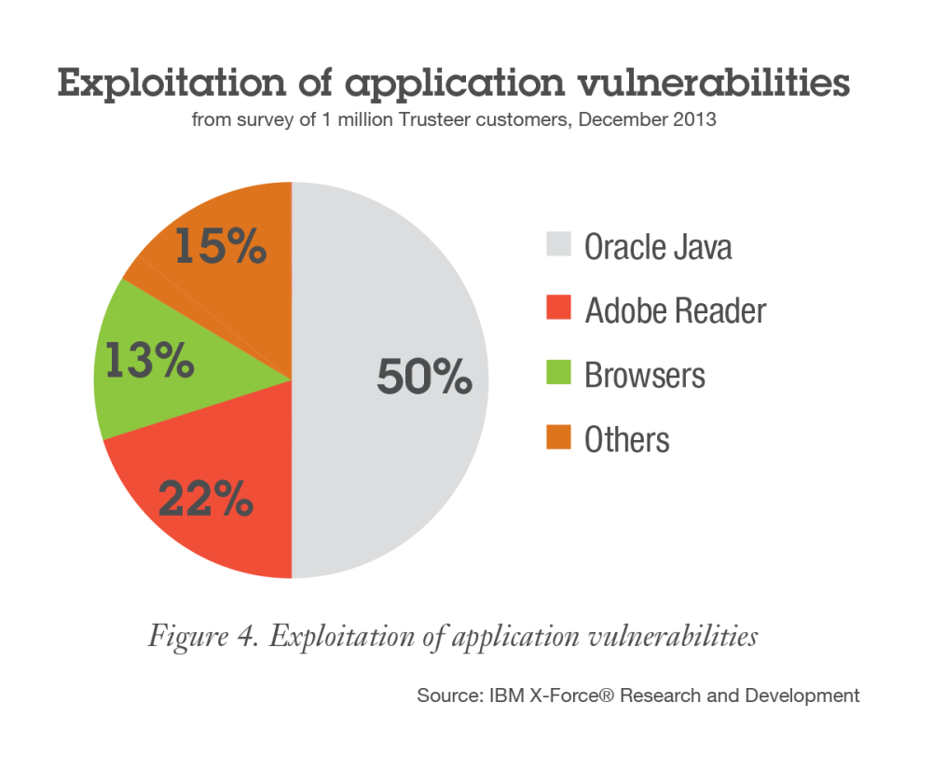
explosive growth of Java vulnerabilities…
… combined with a presence in every enterprise makes Java the top target for exploits.
Notes:
Java is a widely deployed high risk application that exposes organizations to advanced attacks. The number of Java vulnerabilities has continued to rise over the years, and 2013 was no exception. The number of reported Java vulnerabilities jumped significantly between 2012 and 2013, more than tripling.

Slide 14
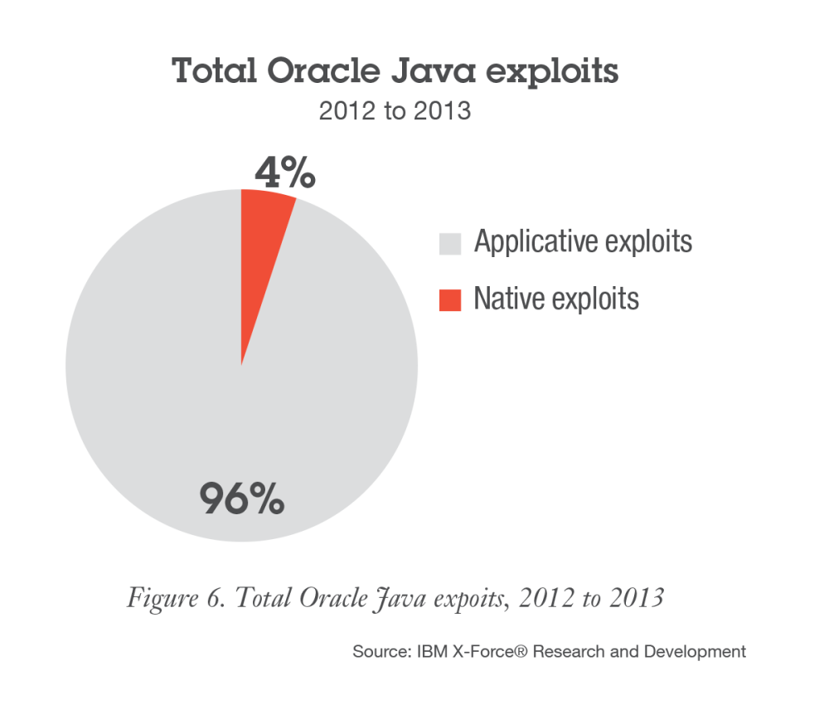
Most successful Java exploits are applicative, exploiting vulnerabilities related to the Java security manager and bypassing native OS-level protections.
Applicative exploits
Difficult to defend
Gain unrestricted privileges
Bypass native OS-level protections
Native exploits
Buffer Overflow
Illegal memory use
Use-after-free
Notes:
Java applicative exploits are more difficult to defend against because they allow the applet to gain unrestricted privileges— which makes malicious activities seem legitimate at the OS level. This means that, unlike native exploits, Java applicative exploits completely bypass native OS-level protections. Plus, Java applicative exploits don’t generate buffer overflow, and hence are not prevented by methods such as DEP, ASLR, SEHOP and others.
A native exploit results in running native shell code. This type of exploit is accomplished by techniques that include buffer overflow, use-after-free and more.

Slide 15

Java Execution Should be Monitored and Controlled
Prevent Exploitation of both Native and Applicative Vulnerabilities
Execution of Java code on the endpoint must be restricted
  Fine grained control is needed
Oracle’s solution: Allow execution of signed JARs
  Not good enough

Slide 16
Questions?

Slide 17



Connect with IBM X-Force Research & Development
Follow us at @ibmsecurity and @ibmxforce
Download IBM X-Force Threat Intelligence Reports http://www.ibm.com/security/xforce/
X-Force Security Insights blog at www.SecurityIntelligence.com/x-force

Slide 18
Notes:
Mandatory Thank You Slide (available in English only).

