Slide 1
Andy Gurd
IBM Rational
A&D Trends, Challenges & Systems Engineering Solutions

Slide 2


Slide 3
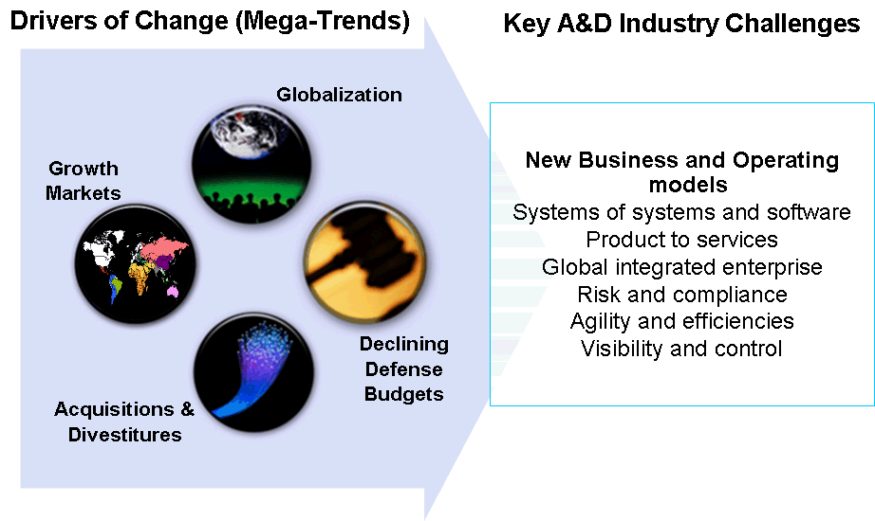
Global Aerospace and Defense Market Environment
Segment health | 2009 | 2010 | 2011 | 2012
Commercial/ Regional Aircraft
General Aviation Shipments
Defense Budgets
A&D companies are seeking growth through new business opportunities across multi-industry ecosystems ….
smarter products
smarter systems
•
Aircraft & Air Vehicles
•
Energy Systems
•
Launch Vehicles
•
Environmental Systems
•
Missiles / Weapons
•
Information Systems
enabling
•
Security Systems
•
Railcars / Trains
•
Transportation Systems
•
Satellites
•
Water Systems
•
Ships / Submarines
•
Weapon Systems
Notes:
Trends driving challenges. Decreasing defence budgets. Diversification into other domains.

Slide 4
Defense Industry Trends
Market Dynamics
Implications
Mature vendors looking to emerging markets amid mature market defense cuts and fiscal issues
Commoditization; Rapid technological Innovation in developed markets; Focus on manufacturing in Emerging markets (offsets)
A&D companies moving into adjacent, growth business areas of energy, etc.
Need to identify and re-use/re-purpose existing IP and skills into profitable new product or service offerings or identify acquisitions such as security
Acquisition Reform and Contract changes to Firm Fixed Price vs. Cost Plus
Program Execution needs to become core competency amid increasing complexity. Increased Systems Engineering Capability
Move to fewer and shorter programs vs. large platforms such as FCS or JSF
Agility in program execution, ability to quickly create product variants to meet specific customer needs.
Increased demand for UAVs, bringing with it civilian FAA/Safety standards.
Adjusting development processes to conform to regulatory requirements
Competition from emerging markets
Drive costs down through product line approach and looking to new, innovative product and services for differentiation
Notes:
Global Markets:

Slide 5

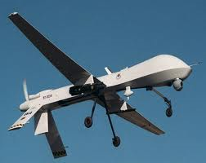
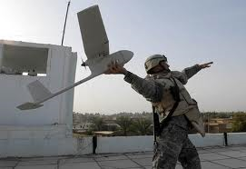
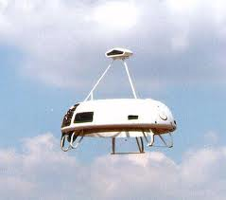
Pursuing New Markets
What products do we move forward?
Where can we best compete?
How can I compete against new low-cost competitors and deliver unique, but related solutions to a diverse customer base?
Boeing purchased Institu, manufacturer of the Scan Eagle UAV . Boeing and Institu were also cooperating in marketing the Scan Eagle. The acquisition solidified the relationship.
Northrop Grumman purchased the Killer Bee UAV line from Swift Engineering to strengthen position in Tier II UAVs. Northrop Grumman has an extremely strong position in larger UAVs such as the Global Hawk and the Fire Scout.
Textron purchased AAI Corp., manufacturer of the Shadow UAV, in 2007. That acquisition revitalized Textron’s position following the Coast Guard decision not to fund further development of its Eagle Eye UAV.
BAE Systems buys Advanced Ceramics Research, a US-based manufacturer of three small UAVs. The purchase gives U.K.-based BAE Systems, a foothold in the U.S. UAV market.
Notes:
Here, it is the ability to do portfolio and business analysis as well as document and find corporate assets. This is about PPM, RAM use cases.
These are examples of pursing UAVs, but there is medical, energy, Rail, health care, cyber security products and services, etc.

Slide 6
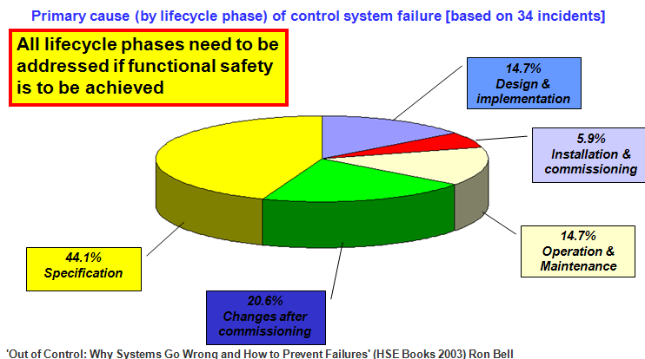
Program Execution and Agility: Defence Systems need to be Affordable, Work Right the First Time and Every Time
DOD maps out plan for acquisition reform and affordability requirements
Jan 03 2011
“Requirements development…has been identified as a weakness in the department and has led to cost and schedule overruns on many programs,” Kendall said in the memo. “Requirements development is paramount to successful acquisition outcomes. Gansler also stressed the need for DOD to institutionalize a rapid acquisition process that uses short acquisition cycles and spiral development.
20.6%
Changes after
commissioning
The DOD is spending nearly $18 billion¹ annually to develop, acquire, and operate satellites and other space-related systems. Space assets are ubiquitous and diversified in military operations.
However, almost every recent major DOD space system acquisition has experienced significant problems that increased costs, delayed schedules, and degraded performance.
1 This includes research, development, and testing; and operations and maintenance accounts (GAO-04-253T).
6
Notes:
The point here: Companies need to increase their ability to execute well (more SE, better PM) as well as to be more agile in their processes to capture new work. They also have to deliver to their promise. Note- 44% of the system faults in the study cited above identify the failure started at the beginning…not understanding the real requirements or capturing and expressing them through the development cycle.
In a memo dated Nov. 19, 2010, Frank Kendall, principal deputy undersecretary of Defense for acquisition, technology and logistics, stressed the importance of improving the development of requirements for DOD goods and services and providing better training for the employees charged with buying, according to a Federal Times report.
Jacques Gansler, former undersecretary of Defense for acquisition, technology and logistics,
6

Slide 7
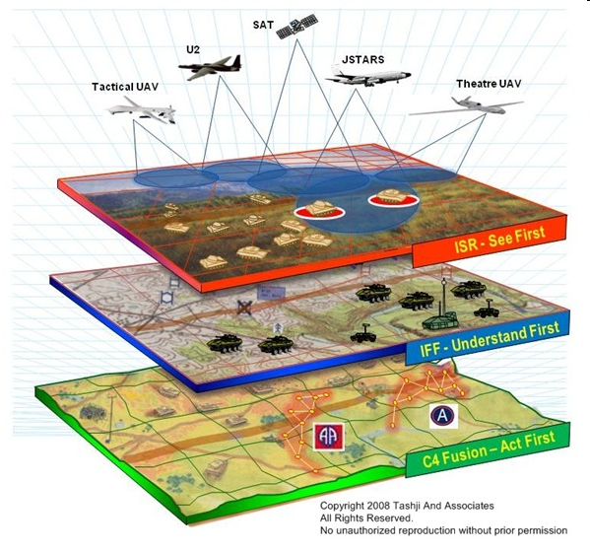
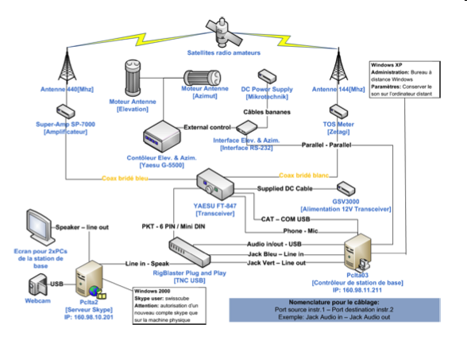
Incremental value is created by global interconnection across products, systems, applications and the Internet
Tier 0: | Small or Micro UAV
Tier 1: | Low altitude, long endurance
Tier 2: | Medium altitude, long endurance (MALE)
Tier2+: | High altitude, long endurance conventional UAV (or HALE UAV)
Tier 3: | High altitude, long endurance low-observable UAV
Notes:
This is Systems of Systems. Enterprise Architectures to understand the system (s) under development and their ecosystem at each level of abstraction. This is where the IBM Integrated Product Management and Integrated Services Management message resonates. The back end IT systems (and people systems) have to work with the embedded product world to deliver overall value.

Slide 8




Tying it All Together: Smart Products and Services Example
From sophisticated in-device software, to complex “system of systems” ecosystems, products will continue to get smarter
System of Systems
Logistics
management
systems
Ground Systems,
Weather Systems
Command and Control, Satellite Communications
Collaboration and visibility across diverse teams and disciplines
Integration of mechanical, electronic, software, and electrical engineering
Systems Engineering
Multi-Mode
Radar
Fly-by-Wire
Flight Control
Stores
Management
Software-intensive Subsystems
Advanced
Displays
Situational
Awareness
Intelligent
navigation
8
Notes:
8
An example showing the HAL Tejas”Radiant” lightweight multirole fighter participating in a complex system of systems, which depends heavily on SW.
Embedded software, delivered through software-intensive subsystems, is driving the value of a wide spectrum of software-intensive subsystems, such as advanced radar and flight controls. Without advance fly-by-wire flight controls pilots cannot react quickly enough to fly aircraft that are slightly aerodynamically unstable by design (negative static stability or “RSS”) which makes them more agile/quick in flight
Systems engineering is needed to integrate this increasingly important software component with the mechanical, electronic, and electrical engineering domains, and to foster collaboration and visibility across diverse engineering teams.
Systems of systems: In a trend that presents significant opportunity across Rational and all of IBM, the aircraft is a part of numerous “systems of systems” that interconnect the aircraft with backend command, control, intelligence and other system.

Slide 9

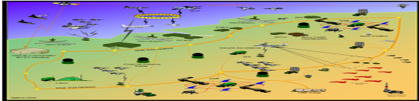




Delivery of smarter products and services will require new investments in software and systems
Connect multiple products and services into a
“system of systems” to deliver unique value
Leverage systems engineering to accelerate
time to market, improve quality and reduce costs
Develop a core competency in software delivery
to produce products that are innovative
9
Notes:
9
To stay competitive, companies must transform their business models. Three core competencies they will need are:
Software delivery
Systems engineering
“System of systems”
1) Software delivery is driving most of today’s innovation. Companies must invest in their software development and delivery capabilities to produce products that are differentiated. Many products look virtually the same on the outside, but the software function inside is what creates competitive advantage. IBM Rational provides an integrated platform for software delivery leveraging a full set of best-of-breed tools, methodologies and best practices.
2) Systems engineering must be done well and efficiently to get high quality products to market with the necessary speed. Gone are the days when it was all about the mechanical design. Today the software and electronics are providing the real innovation and value. The ability to integrate across engineering disciplines (mechanical, software, electronic, electric) is a key competitive advantage. IBM provides a full set of integrated best-of-breed systems engineering capabilities for engineering the “whole product,” including requirements engineering (Rational DOORS), change management and team collaboration (Rational Team Concert and other CCM tools), model-driven systems development (Rational Rhapsody), and quality management (Rational Quality Manager).
3) “Systems of systems” interconnect manufactured products with backend software applications to deliver significant new value to customers. Smart products are converging with conventional information technology to form revolutionary ecosystems that are permanently changing how we work, live and play. Manufacturing and software companies will remain competitive based on how well their products can be integrated into larger “systems of systems,” such OnStar, Google Maps, iTunes, or the smart electric grid. With these opportunities come significant challenges, as “systems of systems” cross multiple organizational, industry, and stakeholder boundaries. This trend presents significant opportunity for Rational and all of IBM to help customers overcome the business and technical issues associated with these large, complex, constantly changing systems.

Slide 10



Rational Solutions for Systems and Software Engineering
Built on a core product set
Open Services for Lifecycle Collaboration
REQUIREMENTS MANAGEMENT
Manage all system requirements
with full traceability across the lifecycle
Rational DOORS
QUALITY MANAGEMENT
Achieve “quality by design” with an integrated, automated testing process
Rational Quality Manager
ARCHITECTURE & DESIGN
Use modeling to validate requirements, architecture and design throughout the development process
Rational Rhapsody
COLLABORATION, PLANNING & CHANGE MANAGEMENT
Collaborate across diverse engineering disciplines and development teams
Rational Team Concert
Integrate
Collaborate
Optimize
Best-of-breed capabilities, integrated on a common platform
10
Notes:
10

Slide 11
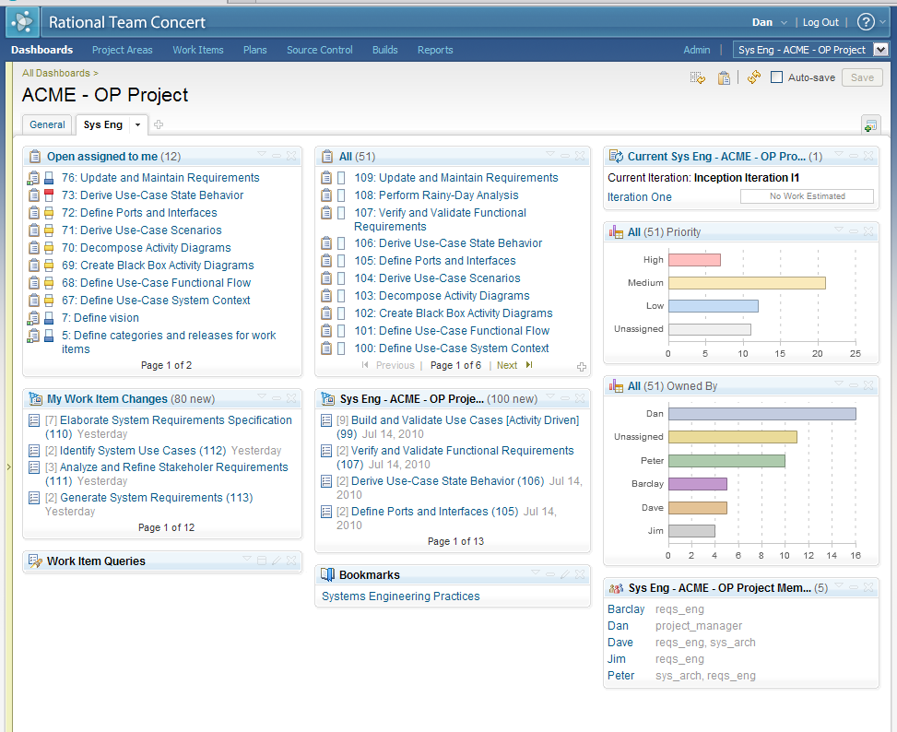


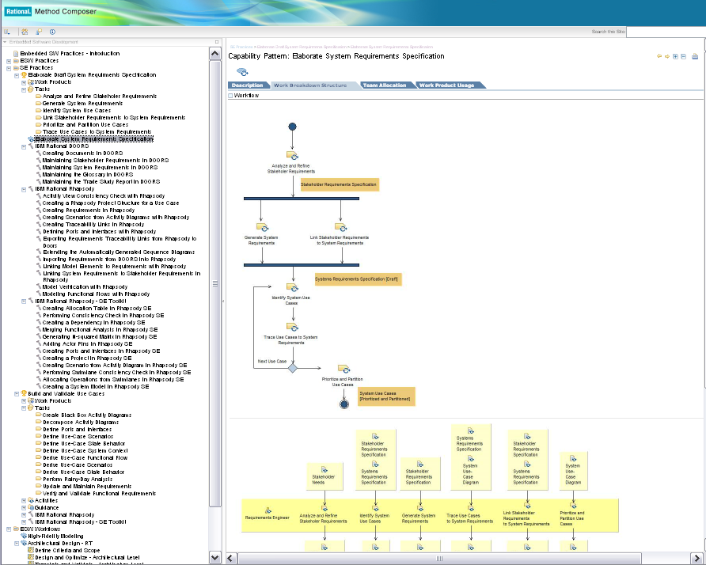
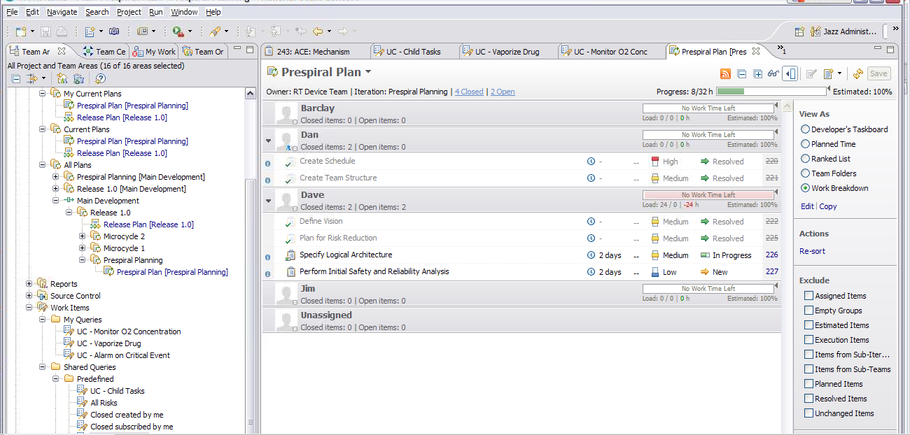

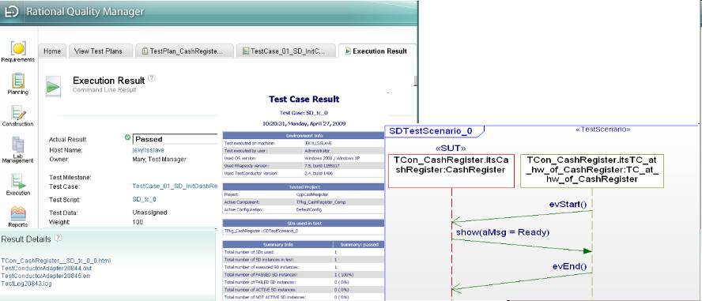
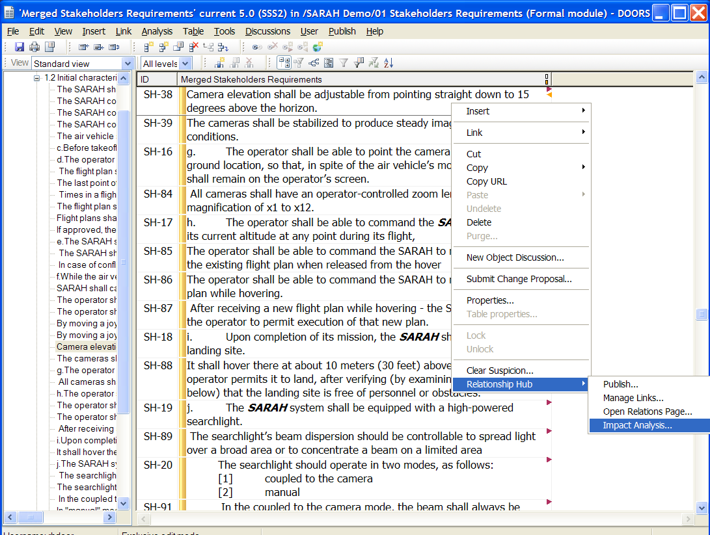
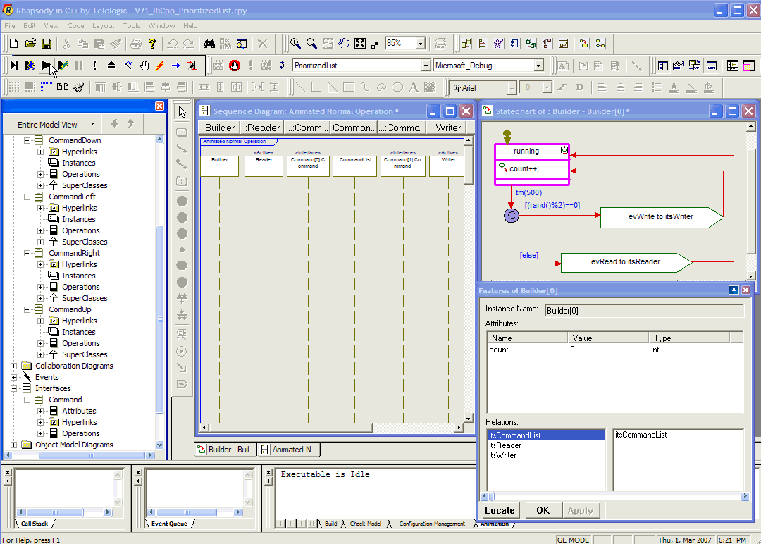

The new Rational A&D Accelerator for Systems and Software Engineering helps to support DO-178B safety critical standard
A dashboard in RTC
Check progress Understand tasks and deliverables
Learn and check how to use a Practice
A Practice library & tool mentors
Practice tasks based on work items in RTC
Execute my tasks
Update my tasks
Collaborate with colleagues
Starting templates
Artifact samples
Tool usage
DOORS
Rhapsody
Notes:
The A&D System and Software Accelerator builds capabilities on the core Systems and Software Engineering tools (DOORS, Rhapsody, RTC and RQM)
The A&D Solution for DO-178B provides a set of industry practices as well as Rational Team Concert project and work items templates so the practices can be enacted
The new version of the Rational A&D accelerator provides:
Integrated solution to produce DO-178B certifiable software by documenting, automating, and enforcing workflow for process governance
Codified best practices that accelerate the ability to document and automate their DO-178B compliant processes
Automate compliance and documentation for DO-178B and other regulatory standards
Integrate the safety case artifacts directly into the development lifecycle; reducing the risk
Generate code directly from the design model into ARINC 653 aerospace industry standard code

Slide 12
Summary
A&D industry challenges are impacting engineering practices
Our solution for Systems and Software Engineering provides the platform to manage complexity in systems specification, design and development
IBM’s solution for Systems and Software Engineering will continue to evolve to address the specific needs of the A&D industry
12

